Slide 1
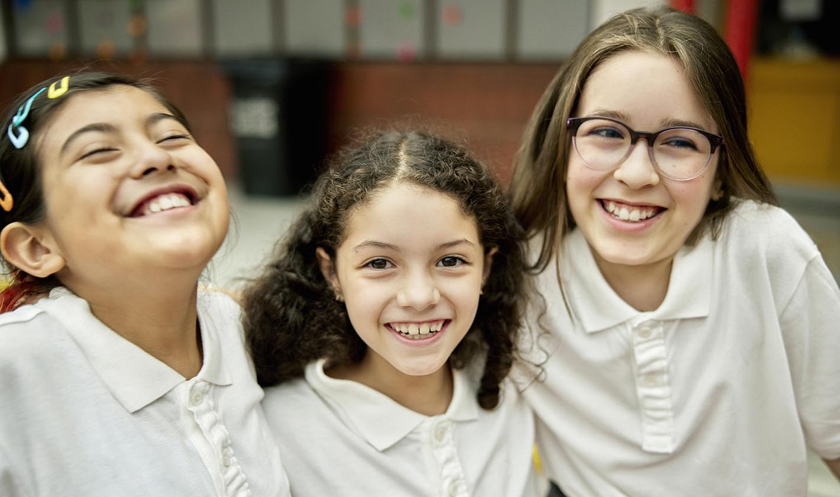
California Social and Emotional Learning
Topic 8
Mindfulness and Well-Being for Students
8.11 Hope for Students
Notes:
For this lesson, you will need:
- A way to show the videos to your participants (links are in the presenter notes and on the screen). The videos are YouTube links, so you will need an internet connection.
- It would be helpful for participants to have writing materials (paper, notebook, and pen/pencil).
- post-it notes & markers for group activity

Slide 2
California Social and Emotional Learning
Add a Welcoming Ritual Here
Notes:
Add SEL Signature Practices (e.g., welcoming rituals, optimistic closures, etc.) to your presentation.
The SEL 3 Signature Practices are one tool for fostering a supportive environment and promoting SEL. They intentionally and explicitly help build a habit of practices through which students and adults enhance their SEL skills.
For a short presentation of what SEL 3 Signature Practices are, along with a list of practices, see the following:
https://ggie.berkeley.edu/wp-content/uploads/2023/05/Welcoming_Closing-Activities.pptx

Slide 3
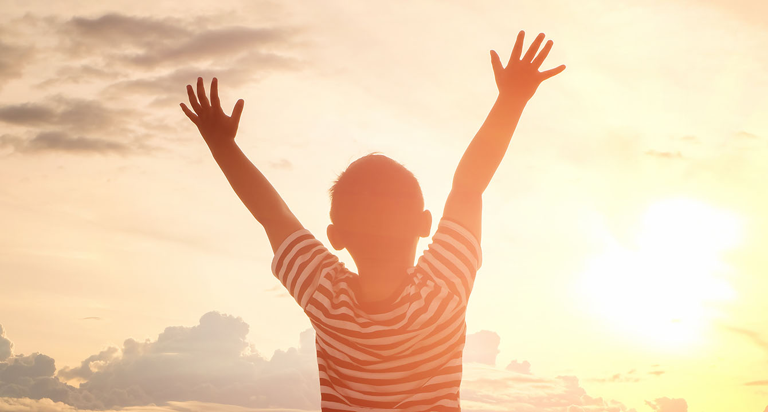
California Social and Emotional Learning
8.11 Hope for Students
TOPIC 8: Mindfulness and Well-Being for Students
Notes:
Suggested intro script:
Hope plays a significant role in students’ lives, often without them even realizing it. They hope to excel on tests, catch the attention of that cute 9th grader, make their parents proud, and secure a job after high school.
Hope is a vital force that drives young people forward amidst the uncertainty and planning for their futures. While the seeds of hope are often planted early in life, they require nurturing, especially when students encounter setbacks and challenges.
Teachers can be instrumental in fostering this hope, providing the support and encouragement students need to thrive.

Slide 4
Learning Objectives
8.11 Hope for Students
Understand the meaning of hope, particularly as it relates to students
Explore how hope can support students’ well-being, resilience, and success in school
Investigate the various ways you can create classrooms that support hope or help students build or harness hope on a daily basis.
Link Objectives to Developmental Indicators in
California Transformative SEL Competencies
Notes:
**Expand objectives to California Developmental Indicators through making connections to SEL competencies in California on developmental age span.
Sourced from CDE (July 2023):
The California Department of Education (CDE) aims to support and advance the efforts of educators across California who are working to fully integrate systemic SEL and equity by building on the promise of T-SEL as a concept. To provide these supports, the CDE has articulated developmental indicators for CASEL’s five core competencies:
Self-Awareness (Intrapersonal Focus)
Self-Management (Intrapersonal Focus)
Social Awareness (Interpersonal Focus)
Relationship Skills (Interpersonal Focus)
Responsible Decision-Making (Inter and Intrapersonal)
Some suggested connections for this workshop are:
Self-awareness:
-Identifying one’s emotions
-Linking feelings, values, and thought
-Experiencing self-efficacy
-Having a growth mindset
Self-management:
-Managing one’s emotions
-Identifying and using stress management and self care strategies
-Cultivating resilience and overcoming adversity
-Setting personal and collective goals
-Using planning and organizational skills
-Demonstrating personal and collective agency
Social awareness:
-Recognizing situational demands and opportunities
Understanding the influences of biased and racist systems and structures on mindset, behavior, and actions
Responsible decision-making:
-Identifying solutions for personal and social problems

Slide 5
“The capacity for hope is the most significant fact of life. It provides human beings with a sense of destination and the energy to get started.”
- Norman Cousins

Slide 6
Video
Notes:
Link: https://youtu.be/4wfl-70Qeks
Video Running Time: 25:48
Next, we are going to watch this video about hope - and its relevance for young people.

Slide 7
Small Group Discussion
What surprised you about the definition of hope?
Did you disagree with some of the definitions?
How might culture - whether your own or your students' - impact how you introduce/talk about hope in the classroom?
Notes:
Invite your learners to discuss the following questions in their small groups

Slide 8
Video
Notes:
Link: https://youtu.be/sA9pXojIGTs
Video Running Time: 7:03
"This next video goes into the benefits of hope for young people "

Slide 9
Small Group Discussion
Share one of the following in your small groups:
A time you feel you instilled some hope in a student
What happened? How did you evoke hope? How did they feel after?
An example of a moment that required some hope in your classroom - either with an individual student or class-wide
What was happening? Why do you think more hope would have helped?
Notes:
Invite your learners to share one of the following and discuss in their small groups.

Slide 10
Video
Notes:
Link: https://youtu.be/TgZJeiWmOoc
Video Running Time: 15:10
"This next video goes into a variety of ways and considerations for fostering hope in classrooms."

Slide 11
Small Group Activity: Hope Mapping
Think of a goal your students might have (if time, you can repeat this activity with a few different goals).
Write the goal at the top of the mind map.
Draw 2 - 3 pathways to achieving this goal (these should be different routes they could take).
Identify some possible obstacles along each path (write them as the “roadblocks” along the paths.
Write some strategies students could use to get past the obstacles.
Goal
Pathways
Pathways
Obstacles/Roadblocks
Strategies
Notes:
If you have mixed-grade teachers in your workshop, invite them to create small groups with teachers who teach similar age groups: Early childhood, upper elementary, middle school, high school.

Slide 12
Group Discussion
How might you handle or speak to students about obstacles that are out of their control?
What can we as educators do?
How can we speak to students about this?
Can we involve parents in the discussion?
For example, if a student says they want to be a professional athlete or a rockstar or something that seems out of most people's reach, what should an educator do/say, if anything?
Is it wrong to discourage a student from an almost impossible goal, or is there value in pursuing it to gain the skills from the process, or something else?
Notes:
Have participants share their maps and discuss the variety of pathways and solutions they identified.
Explore how teaching students to create multiple pathways can help them build resilience and maintain hope even when they face setbacks.

Slide 13
California Social and Emotional Learning
Add an Optimistic Closure Here
Notes:
Add SEL Signature Practices (e.g., welcoming Rituals, optimistic closures, etc. to your presentation).
The SEL 3 Signature Practices are one tool for fostering a supportive environment and promoting SEL. They intentionally and explicitly help build a habit of practices through which students and adults enhance their SEL skills.
For a short presentation of what SEL 3 Signature Practices are, along with a list of practices, see the following:
https://ggie.berkeley.edu/wp-content/uploads/2023/05/Welcoming_Closing-Activities.pptx

Slide 14
“Everything that is done in the world is done by hope. “
- Martin Luther
8.11 Hope for Students
Notes:
"I hope you feel inspired to explore hope with your students!"

