Slide 1
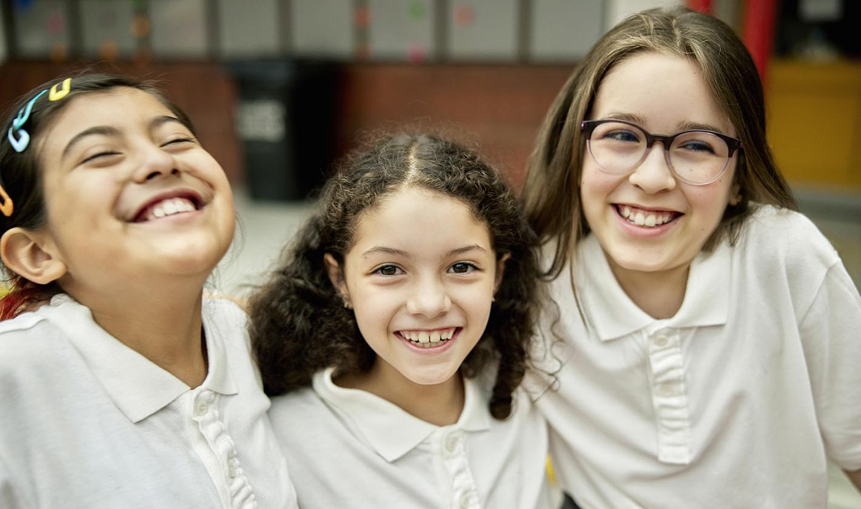
California Social and Emotional Learning
Topic 8
Mindfulness and Well-Being for Students
8.7 Empathy for Students
Notes:
For this lesson, you will need:
- It would be helpful for participants to have writing materials (paper, notebook, and pen/pencil).
- post-it notes & markers for group activity

Slide 2
California Social and Emotional Learning
Add a Welcoming Ritual Here
Notes:
Add SEL Signature Practices (e.g., welcoming rituals, optimistic closures, etc.) to your presentation.
The SEL 3 Signature Practices are one tool for fostering a supportive environment and promoting SEL. They intentionally and explicitly help build a habit of practices through which students and adults enhance their SEL skills.
For a short presentation of what SEL 3 Signature Practices are, along with a list of practices, see the following:
https://ggie.berkeley.edu/wp-content/uploads/2023/05/Welcoming_Closing-Activities.pptx

Slide 3
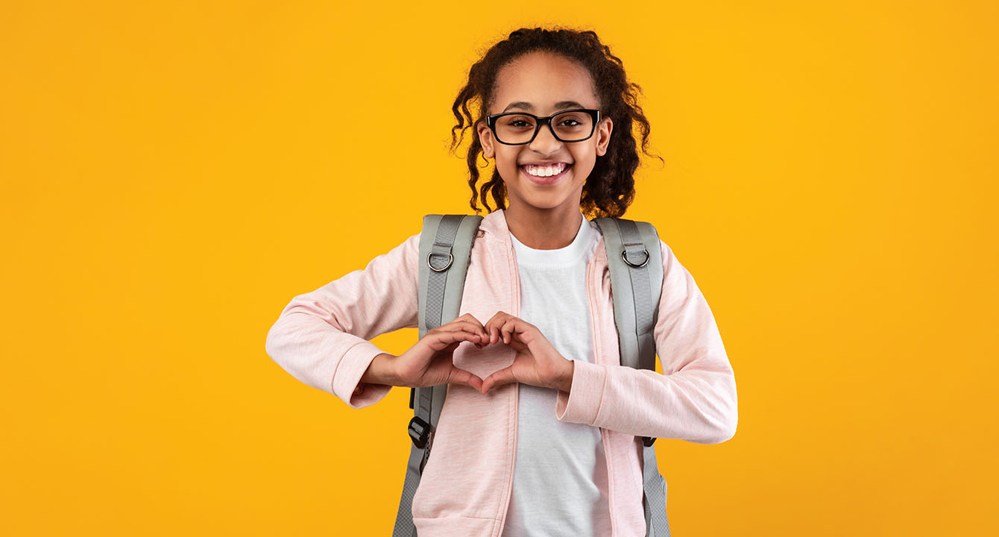
California Social and Emotional Learning
8.7 Empathy for Students
TOPIC 8: Mindfulness and Well-Being for Students
Notes:
Suggested introduction script:
Empathy is the quality of being in tune with the emotions of others. Sometimes the term empathy refers to the ability to imagine and understand how other people might be thinking or feeling (what researchers call cognitive empathy or perspective-taking); other times it indicates the capacity to sense others’ emotions and experience feelings that mirror theirs (referred to as emotional or affective empathy).
Empathy is what enables us to extend beyond our own point of view and truly care for each other. Though empathy alone does not guarantee positive behavior—in fact, if other social-emotional skills are lacking, empathy can be overwhelming and counterproductive. At the same time, it is often considered a vital foundation of morality and prosocial (kind and helpful) action.
Empathy is more than just a virtue; it's a crucial skill for students in today's world. It helps them navigate diverse social landscapes with understanding, forge deeper connections with others, and ultimately become compassionate leaders who can positively impact their communities and the future of our world.
And classrooms can serve as the fertile ground from which empathy can be nurtured and flourish.

Slide 4
Learning Objectives
8.7 Empathy for Students
Understand the definition and components of empathy and how it differs from sympathy and compassion
Explore the development of empathy in young people and the factors that contribute to it
Recognize the impact of empathy on student learning, well-being, and academic performance
Explore practical strategies and techniques for cultivating empathy in the classroom
Link Objectives to Developmental Indicators in
California Transformative SEL Competencies
Notes:
**Expand objectives to California Developmental Indicators through making connections to SEL competencies in California on developmental age span.
Sourced from CDE (July 2023):
The California Department of Education (CDE) aims to support and advance the efforts of educators across California who are working to fully integrate systemic SEL and equity by building on the promise of T-SEL as a concept. To provide these supports, the CDE has articulated developmental indicators for CASEL’s five core competencies:
Self-Awareness (Intrapersonal Focus)
Self-Management (Intrapersonal Focus)
Social Awareness (Interpersonal Focus)
Relationship Skills (Interpersonal Focus)
Responsible Decision-Making (Inter and Intrapersonal)
Some suggested connections for this workshop are:
Self-awareness:
-Identifying one’s emotions
Social awareness:
-Demonstrating empathy and compassion
-Showing concern for the feelings of others
-Understanding the influences of biased and racist systems and structures on mindset, behavior, and actions
-Creating and maintaining a just and caring community.
Relationships skills:
-Developing mutually healthy and productive relationships
-Making and maintaining trusting, respectful friendships

Slide 5
Video
Notes:
Link: https://youtu.be/UXyUEX6PjVg
Video Running Time: 18:02
Next, we are going to watch this video about empathy - and its relevance for young people.

Slide 6
Small group discussion
Which “barriers” to empathy have you seen most often in your classroom? Have you noticed these things getting in the way of students acting more prosocially towards each other?
Empathic Distress
Biases
Inaccurate perspective-taking
Losing power in big groups
Stress
Something else?
Notes:
Invite participants to reflect on the following questions in their small groups

Slide 7
Small group discussion
Can you brainstorm, in your small groups, some ways you could scaffold or remove these barriers in your classroom? (Hint - also think about the things that promote empathy)
Notes:
Invite participants to reflect on the following questions in their small groups

Slide 8
Video
Notes:
Link: https://youtu.be/GaIk7Xx3LvI
Video Running Time: 2:53
"This next video goes into the benefits of empathy for young people "

Slide 9
Individual Reflection & Small Group Sharing
Can you think back to a time in your own childhood when a classmate or teacher showed empathy towards you? How did it impact your experience at school?
In your small groups, take some time to share these stories.

Slide 10
Video
Notes:
Link: https://youtu.be/HB1JY_nfs2o
Video Running Time: 9:25
"This next video goes into a variety of ways and considerations for helping students nurture their empathy"

Slide 11
Large Group Activity: Superstar - Part 1
One powerful way to increase empathy in the classroom is to facilitate students getting to know each other better and finding commonalities.
Form pairs of 2.
Each pair will have 1–2 minutes to find out things they have in common. It can’t be something visible or that you already know (like your hair colour or the school you are from).
Adapted from the GGIE practice SUPERSTAR
Notes:
One powerful way to increase empathy in the classroom is to facilitate students getting to know each other better and finding commonalities.
We are going to try out an activity to do this - that you can then bring to your students as well.
It is called Superstar.
- Form pairs of 2.
- Each pair will have 1–2 minutes to find out things they have in common. It can’t be something visible or that you already know (like your hair colour or the school you are from).
[Give participants a few minutes to set up in a space for a discussion. Then set the timer for 2 minutes. After 2 minutes, invite participants to come back together in the larger group in a circle facing inwards, beside their partner]
Superstar: https://ggie.berkeley.edu/practice/superstar/

Slide 12
Large Group Activity: Superstar - Part 2
Return to the larger group and form a circle, standing beside your partner.
We will go around the circle, and each pair will take turns sharing their commonality.
After sharing their commonality, if others in the group also share that commonality, everyone should put their hands up and yell, “SUPERSTAR!”
Notes:
We will go around the circle, and each pair will take turns sharing their commonality.
After sharing their commonality, if others in the group also share that commonality, everyone should put their hands up and yell, “SUPERSTAR!”
Depending how much time you have, you have do another round with variations such as:
- Have players switch partners and do a round where they have to find something they have in common about a specific topic — for example, sports, school, or hobbies.
- Have players do a round where they can’t speak and can only act out ideas.

Slide 13
Small Group Discussion
Can you imagine how doing an activity like this might help students feel closer to one another? Have you ever tried a “getting to know you” activity like this in the classroom? Did you notice any shifts in behaviors afterwards?
Can you see this having an impact on students’ desire to help one another? Why or why not?

Slide 14
California Social and Emotional Learning
Add an Optimistic Closure Here
Notes:
Add SEL Signature Practices (e.g., welcoming Rituals, optimistic closures, etc. to your presentation).
The SEL 3 Signature Practices are one tool for fostering a supportive environment and promoting SEL. They intentionally and explicitly help build a habit of practices through which students and adults enhance their SEL skills.
For a short presentation of what SEL 3 Signature Practices are, along with a list of practices, see the following:
https://ggie.berkeley.edu/wp-content/uploads/2023/05/Welcoming_Closing-Activities.pptx

Slide 15
8.7 Empathy for Students
Notes:
"I hope you feel inspired to explore courage with your students!

