Slide 1
California Social and Emotional Learning
Topic 7
Mindfulness and Well-Being for Educators
7.7 Empathy for Educators
Notes:
For this lesson, you will need:
- A way to show the videos to your participants (links are in the presenter notes and on the screen). They are YouTube links, so you will need an internet connection.
- It would be helpful for participants to have writing materials (paper, notebook, and pen/pencil).
Optional: Poster board, post-it notes & markers for group discussions/brainstorming

Slide 2
California Social and Emotional Learning
Add a Welcoming Ritual Here
Notes:
Add SEL Signature Practices (e.g., welcoming rituals, optimistic closures, etc.) to your presentation.
The SEL 3 Signature Practices are one tool for fostering a supportive environment and promoting SEL. They intentionally and explicitly help build a habit of practices through which students and adults enhance their SEL skills.
For a short presentation of what SEL 3 Signature Practices are, along with a list of practices, see the following:
https://ggie.berkeley.edu/wp-content/uploads/2023/05/Welcoming_Closing-Activities.pptx

Slide 3
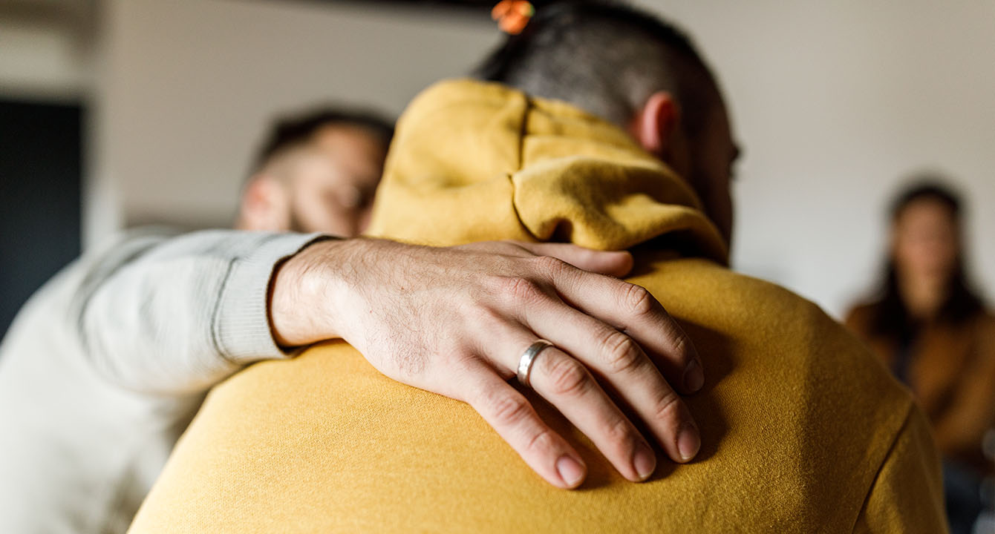
California Social and Emotional Learning
7.7 Empathy for Educators
TOPIC 7: Mindfulness and Well-Being for Educators
Notes:
All humans benefit from cultivating empathy, but as educators, we have so many extra human hearts to care for - that growing our own empathy becomes an utmost priority.
Empathy is the quality of being in tune with the emotions of others. Sometimes the term empathy refers to the ability to imagine and understand how other people might be thinking or feeling (what researchers call cognitive empathy or perspective-taking); other times it indicates the capacity to sense others’ emotions and experience feelings that mirror theirs (referred to as emotional or affective empathy).
Empathy is what enables us to extend beyond our own point of view and truly care for each other. Though empathy alone does not guarantee positive behavior—in fact, if other social-emotional skills are lacking, empathy can be overwhelming and counterproductive. At the same time, it is often considered a vital foundation of morality and prosocial (kind and helpful) action.

Slide 4
Learning Objectives
7.7 Empathy for Educators
Understand the definition and components of empathy and how it differs from sympathy and compassion
Recognize the benefits of empathy for our social, emotional, and professional lives
Reflect on the pitfalls and vulnerabilities of empathy and how to overcome them
Explore how to harness empathy for prosocial behavior
Link Objectives to Developmental Indicators in
California Transformative SEL Competencies
Notes:
Expand objectives to California Developmental Indicators through making connections to SEL competencies in California on developmental age span.
Sourced from CDE (July 2023):
The California Department of Education (CDE) aims to support and advance the efforts of educators across California who are working to fully integrate systemic SEL and equity by building on the promise of T-SEL as a concept. To provide these supports, the CDE has articulated developmental indicators for CASEL’s five core competencies:
Self-Awareness (Intrapersonal Focus)
Self-Management (Intrapersonal Focus)
Social Awareness (Interpersonal Focus)
Relationship Skills (Interpersonal Focus)
Responsible Decision-Making (Inter and Intrapersonal)
Some suggested connections for this workshop are:
Self-awareness:
-Identifying one’s emotions
Social awareness:
-Demonstrating empathy and compassion
-Showing concern for the feelings of others
-Understanding the influences of biased and racist systems and structures on mindset, behavior, and actions
-Creating and maintaining a just and caring community.
Relationships skills:
-Developing mutually healthy and productive relationships
-Making and maintaining trusting, respectful friendships

Slide 5
“Empathy is about finding echoes of yourself in another person.”
–Mohsin Hamid

Slide 6
Video
Notes:
Link: https://youtu.be/ZFu36prwVok
Video Running Time: 20:30
First, we are going to watch a video that answers the question "what is empathy?"

Slide 7
Individual Activity & Reflection
Take this Empathy Quiz: https://greatergood.berkeley.edu/quizzes/take_quiz/empathy
Did anything surprise you about your score?
Did the quiz reveal to you some of your empathy-related strengths?
Were there areas in which you could grow? If so, how might you do that?
Notes:
Invite participants to reflect on the following questions in their small groups

Slide 8
Video
Notes:
Link: https://youtu.be/ZBwwuO6IlP0
Video Running Time: 4:09
It may be helpful to encourage participants to take out a piece of paper or journal for this video.
Next, we are going to watch this video on the benefits of cultivating empathy for educators.

Slide 9
Small Group Discussion
Identify areas in your personal or professional life where you might benefit from cultivating more empathy.
What challenges have you faced in these contexts that made expressing empathy difficult?

Slide 10
Video
Notes:
Link: https://youtu.be/HqCN6cb94SQ
Video Running Time: 15:14
"Now that we have connected with what empathy is and its significance for educators and schools, we are going to shift to some practical strategies for exploring more empathy in our lives.
I invite you to make note of any practices that stand out to you and seem like something you could incorporate into your daily life."

Slide 11
Large Group Activity: Active Listening
Find a quiet place where you can talk with a conversation partner without interruption or distraction. Invite them to share what’s on their mind.
Paraphrase.
Ask questions.
Express empathy.
Use engaged body language.
Avoid judgment.
Avoid giving advice.
Notes:
For this activity you will need:
- space for partners to gather privately
- Printout of the Handout for each pair
Handout Link: https://ggie.berkeley.edu/wp-content/uploads/2024/11/ACTIVE-LISTENING-Handout.pdf
Script:
"We are going to practice active listening with a partner.
Find a quiet place where you can talk with a conversation partner without interruption or distraction. Invite them to share what’s on their mind. As they do so, try to follow the steps below. You don’t need to cover every step, but the more you do cover, the more effective the practice is likely to be.
You can refer to the handout for more details about each step."

Slide 12
Group Reflection
Reflect on the following questions and share in your small groups:
How did it feel to be actively listened to? Did it change your ability to share more details about your situation?
How did it feel to attentively listen to your partner? Which steps came naturally to you? Which ones took more effort or felt more awkward?
Notes:
Invite learners to reflect on this question individually and then share in their small groups.

Slide 13
California Social and Emotional Learning
Add an Optimistic Closure Here
Notes:
Add SEL Signature Practices (e.g., welcoming Rituals, optimistic closures, etc. to your presentation).
The SEL 3 Signature Practices are one tool for fostering a supportive environment and promoting SEL. They intentionally and explicitly help build a habit of practices through which students and adults enhance their SEL skills.
For a short presentation of what SEL 3 Signature Practices are, along with a list of practices, see the following:
https://ggie.berkeley.edu/wp-content/uploads/2023/05/Welcoming_Closing-Activities.pptx

Slide 14
7.7 Empathy for Educators
Notes:
We hope we’ve given you some ideas and maybe some inspiration to strive to cultivate awe in your educational communities.

