Slide 1
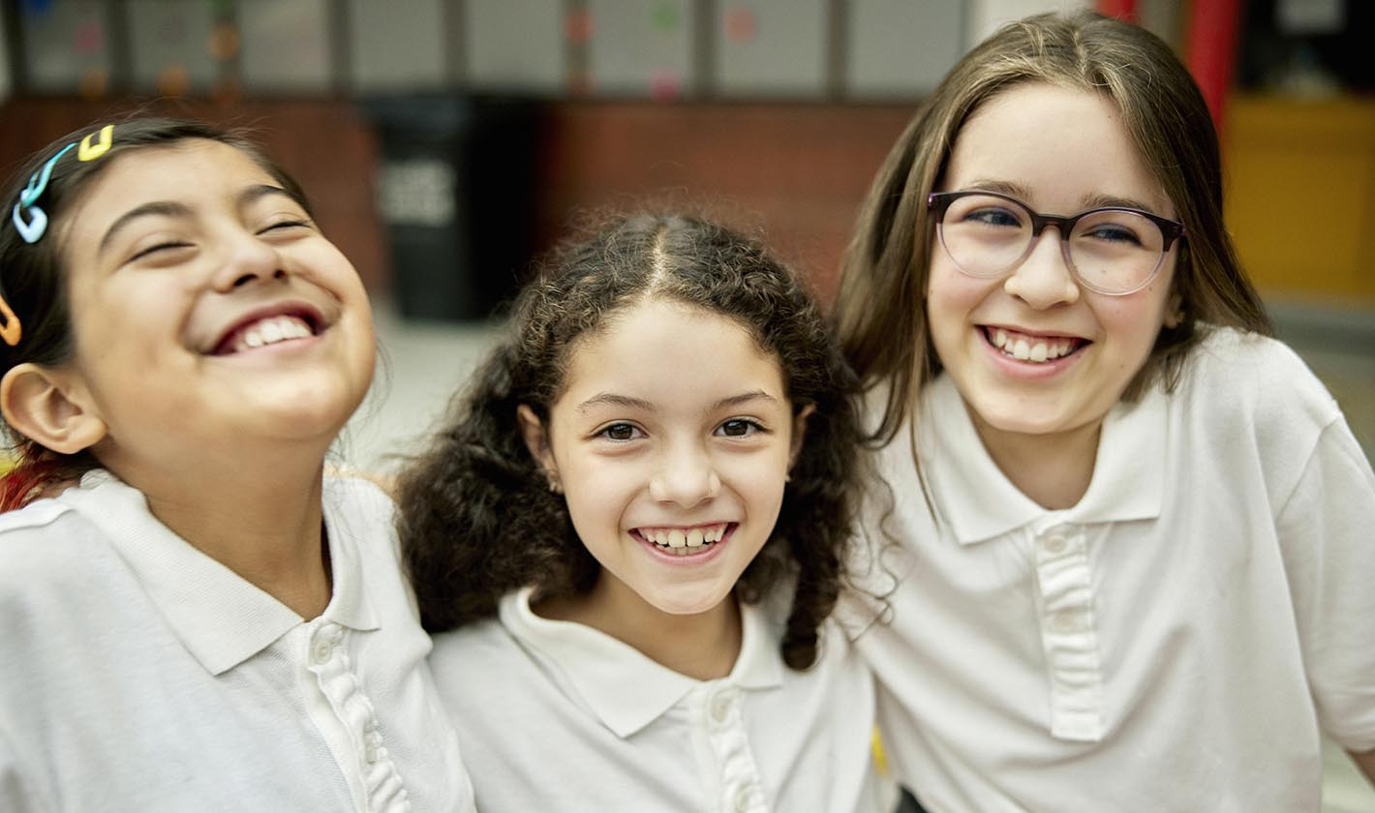
California Social and Emotional Learning
Topic 8
Mindfulness and Well-Being for Students
8.6 Courage for Students
Notes:
For this lesson, you will need:
- It would be helpful for participants to have writing materials (paper, notebook, and pen/pencil).
- post-it notes & markers for group activity

Slide 2
California Social and Emotional Learning
Add a Welcoming Ritual Here
Notes:
Add SEL Signature Practices (e.g., welcoming rituals, optimistic closures, etc.) to your presentation.
The SEL 3 Signature Practices are one tool for fostering a supportive environment and promoting SEL. They intentionally and explicitly help build a habit of practices through which students and adults enhance their SEL skills.
For a short presentation of what SEL 3 Signature Practices are, along with a list of practices, see the following:
https://ggie.berkeley.edu/wp-content/uploads/2023/05/Welcoming_Closing-Activities.pptx

Slide 3
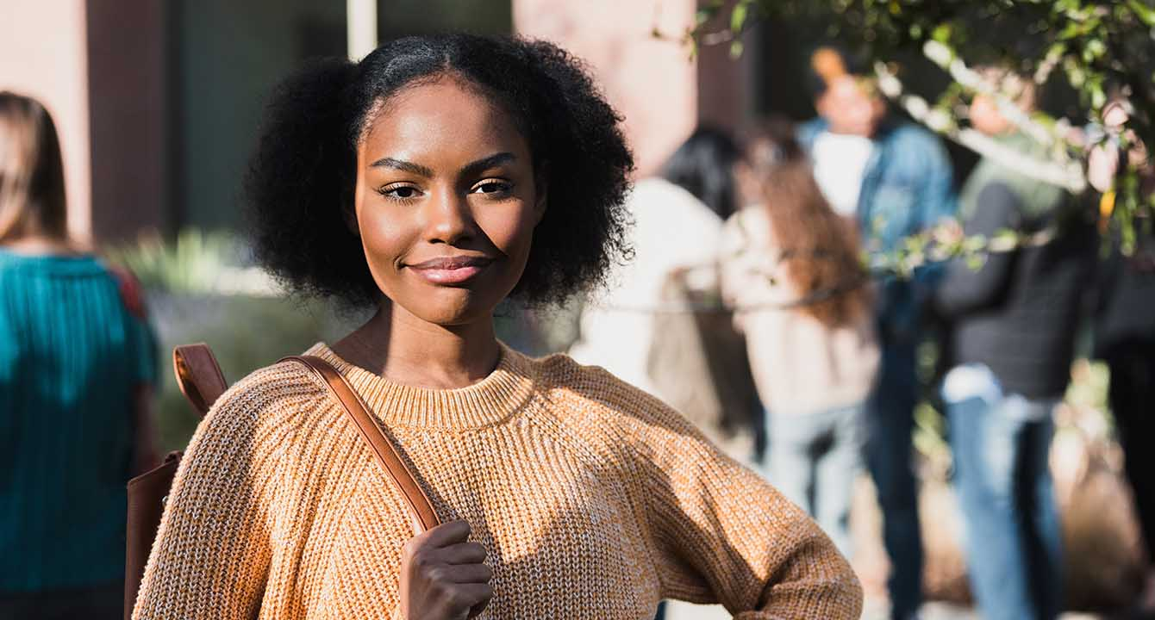
California Social and Emotional Learning
8.6 Courage for Students
TOPIC 8: Mindfulness and Well-Being for Students
Notes:
Suggested introduction script:
As educators, we understand that fostering courage goes beyond teaching academic subjects—it's about equipping students with the confidence and resilience they need to thrive in all aspects of life.
In today's rapidly changing world, where uncertainty and challenges abound, the ability to cultivate courage is more crucial than ever. It's about empowering our students to face adversity, tackle difficult tasks, and pursue their values-based aspirations with determination and resilience.
From fostering a supportive learning environment to providing opportunities for risk-taking and growth, we'll examine how educators can play a pivotal role in helping students develop the courage they need to succeed.

Slide 4
Learning Objectives
8.6 Courage for Students
Identify the components of courage
Understand the difference between “general” courage and “personal” courage
Define academic courage and its relevance for students
Understand what moral courage is and how it plays out for young people
Examine the benefits of courage for young people
Explore tools and practical strategies to help students find their courage
Link Objectives to Developmental Indicators in
California Transformative SEL Competencies
Notes:
Learning Objectives:
Today we are going to cover the following topics:
-Identify the various components of courage
-Understand the difference between “general” courage and “personal” courage
-Define academic courage and its relevance for students
-Understand what moral courage is and how it plays out for young people
-Examine the benefits of courage for young people
-Explore tools and practical strategies to help students find their courage
**Expand objectives to California Developmental Indicators through making connections to SEL competencies in California on developmental age span.
Sourced from CDE (July 2023):
The California Department of Education (CDE) aims to support and advance the efforts of educators across California who are working to fully integrate systemic SEL and equity by building on the promise of T-SEL as a concept. To provide these supports, the CDE has articulated developmental indicators for CASEL’s five core competencies:
Self-Awareness (Intrapersonal Focus)
Self-Management (Intrapersonal Focus)
Social Awareness (Interpersonal Focus)
Relationship Skills (Interpersonal Focus)
Responsible Decision-Making (Inter and Intrapersonal)
Some suggested connections for this workshop are:
Self-management:
-Setting personal and collective goals
-Showing the courage to take initiative
-Cultivating resilience and overcoming adversity
Social awareness
-Recognizing situational demands and opportunities
-Creating and maintaining a just and caring community.
Responsible decision-making:
- Considering personal and collective safety concerns
Relationships skills:
-Resisting negative social pressure
-Showing leadership and contributing productively in groups
-Standing up for the rights of others

Slide 5
Video
Notes:
Link: https://youtu.be/iDe4EjeFp7w
Video Running Time: 13:05
Next, we are going to watch this video about courage

Slide 6
Large Group Activity: Courage Creatures
Take a brief moment to reflect on what courage means to you
What aspects of your life require courage right now?
What helps you feel courageous and able to tackle things that are hard or risky?
Now we are going to create our courage creatures!
Imagine you have a courage creature living inside your heart.
On these papers, draw what you think your courage creature would look like. What does courage or bravery mean to you? Include as many details as you can:
What does your courage creature need courage for?
What does courage feel like in your body or your courage creature’s body?
Is there anything your Courage Creature needs to feel more brave or courageous? Draw what helps your courage creature feel brave!
Notes:
What you need for this activity:
- Pens/writing tools
- Sticky notes
- Large poster Board
"We are going to do an adapted version of a student practice about courage. This is a creative practice you can do with young students - but even older ones could have fun with it, too. It is about seeing yourself as courageous - and exploring what you need courage for.

Slide 7
Group Reflection
Reflect on the following questions and share in your small groups:
Did you notice anything unique about each others’ drawings? Did you learn anything new about anyone?
If you were to try this with students, what might you modify or do differently? What might you do first to set the stage for this activity?
Notes:
Invite learners to reflect on this question individually and then share in their small groups.

Slide 8
Video
Notes:
Link: https://youtu.be/VzZ2OrB_agM
Video Running Time: 8:23
"This next video goes into the benefits of courage for young people "

Slide 9
Small Group Discussion
Research shows that hearing stories of courage can actually boost your own courageous actions. So please share in your small groups:
What is one courageous decision you made in your teaching career that significantly impacted your students' learning and growth?
Notes:
Invite participants to reflect on the following questions in their small groups

Slide 10
Video
Notes:
Link: https://youtu.be/AIJLnz0EuaQ
Video Running Time: 10:04
"This next video goes into a variety of ways and considerations for helping students find their courage"

Slide 11
Large Group Activity: Who are your heroes?
Think of someone you admire or would consider a hero
They can be famous or someone you know.
Choose someone who has shown courage, overcoming risk or adversity.
Write their name (or a description of them, if you want to maintain confidentiality)
e.g., “My neighbor”
Let’s discuss!
Why did you choose this person? What makes them courageous to you? What risks have they faced and overcome? Who was helped by their courage?
Adapted exerpt from:
Notes:
This activity requires:
- Writing tools
- post-it notes
- board/wall/whiteboard to stick them on
Invite learners to think of someone they admire or would consider a hero. They can be famous person or someone they know personally—someone who has shown courage, overcoming risk or adversity.
Ask them to write the name (or description, if they want to keep it anonymous - like "my mom" or "my neighbor") on a post-it, and put their post-it on the board/wall.
If learners are struggling to come up with examples, you can invite them to check out https://giraffeheroes.org for courage stories.
In a large group discussion, invite learners to share "why" they think this person is courageous - what this person overcame or what risks they faced, and who was helped by their courage. They might also consider what other personality traits they think may have helped them to act courageously. (They can maintain confidentiality and speak generally or openly share the name of the person they chose.) Invite those who are comfortable to share a story about the person they chose.

Slide 12
California Social and Emotional Learning
Add an Optimistic Closure Here
Notes:
Add SEL Signature Practices (e.g., welcoming Rituals, optimistic closures, etc. to your presentation).
The SEL 3 Signature Practices are one tool for fostering a supportive environment and promoting SEL. They intentionally and explicitly help build a habit of practices through which students and adults enhance their SEL skills.
For a short presentation of what SEL 3 Signature Practices are, along with a list of practices, see the following:
https://ggie.berkeley.edu/wp-content/uploads/2023/05/Welcoming_Closing-Activities.pptx

Slide 13
8.6 Courage for Students
Notes:
"I hope you feel inspired to explore courage with your students!

