Slide 1
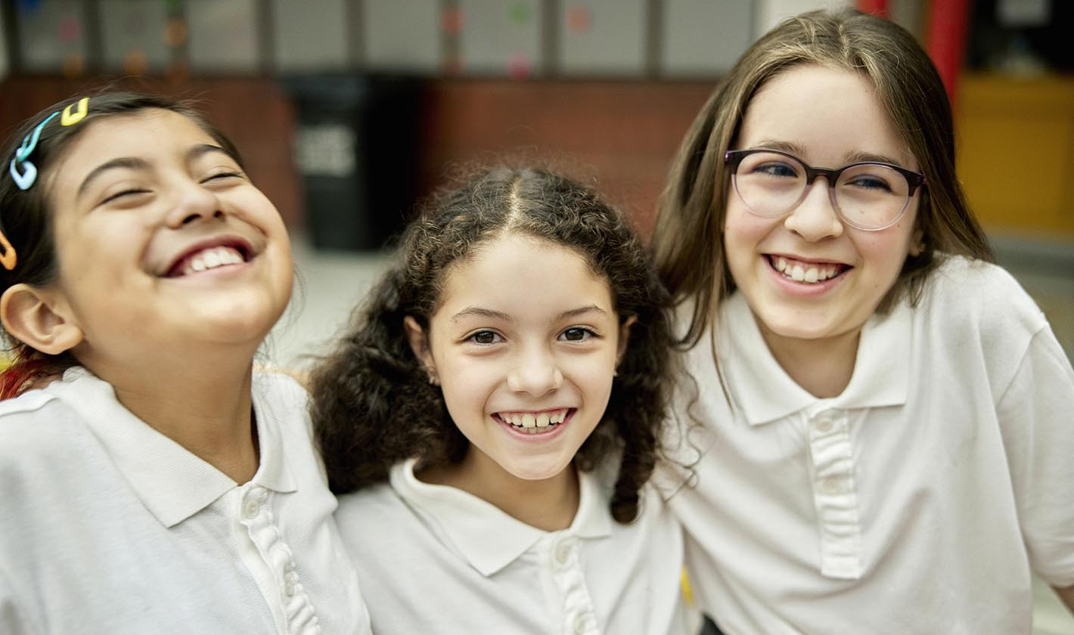
California Social and Emotional Learning
Topic 8
Mindfulness and Well-Being for Students
8.8 Mindfulness for Students
Notes:
For this lesson, you will need:
- It would be helpful for participants to have writing materials (paper, notebook, and pen/pencil).
- post-it notes & markers for group activity

Slide 2
California Social and Emotional Learning
Add a Welcoming Ritual Here
Notes:
Add SEL Signature Practices (e.g., welcoming rituals, optimistic closures, etc.) to your presentation.
The SEL 3 Signature Practices are one tool for fostering a supportive environment and promoting SEL. They intentionally and explicitly help build a habit of practices through which students and adults enhance their SEL skills.
For a short presentation of what SEL 3 Signature Practices are, along with a list of practices, see the following:
https://ggie.berkeley.edu/wp-content/uploads/2023/05/Welcoming_Closing-Activities.pptx

Slide 3
California Social and Emotional Learning
8.8 Mindfulness
for Students
TOPIC 8: Mindfulness and Well-Being for Students
Notes:
Suggested introduction script:
Students' lives can feel overwhelming. As they grow up, young people experience changing brains and bodies, expanding social lives, and mounting school pressures with each new year. And nowadays, with added stressors like climate change, social media, political unrest, and economic struggles, young people face a lot of “turbulence.”
Prasad Mahes once said “The mind is like water. When it’s turbulent, it’s difficult to see. When it’s calm, everything becomes clear.”
Mindfulness offers a tool - a practice and a habit of mind that has the potential to help young people calm the storm and find the pauses, the breaths, between a whirlwind of stimuli and their reactions to it.
Researchers define mindfulness as the awareness that arises when we intentionally pay attention in a kind, open, and discerning way. When we are mindful, we focus on the present moment non-judgmentally.
The concept of mindfulness, rooted in ancient Eastern contemplative traditions, predates modern research and was popularized as a secular practice in the 1990s by Dr. Jon Kabat-Zinn’s work on Mindfulness-Based Stress Reduction (MBSR), eventually making its way into the field of education - with a growing number of mindfulness programs emerging for young people.
Although research continues on mindfulness practices and programs with youth, many studies to date reveal mindfulness as a promising path towards enhanced well-being and effective stress reduction strategies for students in school.

Slide 4
Learning Objectives
8.8 Mindfulness for Students
Link Objectives to Developmental Indicators in
California Transformative SEL Competencies
Understand the definition, origins, and components of mindfulness
Recognize the social, emotional, and ? benefits of mindfulness for young people
Explore ways to introduce and practice mindfulness with young people in your classroom
Notes:
**Expand objectives to California Developmental Indicators through making connections to SEL competencies in California on developmental age span.
Sourced from CDE (July 2023):
The California Department of Education (CDE) aims to support and advance the efforts of educators across California who are working to fully integrate systemic SEL and equity by building on the promise of T-SEL as a concept. To provide these supports, the CDE has articulated developmental indicators for CASEL’s five core competencies:
Self-Awareness (Intrapersonal Focus)
Self-Management (Intrapersonal Focus)
Social Awareness (Interpersonal Focus)
Relationship Skills (Interpersonal Focus)
Responsible Decision-Making (Inter and Intrapersonal)
Some suggested connections for this workshop are:
Self-awareness:
-Identifying one’s emotions
-Linking feelings, values, and thought
Self-management:
-Managing one’s emotions
-Identifying and using stress management and self care strategies
-Cultivating resilience and overcoming adversity
Social awareness:
-Demonstrating empathy and compassion
Relationships skills:
-Developing mutually healthy and productive relationships
-Making and maintaining trusting, respectful friendships
-Demonstrating gratitude
Responsible decision-making:
-Demonstrating curiosity and open-mindedness

Slide 5
Video
Notes:
Link: https://youtu.be/KpaayUeaIFw
Video Running Time: 12:04
Next, we are going to watch this video about mindfulness - and its relevance for young people.

Slide 6
Small group discussion
What challenges or concerns do you anticipate when introducing mindfulness to your students, and how can you address these to ensure the practices are effective and inclusive for all?
How do you think mindfulness could support your students this year?
Notes:
Invite participants to reflect on the following questions in their small groups

Slide 7
Video
Notes:
Link: https://youtu.be/_egN5ZM8RVU
Video Running Time: 4:49
"This next video goes into the benefits of mindfulness for young people "

Slide 8
Small Group Activity: A Mindful Mind Map
Open Awareness
Attention
Notes:
"When it comes to bringing new practices into the classroom, sometimes we need to pitch them a bit - both to our students and to our leadership - as to why they are beneficial.
As we just learned, mindfulness has many benefits beyond the classroom. But sometimes, our administrators, students, or parents want to know how things are related to academics.
So we are going to do a little exercise - a mind map- connecting the two main mindfulness "skills" to school work.
In your small groups - brainstorm all the ways that improved attention is connected to various parts of school - and then do the same for "open awareness".

Slide 9
Share back: A Mindful Mind Map
Open Awareness
Attention
Please pick 1 thing to share with the larger group
from each mindmap (1 for attention, 1 for open awareness)
Notes:
"When it comes to bringing new practices into the classroom, sometimes we need to pitch them a bit - both to our students and to our leadership - as to why it is beneficial.
As we just learned, mindfulness has many benefits beyond the classroom. But sometimes, our administrators, students, or parents want to know how things are related to academics.
So we are going to do a little exercise - a mind map- connecting the two main mindfulness "skills" to school work.
In your small groups - brainstorm all the ways that improved attention is connected to various parts of school - and then do the same for "open awareness".

Slide 10
Video
Notes:
Link: https://youtu.be/JvuA-7IBN5A
Video Running Time: 16:25
"This next video goes into a variety of ways and considerations for helping students cultivate mindfulness."

Slide 11
Small Group Activity: Intention Discussion
Attention
What are your intentions for exploring or introducing mindfulness to your classroom?
Attitude
Intention
(Fischer, 2013; Shapiro, 1992; 2009)
Notes:
As the video described, mindfulness includes attention, attitude, and intention.
Take a few minutes to brainstorm your intentions for bringing mindfulness into your classroom.
You can use the post-its and pasteboards to put your ideas together.

Slide 12
Small Group Share-Out
Pick 1 -2 intentions to share with the larger group.
Notes:
Please pick 1 -2 intentions to share out from your small groups.

Slide 13
Large Group Activity: Flow & Tell
We are going to get into a circle and make “present-moment statements.”
First, we will take a moment for a mindful check-in with ourselves.
Then, we will get into a circle and when it is your turn to speak, I invite you to say what you are experiencing in the present moment.
We can start our sentence with “In the present moment I am aware of __________.”
Some examples would be:
“In the present moment I am aware of an itch on my hand.”
“In the present moment I am aware of feeling nervous.”
“In the present moment I am aware of my busy mind.”
3. We will also practice mindful listening and not judging our own or others’ experiences.
Notes:
Invite learners to sit in a circle.
"Now, we are going to experience a mindfulness practice that you can bring to your students called Flow and tell.
We are going to go in a circle and make “present-moment statements”. Please note you can pass if you choose to.
Making a present-moment statement means simply stating what we experience right now in our bodies.
We can say what sensations we feel in our bodies—what we see, hear, smell, or taste.
We can also share our emotions—if we are, for instance, nervous, happy, or excited.
Instead of Show and Tell we will be practicing Flow and Tell: sharing with each other whatever is flowing in our awareness right now.
First, let's mindfully check-in with ourselves.
- Practice mindfully listening for a minute, noticing everything we hear.
Then, do a scan through your bodies, noticing sensations - like your breath or feeling of your body as it sits in the chair.
For another minute, you can check into your emotions.
Then, we will go in a circle and when it is your turn to speak, I invite you to say what you are experiencing in the present moment.
We can start our sentence with “In the present moment I am aware of __________.”
We can go around in a circle a few times, and everyone can share what they are experiencing in the present moment."
Remind learners to keep their eyes closed (or to gaze downward) and to keep their focus inside themselves. When learners speak, remind them not to tell stories or describe ideas, but speak from what is happening right now.
They can practice listening to other learners without judgments or planning what they are going to say.

Slide 14
Large Group Activity: Flow & Tell Reflection
Write about (or draw) what you noticed in yourself as you were talking or listening..
This activity harnesses mindful senses, mindful listening, & mindful speaking.
Notes:
"Now I invite you to just take a couple minutes to reflect on that practice--what you noticed in yourself as you spoke or listened to others. "

Slide 15
California Social and Emotional Learning
Add an Optimistic Closure Here
Notes:
Add SEL Signature Practices (e.g., welcoming Rituals, optimistic closures, etc. to your presentation).
The SEL 3 Signature Practices are one tool for fostering a supportive environment and promoting SEL. They intentionally and explicitly help build a habit of practices through which students and adults enhance their SEL skills.
For a short presentation of what SEL 3 Signature Practices are, along with a list of practices, see the following:
https://ggie.berkeley.edu/wp-content/uploads/2023/05/Welcoming_Closing-Activities.pptx

Slide 16
“The mind is like water. When it’s turbulent, it’s difficult to see. When it’s calm, everything becomes clear.”
– Prasad Mahes
8.8 Mindfulness for Students
Notes:
"I hope you feel inspired to explore mindfulness with your students!"

