Slide 1


California Social and Emotional Learning
Topic 7
Mindfulness and Well-Being for Educators
7.8 Mindfulness for Educators
Notes:
For this lesson, you will need:
- A way to show the videos to your participants (links are in the presenter notes and on the screen). They are YouTube links, so you will need an internet connection.
- It would be helpful for participants to have writing materials (paper, notebook, and pen/pencil).
Optional: Poster board, post-it notes & markers for group discussions/brainstorming

Slide 2

California Social and Emotional Learning
Add a Welcoming Ritual Here
Notes:
Add SEL Signature Practices (e.g., welcoming rituals, optimistic closures, etc.) to your presentation.
The SEL 3 Signature Practices are one tool for fostering a supportive environment and promoting SEL. They intentionally and explicitly help build a habit of practices through which students and adults enhance their SEL skills.
For a short presentation of what SEL 3 Signature Practices are, along with a list of practices, see the following:
https://ggie.berkeley.edu/wp-content/uploads/2023/05/Welcoming_Closing-Activities.pptx

Slide 3
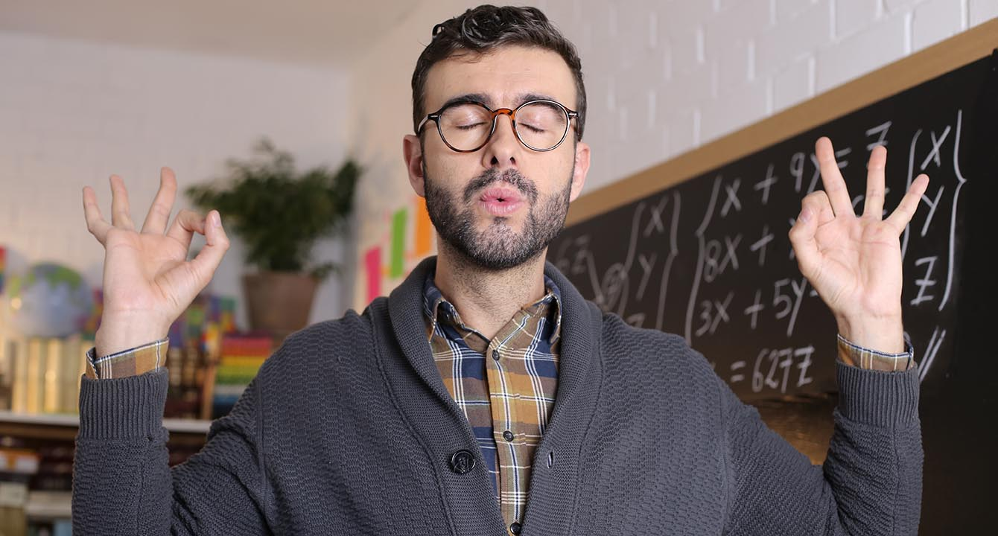
California Social and Emotional Learning
7.8 Mindfulness for Educators
TOPIC 7: Mindfulness and Well-Being for Educators
Notes:
Mindfulness is both a practice and a habit of mind that can help us find those pauses, those breaths, those moments between stimulus and reaction.
Researchers define mindfulness as the awareness that arises when we intentionally pay attention in a kind, open, and discerning way. When we are mindful, we focus on the present moment non-judgmentally.
Through mindfulness, we can learn to appreciate the simple act of being and discover the beauty in the present moment and find tranquility in the flow of life.
The concept of mindfulness, rooted in ancient Eastern contemplative traditions, predates modern research and was popularized as a secular practice in the 1990s by Dr. Jon Kabat-Zinn’s work on Mindfulness-Based Stress Reduction (MBSR), growing in influence and eventually making its way into the field of education.
Growing evidence suggests that when educators cultivate their own mindfulness, it can help reduce stress, improve focus, and create a more empathetic and engaging learning environment for their students.

Slide 4
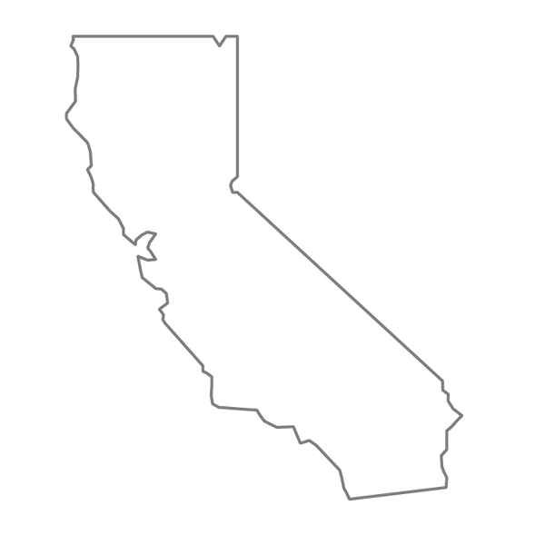

Learning Objectives
7.8 Mindfulness for Educators
  Understand the definition, origins, and components of mindfulness
  Recognize the social, emotional, and professional benefits of mindfulness
  Explore ways to cultivate a personal mindfulness practice and habit of mind
Link Objectives to Developmental Indicators in
California Transformative SEL Competencies
Notes:
Expand objectives to California Developmental Indicators through making connections to SEL competencies in California on developmental age span.
Sourced from CDE (July 2023):
The California Department of Education (CDE) aims to support and advance the efforts of educators across California who are working to fully integrate systemic SEL and equity by building on the promise of T-SEL as a concept. To provide these supports, the CDE has articulated developmental indicators for CASEL’s five core competencies:
Self-Awareness (Intrapersonal Focus)
Self-Management (Intrapersonal Focus)
Social Awareness (Interpersonal Focus)
Relationship Skills (Interpersonal Focus)
Responsible Decision-Making (Inter and Intrapersonal)
Some suggested connections for this workshop are:
Self-awareness:
-Identifying one’s emotions
-Linking feelings, values, and thought
Self-management:
-Managing one’s emotions
-Identifying and using stress management and self care strategies
-Cultivating resilience and overcoming adversity
Social awareness:
-Demonstrating empathy and compassion
Relationships skills:
-Developing mutually healthy and productive relationships
-Making and maintaining trusting, respectful friendships
-Demonstrating gratitude
Responsible decision-making:
-Demonstrating curiosity and open-mindedness

Slide 5
“Sometimes the most important thing in the whole day is the rest we take between two deep breaths.”
–Etty Hillesum

Slide 6

Large Group Activity: Mindful Breathing
Reflection: How did this practice feel for you? What thoughts or feelings arose for you? Can you see yourself continuing with a mindful breathing practice? Why or why not?
Notes:
Before we get into the videos, I invite you to join me in this short mindful breathing exercise. You can close your eyes or you can watch this video as you focus on your breath.
https://www.youtube.com/watch?v=uxayUBd6T7M&pp=ygUebWluZGZ1bCBicmVhdGhpbmcgbmF0dXJlIHZpZGVv
This can be a helpful mindful breathing practice because it is anchored in other senses - sight and sound as well. It gives you something to focus on, in addition to your breath.

Slide 7


Videos
Notes:
Link to video: https://youtu.be/KpaayUeaIFwVideo
Running Time: 10:34
First, we are going to watch a video that answers the question "what is mindfulness?"

Slide 8
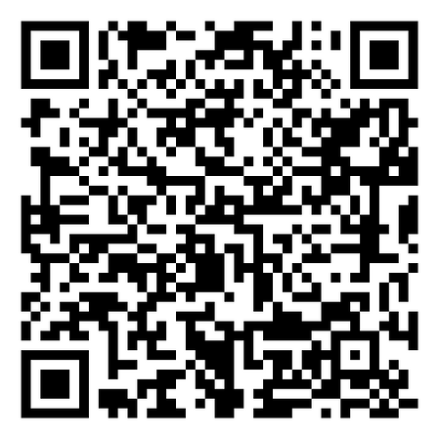
Individual Activity & Reflection
Take this Mindfulness Quiz to consider where you are in your mindfulness journey:
  Which aspects of mindfulness come more easily for you?
  Which aspects will benefit from more practice?
Notes:
Invite participants to reflect on the following questions in their small groups

Slide 9
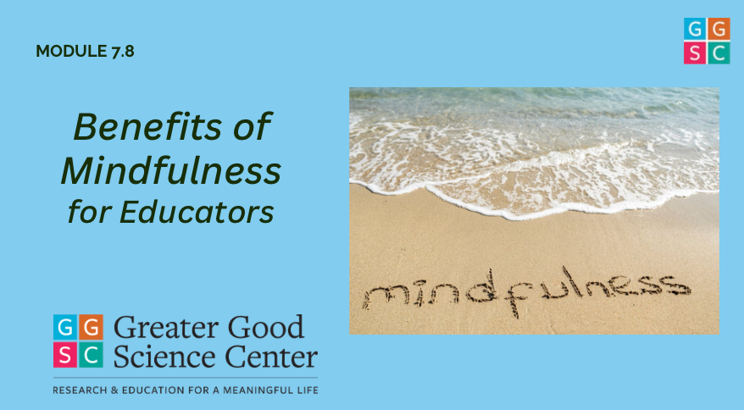
Video
Notes:
Link: https://youtu.be/B4I2_iW0mIk
Video Running Time: 5:54
It may be helpful to encourage participants to take out a piece of paper or journal for this video.
Next, we are going to watch this video on the benefits of cultivating mindfulness for educators.

Slide 10
Small Group Discussion
  Can you recall a time when you were really in the present moment or maybe in a state of “flow” (the experience of being fully immersed in an activity while losing all sense of time)? How did it feel? What emotions were present (or not present)?
  Share with your small group - what naturally inspires mindful moments for you?

Slide 11

Video
Notes:
Link: https://youtu.be/8Vz2i82lqDs
Video Running Time: 14:00
"Now that we have connected with what mindfulness is and its significance for educators and schools, we are going to shift to some practical strategies for exploring more mindfulness in our lives.
I invite you to make note of any practices that stand out to you and seem like something you could incorporate into your daily life."

Slide 12





Large Group Activity: Intentions
Attention
Add your intentions for mindfulness to a post-it
& add it to our collective intention board/wall.
Attitude
Intention
(Fischer, 2013; Shapiro, 1992; 2009)
Notes:
As the video described, mindfulness includes attention, attitude, and intention.
"Take a moment to think about your own personal intentions for practicing mindfulness. Not just for today, but your overall intentions for exploring mindfulness. Write 1-2 intentions on post-its and add it to our wall/board."
Optional: If time permits, you can give learners some time to do a gallery walk to view others' intentions for inspiration.

Slide 13
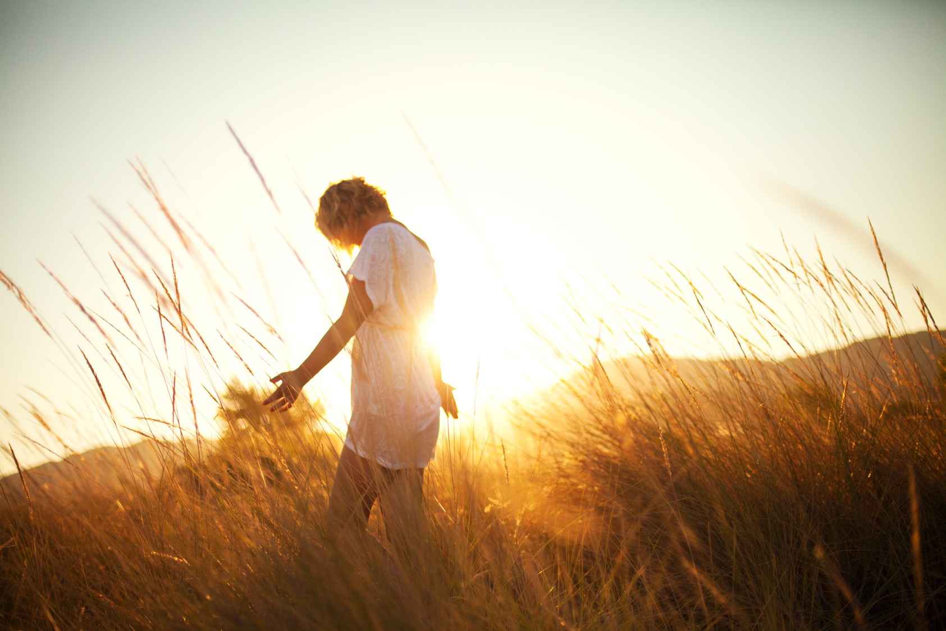
Group Activity: Mindful Nature Walk + Gratitude
Take 5 - 7 minutes to go
for a mindful nature walk.
If inside, listen to the music and nature sounds. You can soften your eyes as you walk. Feeling your feet on the ground, noticing your breath and any sounds you can hear.
If outside, take your time, engaging your five senses. Notice what you see, hear, feel, smell, and maybe taste.
Notes:
If possible, take your learners outside where they can walk in the fresh air and nature.
If not, invite them to quietly walk around the room.
You can play some nature-inspired music if they remain inside, to evoke natural sounds. We have provided some suggestions (but any nature-based mindfulness music works):
- https://www.youtube.com/watch?v=Nd7e4SNjGBM&pp=ygUYbmF0dXJlIG1pbmRmdWxuZXNzIG11c2lj
https://www.youtube.com/watch?v=lE6RYpe9IT0&pp=ygUYbmF0dXJlIG1pbmRmdWxuZXNzIG11c2lj

Slide 14
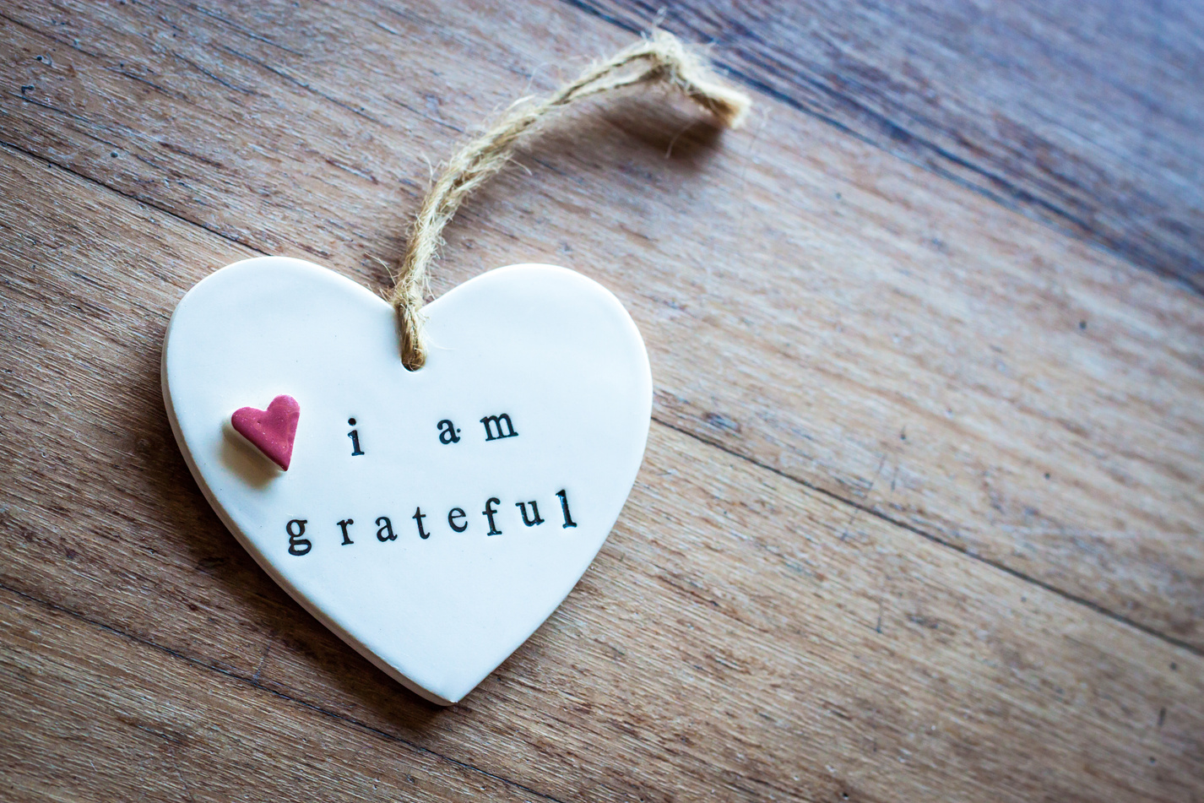
Group Activity: Mindful Nature Walk + Gratitude
After your walk, take note of 2-3 things you are grateful for.
Notes:
After learners return from their walk, invite them to reflect on 2-3 things they are grateful for. Either from their walk or in general.
This can serve as part of your optimistic closure, if you choose.

Slide 15
California Social and Emotional Learning
Add an Optimistic Closure Here
Notes:
Add SEL Signature Practices (e.g., welcoming Rituals, optimistic closures, etc. to your presentation).
The SEL 3 Signature Practices are one tool for fostering a supportive environment and promoting SEL. They intentionally and explicitly help build a habit of practices through which students and adults enhance their SEL skills.
For a short presentation of what SEL 3 Signature Practices are, along with a list of practices, see the following:
https://ggie.berkeley.edu/wp-content/uploads/2023/05/Welcoming_Closing-Activities.pptx

Slide 16
7.8 Mindfulness for Educators
Notes:
We hope we’ve given you some ideas and maybe some inspiration to strive to cultivate awe in your educational communities.

