Slide 1
California Social and Emotional Learning
Topic 8
Mindfulness and Well-Being for Students
8.5 Awe for Students
Notes:
For this lesson, you will need:
- A way to show the videos to your participants (links are in the presenter notes and on the screen). They are YouTube links so you will need an internet connection.
- It would be helpful for participants to have writing materials (paper, notebook, and pen/pencil).
Optional: Poster board, post-it notes & markers for group discussions/brainstorming

Slide 2
California Social and Emotional Learning
Add a Welcoming Ritual Here
Notes:
Add SEL Signature Practices (e.g., welcoming rituals, optimistic closures, etc.) to your presentation.
The SEL 3 Signature Practices are one tool for fostering a supportive environment and promoting SEL. They intentionally and explicitly help build a habit of practices through which students and adults enhance their SEL skills.
For a short presentation of what SEL 3 Signature Practices are, along with a list of practices, see the following:
https://ggie.berkeley.edu/wp-content/uploads/2023/05/Welcoming_Closing-Activities.pptx

Slide 3
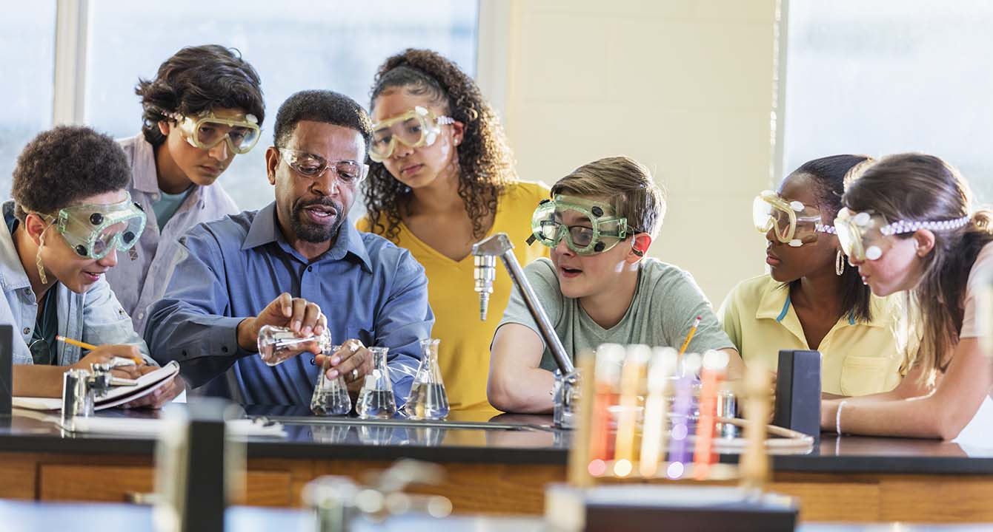
California Social and Emotional Learning
8.5 Awe for Students
TOPIC 8: Mindfulness and Well-Being for Students
Notes:
Suggested introduction script:
Educators have a deep sense that when children are really learning, when they’re really connecting to other students, when they’re finding their passions and their sense of meaning in the classroom, the experience of awe is often nearby.
Scientists describe awe as a feeling of vastness that transforms how we view the world.
And while awe may not be a term familiar to students, most of them have probably already experienced it in their young lives.
Perhaps they got chills visiting a national park with their family, or were moved to tears as they walked across a stage with their classmates, in unison, during graduation. Maybe they were amazed by the birth of their sibling, or got goosebumps when they first contemplated quantum physics. Even though they may not have recognized what they felt was awe, it still may have had a profound impact on them.
Scientists who have been studying awe have found that humans, adults and children alike, have a fundamental need for awe. They have also discovered that awe is quite important for our social fabric and wellbeing, both individually and collectively. Indeed, this powerful emotion has the ability to foster kindness and generosity in students, help them discover a sense of purpose, improve their academic success, and awaken their motivation and curiosity for learning—a useful emotion to cultivate in the classroom!
While awe can be found in response to profound experiences, it can also be experienced in the simple moments of students’ lives. Singing together in an assembly or exploring a new and fascinating idea in class - like the wondrous life cycle of a butterfly.
This is what makes awe so powerful. Awe doesn’t have to come from a rare, once or twice-in-a-lifetime moment. Every single person on the planet can experience awe every day of their lives…if they know how to look for it.

Slide 4
Learning Objectives
8.5 Awe for Students
Define awe and explore the various ways it can be sparked
Explore the benefits of seeking and experiencing awe for young people
Explore the potential role of awe for students’ wellbeing, relationships, and thriving at school
Link Objectives to Developmental Indicators in
California Transformative SEL Competencies
Notes:
Learning Objectives:
Today we are going to cover the following topics:
-Define awe and explore the various ways it can be sparked
-Explore the benefits of seeking and experiencing awe for young people
-Explore the potential role of awe for students’’ wellbeing, relationships, and thriving at school
**Expand objectives to California Developmental Indicators through making connections to SEL competencies in California on developmental age span.
Sourced from CDE (July 2023):
The California Department of Education (CDE) aims to support and advance the efforts of educators across California who are working to fully integrate systemic SEL and equity by building on the promise of T-SEL as a concept. To provide these supports, the CDE has articulated developmental indicators for CASEL’s five core competencies:
Self-Awareness (Intrapersonal Focus)
Self-Management (Intrapersonal Focus)
Social Awareness (Interpersonal Focus)
Relationship Skills (Interpersonal Focus)
Responsible Decision-Making (Inter and Intrapersonal)
Some suggested connections for this workshop are:
Self-awareness:
-Identifying one’s emotions
-Developing interests and a sense of purpose
Self-management:
-Identifying and using stress management and self care strategies
Social awareness
-Leaning into others’ perspectives with curiosity
Responsible decision-making:
- Evaluating personal, interpersonal, community, and institutional impacts
Relationships skills:
-Demonstrating gratitude
Responsible decision-making:
- Demonstrating curiosity and open-mindedness

Slide 5
Video
Notes:
Link: https://youtu.be/mp3iSnPKKKI
Video Running Time: 10:14
Next, we are going to watch this video about awe

Slide 6
Large Group Activity: An Awe-some Web
Interconnections trigger awe. So do patterns, and the wonders of nature. So we are going to harness this and create our own awe-some web.
On your sticky notes:
Write 2- 3 things that have sparked awe for you
Add your sticky notes to the poster board.
Take a look at what other folks have written.
Take your pen - draw lines between things that have commonalities (you can write the connection on the line)
Then let’s step back - and see our awe-filled web of wonder!
Notes:
What you need for this activity:
- Pens/writing tools
- Sticky notes
- Large poster Board

Slide 7
Group Reflection
Reflect on the following questions and share in your small groups:
How can we design awe-inspiring experiences that are accessible and inclusive for all students, regardless of their backgrounds and experiences?
Notes:
Invite learners to reflect on this question individually and then share in their small groups.

Slide 8
Video
Notes:
Link: https://youtu.be/H3SBl31sA7k
Video Running Time: 7:09
"This next video goes into the benefits of awe for young people "

Slide 9
Group Discussion
After watching the videos, reflect on the following questions, first individually then share in your small groups:
Have you explored awe with your students or staff before or witnessed any awe-moments in your school?
What triggered it?
Did you notice any changes in emotions or engagement afterwards?
Notes:
Invite participants to reflect on the following questions in their small groups

Slide 10
Video
Notes:
Link: thttps://www.youtube.com/watch?v=hqZua-_NCVI
Video Running Time: 13:55
"This next video goes into a variety of ways and considerations for exploring awe in your classroom. Feel free to make note of any that resonate with you."

Slide 11
Group Activity: Trying out awe practice
We are going to try out some practices you can bring to your classrooms.
In your small groups, pick one of the 8 wonders to explore.
Watch the resource or do the activity presented for your wonder.
Reflect as a group:
Did that experience trigger awe (or other emotions) for you? [remember, it is ok if it didn’t!]
How do you think your students would react to this activity?
Is there anything you would need to do first, to set up a good tone in the classroom for this activity?
Notes:
This activity requires:
- A way to disseminate the 8 wonder activities to the small groups (either show each group their slide OR print out the slide PDFs for each group: provide here [insert link])
- Enough space for small groups to separate a bit - to watch their awe video, or go for a walk, without disturbing other groups.
Note: If there isn't enough space or it is not feasible to separate into smaller groups, you can pre-select 2 - 3 wonders to do as a large group together instead.

Slide 12
Moral Beauty
Share stories of moral beauty—those stories of courage, kindness, or overcoming adversity that you have experienced or witnessed from others
Moral Beauty

Slide 13
Nature
Option 1: Awe Walk
Take a brief awe walk (5-10 min). Take notice of what you see.
Notice if anything sparks awe for you. It doesn’t have to be something profound - it can be the clouds in the sky or the intricacies of a spider web.
Return to your small group and share what you found awe-inspiring and why.
Option 2
If you are unable to get outside, watch this nature video:
BBC Planet Earth Trailer: https://shorturl.at/eoHVZ
Discuss what watching this made you think/feel/reconsider/wonder
Nature

Slide 14
Music
Share a piece of music you find awe-inspiring. (If you have a way of playing a clip of it - that’s best!)
Mindfully listen to others’ awe-inspiring music pieces.
Notice if you feel any shifts in emotions, thinking, or if you feel goosebumps, an expansiveness in the chest, or even tears - all signs it could be triggering awe for you.
Music

Slide 15
Collective Effervescence
Option 1: Try it out
Try finger tapping or do a human wave.
For finger tapping - have someone start a rhythm, and one by one add everyone in the circle, doing the same rhythm.
Option 2: Watch it
Starling murmuration:
https://www.youtube.com/watch?v=X0sE10zUYyY
Amazing synchronized human wave:
https://www.youtube.com/watch?v=ZAcweZ_VDlU
Find a video of a flash mob to watch.
Collective Effervescence

Slide 16
Life Cycles
Watch this incredible short video of the life cycle of a butterfly: https://shorturl.at/grEL5
Discuss what makes this so awe-inducing.
What parallels can you draw to the human life cycle?
Life Cycles

Slide 17
Visual Design
Take a look at one of these websites together:
Awe-inspiring Art installations: https://illuminate.org/projects/
26 Awe-Inspiring Architectural Wonders: https://shorturl.at/I3469
What repetitive patterns did you notice?
Light/dark contrasts?
Representations of vastness?
What other examples of awe-inducing visual design have you seen in your daily life or travels?
Visual Design

Slide 18
Meaning/Transcendence
Option 1:
Consider doing a brief meditation together
Here are some audios to follow along:
Happiness Break: Tap into Joy that Surrounds You (5 min)
https://greatergood.berkeley.edu/podcasts/item/Happiness_break_Tap_into_Joy_that_Surrounds_You_Anushka_Fernandopulle
Happiness Break: Awe for Others (10 min)
https://greatergood.berkeley.edu/podcasts/item/happiness_break_awe_for_others
Option 2:
Discuss awe and meaning together instead.
Have you (or someone you know) ever experienced a shift in meaning or purpose after an awe-moment?
Discuss how you think awe could impact your teaching
Meaning/Transcendence

Slide 19
California Social and Emotional Learning
Add an Optimistic Closure Here
Notes:
Add SEL Signature Practices (e.g., welcoming Rituals, optimistic closures, etc. to your presentation).
The SEL 3 Signature Practices are one tool for fostering a supportive environment and promoting SEL. They intentionally and explicitly help build a habit of practices through which students and adults enhance their SEL skills.
For a short presentation of what SEL 3 Signature Practices are, along with a list of practices, see the following:
https://ggie.berkeley.edu/wp-content/uploads/2023/05/Welcoming_Closing-Activities.pptx

Slide 20
“Gratitude bestows reverence, allowing us to encounter everyday epiphanies, those transcendent moments of awe that change forever how we experience life and the world.”
–John Milton
8.5 Awe for Students
Notes:
"I hope you feel inspired to explore awe with your students!

