Slide 1
California Social and Emotional Learning
Topic 7
Mindfulness and Well-Being for Educators
7.4 Gratitude for Educators
Notes:
For this lesson, you will need:
- A way to show the videos to your participants (links are in the presenter notes and on the screen). They are YouTube links so you will need an internet connection.
- It would be helpful for participants to have writing materials (paper, notebook, and pen/pencil).
Optional: Poster board, post-it notes & markers for group discussions/brainstorming [See especially "Gratitude Tree" for materials]

Slide 2
California Social and Emotional Learning
Add a Welcoming Ritual Here
Notes:
Add SEL Signature Practices (e.g., welcoming rituals, optimistic closures, etc.) to your presentation.
The SEL 3 Signature Practices are one tool for fostering a supportive environment and promoting SEL. They intentionally and explicitly help build a habit of practices through which students and adults enhance their SEL skills.
For a short presentation of what SEL 3 Signature Practices are, along with a list of practices, see the following:
https://ggie.berkeley.edu/wp-content/uploads/2023/05/Welcoming_Closing-Activities.pptx

Slide 3
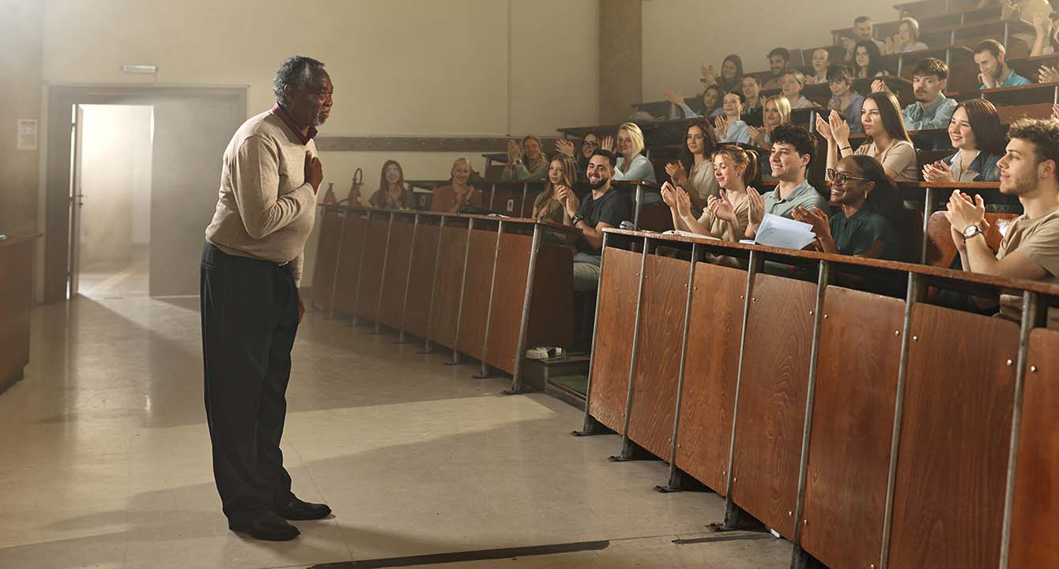
California Social and Emotional Learning
7.4 Gratitude for Educators
TOPIC 7: Mindfulness and Well-Being for Educators
Notes:
Gratitude may seem like a simple concept, but it actually holds great power. Why? Because, as leading gratitude researcher Robert Emmons writes, “gratitude is an affirmation of goodness.” Not only does it foster positive relationships, it strengthens our self-worth by showing us that we are worthy of receiving goodness from others.
While there are many definitions of gratitude, it is generally thought of as the positive feeling we get when we recognize a gift or positive outcome, either from within ourselves or from others.
However, importantly, studies have found that the idea and expression of gratitude can differ significantly in different cultural contexts. In other words, not everyone will respond the same way to keeping a gratitude journal.
As educators, who are constantly facing stress and juggling the many emotions of those around them, researchers have found that gratitude can be a beneficial practice - one that leads to reductions in burnout, increased well-being and improvements in relationships. Also, if we want to teach our students the benefits of gratitude, it can be helpful to do so from an authentic place of our own gratitude practice.

Slide 4
Learning Objectives
7.4 Gratitude for Educators
Define gratitude and discuss the different ways to understand it
Explore what contributes to or increases gratitude
Explore the importance of developing our own capacity for gratitude as educators
Review the benefits of gratitude for educators
Explore a variety of ways to boost our own gratitude
Link Objectives to Developmental Indicators in
California Transformative SEL Competencies
Notes:
Some topics we are going to cover are:
-Define gratitude and discuss the different ways to understand it
-Explore what contributes to or increases gratitude
-Explore the importance of developing our own capacity for gratitude as educators
--Review the benefits of gratitude for educators
-Explore a variety of ways to boost our own gratitude
Expand objectives to California Developmental Indicators through making connections to SEL competencies in California on developmental age span.
Sourced from CDE (July 2023):
The California Department of Education (CDE) aims to support and advance the efforts of educators across California who are working to fully integrate systemic SEL and equity by building on the promise of T-SEL as a concept. To provide these supports, the CDE has articulated developmental indicators for CASEL’s five core competencies:
Self-Awareness (Intrapersonal Focus)
Self-Management (Intrapersonal Focus)
Social Awareness (Interpersonal Focus)
Relationship Skills (Interpersonal Focus)
Responsible Decision-Making (Inter and Intrapersonal)
Some suggested connections for this workshop are:
Self-awareness:
- Identifying personal, cultural, and linguistic assets
-Identifying one’s emotions
Self-management:
-Identifying and using stress management and self care strategies
Social awareness
-Creating and maintaining a just and caring community
Responsible decision-making:
- Evaluating personal, interpersonal, community, and institutional impacts
Relationships skills:
-Developing mutually healthy and productive relationships
-Making and maintaining trusting, respectful friendships
-Demonstrating gratitude

Slide 5
“Gratitude is an affirmation of goodness.”
-Robert Emmons

Slide 6
Video
Notes:
https://www.youtube.com/watch?v=nyFdLfNqywY
Video Running Time: 8:59
First, we are going to watch a video that answers the question "what is gratitude?"

Slide 7
Individual Reflection
Individually:
Invite you to take the Gratitude Quiz https://greatergood.berkeley.edu/quizzes/take_quiz/gratitude
Did anything surprise you about your own sense of gratitude?
Are there areas of your life in which feelings of gratitude come more naturally? What are some aspects of your life where feeling or expressing gratitude feels less authentic?
Notes:
Encourage learners to first take the quiz individually and reflect on their results.
Then come together as a small group to discuss the questions.

Slide 8
Optional Practice: Gratitude Circle
Please gather in a circle
Take a moment to reflect on some interactions you have had throughout the week that you are grateful for. Especially if they involve people in this circle.
Popcorn style - just for those who are comfortable sharing - I invite you to express gratitude directly to the person in the circle who was involved.
Notes:
Optional practice, if you have time - and with consideration for the cultural backgrounds and comforts (and relationships) of your learners.
This practice should be invitational regardless, with people only sharing if they feel comfortable to do so.

Slide 9
Debrief: Gratitude Circle
How did that feel? What emotions arose for you?
How could you see that going in a staff meeting?

Slide 10
Video
Notes:
Link: https://www.youtube.com/watch?v=KTQFiNHMmfo
Video Running Time: 8:55
It may be helpful to encourage participants to take out a piece of paper or journal for this video.
Next we are going to watch this video on the benefits of gratitude for educators.

Slide 11
Small Group Discussion
Reflect on the following questions:
Did anything surprise you about the benefits of gratitude?
If you have tried gratitude practices in the past, have you experienced any of these benefits (or others) after practicing for some time?
Do you have any tips or tricks (or ideas) to share with other learners about how you have (or could) integrated these practices into your school day?
Notes:
Invite participants to reflect individually after the last video.
"Take a moment now to consider these two questions, individually. Feel free to write them down or contemplate in your mind."
If time permits, invite participants to share their reflections with a partner, in a small group, or with the whole group.

Slide 12
Video
Notes:
Link: https://www.youtube.com/watch?v=d-3AF5h3-qQ
Video Running Time: 8:39
"Now that we have connected with what gratitude is and its significance for educators and schools, we are going to shift to some practical strategies for cultivating our own gratitude as educators.
I invite you to make note of any practices that stand out to you and seem like something you could incorporate into your daily life."

Slide 13
Large Group Activity: Gratitude Tree
Take a post-it/Leaf
Write something (or a few things) you are grateful for
Come up, and add your note to the tree
Feel free to check out everyone else’s gratitude as well!
Notes:
This activity requires:
- A poster board with a (very simple) drawing of a tree trunk and empty branches (you can even ask for a volunteer in the workshop to draw this for you on a blank poster board).
- Post-it notes (ideally green!) or pieces of paper in the shapes of leaves if you want to get fancy!
-Tape
Invite learners to write 1-3 things they are grateful for on a post-it or leaf. Then they can come up and stick it on the tree - filling up the gratitude leaves of the tree.
This is a nice way to end the workshop and can work well as an optimistic closure.
You can also share that this is a really nice and accessible practice to bring to their students as well.

Slide 14
California Social and Emotional Learning
Add an Optimistic Closure Here
Notes:
Add SEL Signature Practices (e.g., welcoming Rituals, optimistic closures, etc. to your presentation).
The SEL 3 Signature Practices are one tool for fostering a supportive environment and promoting SEL. They intentionally and explicitly help build a habit of practices through which students and adults enhance their SEL skills.
For a short presentation of what SEL 3 Signature Practices are, along with a list of practices, see the following:
https://ggie.berkeley.edu/wp-content/uploads/2023/05/Welcoming_Closing-Activities.pptx

Slide 15
May we continue to cultivate an attitude of gratitude.
7.4 Gratitude for Educators
Notes:
We hope we’ve given you some ideas and maybe some inspiration to strive to cultivate a culture of gratitude in your educational communities.

