Slide 1
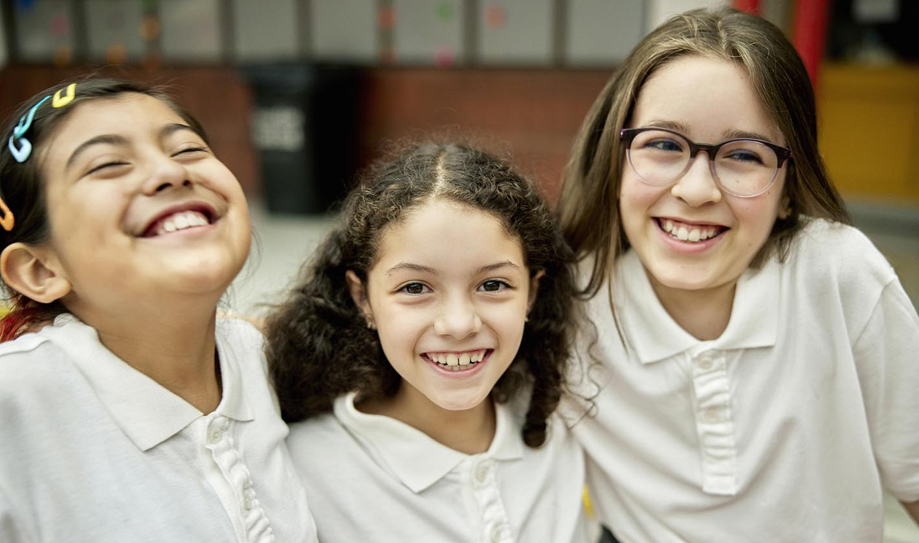
California Social and Emotional Learning
Topic 8
Mindfulness and Well-Being for Students
8.3 Kindness & Compassion for Students
Notes:
For this lesson, you will need:
- A way to show the videos to your participants (links are in the presenter notes and on the screen). They are YouTube links so you will need an internet connection.
- It would be helpful for participants to have writing materials (paper, notebook, and pen/pencil).
Optional: Poster board, post-it notes & markers for group discussions/brainstorming
Suggested introduction script:
"Today, we are going to explore the value of creating space and time for focusing on kindness and compassion in the classroom. Research supports that its not only a nice thing to do, but an essential contributor to resilience, well-being, positive relationships and even academic success. We will dive into the latest research as well as some practical strategies today. - that hopefully you will feel excited to try in your classrooms tomorrow (or next week!)"

Slide 2
California Social and Emotional Learning
Add a Welcoming Ritual Here
Notes:
Add SEL Signature Practices (e.g., welcoming rituals, optimistic closures, etc.) to your presentation.
The SEL 3 Signature Practices are one tool for fostering a supportive environment and promoting SEL. They intentionally and explicitly help build a habit of practices through which students and adults enhance their SEL skills.
For a short presentation of what SEL 3 Signature Practices are, along with a list of practices, see the following:
https://ggie.berkeley.edu/wp-content/uploads/2023/05/Welcoming_Closing-Activities.pptx

Slide 3
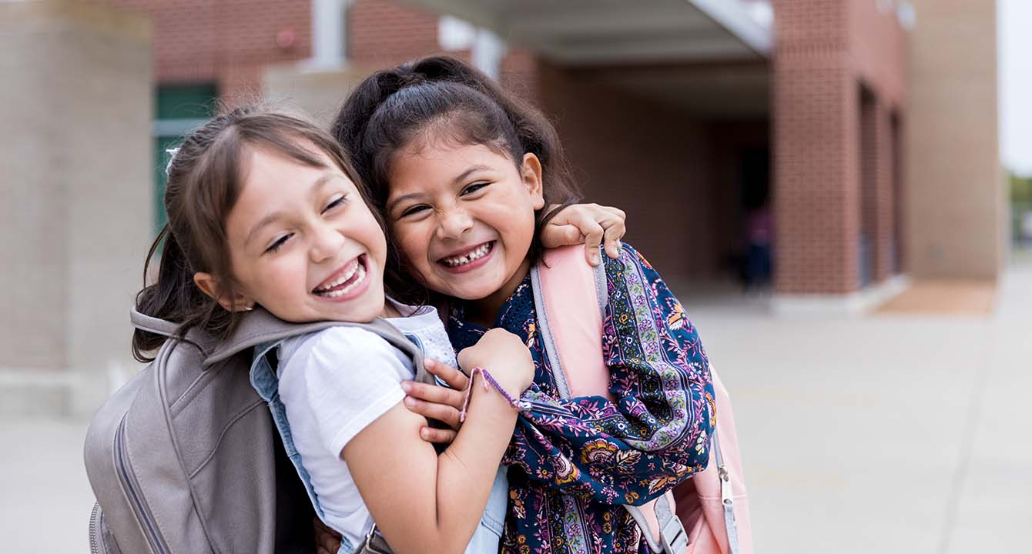
California Social and Emotional Learning
8.3 Kindness & Compassion for Students
TOPIC 8: Mindfulness and Well-Being for Students
Notes:
We all know it’s good to be kind, but what does it really mean to be compassionate? What constitutes kindness?

Slide 4
Learning Objectives
8.3 Kindness & Compassion for Students
Define kindness, compassion, and altruism
Explore the research behind kindness and compassion
Explore the development of kindness in children and adolescents
Identify the benefits of compassion/kindness on well-being & education
Explore compassion that fights for the rights and freedom of all
Identify ways to foster students’ compassion and kindness
Link Objectives to Developmental Indicators in
California Transformative SEL Competencies
Notes:
Learning Objectives:
In this module, we will:
Define kindness, compassion, and altruism
Explore the research behind kindness and compassion
Explore the development of kindness in children and adolescents
Identify the benefits of compassion/kindness on well-being & education
Explore compassion that fights for the rights and freedom of all
Identify ways to foster students’ compassion and kindness
**Expand objectives to California Developmental Indicators through making connections to SEL competencies in California on developmental age span.
Sourced from CDE (July 2023):
The California Department of Education (CDE) aims to support and advance the efforts of educators across California who are working to fully integrate systemic SEL and equity by building on the promise of T-SEL as a concept. To provide these supports, the CDE has articulated developmental indicators for CASEL’s five core competencies:
Self-Awareness (Intrapersonal Focus)
Self-Management (Intrapersonal Focus)
Social Awareness (Interpersonal Focus)
Relationship Skills (Interpersonal Focus)
Responsible Decision-Making (Inter and Intrapersonal)
Some suggested connections for this module are:
Self-awareness:
- Linking feelings, values, and thoughts
-Examining prejudices and biases
Self-management:
-Managing one’s emotions
-Identifying and using stress management and self care strategies
-Showing the courage to take initiative
Social awareness
-Demonstrating empathy and compassion
Responsible decision-making:
- Identifying solutions for personal and social problems
-Reflecting on one’s role to promote personal, family, and community well-being
Relationships skills:
-Developing mutually healthy and productive relationships
-Making and maintaining trusting, respectful friendships
-Practicing collaborative problem-solving focused on the common good
-Attending to harm or conflict through restorative practices
-Resisting negative social pressure
-Standing up for the rights of others

Slide 5
“Love and compassion are necessities, not luxuries. Without them humanity cannot survive.”
—Dalai Lama
Notes:
Compassion is the capacity to feel and motivation to relieve the suffering of others. As the Dalai Lama states in his quote, compassion and prosocial behaviors, like kindness, are essential for well-functioning societies. We need to be kind to one another—for our health and happiness, and for real progress to occur. When we cooperate and listen to one another, creativity and problem-solving flourish; whereas excessive competition depletes resources, leads to wars and conflict, and stalls innovation.
Research has shown that compassion and kindness are deeply rooted in human nature–our first impulse is to cooperate rather than compete. Indeed, as Darwin argued, sympathy for others is how we got here as a species. Even toddlers spontaneously help people in need out of genuine concern for their welfare. This innate kindness, however, often gets lost in a society built on competition. Hence, schools have a golden opportunity to cultivate the compassionate side of students by creating a school culture in which kindness is valued and practiced.
And this opportunity isn’t just a good thing to do—it’s a dire need. In a world where hateful rhetoric and turning a blind eye to suffering seems increasingly to take up space and airtime, we need compassion to be louder. We also need to be more than just nice. We need compassion that fights for the rights and freedom of all peoples.
A powerful place is to start with young people.

Slide 6
Video
Notes:
https://youtu.be/r8m51dJCeMo
Video Running Time: 11:32
Next, we are going to watch this video about kindness and compassion.

Slide 7
Group Reflection
Reflect on the following questions and share in your small groups:
How have you seen kindness show up in your classroom or school? Have you witnessed moments of compassion between your students?
Can you picture a recent moment in your classroom or on the playground or in the hallways that would have benefitted from compassion but didn’t receive it? Can you identify what got in the way of a kind response?
Notes:
Invite learners to reflect on these two questions individually and then share in their small groups.
Remind them "research shows that when we witness others being kind, or hear stories of compassion, our bodies and hearts react. We feel good and we’re motivated to act compassionately towards others. So let's share some shining examples of compassion in your classrooms"
"then let's brainstorm together what gets in the way of compassion, and how we might navigate these barriers in our classrooms or schools"

Slide 8
Video
Notes:
https://www.youtube.com/watch?v=RogRAHh96S8
Video Running Time: 3:35
"This next video goes into the benefits of compassion and kindness young people - and why it is a worthwhile thing to spend time supporting in the classroom."

Slide 9
Individual Reflection
After watching the videos, reflect on the following questions:
Think of a time when you witnessed a student offering kindness or compassion to someone.
How did it make you feel?
Did you notice a response in the student or the person receiving the care?
Notes:
Invite participants to reflect on the following questions individually. They can write down notes if they would like to.
If time permits, invite participants to share their reflections with a partner, in a small group, or with the whole group.

Slide 10
Video
Notes:
https://www.youtube.com/watch?v=YUj1NmCc_uY
Video Running Time: 16:37
"This next video goes into some practical strategies and considerations for creating fertile ground in your classroom from which kindness and compassion can grow. Feel free to make note of any that resonate with you."
You can mention to your learners:
"We will have time immediately following the video for discussion and brainstorming about how to bring these strategies into our classrooms."

Slide 11
Group Activity: Draw your Compassionate Classroom
In your small groups:
Let’s design our “ideal kind and compassion classroom”!
On your poster board, draw a classroom (don’t worry, no points for artistic talents).
Draw the components that you think would foster kindness and compassion. Some things to consider:
Do you have a classroom charter/agreement hanging somewhere?
What is the set-up of the classroom? Desks?
What are on the walls? Does it have walls? Is it inside at all?
What are the students doing? What are you doing?
Are there other people in the room? Outside, in the school? How are they contributing?
Remember FUN & pleasant emotions actually positively influence compassionate behaviors! Share what has worked well in your classrooms!
Notes:
If facilitating with a group, watch videos and then put participants in groups of 3-5 to discuss these questions. Encourage people to form groups with educators who teach similar age groups.
If you can, provide a poster board, markers, & post-its - for groups to brainstorm actively together.
Invite teachers:
"Now, we are going to get creative and visualize and draw our kind and compassionate classrooms. On your poster boards, I'd like to brainstorm and draw with your group. Consider some of the features we talked about in the videos - and these points on this slide.
There are no rules - you can get as creative as you want!"
Remind learners that this is a great activity to do with their students - when teaching about kindness! Young people quite often come up with ideas we wouldn't have thought of - and this also values their voices!

Slide 12
LARGE GROUP SHARE OUT
Pick 1 - 2 features of your drawing to highlight for the larger group.I
8.3 Kindness & Compassion
Notes:
Invite groups to share their posters and pick 1-2 features to highlight for the larger group

Slide 13
California Social and Emotional Learning
Add an Optimistic Closure Here
Notes:
Add SEL Signature Practices (e.g., welcoming Rituals, optimistic closures, etc. to your presentation).
The SEL 3 Signature Practices are one tool for fostering a supportive environment and promoting SEL. They intentionally and explicitly help build a habit of practices through which students and adults enhance their SEL skills.
For a short presentation of what SEL 3 Signature Practices are, along with a list of practices, see the following:
https://ggie.berkeley.edu/wp-content/uploads/2023/05/Welcoming_Closing-Activities.pptx

Slide 14
“No act of kindness, no matter how small, is ever wasted.”
– Aesop
8.3 Kindness & Compassion
Notes:
"I hope you feel inspired to embrace self-compassion and encourage your students to do the same. Through our efforts, we can inspire and empower a new generation of resilient young people who not only radiate compassion and kindness throughout the world but also extend the same warmth and love towards themselves."

