Slide 1
California Social and Emotional Learning
Topic 7
Mindfulness and Well-Being for Educators
7.3 Kindness & Compassion for Educators
Notes:
For this lesson, you will need:
- A way to show the videos to your participants (links are in the presenter notes and on the screen). They are YouTube links so you will need an internet connection.
- It would be helpful for participants to have writing materials (paper, notebook, and pen/pencil).
Optional: Poster board, post-it notes & markers for group discussions/brainstorming

Slide 2
California Social and Emotional Learning
Add a Welcoming Ritual Here
Notes:
Add SEL Signature Practices (e.g., welcoming rituals, optimistic closures, etc.) to your presentation.
The SEL 3 Signature Practices are one tool for fostering a supportive environment and promoting SEL. They intentionally and explicitly help build a habit of practices through which students and adults enhance their SEL skills.
For a short presentation of what SEL 3 Signature Practices are, along with a list of practices, see the following:
https://ggie.berkeley.edu/wp-content/uploads/2023/05/Welcoming_Closing-Activities.pptx

Slide 3
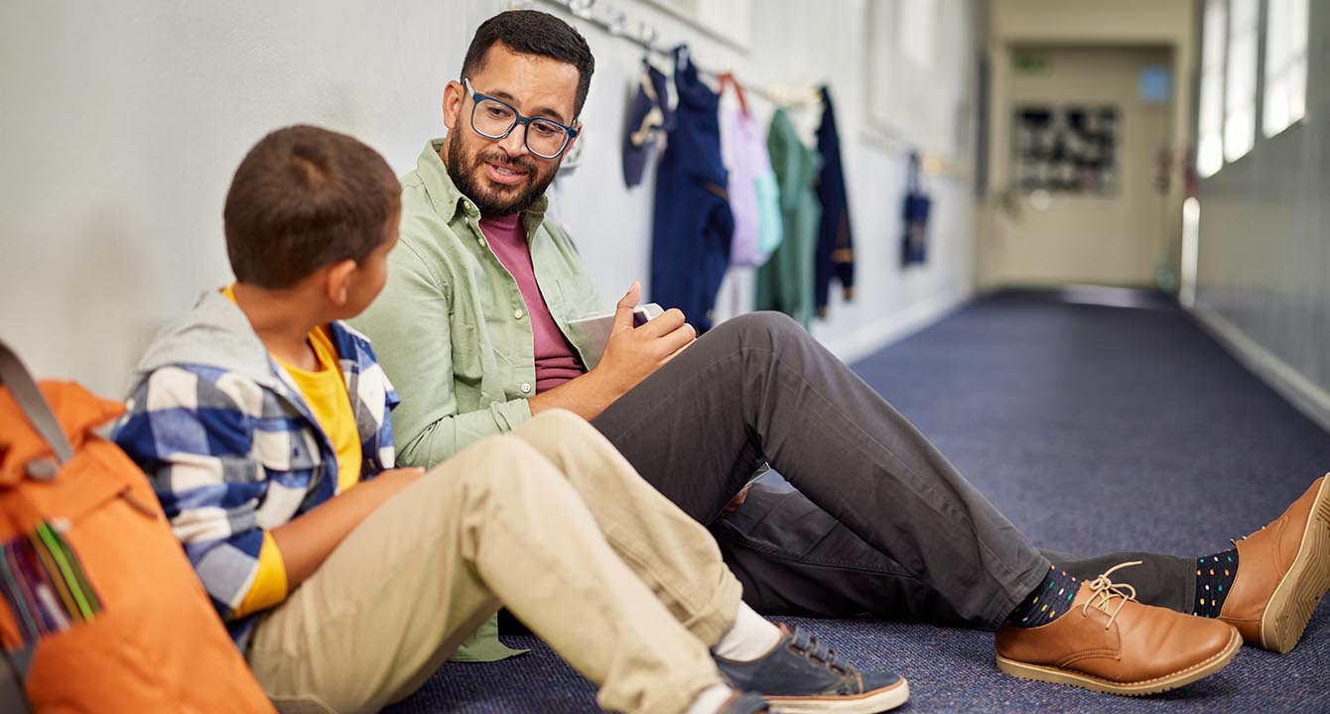
California Social and Emotional Learning
7.3 Kindness & Compassion for Educators
TOPIC 7: Mindfulness and Well-Being for Educators
Notes:
Compassion and prosocial behaviors, like kindness, are essential for well-functioning societies. We need to be kind to one another—for our health and happiness, and for real progress to occur.
Research has found that practicing compassion and kindness can improve our health, well-being, and relationships.
Of course, beyond our own lives, these qualities strengthen our communities and may even be vital to the survival of our species as a whole.
When we cooperate and listen to one another, creativity and problem-solving flourish; whereas excessive competition depletes resources, leads to wars and conflict, and stalls innovation.
Research has shown that compassion and kindness are deeply rooted in human nature–our first impulse is to cooperate rather than compete.
This innate kindness, however, often gets lost in a society built on competition. Hence, schools have a golden opportunity to cultivate the compassionate side of students by creating a school culture in which kindness is valued and practiced.
And this opportunity isn’t just a good thing to do—it’s a dire need. In a world where hateful rhetoric and turning a blind eye to suffering seems increasingly to take up space and airtime, we need compassion to be louder. We also need to be more than just nice. We need compassion that fights for the rights and freedom of all peoples.
And to teach our students to be kind, and to create kinder schools & classrooms, we need to start with ourselves.

Slide 4
Learning Objectives
7.3 Kindness & Compassion for Educators
Link Objectives to Developmental Indicators in
California Transformative SEL Competencies
Define kindness, compassion, and related terms
Explore the benefits of kindness & compassion for educator well-being & relationships
Explore the benefits of cultivating your own kindness & compassion for your students & classrooms
Notes:
Some topics we will explore today are:
-Define kindness, compassion, & related terms
-Explore the benefits of kindness & compassion for educator well-being & relationships
-Explore the benefits of cultivating your own kindness & compassion for your students & classrooms
Expand objectives to California Developmental Indicators through making connections to SEL competencies in California on developmental age span.
Sourced from CDE (July 2023):
The California Department of Education (CDE) aims to support and advance the efforts of educators across California who are working to fully integrate systemic SEL and equity by building on the promise of T-SEL as a concept. To provide these supports, the CDE has articulated developmental indicators for CASEL’s five core competencies:
Self-Awareness (Intrapersonal Focus)
Self-Management (Intrapersonal Focus)
Social Awareness (Interpersonal Focus)
Relationship Skills (Interpersonal Focus)
Responsible Decision-Making (Inter and Intrapersonal)

Slide 5
“I've learned that people will forget what you said, people will forget what you did, but people will never forget how you made them feel.”
-Maya Angelou
Notes:
"Today, we are going to explore the value of creating space and time for focusing on our own kindness and compassion. Research supports that it's not only a nice thing to do, but essential for well-functioning schools and societies. We will dive into the latest research as well as some practical strategies today. And hopefully you will feel excited or re-inspired to focus more time and attention on kindness & compassion in coming weeks.

Slide 6
Videos
Notes:
https://youtu.be/Nhktf60Aizg
Video Running Time: 15:30
First, we are going to watch a video that answers the question "what are kindness and compassion"

Slide 7
Reflection & Group Discussion
Individually:
Think of a time when you think you should have felt compassion, but didn't. What do you think might have been the reason?
In small groups:
What are some situations or mental states in which you find it most difficult to muster kindness and compassion at school?
What would help you cultivate kindness or compassion during these times?
Notes:
Encourage learners to consider the first question individually, and then come together to discussion the second and third questions in their small groups.

Slide 8
Practice: I See You. Everyone Matters.
Invitation is to all stand or sit in a circle
Take a moment to look around the circle, looking into the faces, and when possible, the eyes of everyone in the room, around the circle.
If we are willing, we offer one another a smile, but at a minimum, we respectfully offer our gentle attending gaze.
“We will all repeat this phrase together “I see you. Everyone matters,
Notes:
Tell the group:
Once we are in a [learning] circle, this practice called “I See You; Everyone Matters” may be used to deepen our sense of connection.
This is a simple practice of looking into the faces, and when possible, the eyes of everyone in the room, around the circle.
If we are willing, we offer one another a smile, but at a minimum, we respectfully offer our gentle attending gaze.
In this way we bring to life our intention of being with others respectfully, of giving everyone our attention, of actually taking each person’s humanity in, as we embark on a learning journey together.
Begin by taking one minute in silent awareness of each other.
Then repeat this phrase together “I see you. Everyone matters,” or “We see you. Everyone matters.”
After the practice, you can invite reflections from the group about how it felt for them. Invite learners to keep these feelings in mind, as we watch the next video on the benefits of kindness & compassion.

Slide 9
Video
Notes:
https://youtu.be/NhKJAt4PRvQ
Video Running Time: 3:48
It may be helpful to encourage participants to take out a piece of paper or journal for this video.
Next we are going to watch this video on why kindness & compassion are important qualities for educators to cultivate. Feel free to jot down notes as you watch. We will have time for individual reflection after the video.

Slide 10
Video Reflection
Individually, reflect on the following questions:
Take a moment to think of a time when you offered intentional kindness or compassion to a student or a colleague. How did it make you feel? Was it challenging? Did it shift your relationship with this person in any way?
Next, think of a time someone at your school, a student or colleague, showed you compassion or kindness. How did it make you feel? Did you notice the dynamic change between you and that person afterwards?
Notes:
Invite participants to reflect individually after the last video.
"Take a moment now to consider these two questions, individually. Feel free to write them down or contemplate in your mind."
If time permits, invite participants to share their reflections with a partner, in a small group, or with the whole group.

Slide 11
Video
Notes:
https://youtu.be/BJCbyGstDJA
Video Running Time: 18:36
"Now that we have connected with what kindness & compassion are and their significance for educators and schools, we are going to shift to some practical strategies for creating space for our own kindness and compassion to emerge and flourish.
I invite you to make note of any practices that stand out to you and seem like something you could incorporate into your daily life."

Slide 12
Group Activity: Draw your Kind Classroom or Staff Room
In your small groups:
Let’s design our “ideal kind and compassion classroom or staff room!
On your poster board, draw one of the two above (don’t worry, no points for artistic talents).
Draw the components that you think would foster kindness and compassion. Some things to consider:
Do you have a classroom charter/agreement hanging somewhere?
What is the set-up of the classroom or staff room?
What are on the walls? Does it have walls? Is it inside at all?
What are the students/staff doing? What are you doing?
Are there other people in the room? Outside, in the school? How are they contributing?
Remember FUN & pleasant emotions positively influence compassionate behaviors! Share what has worked well in your schools!
Notes:
If facilitating with a group, watch videos and then put participants in groups of 3-5 to discuss these questions. Encourage people to form groups with educators who teach similar age groups.
If you can, provide a poster board, markers, & post-its - for groups to brainstorm actively together.
Invite teachers:
"Now, we are going to get creative and visualize and draw our kind and compassionate classrooms or staff rooms. In your groups, choose one space to focus on. On your poster boards, I'd like to brainstorm and draw with your group. Consider some of the features we talked about in the videos - and these points on this slide.
There are no rules - you can get as creative as you want! Think outside the box!"
Remind learners that this is a great activity to do with students or with staff - as a kindness exercise - and to mine the wisdom in those rooms. This values everyone's voices - another contributor to well-being and prosocial behaviors!

Slide 13
LARGE GROUP SHARE OUT
Pick 1 - 2 features of your drawing to highlight for the larger group.I
7.3 Kindness & Compassion
Notes:
Invite groups to share their posters and pick 1-2 features to highlight for the larger group

Slide 14
California Social and Emotional Learning
Add an Optimistic Closure Here
Notes:
Add SEL Signature Practices (e.g., welcoming Rituals, optimistic closures, etc. to your presentation).
The SEL 3 Signature Practices are one tool for fostering a supportive environment and promoting SEL. They intentionally and explicitly help build a habit of practices through which students and adults enhance their SEL skills.
For a short presentation of what SEL 3 Signature Practices are, along with a list of practices, see the following:
https://ggie.berkeley.edu/wp-content/uploads/2023/05/Welcoming_Closing-Activities.pptx

Slide 15
“Be kind whenever possible. It is always possible” - Dalai Lama
7.3 Kindness & Compassion
Notes:
"Thank you for joining me today in exploring kindness and compassion.
There is some recent rhetoric in social media, to save your energy and only show your kindness to those who deserve it. However, we hope this workshop has maybe inspired you to think differently.
As the Dalai Lama has said "Be kind whenever possible. It is always possible."

