Slide 1
California Social and Emotional Learning
Topic 7
Mindfulness and Well-Being for Educators
7.2 Self-Compassion for Educators
Notes:
For this lesson, you will need:
- A way to show the videos to your participants (links are in the presenter notes and on the screen). They are YouTube links so you will need an internet connection.
- It would be helpful for participants to have writing materials (paper, notebook, and pen/pencil).
Optional: Poster board, post-it notes & markers for group discussions/brainstorming

Slide 2
California Social and Emotional Learning
Add a Welcoming Ritual Here
Notes:
Add SEL Signature Practices (e.g., welcoming rituals, optimistic closures, etc.) to your presentation.
The SEL 3 Signature Practices are one tool for fostering a supportive environment and promoting SEL. They intentionally and explicitly help build a habit of practices through which students and adults enhance their SEL skills.
For a short presentation of what SEL 3 Signature Practices are, along with a list of practices, see the following:
https://ggie.berkeley.edu/wp-content/uploads/2023/05/Welcoming_Closing-Activities.pptx

Slide 3
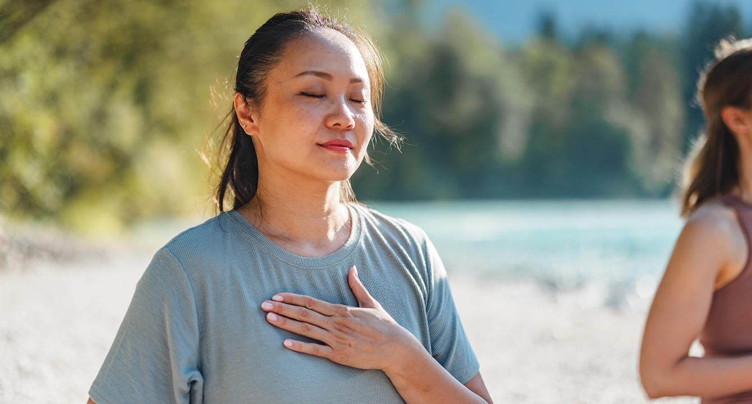
California Social and Emotional Learning
7.2 Self-Compassion for Educators
TOPIC 7: Mindfulness and Well-Being for Educators
Notes:
We are often easier on and even kinder to others than we are ourselves. How do you treat yourself after a challenging moment in the classroom? Are you kind and forgiving or overly critical of yourself? Do you lie awake at night ruminating on mistakes from the day, or ones that happened long, long ago? Are you afraid to try something new because you might fail or face harsh criticism—perhaps from others, but mainly from yourself?
What would happen if, in all these scenarios, you chose to, as Brene Brown suggests, “talk to yourself as you would someone you love?”
Self-compassion, or extending kindness and compassion to ourselves, has been shown to protect educators from burnout. Indeed, self-compassion can help lessen the mental pain that we inflict on ourselves when we bully rather than love ourselves. Self-compassion can also help to improve our teaching, by reducing stress, improving emotion regulation, and even promoting teaching practices that lead to more autonomy and motivation for students.

Slide 4
Learning Objectives
7.2 Self-Compassion for Educators
Link Objectives to Developmental Indicators in
California Transformative SEL Competencies
Identify the elements of self-compassion and the research behind it
Distinguish between self-compassion and self-esteem
Discover the fierceness of self-compassion - how it is not weak
Consider how self-compassion can support our teaching
Explore how to build our self-compassion muscles
Notes:
Some topics we will explore today are:
-Identifying the elements of self-compassion and the research behind it
-Distinguishing between self-compassion and self-esteem
-Discovering the fierceness of self-compassion - how it is not weak
-Considering how self-compassion can support our teaching
and
-Exploring how to build our self-compassion muscles
Expand objectives to California Developmental Indicators through making connections to SEL competencies in California on developmental age span.
Sourced from CDE (July 2023):
The California Department of Education (CDE) aims to support and advance the efforts of educators across California who are working to fully integrate systemic SEL and equity by building on the promise of T-SEL as a concept. To provide these supports, the CDE has articulated developmental indicators for CASEL’s five core competencies:
Self-Awareness (Intrapersonal Focus)
Self-Management (Intrapersonal Focus)
Social Awareness (Interpersonal Focus)
Relationship Skills (Interpersonal Focus)
Responsible Decision-Making (Inter and Intrapersonal)
Some suggested connections for this module are:
Self-awareness:
- Identifying one’s emotions
-Linking feelings, values, and thoughts
-Having a growth mindset
Self-management:
- Identifying and using stress management and self care strategies
-Cultivating resilience and overcoming adversity
Social awareness
-Demonstrating empathy and compassion
Relationship skills
-Listening actively, communicating effectively, and self-advocating
Responsible decision-making:
- Demonstrating curiosity and open-mindedness

Slide 5
“I love myself. The quietest. Simplest. Most powerful. Revolution. Ever.”
— Nayyirah Waheed
Notes:
"It is remarkable to think that so many of us consider self-kindness and self-compassion....akin to a revolution....a not-so-easy thing to do. We find we can show kindness, gentleness, and compassion to others much more easily. "
We are going to explore some videos and practices together today to try to stretch our brains into a different perspective."

Slide 6
Videos
What is Self-Compassion
&
What are the benefits of self-compassion
Notes:
https://www.youtube.com/watch?v=ExdO0iBVuD8
Video Running Time: 6:54
https://www.youtube.com/watch?v=SNTEPhQNQNc
Video Running Time: 4:31
"First, we are going to watch two short videos that help help to answer the questions "What is self-compassion" and why is it important?

Slide 7
Group Reflection
In your small groups (3-5 people), brainstorm some ideas/phrases related to teaching for each of the 3 components of self-compassion, starting with the first two:
What is something you are experiencing that you might consider as common to humanity (or maybe at least other educators) right now?
What are some mindfulness phrases you can imagine needing to say to yourself?
Then, what are some words or actions of kindness you could offer yourself in response to these?
Notes:
If facilitating with a group, put participants in groups of 3-5 to discuss these questions after the video.
Consider giving each group a poster board & markers (or post-it notes).
If you don't have post-it notes or poster boards, first invite discussion in the small groups, and then invite a group share-out with speakers appointed from each group.
Invite groups to brainstorm together, some real-life examples and phrases for each of the 3 components of self-compassion.
Prompts are provided on this slide and examples on the following slide

Slide 8
Group Reflection
EXAMPLE
Common Humanity:
All teachers are feeling strapped for time lately
Mindfulness:
I am feeling burnt out
Self-Kindness:
I am worthy of rest and more balance

Slide 9
Video
Why is self-compassion important for educators?
Notes:
https://www.youtube.com/watch?v=9iP1OjDrDIU
Video Running Time: 4:44
It may be helpful to encourage participants to take out a piece of paper or journal for this video.
Next we are going to watch this video on why self-compassion is important for educators. Feel free to jot down notes as you watch. We will have time for individual reflection after the video.

Slide 10
Video Reflection
Individually, reflect on the following questions:
What emotions or thoughts arise when you think about being kinder and gentler to yourself?
Can you identify some situations in your work or personal life where fierce self-compassion might serve you?
Notes:
Invite participants to reflect individually after the last video.
"Take a moment now to consider these two questions, individually. Feel free to write them down or contemplate in your mind.
1) What emotions or thoughts arise when you think about being kinder and gentler to yourself?
2) Can you identify some situations in your work or personal life where fierce self-compassion might serve you?

Slide 11
Video
How to practice self-compassion
Notes:
https://youtu.be/tdGSn4T2v5I
Video Running Time: 9:59
"Now that we have connected with self-compassion more deeply; what it is how the significance it has for educators, we are going to shift to some practical strategies for practicing self-compassion.
As the videos talk about, self-compassion is a practice. Like any muscle, it requires us to exercise it.
I invite you to make note of any practices that stand out to you and seem like something you could incorporate into your daily life.

Slide 12
Group Reflection
After watching the videos, reflect on the following questions:
Individually:
Are you more compassionate towards yourself in some areas of life, compared to others? Can you identify a few areas of life where you are especially critical of yourself (as a parent? at work? elsewhere?)
Share in a group discussion.
As a group:
As educators, what additional resources or supports would help you deepen your practice of self-compassion? How could you advocate for these supports (i.e., fierce self-compassion!)?
Notes:
"I invite you to gather in your groups again. We will reflect on the first question individually. Followed by sharing in your small groups, if you feel comfortable. This is optional as this could be a personal reflection.
(Give 5-7 minutes for these reflections & sharing).
"Now, as a group, can you discuss and brainstorm what kinds of supports would be helpful - for you as educators - to deepen or allow you to practice more self-compassion? How might you advocate for these supports (hint - this is its own act of fierce self-compassion!)"

Slide 13
PRACTICE
Self-Compassion Meditation
7.2 Self-Compassion
Notes:
Provide link for downloading.
https://ggie.berkeley.edu/practice/mindful-self-compassion-for-adults/#tab__2
Finally, we are going to end on a brief self-compassion meditation [6:44]. I welcome all of you to participate, if you feel comfortable. You can close your eyes or gently look down. You can even write as you listen to the audio.

Slide 14
LARGE GROUP SHARE OUT
Can you share one word to describe how that self-compassion meditation felt?
7.2 Self-Compassion
Notes:
Go around the circle/room and ask folks to:
Can you share one word to describe how that self-compassion meditation felt? Feel free to pass.

Slide 15
California Social and Emotional Learning
Add an Optimistic Closure Here
Notes:
Add SEL Signature Practices (e.g., welcoming Rituals, optimistic closures, etc. to your presentation).
The SEL 3 Signature Practices are one tool for fostering a supportive environment and promoting SEL. They intentionally and explicitly help build a habit of practices through which students and adults enhance their SEL skills.
For a short presentation of what SEL 3 Signature Practices are, along with a list of practices, see the following:
https://ggie.berkeley.edu/wp-content/uploads/2023/05/Welcoming_Closing-Activities.pptx

Slide 16
Hope you feel inspired to exercise your self-compassion muscles
7.2 Self-Compassion
Notes:
"Thank you for joining me today in exploring self-compassion. I hope you feel inspired to stretch and strengthen your self-compassion muscles, with daily exercise!"

