Slide 1
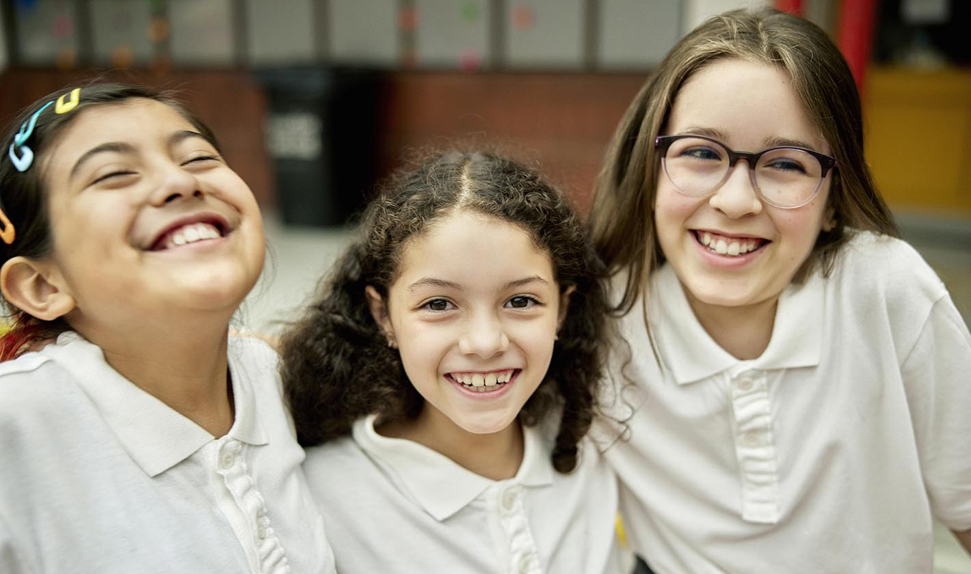
California Social and Emotional Learning
Topic 8
Mindfulness and Well-Being for Students
8.1 Purpose for Students
Notes:
"The bigger picture goals we strive towards as educators - like wanting them to have a love of learning....or hoping they'll be active and engaged citizens. or wishing for them that they'll know what they want to pursue after high-school ---- all relate to students’ sense of purpose. And purpose is a really important aspect of student well-being and their motivation in school.
In this session together, we will explore the value of purpose for students and how we can support them in developing it."

Slide 2
California Social and Emotional Learning
Add a Welcoming Ritual Here
Notes:
Add SEL Signature Practices (e.g., welcoming rituals, optimistic closures, etc.) to your presentation.
The SEL 3 Signature Practices are one tool for fostering a supportive environment and promoting SEL. They intentionally and explicitly help build a habit of practices through which students and adults enhance their SEL skills.
For a short presentation of what SEL 3 Signature Practices are, along with a list of practices, see the following:
https://docs.google.com/presentation/d/1utb0X71RHbzQdt-aZmOQfiFkg_kHltO7i-hUoOPb2m0/edit?usp=sharing

Slide 3
California Social and Emotional Learning
8.1 Purpose for Students
TOPIC 8: Mindfulness and Well-Being for Students
Notes:
"To help support your students’ path towards purpose, we begin by exploring what purpose is, why it is important, and some practical ways you can lay a foundation for purpose development in your classroom.
Research has shown that the support of teachers, mentors, and other adults outside the family is often crucial to young people’s development of purpose, particularly in the early stages."

Slide 4
Learning Objectives
8.1 Purpose for Students
Link Objectives to Developmental Indicators in
California Transformative SEL Competencies
Explore what purpose is and why it is important for young people
Understand how purpose develops in students
Explore how identity relates to purpose
Identify ways educators can inspire students to explore and find their purpose(s)
Notes:
"Some questions we will explore together today are:
-What is purpose? Why is it important for young people?
-How does purpose develop in students? When can you start talking about purpose with students?
-How does identity relate to purpose?
AND
-What can educators do to inspire students to explore and find their purpose(s)?"
**Expand objectives to California Developmental Indicators through making connections to SEL competencies in California on developmental age span.
Sourced from CDE (July 2023):
The California Department of Education (CDE) aims to support and advance the efforts of educators across California who are working to fully integrate systemic SEL and equity by building on the promise of T-SEL as a concept. To provide these supports, the CDE has articulated developmental indicators for CASEL’s five core competencies:
Self-Awareness (Intrapersonal Focus)
Self-Management (Intrapersonal Focus)
Social Awareness (Interpersonal Focus)
Relationship Skills (Interpersonal Focus)
Responsible Decision-Making (Inter and Intrapersonal)
Some suggested connections for this module are:
Self-awareness:
- Linking feelings, values, and thoughts
- Developing interests and a sense of purpose
- Reflecting on one’s personal role and contributions within a community
Self-management:
- Setting personal and collective goals
- Using planning and organizational skills
Social awareness
-Demonstrating empathy and compassion
Responsible decision-making:
- Identifying solutions for personal and social problems
- Evaluating personal, interpersonal, community, and institutional impacts
-Reflecting on one’s role to promote personal, family, and community well-being

Slide 5
“What if purpose were the purpose of education?”
— Dr. Heather Malin
Notes:
Dr. Heather Malin invites us to ponder "What if purpose were the purpose of education"?
Before we jump into our first video, I wanted to see how this quote lands for folks? Have you considered the role of purpose in young people's educational lives before?
*allow a few minutes for a larger group discussion.

Slide 6
Video
Video: What is Purpose & Why is it important
Notes:
https://www.youtube.com/watch?v=W7SYx5JVHSY&t=2s
Video Running Time: 9:44
**NOTE: If your learners have attended or taken the Purpose for Educators lesson - you can skip this video as it is the same intro video on Purpose.
"First, we are going to watch this short video from purpose expert Dr. Kendall Cotton Bronk who defines purpose and describes its benefits.
As you watch it, consider how some of these benefits may show up in your students' lives. Or maybe if you've noticed some symptoms when they don't have a sense of meaning or purpose."

Slide 7
Small Group Reflection
After watching the videos, reflect on the following questions:
What is one reason you might want to help students foster a sense of purpose?
Why do you think having a sense of purpose might be linked to so many benefits for our psychological, physical, and/or social well-being?
Notes:
If facilitating with a group, watch videos and then put participants in groups of 3-5 to discuss these questions.
Before we delve further into purpose for students - from the introduction to purpose - can you talk in your small groups about these two questions:
1 - Given its benefits and correlates what is one reason you might want to help students foster a sense of purpose?
2 - Why do you think purpose is linked to so many benefits for our psychological, physical, and social well-being?

Slide 8
Video
Video: Purpose for Students
Notes:
https://youtu.be/Zne_MQOlD24
Video Running Time: 9:44
"This next video goes a little deeper into why Purpose is so important for young people - and how it shows up in the lives of students in your classrooms.
Keep your previous group discussions in mind - to see how they might show up or be expanded upon in this video."

Slide 9
Individual Reflection
After watching the videos, reflect on the following questions:
Did anything inspire you to think differently about the role of purpose in education?
Reflecting on your current students, can you identify any of their interests or something that suggests a sense of purpose - from what you know of them so far?
Notes:
Invite learners to reflect on these two questions individually. They can jot down their thoughts on paper or notebooks.
1) Did anything inspire you to think differently about the role of purpose in education?
2) Reflecting on your current students, can you identify any of their interests or something that suggests a sense of purpose - from what you know of them so far?
---------
"In the next video, I invite you to keep your students in your mind - as we talk about strategies for helping them discover purpose. Consider which strategies resonate with you and you think would really work in your classrooms. Feel free to jot down ideas as we go - these videos are a bit longer, so we can take a break half-way through as well to reflect".

Slide 10
Video
Video: Teaching for purpose - Early and Middle Childhood
Notes:
https://youtu.be/tydr57EKRdU
Video Running Time: 16:17
Depending on your group, you can choose to show one of the following videos - either Early & Middle Childhood or Adolescence. They are similar but have some specific strategies for the developmental stage.
These videos are quite long. Feel free to pause throughout. Invite your learners to jot notes down for any strategies that really caught their eye.
You can mention to your learners:
"We will have time immediately following the video for discussion and brainstorming about how to bring these strategies into our classrooms."

Slide 11
Video
Video: Teaching for purpose -Adolescence
Notes:
https://youtu.be/MbnbYCcwmew
Video Running Time: 16:58

Slide 12
Reflection & Group Action Brainstorm
After watching this video, we are going to spend some time brainstorming ideas together in our small groups.
First consider these questions individually, then spend some time in your small groups - sharing your ideas:
Which of the strategies resonated the most with you? Which can you see yourself carrying into your classroom?
What ideas do you have to bring purpose and meaning more intentionally into your classroom?
Notes:
If facilitating with a group, watch videos and then put participants in groups of 3-5 to discuss these questions.
If you can, provide a poster board, markers, & post-its - for groups to brainstorm actively together.
Invite learners to first consider the questions individually, then take some time to brainstorm - using the poster boards, markers, post-its, some tangible ideas for bringing more purpose in their classrooms.

Slide 13
Large Group Share-Out
Please nominate a speaker to share some of the highlights from your smaller discussions with the larger group. You can share your poster boards or just speak on them.
A reminder of the questions below:
Which of the strategies resonated the most with you? Which can you see yourself carrying into your classroom?
What ideas do you have to bring purpose and meaning more intentionally into your classroom?
Notes:
After the small group discussions, invite groups to nominate a speaker to share some of the highlights from the smaller discussions.
A reminder of the questions below:
Which of the strategies resonated the most with you? Which can you see yourself carrying into your classroom?
What ideas do you have to bring purpose and meaning more intentionally into your classroom?

Slide 14
California Social and Emotional Learning
Add an Optimistic Closure Here
Notes:
Add SEL Signature Practices (e.g., welcoming Rituals, optimistic closures, etc. to your presentation).
The SEL 3 Signature Practices are one tool for fostering a supportive environment and promoting SEL. They intentionally and explicitly help build a habit of practices through which students and adults enhance their SEL skills.
For a short presentation of what SEL 3 Signature Practices are, along with a list of practices, see the following:
https://docs.google.com/presentation/d/1utb0X71RHbzQdt-aZmOQfiFkg_kHltO7i-hUoOPb2m0/edit?usp=sharing

Slide 15
“The meaning of life is to find your gift. The purpose of life is to give it away.”
-Pablo Picasso
8.1 Purpose
Notes:
In the end, it may very well be summed up in this famous quote by Pablo Picasso:
“The meaning of life is to find your gift. The purpose of life is to give it away.”
I hope you feel inspired to try something new in your classroom - and to support your students' on their purpose journeys.

