Slide 1
Welcome!
1
Editing Slides
Before your workshop, review each slide and the accompanying speaker notes. Make any necessary edits to best meet the needs of your parent community.
2
Speaker Notes
There are two parts to the speaker notes for the slides throughout this slide deck. The first part is key points for you to keep in mind as the speaker. The second part is a suggested script. Not all slides contain a suggested script.
3
Online vs. In-Person Presentations
If presenting in an online format, please modify the slides for a virtual workshop. For example, if the directions suggest participants turn to a partner next to them to share, modify the instructions and put participants into small breakout rooms.
A few notes on how to use this slide deck
4
Hide or delete this slide before your workshop.
Notes:
Note: This slide should not be included in the workshop presentation. Hide or delete this slide before your workshop.

Slide 2
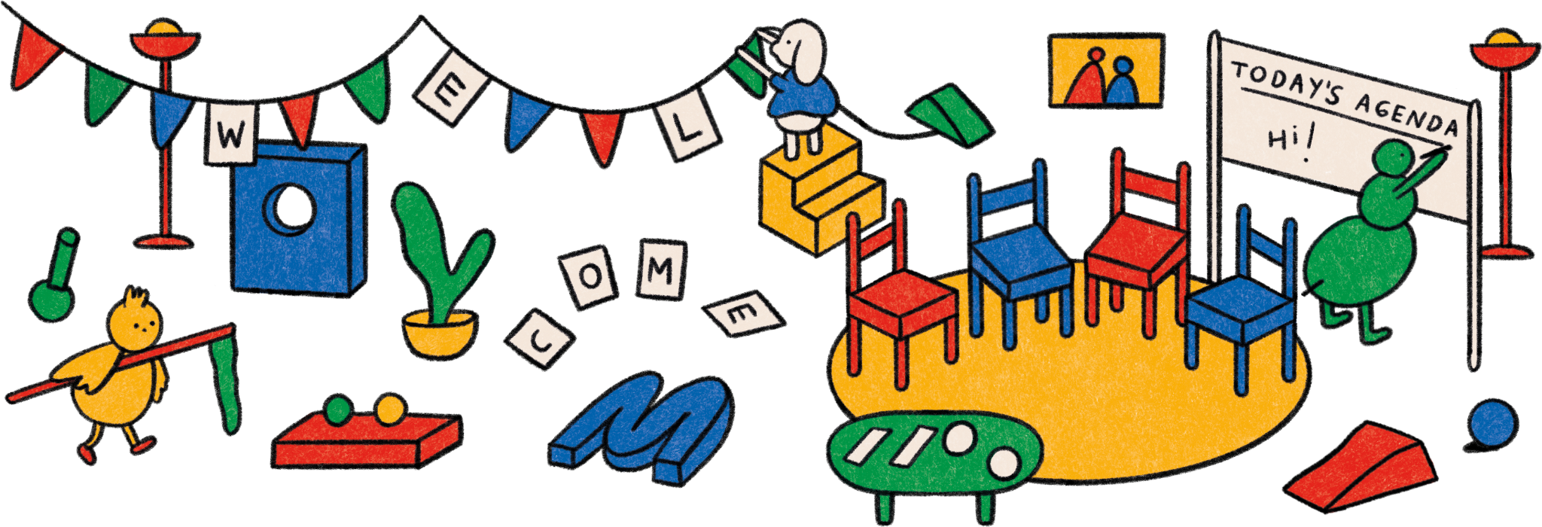

Slide 3
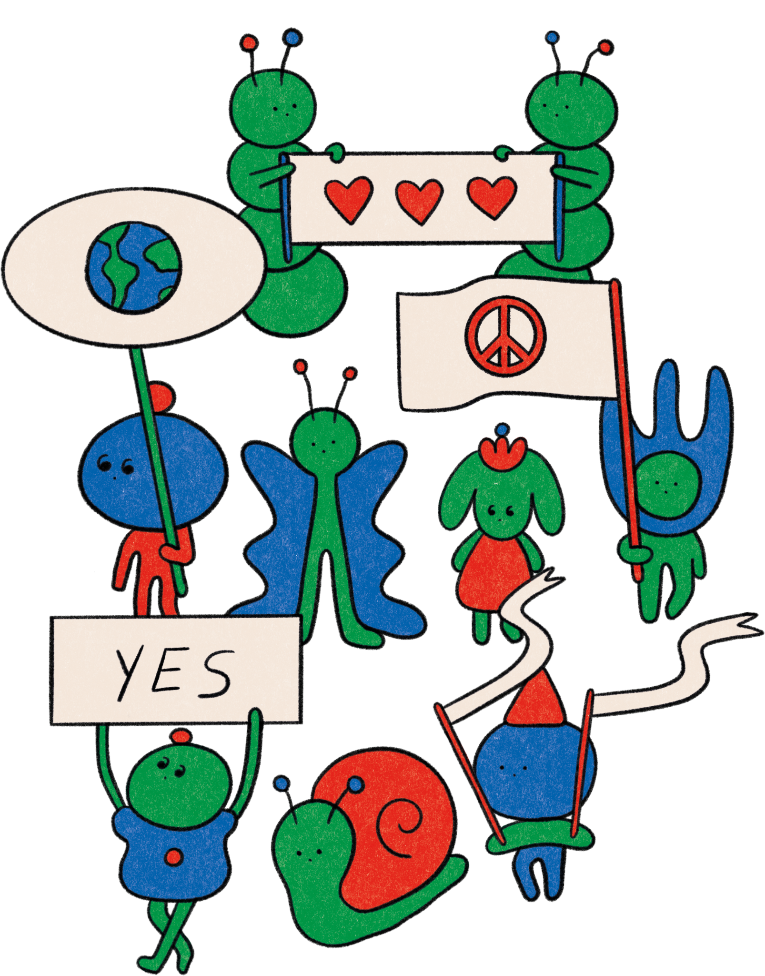
pur- pose-

Slide 4
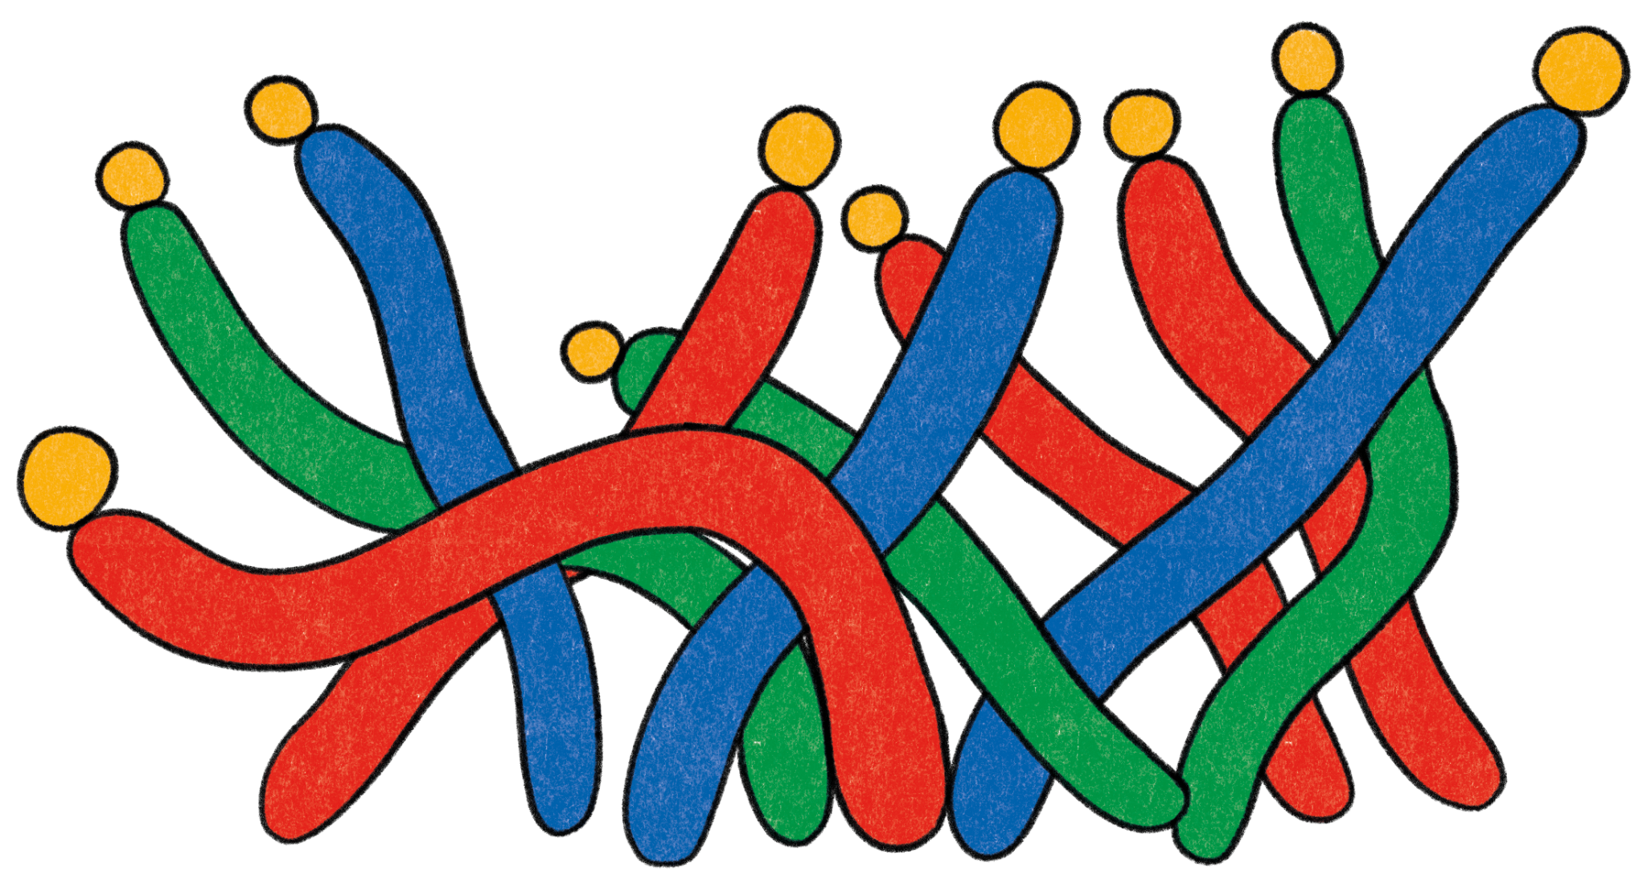
Today’s Workshop Facilitator(s):
1
Your name here
Your Title
Some contact information
2
Your name here
Your Title
Some contact information
Notes:
Key points:
Take a few moments to introduce yourself to your parent community and welcome them to the workshop.
Edit this slide to include a picture of yourself, your name and/or how you prefer to be addressed, your title, and your contact information.

Slide 5
Today’s agenda:
1
4
Welcoming Activity
What is Purpose?
Purpose in Parenthood
Purpose in Childhood
Questions
Closing Activity
2
5
3
6
Notes:
Key points:
Review what you will discuss during today’s workshop with your parent community.
Suggested script:
Over the next hour, we are going to explore the topic of Purpose. We will start with a welcoming activity for the whole group, and then we will define Purpose. Next, we will discuss what Purpose looks like in parenthood and provide you with a practice to nurture Purpose and your own well-being. After that, we will discuss Purpose in childhood and provide you with a Purpose activity to try out with your child. Finally, we’ll have some time for questions and then finish with a closing activity.

Slide 6
Welcome Activity
Ice Breaker
When your child is an adult, what do you want them to remember about you?
Notes:
Key points:
Have participants turn to a neighbor next to them and share what they want their child to remember about them as an adult.

Slide 7
What is Purpose?
Notes:
Key points:
Ask your parent community to take 60 seconds and write down what Purpose means to them. Participants may write down a definition, a few words that come to mind when thinking about Purpose, or even a feeling.
Before moving to the next slide, invite a few participants to share what they wrote down.

Slide 8
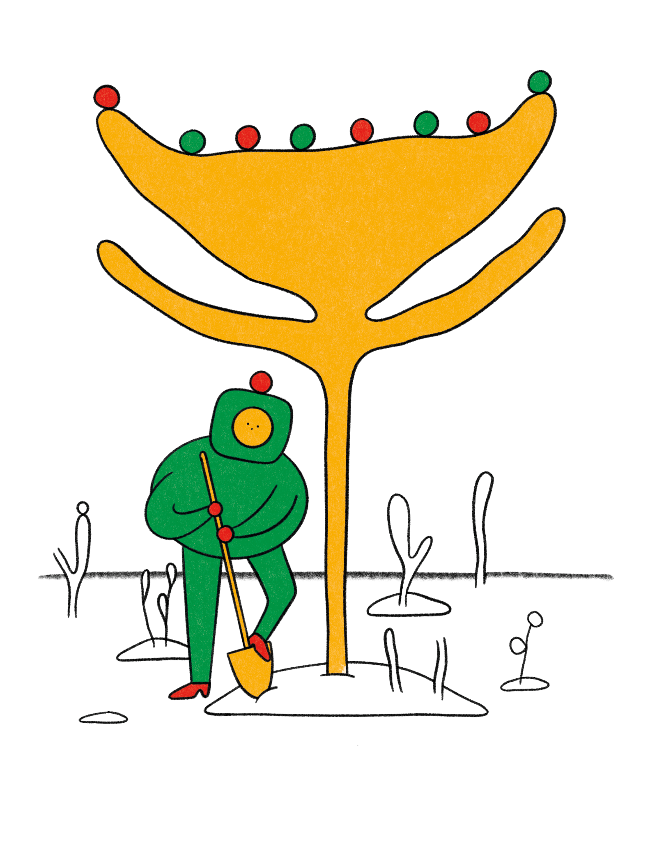
What is Purpose?
Purpose: an intention to achieve a long-term goal that is both personally meaningful and makes a positive impact on the world
Notes:
Key points:
Define Purpose for your parent community.
Be sure to highlight any answers from the previous slide that are reflected in the definition on this slide.
Suggested script:
Thank you for sharing what Purpose means to you. For the rest of our time together, we are going to define purpose as an intention to achieve a long-term goal that is both personally meaningful and makes a positive impact on the world, potentially changing the lives of others.
It’s important to remember that purpose is not a destination, but a journey and a practice. We can explore our purpose at any age and research finds that our sense of purposes changes over our lifetimes. This research also shows that we can look forward to more satisfying and meaningful lives if we’re able to revisit and renew our sense of purpose throughout our lives.

Slide 9
What is Purpose?
Having a greater sense of purpose provides:
1
Resiliency during more challenging times
2
Better health and cognitive functioning
3
Longer lives
Notes:
Key points:
Explain why Purpose is important, relevant, and beneficial to your parent community. Be sure to highlight:
Parenthood has joyful moments, and challenging ones, too. Research suggests that having a greater sense of purpose is important for resiliency during the more challenging moments.
Research shows purposeful people are happier, have better health and cognitive functioning, and live longer.
Suggested script:
Now, why is Purpose so important? Why are we all here today? We know that parenthood can be full of joyful and peaceful moments, and it can have some challenging moments, as well. Research suggests that having a greater sense of purpose is important for resiliency during those more challenging moments. Research also shows that purposeful people are happier, have better health and cognitive functioning, and live longer.

Slide 10
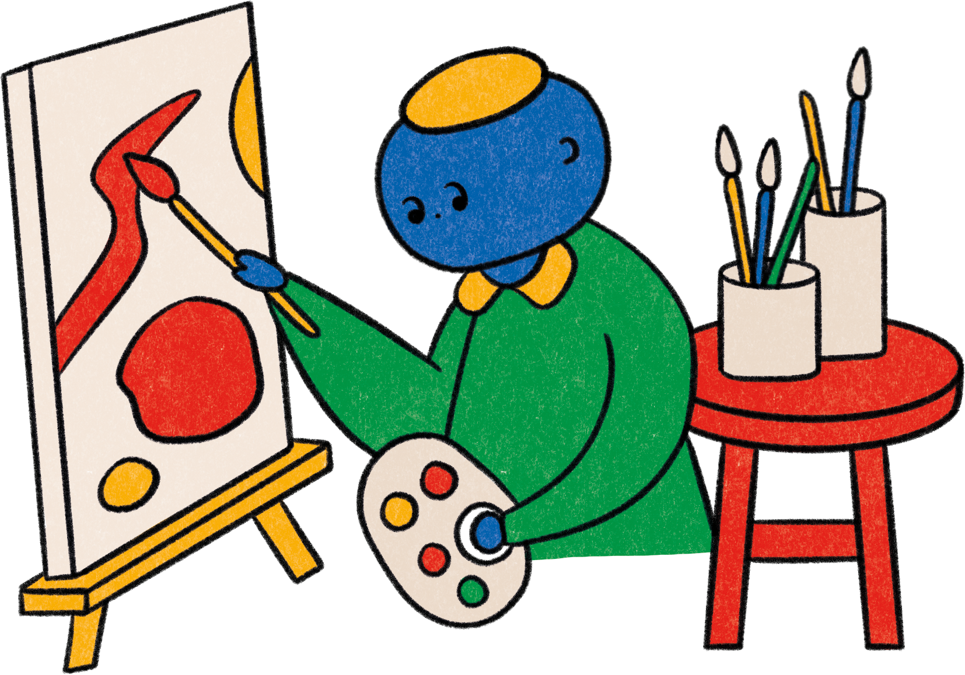
Purpose in Parenthood

Slide 11
Purpose in Parenthood
Can act as a buffer to decrease fight-or-flight stress responses
Helps parents build their emotional reserves
Benefits children when parents model self-compassion
Notes:
Key points:
Explain why fostering Purpose is important for parents and caregivers. Be sure to include:
Many parents feel a deep sense of purpose from becoming parents and raising their children.
Parents may also find a sense of purpose through their work, volunteering, or engaging in civic life.
Having a sense of purpose can help parents sustain their energy and be persistent when times are tough.
Fostering a sense of purpose can also make parents healthier.
Suggested script:
Now, what role does purpose and fostering a sense of purpose play as a parent or primary caregiver? Many parents feel a deep sense of purpose from becoming parents and raising children. Transitioning into parenthood can become a time when you explore a new aspect of your identity and help explore new long-terms goals. Many of you may also find a sense of purpose at work, volunteering, or participating in civic life. Research shows that having a sense of purpose can help parents sustain their energy and be persistent when times are tough. Some studies have found that parenthood provides some parents with a sense of purpose that can motivate them to take better care of themselves and live healthier.

Slide 12
Nurturing
Purpose
The Magic Wand
Best Possible Self
Recognize your strengths
Clarify your values
Read
Tell your story
Notes:
Key points:
Share practical tips on nurturing purpose in our own lives. Be sure to include the following activities:
Best Possible Self.
Tell your story.
Read.
The Magic Wand.
Recognize your strengths.
Clarify your values.
Suggested script:
We now understand why fostering Purpose for parents and caregivers is important, but you may be wondering, “Now what? How do we foster Purpose?” We have a few ideas for nurturing Purpose in our own lives with our own communities.
In Marisa Franco’s 2022 book, Platonic: How the Science of Attachment Can Help You Make—and Keep—Friends, Franco encourages us to:
Best Possible Self: Imagine yourself at a future age and think about your life if everything went as well as possible. Ask yourself, “What am I doing? What is important to me?”
Tell your story: Creating our narratives of our own lives can help us see our strengths and how we can use those strengths to make a difference in the world.
Read: Reading may be particularly useful for young people, as seeing purpose in the lives of other people helps them see it in their own.
The Magic Wand: Think about the world around you and visualize what you would change if you had a magic wand and could change anything. How can you move the world a little closer to that ideal?
Recognize your strengths: Take a survey to find your strengths or ask people who know you what you’re good at and how you might make your mark on the world.
Clarify your values: Clarifying your values can help you get clearer about your purpose.

Slide 13
Practicing Purpose in Parenthood:
Life Crafting
Why Try It?
Reflecting on your values and goals can:
1
Help you renew passions or see new ones
2
Assist in making sense of your priorities in life
3
Support your mental health and goal attainment
Notes:
Key points:
Explain how Life Crafting is a useful practice and why they should try it. Be sure to include:
Reflecting specifically on values and activities that provide us with meaning and motivation can help us renew certain passions or see new possibilities.
This practice can help you make sense of your priorities in life, better articulate the values and passions that are important to you, and possibly contribute to the wider world.
Writing about thoughts, feelings, and goals can help support mental health and goal attainment.
Remind participants where they can find this activity on their workshop handout.
Suggested script:
In addition to the previous tips on nurturing purpose, we also have a practice for you to try called Life Crafting. This is a short activity that helps you sharpen your sense of purpose by defining and committing to your goals. Reflecting on values and activities that provide us with meaning and motivation can help us renew certain passions or see new possibilities. This practice, Life Crafting, can help you make sense of your priorities in life, better articulate the values and passions that are important to you, and possibly contribute to the larger world. Research also suggests that writing about thoughts, feelings, and goals can help support your mental health and goal attainment.

Slide 14
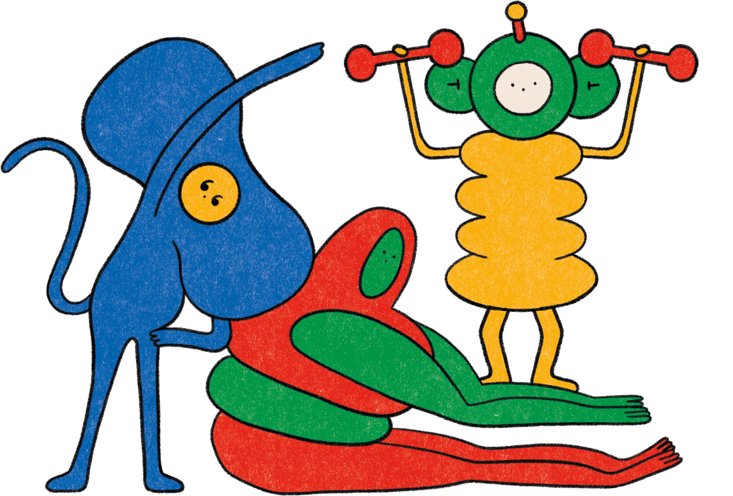
Practicing Purpose in Parenthood:
Life Crafting
How To Do It:
Identify your values and passions
Reflect on your ideal future
Write down how you’ll achieve those goals
Make a public commitment
Notes:
Key points:
Walk participants through Life Crafting.
During and after the practice, encourage the parents to pause to notice their thoughts, sensations, and feelings.
Remind participants where they can find this activity on their workshop handout.
Suggested script:
Now, you’ll start by identifying your deepest values and passions. Write a list of your greatest values and a separate list of what you most like to do in life.
Next, take a few minutes to reflect on your ideal future. Write a paragraph envisioning how you’d like your social life, family life, or career path to be if you had no restrictions.
Now, write down how you’ll attain those goals by, first, prioritizing your goals, and then, in another paragraph, identify obstacles and how you’ll overcome those obstacles. Also write down how you will track your progress towards these goals.
Finally, make a public commitment to your goals and communicate these goals to others in your community.

Slide 15
Reflect - Pair - Share
Notes:
Key points:
Participants will take a few moments to reflect on their experience, share their reflections with a partner, and then share with the group.
Suggested script:
Now that you have tried the Life Crafting practice, I want to give you all some time to reflect. First you’re going to take a minute and reflect on your experience trying this practice. Think about how you felt and which parts of this practice felt comfortable. Did any parts feel uncomfortable? Then, you’ll turn to a partner next to you and share your reflections. Finally, we’ll have time for a couple people to share their reflections with the group.

Slide 16
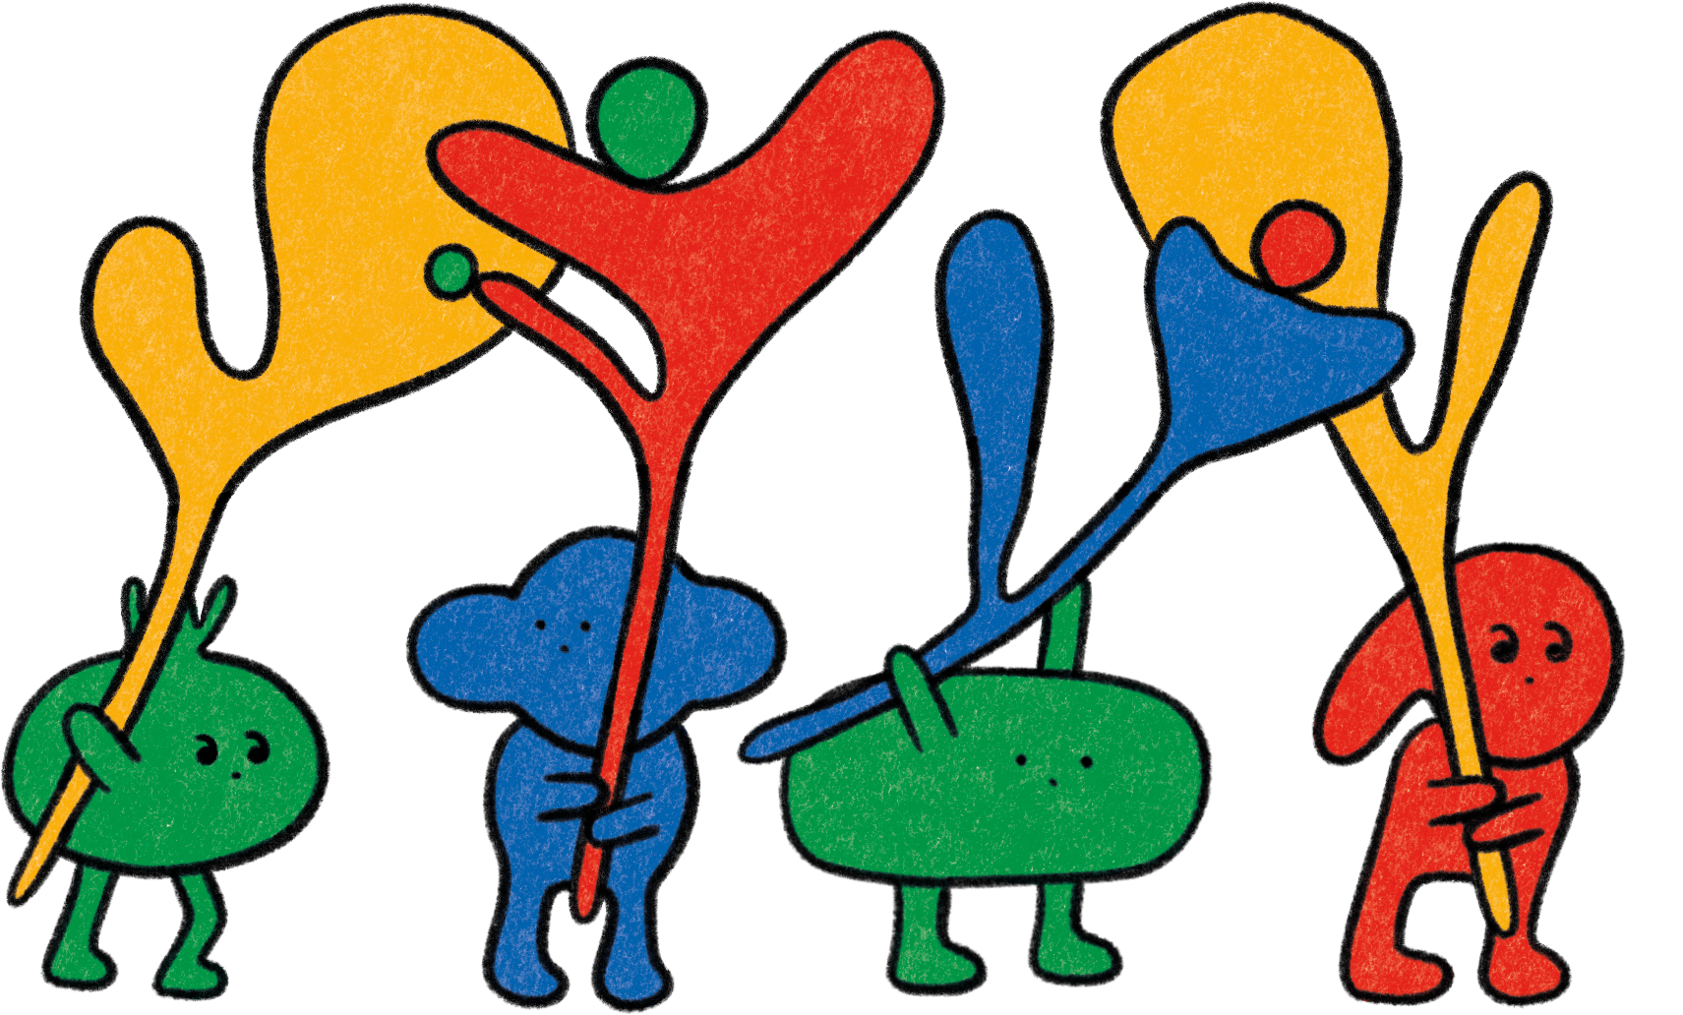
Purpose in Childhood

Slide 17
Purpose in Childhood
The process of finding our purpose begins when we’re teens
Discovering a sense of purpose may help teens overcome difficult situations
Mentorship is an important part of teens discovering a sense of purpose
Notes:
Key points:
Explain why fostering purpose is important for children. Be sure to include:
Research suggests that our paths to finding purpose can be shaped by early childhood experiences, but the process really begins when we’re teens, as we explore who we are, what we value, and what we want out of life.
The teen years are also important for identity development, and research shows that developing purpose and identity are intertwined processes.
Discovering a sense of purpose may help teens overcome difficult situations.
Research shows that mentorship is an important part of the process of discovering a sense of purpose, as children often need inspiration.
Suggested script:
Thank you all for participating and being open to the last practice. Now let’s explore the importance and development of purpose in childhood.
Research suggests that our paths to finding purpose can be shaped by early childhood experiences, but the process really begins when we’re teens, as we explore who we are, what we value, and what we want out of life. As parents, you can help young people to identify something in their environment that could be improved, and recognize something in themselves that they can bring to support that improvement.
The teen years are also important for identity development, and research shows that developing purpose and identity are intertwined processes. Some studies have shown that discovering a sense of purpose may help teens overcome difficult situations.
In discovering their purpose, research also shows that mentorship is an important part of the process of discovering a sense of purpose, as children often need inspiration and guidance.

Slide 18
Practicing Purpose in Adolescence:
Talk with Teens about Purpose
Why Try It?
1
Youth with a greater sense of purpose have greater coping skills, resilience, and well-being.
2
More purposeful adults have better physical and psychological health.
3
You are in a unique position to help your child cultivate a sense of purpose.
Notes:
Key points:
Explain how Talk with Teens about Purpose is a useful practice and why they should try it. Be sure to share:
Youth who have a sense of purpose tend to have greater coping skills, resilience, and well-being.
As they get older, more purposeful adults have better physical and psychological health, including better sleep, less chronic pain, and greater life satisfaction.
Parents are in a unique position to help their children cultivate a sense of purpose by identifying a cause they are interested in or ways their talents can be used for the greater good.
Remind participants where they can find this activity on their workshop handout.
Suggested script:
And, once again, the question is how - how can we foster Purpose in childhood? Talk with Teens about Purpose is a great practice to help teens start exploring and reflection on meaningful goals.
Studies have shown that youth with a greater sense of purpose tend to have greater coping skills, resilience, and well-being, and, as they get older, more purposeful adults have better physical and psychological health, including better sleep, less chronic pain, and greater life satisfaction. As parents, you are in a unique position to help your child cultivate a sense of purpose by identifying a cause they are interested in or ways their talents can be used for the greater good.

Slide 19
Practicing Purpose in Adolescence:
Talk with Teens about Purpose
How To Do It:
Discuss
Seek input
Think far out
Notes:
Key points:
Walk participants through Talk with Teens about Purpose.
Remind participants that these questions are designed to get progressively more intimate to mirror developing a new friendship.
Remind participants where they can find this activity on their workshop handout.
Suggested script:
You can use these three research-based strategies to talk regularly with your teen about purpose.
Start by discussing your experiences finding your own path to purpose. Be sure to show and tell them what you’re doing right now toward that end. Ask questions like “What’s most important in your life?” and “Do you have any long-term goals?” to help them start thinking about purpose.
Next, have them seek input. Encourage your child to talk about their life purpose with at least five adults who know them well. They can ask questions like “What do you think I’m particularly good at?” and “What are my greatest strengths?”
Finally, have them think far out. Help your child move from thinking about today to thinking about the future and envisioning their lives in two years, five years, ten years, or twenty years from now.

Slide 20
Reflect - Pair - Share
Notes:
Key points:
Participants will take a few moments to reflect on their experience, share their reflections with a partner, and then share with the group.
Suggested script:
Now we’ll take a few minutes to reflect on this practice. First, I’ll give you a minute to reflect on how you might introduce this activity to your child. What do you think would work well for you? Are you anxious about any pieces of this practice? Then, you’ll turn to a partner next to you and share your reflections. Finally, we’ll have time for a couple people to share their reflections with the group.

Slide 21
Questions
Notes:
(This is an optional slide, please remove it if you aren’t interested in a question period)
Key points:
Take questions from the parent community.

Slide 22
Closing Activity
What is one word that describes your learnings from today’s workshop?
Notes:
Key points:
Go around the room and invite each parent community member to share one word that describes their learnings from today or how they’re feeling after today’s workshop.

Slide 23
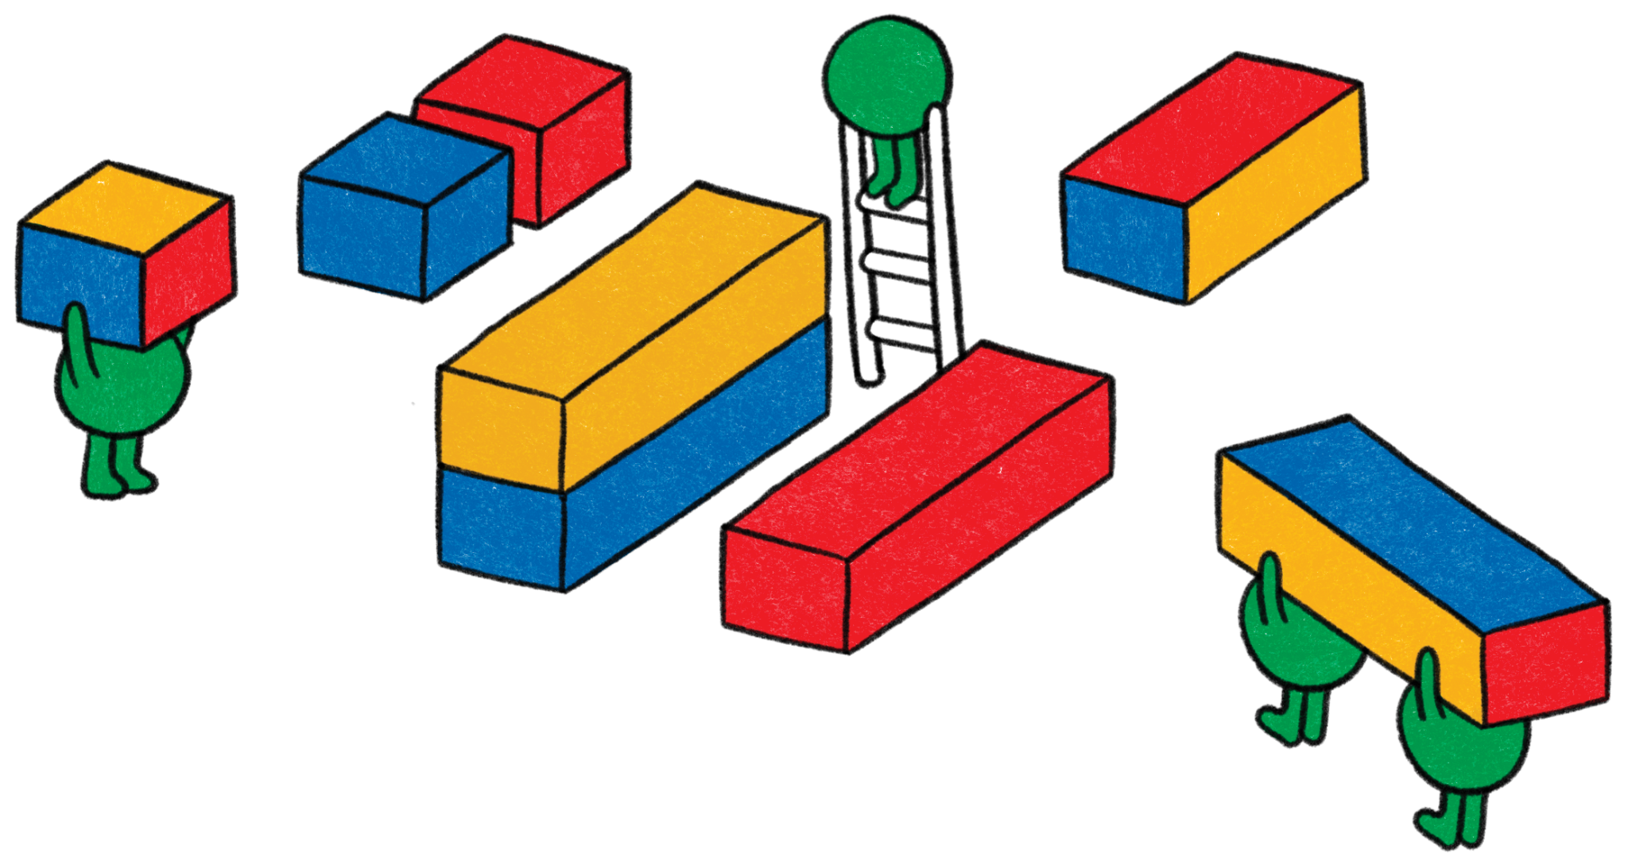
Thank You!
1
Your name here
Your Title
Some contact information
2
Your name here
Your Title
Some contact information

