Slide 1
Welcome!
1
Editing Slides
Before your workshop, review each slide and the accompanying speaker notes. Make any necessary edits to best meet the needs of your parent community.
2
Speaker Notes
There are two parts to the speaker notes for the slides throughout this slide deck. The first part is key points for you to keep in mind as the speaker. The second part is a suggested script. Not all slides contain a suggested script.
3
Online vs. In-Person Presentations
If presenting in an online format, please modify the slides for a virtual workshop. For example, if the directions suggest participants turn to a partner next to them to share, modify the instructions and put participants into small breakout rooms.
If you prefer working in Google Slides, you can make a copy of the Google Slides to work in here: https://bit.ly/3MmB0k1
4
Hide or delete this slide before your workshop.
Notes:
Note: This slide should not be included in the workshop presentation. Hide or delete this slide before your workshop.

Slide 2
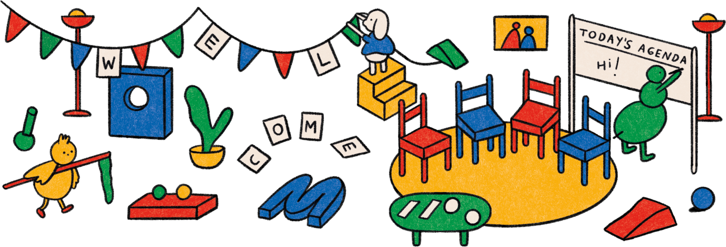

Slide 3
mind- ful-
ness

Slide 4
Today’s Workshop Facilitator(s):
1
Your name here
Your Title
Some contact information
2
Your name here
Your Title
Some contact information
Notes:
Key points:
Take a few moments to introduce yourself to your parent community and welcome them to the workshop.
Edit this slide to include a picture of yourself, your name and/or how you prefer to be addressed, your title, and your contact information.

Slide 5
Today’s agenda:
1
4
Welcoming Activity
What is Mindfulness?
Mindfulness in Parenthood
Mindfulness in Childhood
Questions
Closing Activity
2
5
3
6
Notes:
Key points:
Review what you will discuss during today’s workshop with your parent community.
Suggested script:
Over the next hour, we are going to explore the topic of mindfulness. We will start with a welcoming activity for the whole group, and then we will define mindfulness. Next, we will discuss what mindfulness looks like in parenthood and provide you with a practice to nurture mindfulness and your own well-being. After that, we will discuss mindfulness in childhood and provide you with a mindfulness activity to try out with your child. Finally, we’ll have some time for questions and then finish with a closing activity.

Slide 6
Welcome Activity
Ice Breaker
What is a parenting stereotype you think needs to be busted?
Notes:
Key points:
Have participants turn to a neighbor and share a parenting stereotype they think needs to be busted. If they can’t think of one that needs to be busted, have them share a parenting stereotype they think is true.

Slide 7
What is Mindfulness?
Notes:
Key points:
Ask your parent community to take 60 seconds and write down what mindfulness means to them. Participants may write down a definition, a few words that come to mind when thinking about Mindfulness, or even a feeling.
Before moving to the next slide, invite a few participants to share what they wrote down.

Slide 8
What is Mindfulness?
Mindfulness: the practice of observing moment-to-moment awareness of our thoughts, emotions, physical sensations and surrounding environments
Mindfulness:
1
Can be practiced in multiple ways
2
Involves acceptance
Notes:
Key points:
Define Mindfulness for your parent community.
Be sure to highlight any answers from the previous slide that are reflected in the definition on this slide.
Suggested script:
Thank you for sharing what Mindfulness means to you. For the rest of our time together, we are going to define mindfulness as the practice of observing moment-to-moment awareness of our thoughts, emotions, physical sensations, and surrounding environments with curiosity and kindness. Mindfulness can be practiced in many ways, like through meditation, focusing on your breath, or noticing sensations like how your feet feel on the ground. When practicing mindfulness, you are focusing on the present, rather than on the past or the future.

Slide 9
What is Mindfulness?
Mindfulness Can:
1
4
Strengthen your immune system
Enhance relationships
2
Fight off depression
5
Increase self-esteem and creativity
3
Improve memory and decision-making
6
Reduce bias and prejudice
Notes:
Key points:
Explain why mindfulness is important, relevant, and beneficial to your parent community. Be sure to highlight:
The benefits of practicing mindfulness, such as strengthening your immune system, helping with stress, fighting off depression, improving memory and decision-making, enhancing relationships, increasing self-esteem and creativity, and reducing bias and prejudice.
Researchers and practitioners are continuing to expand the science and practice of mindfulness to be more diverse and inclusive
Adaptations to mindfulness practices can uplift culturally important strengths within different cultures.
Suggested script:
Now, why is mindfulness so important? Why are we all here today? Over the years, thousands of studies have documented the physical and mental health benefits of mindfulness. Practicing mindfulness can:
Strengthen your immune system
Help with stress
Fight off depression
Improve memory and decision-making
Enhance relationships
Increase self-esteem and creativity
And reduce bias and prejudice
Researchers also work to continue to expand the science and practice of mindfulness to be more diverse and inclusive, like translating mindfulness practices into different languages or adapting goals to affirm cultural values, customs, and traditions. These adaptations can, ultimately, uplift culturally important strengths within different cultures.

Slide 10
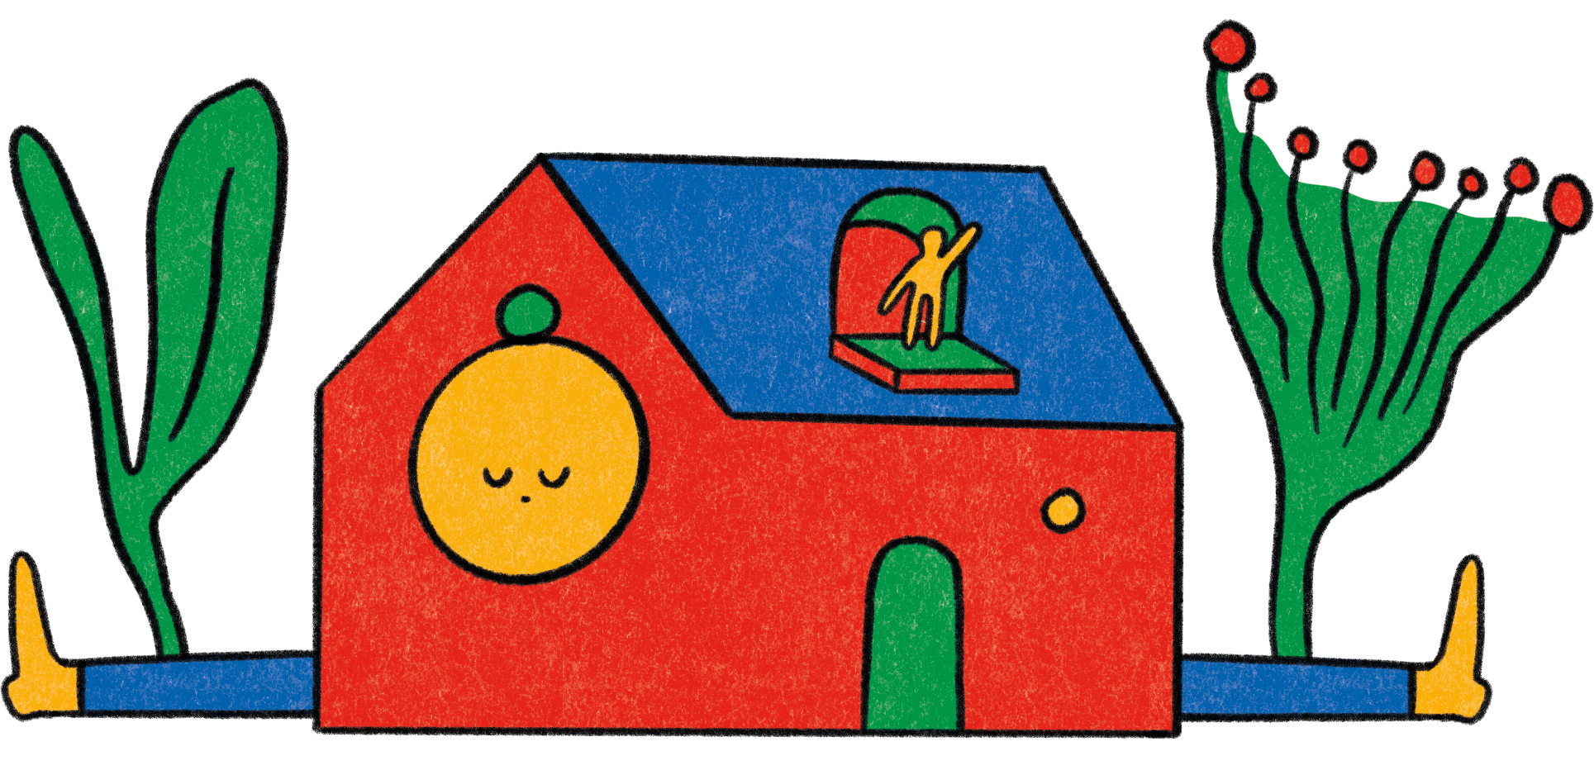
Mindfulness in Parenthood

Slide 11
Mindfulness in Parenthood
More mindful parents have less parenting stress, depression, and anxiety
More mindful parenting can result in children having fewer symptoms of anxiety or depression
Notes:
Key points:
Explain why fostering mindfulness is important for parents and caregivers. Be sure to include:
One study found that more mindful mothers of preschoolers have less parenting stress, depression, and anxiety.
A recent study shows parents who engage in more mindful parenting share more positive emotions during difficult conversations with their teen children, and those children are less likely to use drugs or have anxiety, depression, or act out.
Parents who are less self-critical of their parenting have teens with fewer symptoms of anxiety and depression.
In one study, parents who attended an eight week Mindful Families Stress Reduction course with their early-adolescent children reported decreased stress and their children reported their parents paid them more attention after the course.
Suggested script:
So why is practicing mindfulness important for you as a parent or primary caregiver? One study found that more mindful mothers of preschoolers have less parenting stress, depression, and anxiety. In addition, parents who are less critical of their parenting have teens with fewer symptoms of anxiety and depression. Another recent study shows that parents who engage in more mindful parenting end up sharing more positive emotions during difficult conversations with their teen children, and those children are less likely to use drugs, or have anxiety, depression, or act out.
While mindfulness doesn’t come naturally to everyone, it can be taught. In one study, parents who attended an 8-week Mindful Families Stress Reduction course with their early-adolescent children found their stress was decreased and their children reported that their parents paid more attention to them after completing the course.

Slide 12
Nurturing
Mindfulness
Accept that you are flawed
Accept that your child is flawed
Recognize that most parenting issues are temporary
Take a head-to- toe inventory
Use your phone intentionally
Pause to consider what your child needs now
Recognize when you need to adjust your schedule
Notes:
Key points:
Share practical tips on nurturing mindfulness in our own lives. Be sure to include the following tips:
Accept that you (and your parenting) are flawed.
Accept that your child is flawed.
Recognize that most parenting issues are temporary.
Take a head-to-toe inventory.
Use your phone intentionally.
Pause to consider what your child needs at the current moment.
Recognize when you need to adjust your schedule.
Suggested script:
We now understand why fostering Mindfulness for you as parents and caregivers is important, but you may be wondering, “Now what? How do we nurture Mindfulness?” We have a few tips here on nurturing Mindfulness in our parenting.
Accept that you and your parenting are flawed: Be careful not to find yourself constantly striving toward an unrealistic ideal of parenting or scrutinizing your every move.
Accept that your child is flawed: Remember that most well-adjusted adults had several difficult traits as children.
Recognize that most parenting issues are temporary: Try adding the phrase, “...for now” to the end of any observations you make about your child, like “They aren’t sleeping through the night…for now.”
Take a head-to-toe inventory: Check in with your head, heart, and instincts to make sure they’re aligned with your actions to support your child.
Use your phone intentionally: Try putting your phone away during dinner or for 30-minutes of parent-child connection time
Pause to consider what your child needs now: Take a moment, breathe, and then ask yourself, “Does my child need space, autonomy, or a boundary right now?”
Recognize when you need to adjust your schedule: Build in some buffer time between activities to give yourself time to connect and listen to your child

Slide 13
Practicing Mindfulness in Parenthood:
Mindful Breathing
Why Try It?
Practicing mindfulness and mindful breathing can:
1
Help us make sound decisions by allowing us to focus on our thoughts, emotions, and sensations
2
Help us navigate challenging feelings
3
Provide us with a physical anchor to return to when we feel overwhelmed
Notes:
Key points:
Explain how Mindful Breathing is a useful practice and why they should try it. Be sure to include:
The impact of stress, anger, and anxiety extends beyond our health and can affect our ability to focus and make sound decisions.
Mindfulness can combat that by allowing us to focus on our thoughts, emotions, and sensations without judgement.
Practicing mindfulness helps us manage and navigate challenging feelings without being consumed by those feelings.
In particular, mindful breathing provides us with a physical anchor to return to when we feel overwhelmed by stressful thoughts.
During and after the practice, encourage the parents to pause to notice their thoughts, sensations, and feelings.
Remind participants where they can find this activity on their workshop handout.
Suggested script:
In addition to the previous tips on nurturing Mindfulness, we also have a practice for you to try called Mindful Breathing.
This practice doesn’t take long; we’re actually going to take a few minutes and try the practice here today. It is a way to build resilience to stress, anxiety, and anger by directing your attention to the rhythm of your breath as it goes in and out when inhaling and exhaling. Research shows that the impact of stress, anger, and anxiety can affect our ability to focus and make sound decisions, but practicing mindfulness can combat that by allowing us to focus on our thoughts, emotions, and sensations without judgement. Practicing mindfulness helps us manage and navigate challenging feelings without being consumed by those feelings. Mindful breathing, in particular, provides us with a physical anchor to return to when we feel overwhelmed by stressful thoughts.
To begin, get as comfortable as you can. Practicing this later during times of stress or anxiety can be beneficial, too.

Slide 14
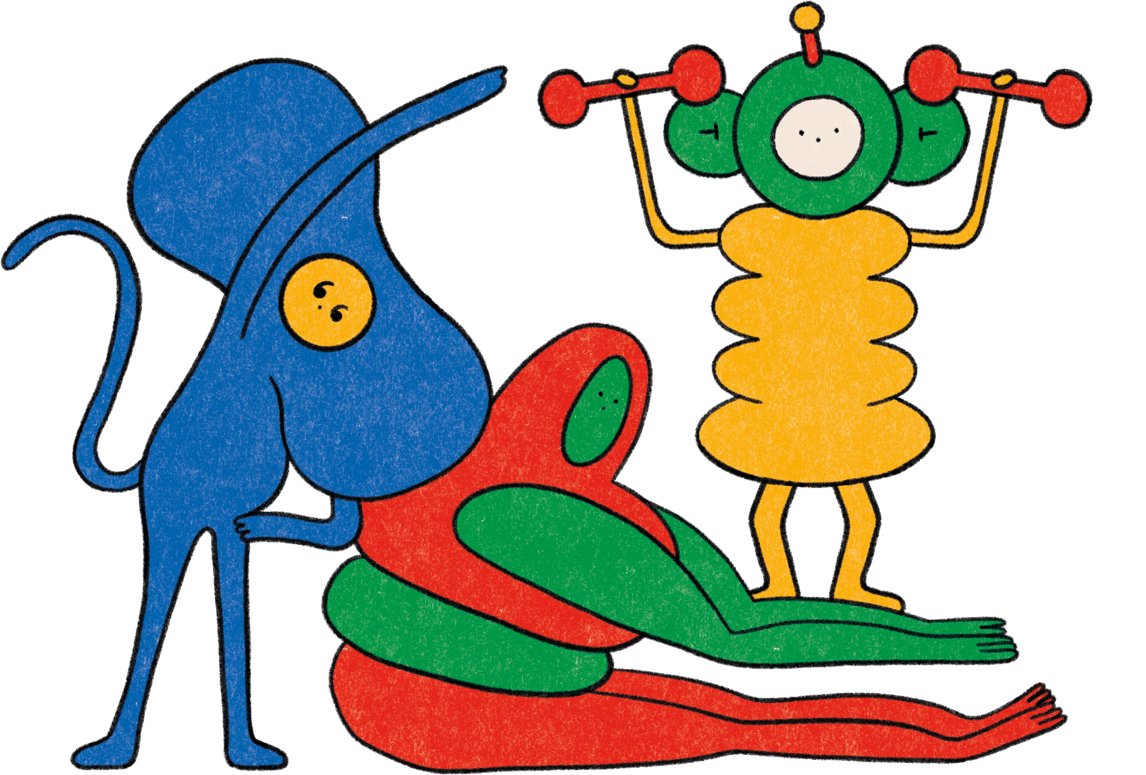
Practicing Mindfulness in Parenthood:
Mindful Breathing
How To Do It:
Maintain a soft gaze while you are standing, sitting, or lying down comfortably
Observe each breath
Focus on the rise and fall of your chest
Bring your attention back to your breath when your mind gets distracted
After 5 minutes, thank yourself for completing this practice
Notes:
Key points:
Walk participants through Mindful Breathing.
During and after the practice, encourage the parents to pause to notice their thoughts, sensations, and feelings.
Remind participants where they can find this activity on their workshop handout.
Suggested script:
Now, close your eyes or maintain a soft gaze, depending on your comfort level. For five minutes, observe each breath - both when inhaling and when exhaling - without trying to change your natural rhythm. You may find it helpful to begin by taking a deliberate, deep breath by inhaling deeply through your nostrils for 3 seconds, holding your breath for 2 seconds, and releasing your breath through your mouth for 4 seconds. While you’re breathing, focus on the rise and fall of your chest or on the sensation of air flowing through your nostrils. It’s okay for your mind to get distracted during this practice. When that happens, bring your attention back to your breath without judgement. Once you have done this for five minutes, thank yourself for completing this practice.

Slide 15
Reflect - Pair - Share
Notes:
Key points:
Participants will take a few moments to reflect on their experience, share their reflections with a partner, and then share with the group.
Suggested script:
Now that you have tried practicing mindful breathing, I want to give you all a some time to reflect. First you’re going to take a minute and reflect on your experience trying this practice. Think about how you felt and which parts of this practice felt comfortable. Did any parts feel uncomfortable? Then, you’ll turn to a partner next to you and share your reflections. Finally, we’ll have time for a couple people to share their reflections with the group.

Slide 16
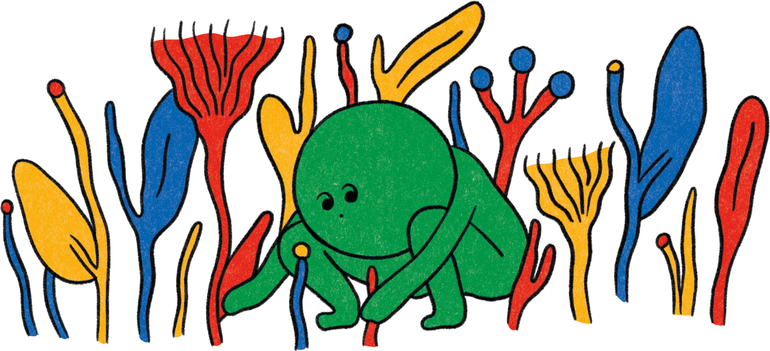
Mindfulness in Childhood

Slide 17
Mindfulness in Childhood
Young children are often naturally mindful.
Children of all ages can benefit from mindfulness practices.
More mindful children may be more emotionally resilient.
Practicing mindfulness has shown different benefits for children of different ages.
Notes:
Key points:
Explain why fostering mindfulness is important for children. Be sure to include:
Led by their curiosity to explore the world and all the sensations it has to offer, young children are often naturally mindful, but this can change as they get older.
Children of all ages can benefit from mindfulness practices.
Studies suggest that more mindful children may be more emotionally resilient.
Practicing mindfulness has shown different benefits for children of different ages.
Suggested script:
Thank you all for participating and being open to the last practice. Now let’s explore the importance of mindfulness in childhood.
Led by their curiosity to explore the world and all the sensations it has to offer, young children are often naturally mindful, although this can change as they get older.
Studies have shown that children of all ages can benefit from mindfulness practices. For example, one study found that more mindful 8-to-10-year-olds were less negatively affected by the COVID-19 pandemic and another study showed that more mindful college students are better able to bounce back from academic challenges, suggesting that more mindful children may be more emotionally resilient.
Fortunately, mindfulness can be taught, and many classrooms and schools are integrating mindfulness videos and training programs. These programs can increase resilience, executive function, attention, and kind behavior and decrease behavior problems and anxiety.
Mindfulness can be especially beneficial to teens, as one study found that teens who participated in a five-day mindfulness retreat felt less stressed and more happy, self-compassionate, and satisfied with their lives. Those teens even reported feeling better three months after the retreat!

Slide 18
Practicing Mindfulness in Childhood:
Raisin Meditation
Why Try It?
This practice can:
1
Teach us to focus on the present moment
2
Help lessen stress and enhance our capacity to experience positive moments
3
Help us recognize the simple joys of everyday life
Notes:
*Note: there are two activities for practicing mindfulness in childhood. This slide is for Raisin Meditation. Please choose the appropriate one to share with your parent community and hide the slides for the other activity.
Key points:
Explain how Raisin Meditation is a useful practice and why they should try it. Be sure to share:
Oftentimes we find ourselves thinking about the past or the future, neglecting to appreciate the present.
Practicing mindfulness teaches us to focus on the present moment, helping to lessen stress and enhance our capacity to experience positive emotions.
By enhancing awareness of our internal mental and physical states, mindfulness can help children and teens develop a deeper understanding of their thoughts, emotions, and actions in the present, which helps them recognize the simple joys of everyday life.
During and after the practice, encourage the parents to pause to notice their thoughts, sensations, and feelings.
Remind participants where they can find this activity on their workshop handout.
Suggested script:
And, once again, the question is how - how can we foster mindfulness in childhood? Raisin Meditation is a great practice to help cultivate mindfulness, ease stress, and savor simple joys.
Oftentimes we find ourselves dwelling on the past or thinking about the future, and we end up neglecting to appreciate the present moment. Practicing mindfulness teaches us to focus on the present moment and become more aware of our thoughts, emotions, and physical sensations without passing judgement. This helps lessen stress and enhances our capacity to experience positive emotions. Mindfulness can help children and teens develop a deeper understanding of their thoughts, emotions, and actions in the present moment, which creates a way for them to recognize and enjoy the simple joys of everyday life.

Slide 19
Practicing Mindfulness in Childhood:
Raisin Meditation
How To Do It:
Holding
Seeing
Touching
Smelling
Placing
Tasting
Swallowing
Following
Notes:
*Note: there are two activities for practicing mindfulness in childhood. This slide is for Raisin Meditation. Please choose the appropriate one to share with your parent community and hide the slides for the other activity.
Key points:
Walk participants through Raisin Meditation.
Remind participants where they can find this activity on their workshop handout.
Suggested script:
To get started, have your child pick up a raisin or another piece of fruit and hold it in their palm or between their fingers and have them imagine it is their first time seeing this fruit.
Ask them to see the piece of fruit and allow their gaze to go all over the piece of fruit. Pay attention to the details, like where light shines on it and where it has shadows.
Then ask them to touch the piece of fruit between their fingers, exploring the texture of the fruit.
Have them bring the piece of fruit close to their nose and smell it. As they’re smelling the piece of fruit, you can also ask them to pay attention to any sensations that come up in their mouth or stomach.
Next, have them bring the piece of fruit to their mouth and gently place it in their mouth without chewing it. Ask them to take a few moments to concentrate on the experience of having it in their mouth.
When they are ready, have them take one or two bites into the piece of fruit and pay attention to any flavors that come up.
Next, guide them through swallowing the piece of fruit. See if they can first notice the urge to swallow before actually swallowing it.
Finally, follow the piece of fruit and see if they can feel the fruit moving down into their stomach.

Slide 20
Practicing Mindfulness in Adolescence:
Walking Meditation
Why Try It?
This practice can:
1
Help children and teens practice a different pace of life
2
Can reduce stress and help us tune into positive emotions
3
Provide us with more more control over our thoughts, emotions, and behaviors
Notes:
*Note: there are two activities for practicing mindfulness in childhood. This slide is for Walking Meditation. Please choose the appropriate one to share with your parent community and hide the slides for the other activity.
Key points:
Explain how Walking Meditation is a useful practice and why they should try it. Be sure to share:
Walking meditation helps children and teens practice a different pace of being in the world by deeply experiencing an ordinary part of life as they live it.
Deeply experiencing an ordinary part of life as they live it can help reduce stress and help us tune into positive emotions.
Having a heightened awareness of what we are experiencing can empower us with greater control over our thoughts, emotions, and behaviors, allowing us to respond more constructively to more negative thoughts or feelings.
Remind participants where they can find this activity on their workshop handout.
Suggested script:
And, once again, the question is how - how can we foster Mindfulness in childhood? Walking Meditation is a great practice to turn everyday actions into a mindfulness and stress reduction tool.
In our fast-paced world, we often rush from one place to another. A basic method for practicing mindfulness is a “walking meditation”, which involves focusing closely on the physical experience of an ordinary part of life, like walking. Deeply experiencing an ordinary part of life as we live it can reduce stress and help us tune into positive emotions. Walking meditation - like mindfulness overall - can empower us with greater control over our thoughts, emotions, and behaviors, allowing us to respond more constructively to negative thoughts or feelings.

Slide 21
Practicing Mindfulness in Adolescence
Walking Meditation
How To Do It:
Find a location
Start your pace
Speed
The components of each movement
Hands and arms
Focusing your attention
What to do when your mind wanders
Making this meditation part of your daily life
Notes:
*Note: there are two activities for practicing mindfulness in childhood. This slide is for Walking Meditation. Please choose the appropriate one to share with your parent community and hide the slides for the other activity.
Key points:
Walk participants through Walking Meditation.
Remind participants where they can find this activity on their workshop handout.
Suggested script:
To get started with your child, find a calm location where you are unlikely to be interrupted. You will need to be able to pace back and forth for 10-25 steps, or about 20-40 feet. This exercise is adaptable for wheelchair users or those with limited mobility.
Take 10-15 steps or wheel yourselves for 20-40 feet along the chosen path, the pause and breathe at your own pace. When you’re ready, turn around and retrace your path back to the other end, where you’ll pause again to breathe. When you’re ready, turn around again and continue along your chosen path.
As you and your child are walking, notice the small ways you move. If you are walking, you might observe as you life one foot of the ground or as you shift your body weight onto the forward leg as your back heel lifts when taking a step. For wheelchair users, you might focus as you place your hands on the handrims or you might observe how the earth underneath you supports your wheelchair and your body.
While practicing your walking meditation, try going slowly as you’re focusing on your small, natural movements. Think about how you want to uses your hands and arms. As you move, direct your attention towards a sensation you typically overlook, like the rhythm of your breath flowing in and out of your body. Expect your mind to wander; when you see your mind drifting, try to bring your focus back to one of those sensations.
Try and make this meditation a part of your daily life - the more you practice, the more likely it will grow on you.

Slide 22
Reflect - Pair - Share
Notes:
Key points:
Participants will take a few moments to reflect on their experience, share their reflections with a partner, and then share with the group.
Suggested script:
Now we’ll take a few minutes to reflect on this practice. First, I’ll give you a minute to reflect on how you might introduce this activity to your child. What do you think would work well for you? Are you anxious about any pieces of this practice? Then, you’ll turn to a partner next to you and share your reflections. Finally, we’ll have time for a couple people to share their reflections with the group.

Slide 23
Questions
Notes:
(This is an optional slide, please remove it if you aren’t interested in a question period)
Key points:
Take questions from the parent community.

Slide 24
Closing Activity
What is one word that describes your learnings from today’s workshop?
Notes:
Key points:
Go around the room and invite each parent community member to share one word that describes their learnings from today or how they’re feeling after today’s workshop.

Slide 25
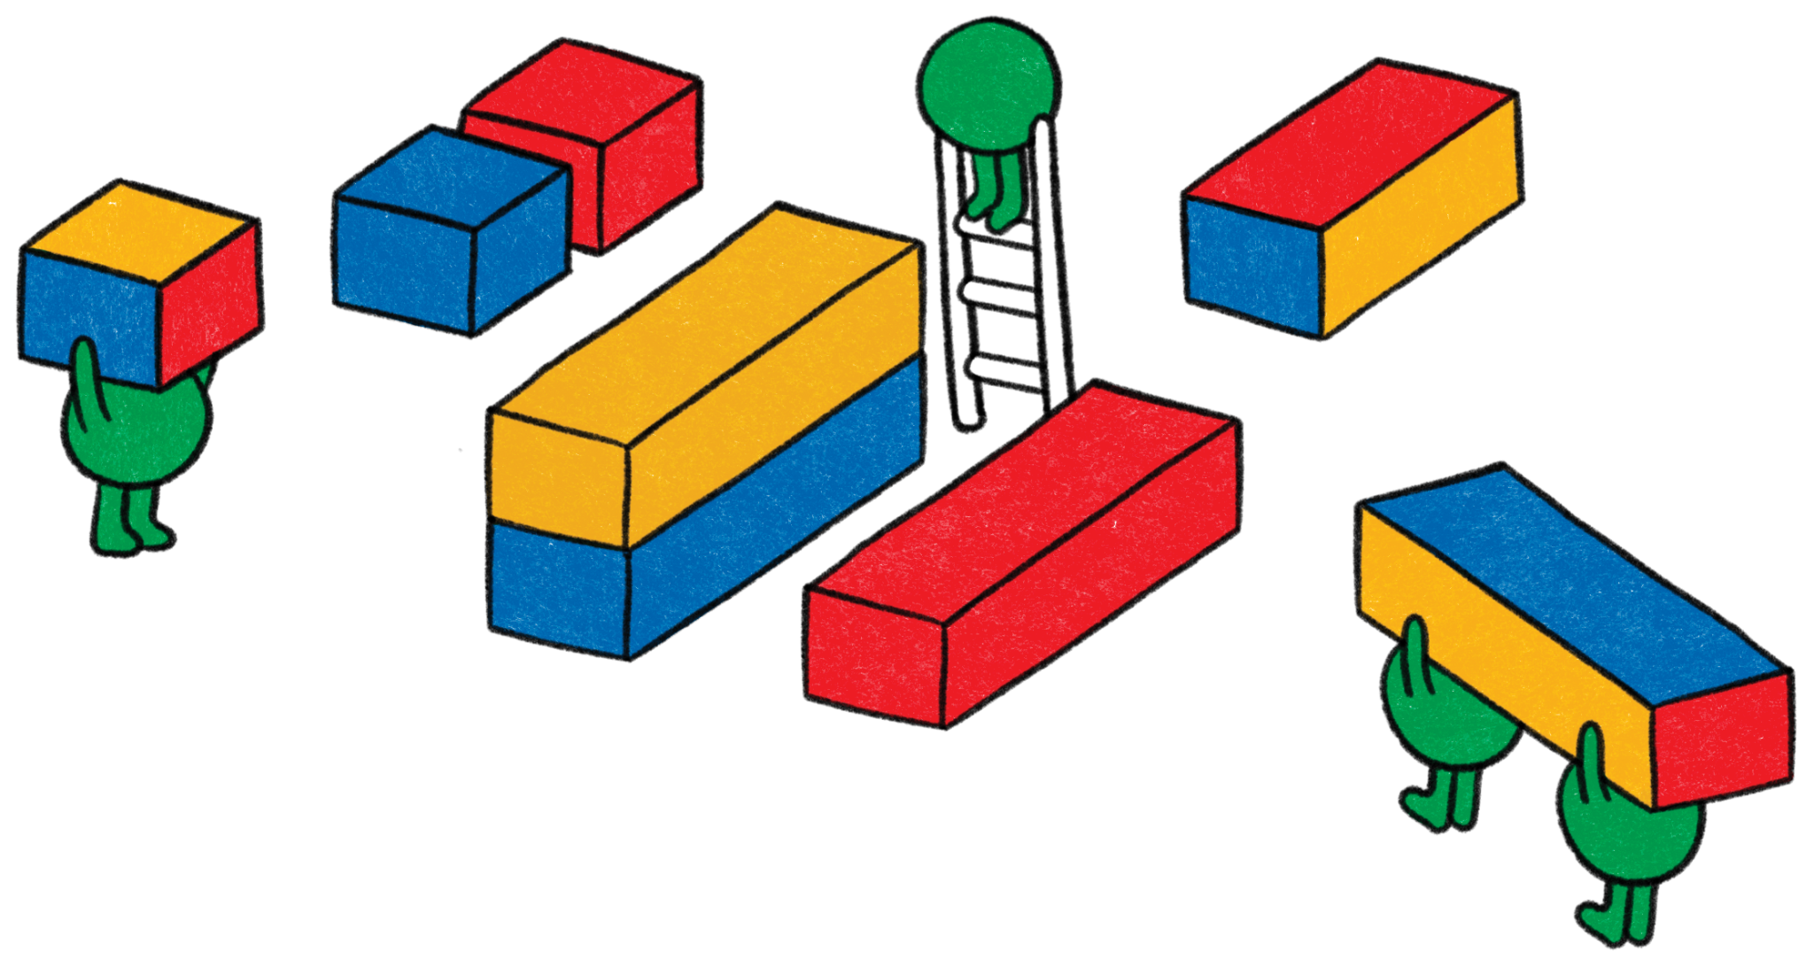
Thank You!
1
Your name here
Your Title
Some contact information
2
Your name here
Your Title
Some contact information

