Slide 1
Welcome!
1
Editing Slides
Before your workshop, review each slide and the accompanying speaker notes. Make any necessary edits to best meet the needs of your parent community.
2
Speaker Notes
There are two parts to the speaker notes for the slides throughout this slide deck. The first part is key points for you to keep in mind as the speaker. The second part is a suggested script. Not all slides contain a suggested script.
3
Online vs. In-Person Presentations
If presenting in an online format, please modify the slides for a virtual workshop. For example, if the directions suggest participants turn to a partner next to them to share, modify the instructions and put participants into small breakout rooms.
A few notes on how to use this slide deck
4
Hide or delete this slide before your workshop.
Notes:
Note: This slide should not be included in the workshop presentation. Hide or delete this slide before your workshop.

Slide 2
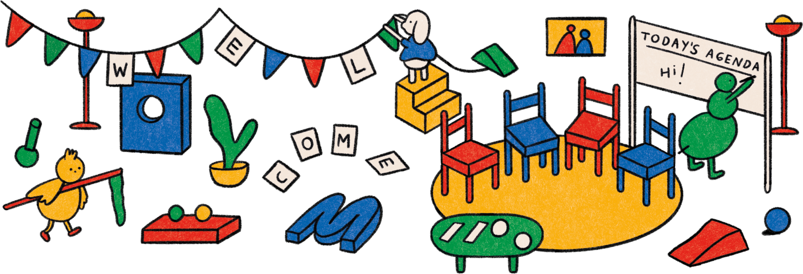

Slide 3
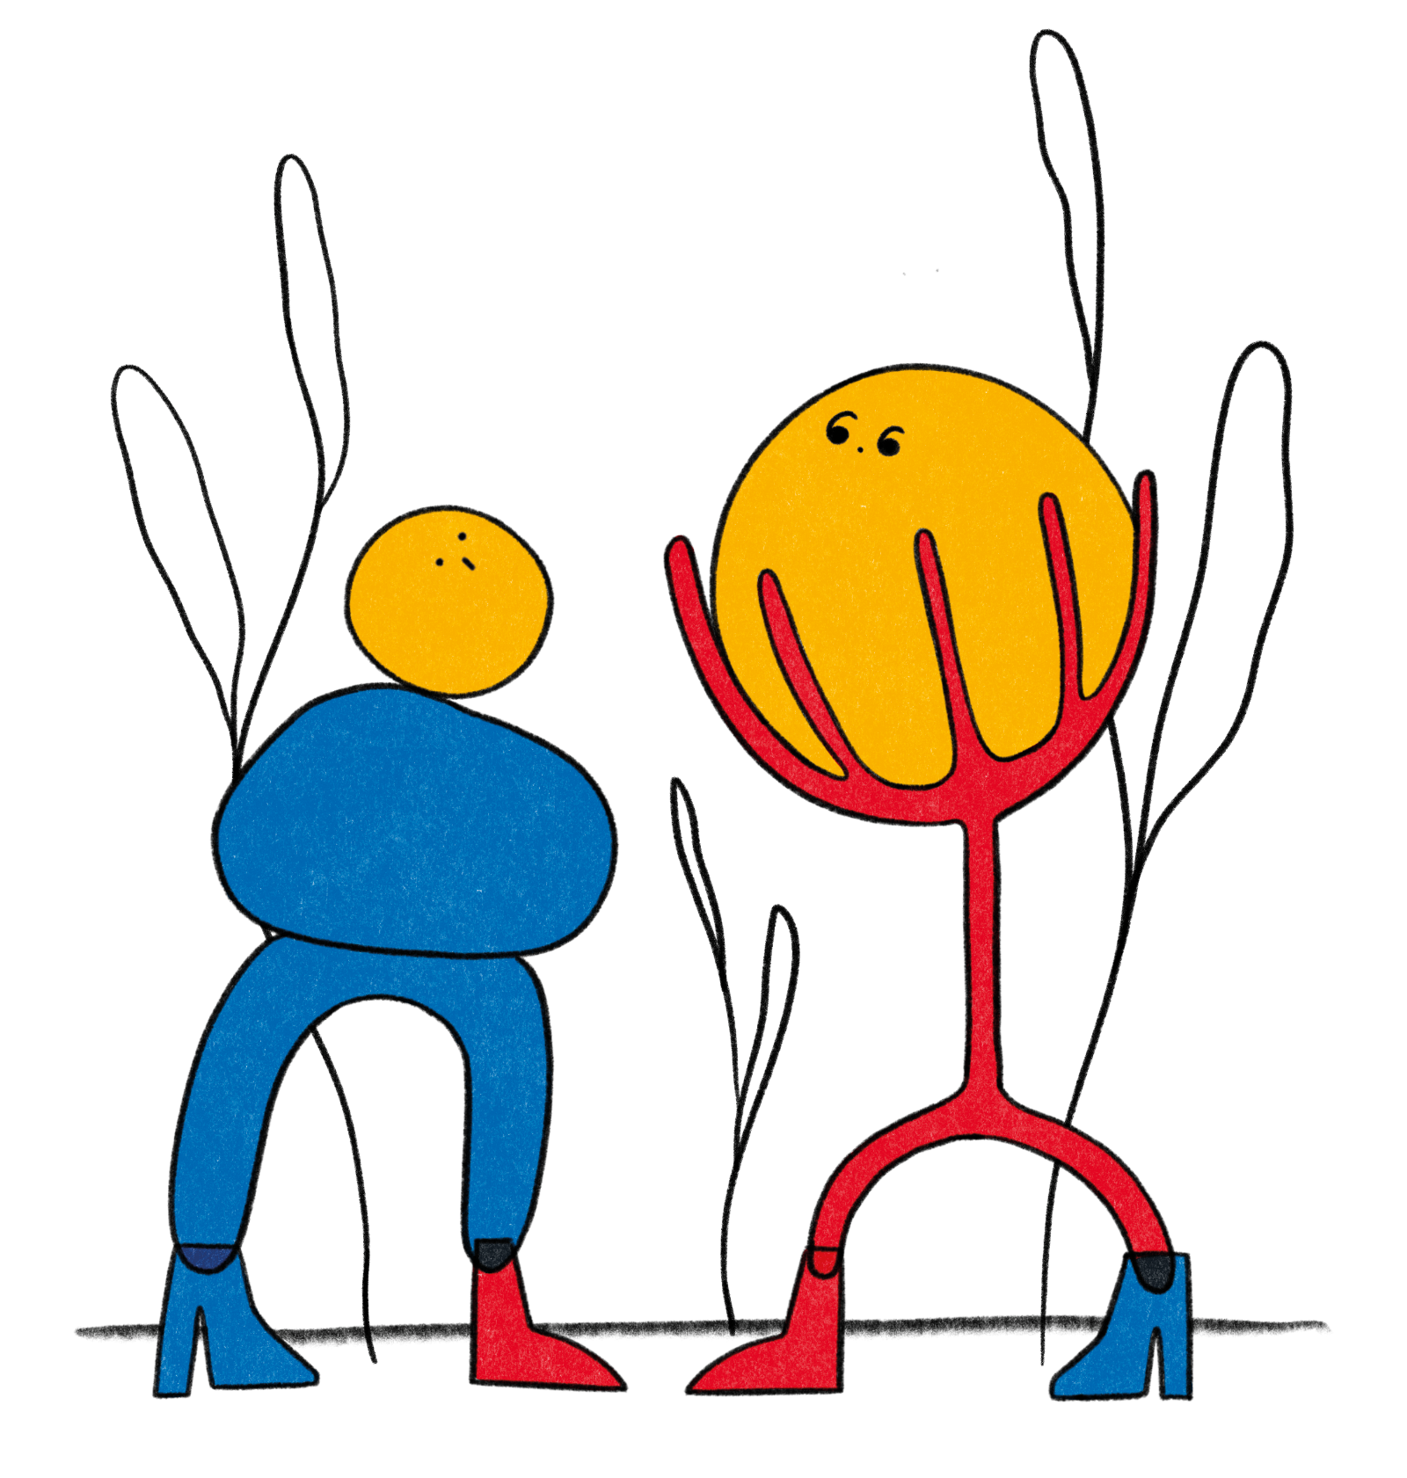
em- pa-
thy

Slide 4
Today’s Workshop Facilitator(s):
1
Your name here
Your Title
Some contact information
2
Your name here
Your Title
Some contact information
Notes:
Key points:
Take a few moments to introduce yourself to your parent community and welcome them to the workshop.
Edit this slide to include a picture of yourself, your name and/or how you prefer to be addressed, your title, and your contact information.

Slide 5
Today’s agenda:
1
4
Welcoming Activity
What is Empathy?
Empathy in Parenthood
Empathy in Childhood
Questions
Closing Activity
2
5
3
6
Notes:
Key points:
Review what you will discuss during today’s workshop with your parent community.
Suggested script:
Over the next hour, we are going to explore the topic of empathy. We will start with a welcoming activity for the whole group, and then we will define empathy. Next, we will discuss what empathy looks like in parenthood and provide you with a practice to nurture empathy and your own well-being. After that, we will discuss empathy in childhood and provide you with a empathy activity to try out with your child. Finally, we’ll have some time for questions and then finish with a closing activity.

Slide 6
Welcome Activity
Ice Breaker
What is the best compliment you've given your child?
Notes:
Key points:
Ask your parent community to turn to a neighbor and share the best compliment they’ve given their child/children. If they can’t think of a compliment they’ve given in the past, they can share a compliment they would like to give to their child/children when they next see them.

Slide 7
What is Empathy?
Notes:
Key points:
Ask your parent community to take 60 seconds and write down what empathy means to them. Participants may write down a definition, a few words that come to mind when thinking about empathy, or even a feeling.
Before moving to the next slide, invite a few participants to share what they wrote down.

Slide 8
What is Empathy?
Empathy: the ability to sense other people’s emotions and imagine what someone else might be thinking or feeling
Two types of empathy:
1
Affective empathy
2
Cognitive empathy
Notes:
Key points:
Define empathy for your parent community.
Be sure to highlight any answers from the previous slide that are reflected in the definition on this slide.
Suggested script:
Thank you for sharing what empathy means to you. For the rest of our time together, we are going to define empathy as the ability to sense other people’s emotions and imagine what someone else might be thinking or feeling. Researchers often differentiate between two types of empathy:
Affective empathy: the sensations and feelings we get in response to others’ emotions; this can include mirroring what that person is feeling or feeling stressed when we detect another’s fear or anxiety
Cognitive empathy: our ability to identify and understand other people’s emotions, sometimes called “perspective-taking”

Slide 9
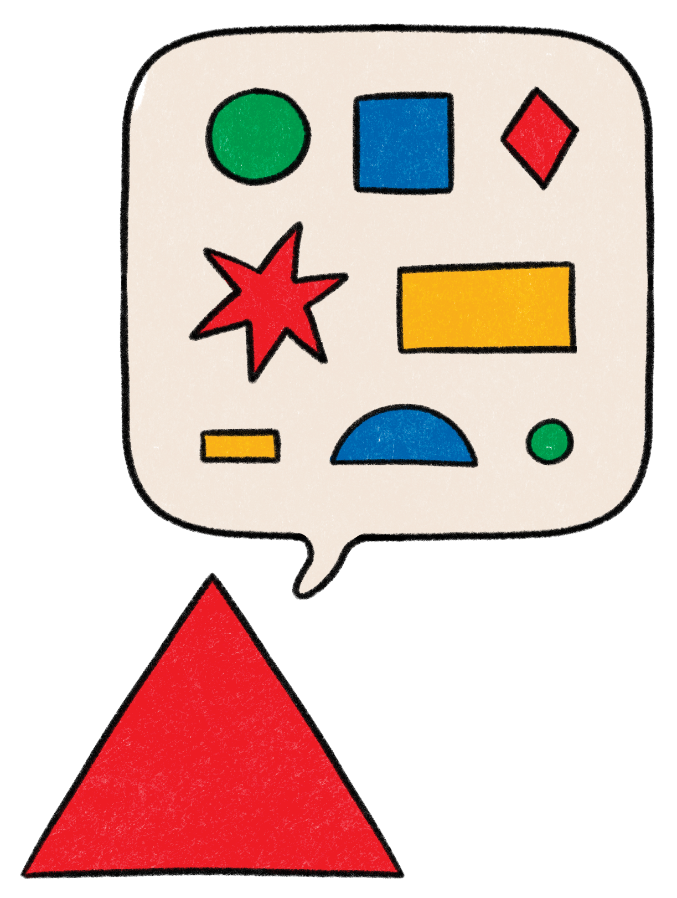
What is Empathy?
Empathy:
1
May have evolved as a parental instinct in mammals
2
Helps nurture social connections
3
Reduces prejudice and racism
Notes:
Key points:
Explain why Empathy is important, relevant, and beneficial to your parent community. Be sure to highlight:
Some researchers hypothesize that empathy evolved as a parental instinct in mammals because it motivates parents to care for their vulnerable offspring.
Empathy is fundamental for nurturing social connections.
Empathy and practicing perspective-taking reduces prejudice and racism.
Suggested script:
Now, why is empathy so important?
Looking back through our evolutionary history, some researchers hypothesize that empathy evolved over time as a parental instinct to motivate parents to care for their vulnerable offspring and to keep them safe.
Research has also shown that empathy allows us to nurture social connections, which in turn leads to greater emotional well-being. Understanding others deepens intimacy, helps us resolve interpersonal conflicts, and practicing empathy is often the first step to taking compassionate action. Studies show that empathy and practicing perspective-taking reduces prejudice and racism, too.

Slide 10
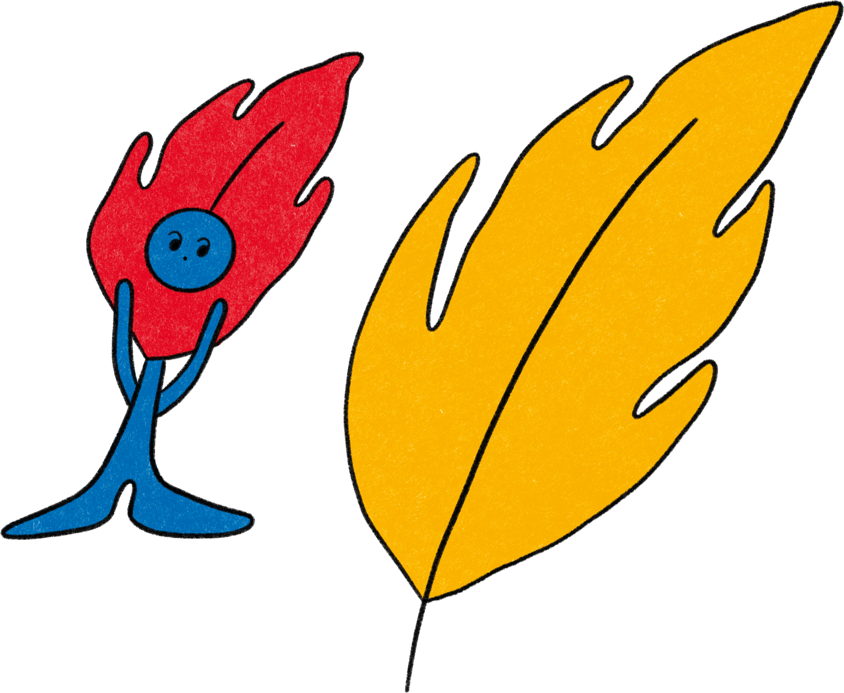
Empathy in Parenthood

Slide 11
Empathy in Parenthood
Empathy helps you understand your child’s perspective
Adolescents with more empathetic parents can better regulate their emotions
Practicing perspective taking can help in more challenging times
Notes:
Key points:
Explain why fostering empathy is important for parents and caregivers. Be sure to include:
Empathy helps parents understand their child’s perspective and anticipate their needs.
Adolescents with more empathic parents have been found to better regulate their emotions.
More empathic parents have greater self-esteem and life purpose than parents with less empathy.
One organization found that practicing perspective taking in more challenging times helps parents and caregivers learn to empathize with their co-parent, de-escalate feelings of rage, and help them communicate more mindfully.
Suggested script:
Now that we’ve talked about why empathy is important in general, why is important for you as a parent or caregiver? As we just discussed, practicing empathy allows you to nurture social connections, including those with your child. Empathy helps you understand your child’s perspective and to anticipate their needs. In one study, researchers found that more empathetic parents have greater self-esteem and life purpose, and adolescents with more empathetic parents are better able to regulate their emotions.
In addition, we can all agree that parenting can be difficult at times. In those more difficult times, one organization that offers parenting support found that practicing perspective taking during more challenging times can help you learn to empathize with a co-parent, can help de-escalate feelings of anger or rage, and can help you communicate more mindfully with others.

Slide 12
Nurturing
Empathy
Believe empathy can be learned
Get creative!
Pursue diverse friendships
Be mindful
Get out of your own head
Notes:
Key points:
Share practical tips on nurturing empathy in our own lives. Be sure to include the following tips:
Believe empathy can be learned.
Get out of your own head.
Be mindful.
Pursue diverse friendships.
Get creative.
Suggested script:
We now understand why fostering empathy is important, but you may be wondering, “Now what? How do we foster empathy?” We have a few tips for you on nurturing empathy in ourselves and our children.
Believe empathy can be learned: Studies show that people who think their empathy levels are changeable put more effort into being empathic, listening to others, and helping, even when it’s challenging.
Get out of your own head: Research shows that actively imagining what someone else might be experiencing can increase levels of empathy. One way to practice this is to read more fiction, as people who read fiction are more attuned to others’ emotions and intentions.
Be mindful: Practicing mindfulness helps us take other people's perspectives yet not feel overwhelmed when we encounter their negative emotions.
Pursue diverse friendships: Taking time to get to know people who are different from us makes it easier for us to empathize with them and reduces prejudice towards others of that group.
Get creative: Engage in creative group activities like joining a band or playing games together. Research shows that playing music together boosts empathy in kids, and that when we compete against others, like when playing games, our brains are trying to understand the other person’s thoughts and intentions

Slide 13
Practicing Empathy in Parenthood:
Active Listening
Why Try It?
Practicing active listening can:
1
Foster empathy and connection
3
Help speakers feel understood
2
Help listeners understand others’ perspectives
4
Make relationships more satisfying
Notes:
Key points:
Explain how Active Listening is a useful practice and why they should try it. Be sure to include:
Expressing interest in what the other person has to say and making others feel heard fosters empathy.
Practicing active listening helps listeners understand others’ perspectives and can help speakers feel understood.
Active listening can also prevent miscommunication and make relationships more satisfying.
Remind participants where they can find this activity on their workshop handout.
Suggested script:
In addition to the previous tips on nurturing empathy, we also have a practice for you to try called Active Listening.
This practice doesn’t take long; we’re actually going to take a few minutes and try the practice here today. This Active Listening practice only takes a few minutes and allows you to connect with a partner through empathy and understanding. Expressing active interest in what the other person has to say and making others feel heard fosters empathy and connection.
Practicing active listening helps listeners better understand others’ perspectives and can help speakers feel understood and less threatened. It can prevent miscommunication and can ultimately make relationships more satisfying by improving communication.

Slide 14
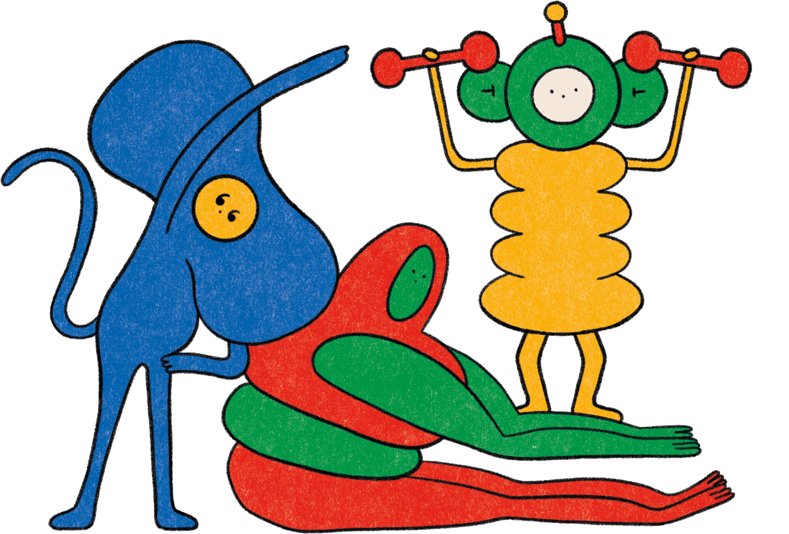
Practicing Empathy in Parenthood:
Active Listening
How To Do It:
Invite your partner to share what’s on their mind. As you are listening:
Paraphrase
Ask questions
Express empathy
Use engaged body language
Avoid judgment
Avoid giving advice
Take turns
Notes:
Key points:
Walk participants through Active Listening practice.
Remind participants where they can find this activity on their workshop handout.
Suggested script:
Now, find a quiet place in this space to talk with your conversation partner without interruption or distraction. You will invite this person to share what’s on their mind, and as they do so, try keep the following things in mind:
Paraphrase: You can say, “What I hear you saying is…” or “If I understand you right…”
Ask questions: Instead of jumping to conclusions about what the other person means, ask questions to clarify what they mean.
Express empathy: If the speaker expresses a certain emotion, try to consider why they might feel that way and respond with understanding.
Use engaged body language: You can make eye contact, nod, and maintain a relaxed body posture to show your conversation partner you’re engaged and interested in what they are saying.
Avoid judgement: You want to understand and accept the other person’s perspective, even if you disagree with it.
Avoid giving advice: It’s easier and more effective to problem-solve after you each understand the other person’s perspective.
Take turns: Once the other person has had a chance to speak, ask if it’s OK for you to share your thoughts and feelings and then express yourself as clearly as possible using “I” statements.

Slide 15
Reflect - Pair - Share
Notes:
Key points:
Participants will take a few moments to reflect on their experience, share their reflections with a partner, and then share with the group.
Suggested script:
Now that you have tried practicing empathy in the context of parenthood, I want to give you all a some time to reflect. First you’re going to take a minute and reflect on your experience trying this practice. Think about how you felt, what felt useful to you, or maybe what you might do differently the next time you practice this. Then, you’ll turn to a partner next to you and share your reflections. Finally, we’ll have time for a couple people to share their reflections with the group.

Slide 16
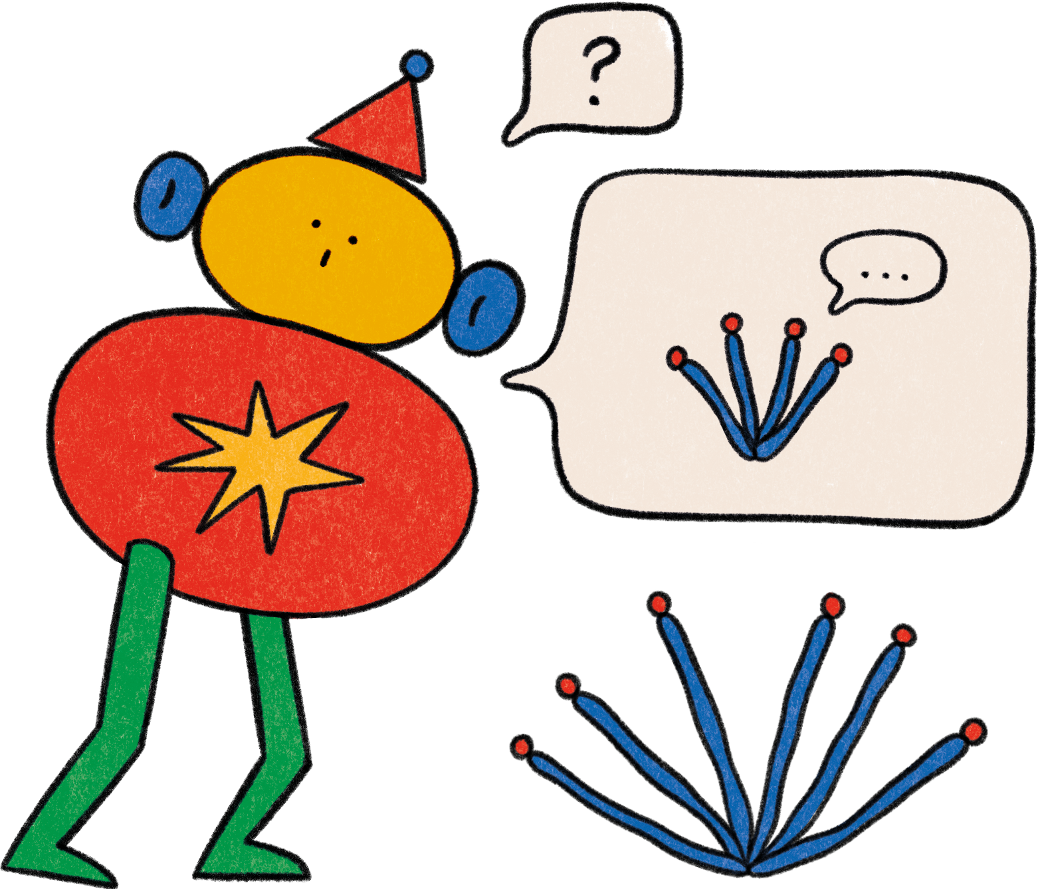
Empathy in Childhood

Slide 17
Empathy in Childhood
We begin to experience affective empathy from infancy
We then develop cognitive empathy around ages 3-4
Many different elements can impact your child’s sense of empathy
Teaching children empathy skills helps them socially and morally
Notes:
Key points:
Explain why fostering empathy is important for children. Be sure to include:
Humans experience affective empathy from infancy.
Cognitive empathy emerges later in development, around three to four years of age, and then continues to develop their empathic abilities
throughout childhood and adolescence.
Many different elements can impact a child’s sense of empathy.
Evidence suggests that teaching children empathy skills helps them socially and morally.
Suggested script:
Thank you all for participating and being open to the last practice. Now let’s explore the role empathy plays in childhood. As we discussed earlier, empathy helps nurture social connections and can reduce prejudice, but what is the importance of empathy in childhood?
Research shows that we begin to experience affective empathy - or the sensations and feelings we get in response to others’ emotions - from infancy. Babies can actually sense your emotions and will mirror those emotions, they can differentiate between happy and sad faces, and they respond differently to different vocal emotions. Around three to four years of age, right around the time children develop the understanding that other people experience the world differently than they do, they begin to develop cognitive empathy - or the ability to identify and understand other people’s emotions. We continue to develop both kinds of empathy throughout childhood and adolescence.
Many different elements can impact your child’s sense of empathy. For example, a 2022 article found that children with autism may have an easier time
with affective empathy than with cognitive empathy, research has shown that children in lower socioeconomic classes are more accurate in judging the emotions of other people than people with higher socioeconomic status, and a recent study found that children from multiethnic and/or multi-faith families may have stronger empathy and conflict-resolution skills.
Evidence also suggests that teaching children empathy skills helps them socially and morally, leading to less bullying and makings kids kinder and more inclusive to their peers.

Slide 18
Practicing Empathy in Childhood:
Talk With Kids About Emotions
Why Try It?
Emotion labeling can:
1
Help children recognize and internalize the emotions of others
2
Help children differentiate others’ emotions from their own
3
Help children make sense of others’ experiences that are less obvious
Notes:
*Note: there are two activities for practicing empathy in childhood. This slide is for Talk With Kids About Emotions. Please choose the appropriate one to share with your parent community and hide the slides for the other activity.
Key points:
Walk participants through Talk With Kids About Emotions.
During and after the practice, encourage the parents to pause to notice their thoughts, sensations, and feelings.
Remind participants where they can find this activity on their workshop handout.
Suggested script:
During this practice with your child, you will help them understand other people’s feelings through emotion labeling, or directly pointing out and naming feelings so your child can build their emotion vocabulary. You can do this in a variety of different contexts, so they can begin to understand that emotions are complex and nuanced. The next time you notice someone experiencing big feelings nearby - this can be a friend, a family member, or someone out in public - try this with your child:
Describe the emotions that person might be feeling: For example, you could say, “I heard that Jaime’s dog was sick and died. They might be feeling sad and overwhelmed right now.”
Invite your child to name other related feelings: You could say something like, “What other emotions do you think they might be feeling?”
Encourage your child to reflect on and share their experiences with similar emotions: You could ask, “Have you ever felt that way? What happened?”

Slide 19
Practicing Empathy in Childhood:
Talk With Kids About Emotions
How To Do It:
The next time you notice someone experiencing big emotions nearby:
Describe the emotions they might be feeling
Invite your child to name other related feelings
Encourage your child to reflect and share
Notes:
Note: there are two activities for practicing empathy in childhood. This slide is for Talk With Kids About Emotions. Please choose the appropriate one to share with your parent community and hide the slides for the other activity.
Key points:
Walk participants through Talk With Kids About Emotions.
During and after the practice, encourage the parents to pause to notice their thoughts, sensations, and feelings.
Remind participants where they can find this activity on their workshop handout.
Suggested script:
During this practice with your child, you will help them understand other people’s feelings through emotion labeling, or directly pointing out and naming feelings so your child can build their emotion vocabulary. You can do this in a variety of different contexts, so they can begin to understand that emotions are complex and nuanced. The next time you notice someone experiencing big feelings nearby - this can be a friend, a family member, or someone out in public - try this with your child:
Describe the emotions that person might be feeling: For example, you could say, “I heard that Jaime’s dog was sick and died. They might be feeling sad and overwhelmed right now.”
Invite your child to name other related feelings: You could say something like, “What other emotions do you think they might be feeling?”
Encourage your child to reflect on and share their experiences with similar emotions: You could ask, “Have you ever felt that way? What happened?”

Slide 20
Practicing Empathy in Adolescence:
Listening to Teens With Love
Why Try It?
Listening to your teen with non-judgement can:
1
Help nurture a sense of intimacy between you
2
Foster their well-being and improve your relationship
3
Support their confidence in their capacity for self-expression
Notes:
*Note: there are two activities for practicing empathy in childhood. This slide is for Listening to Teens With Love. Please choose the appropriate one to share with your parent community and hide the slides for the other activity.
Key points:
Explain how Listening to Teens With Love is a useful practice and why they should try it. Be sure to share:
Listening to your teen with empathy and non-judgement can help nurture a sense of intimacy between you and a willingness to disclose to you again.
When children feel heard, they feel your support and validation, which foster their well-being and improve your relationship.
When teens can rely on parents to be good listeners, they feel a sense of freedom and confidence in their capacity for self-expression and a greater sense of connection with their parents.
This practice is for teens.
Remind participants where they can find this activity on their workshop handout.
Suggested script:
And, once again, the question is how - how can we foster empathy in childhood? For your teenage-aged children, Listening to Teens With Love is a practice of creating a warm, non-judgmental space for your teens to talk.
It can be difficult communicating with our teens, but listening to your teen with empathy and without judgement can nurture a sense of intimacy and a willingness to share with you again in the future. You can foster their well-being and the relationship between you by creating a space where they feel heard, and, in turn, feel your support and validation.
Teens feel a sense of freedom and confidence in expressing themselves when they can rely on parents to be good listeners, and they feel a greater sense of connection with you. This fosters their basic need for autonomy, or to be themselves, and relatedness, or feeling closeness.

Slide 21
Practicing Empathy in Adolescence
Listening to Teens With Love
How To Do It:
When teens talk to you about their challenges:
Make eye contact
Have responsive body language
Remain engaged
Keep your full attention on your teen
Nod your head
Speak slowly and softly
Show empathy
Be natural
Notes:
*Note: there are two activities for practicing empathy in childhood. This slide is for Listening to Teens With Love. Please choose the appropriate one to share with your parent community and hide the slides for the other activity.
Key points:
Walk participants through Listening to Teens With Love.
Remind participants where they can find this activity on their workshop handout.
Suggested script:
Teens often share less about their personal hardships as they become more independent from their parents. When they do share with you, showing them your love and that you want to understand where they are coming from can be a valuable opportunity.
When they share with you, let them know you’re listening with love and understanding by:
Making eye contact throughout the conversation
Leaning forward and having responsive body language
Sitting straight and remaining engaged while they talk to you
Keeping your full attention on your teen
Nodding your head in response to what they say
Speaking slowly and softly
Showing empathy through your body language
Being as natural as possible with your teen
When they are vulnerable with you, it’s helpful to recognize the courage it took be vulnerable and acknowledging their initiative.

Slide 22
Reflect - Pair - Share
Notes:
Key points:
Participants will take a few moments to reflect on their experience, share their reflections with a partner, and then share with the group.
Suggested script:
Now we’ll take a few minutes to reflect on this practice. First, I’ll give you a minute to reflect on how you might introduce this activity to your child. What do you think would work well for you? Are you anxious about any pieces of this practice? Then, you’ll turn to a partner next to you and share your reflections. Finally, we’ll have time for a couple people to share their reflections with the group.

Slide 23
Questions
Notes:
(This is an optional slide, please remove it if you aren’t interested in a question period)
Key points:
Take questions from the parent community.

Slide 24
Closing Activity
What is one word that describes your learnings from today’s workshop?
Notes:
Key points:
Go around the room and invite each parent community member to share one word that describes their learnings from today or how they’re feeling after today’s workshop.

Slide 25
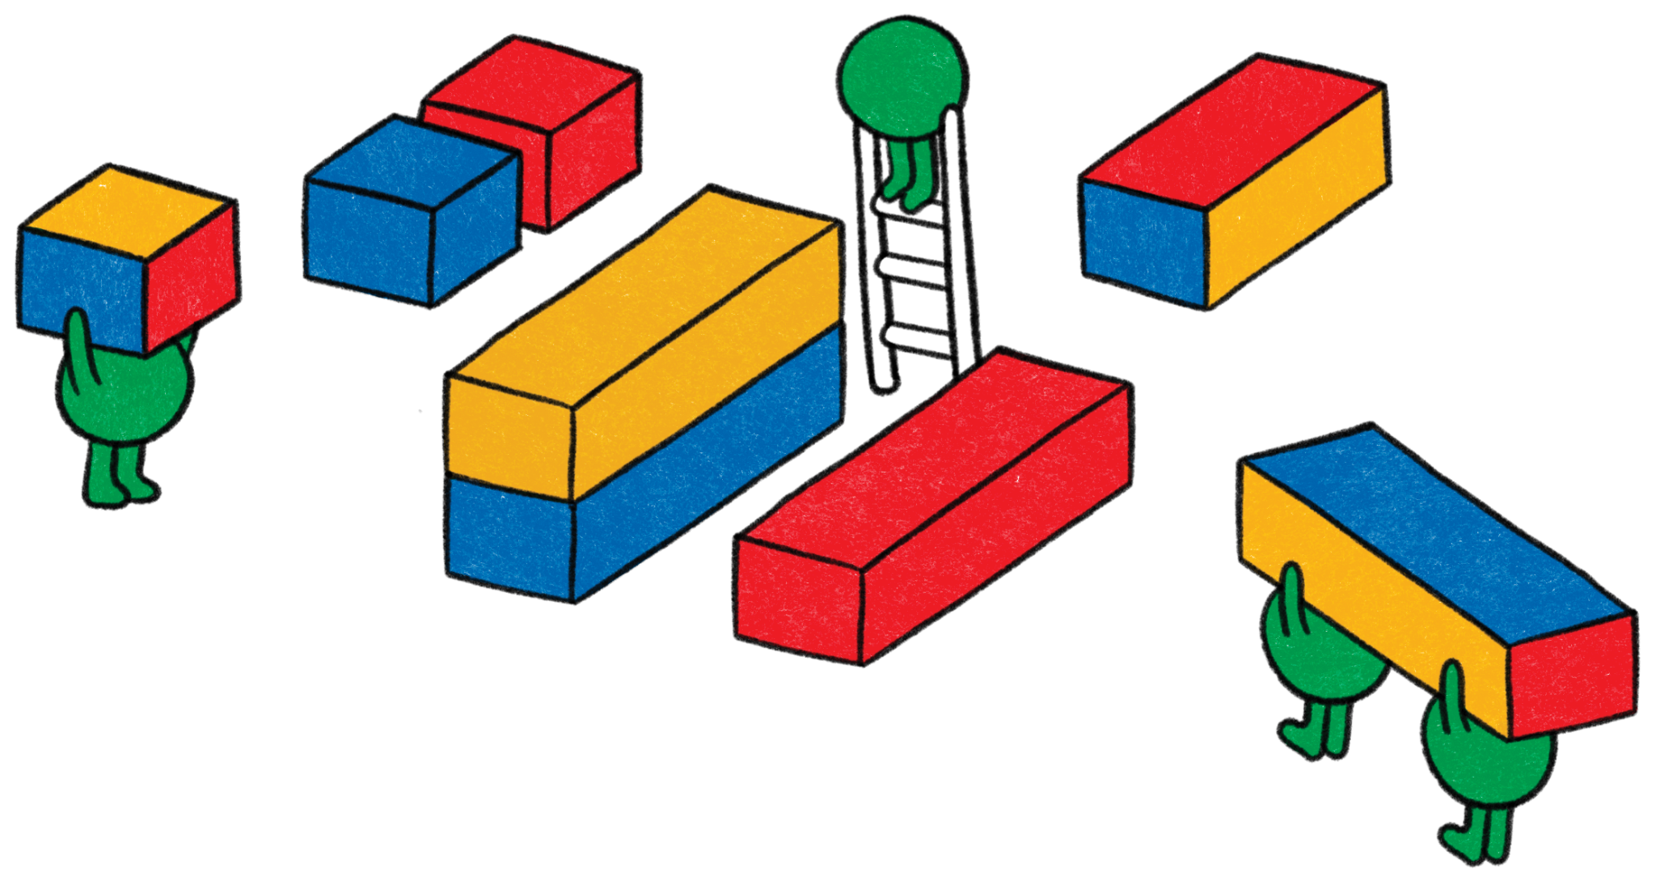
Thank You!
1
Your name here
Your Title
Some contact information
2
Your name here
Your Title
Some contact information

