Slide 1
Welcome!
1
Editing Slides
Before your workshop, review each slide and the accompanying speaker notes. Make any necessary edits to best meet the needs of your parent community.
2
Speaker Notes
There are two parts to the speaker notes for the slides throughout this slide deck. The first part is key points for you to keep in mind as the speaker. The second part is a suggested script. Not all slides contain a suggested script.
3
Online vs. In-Person Presentations
If presenting in an online format, please modify the slides for a virtual workshop. For example, if the directions suggest participants turn to a partner next to them to share, modify the instructions and put participants into small breakout rooms.
If you prefer working in Google Slides, you can make a copy of the Google Slides to work in here: https://bit.ly/3X6HgS1
4
Hide or delete this slide before your workshop.
Notes:
Note: This slide should not be included in the workshop presentation. Hide or delete this slide before your workshop.

Slide 2
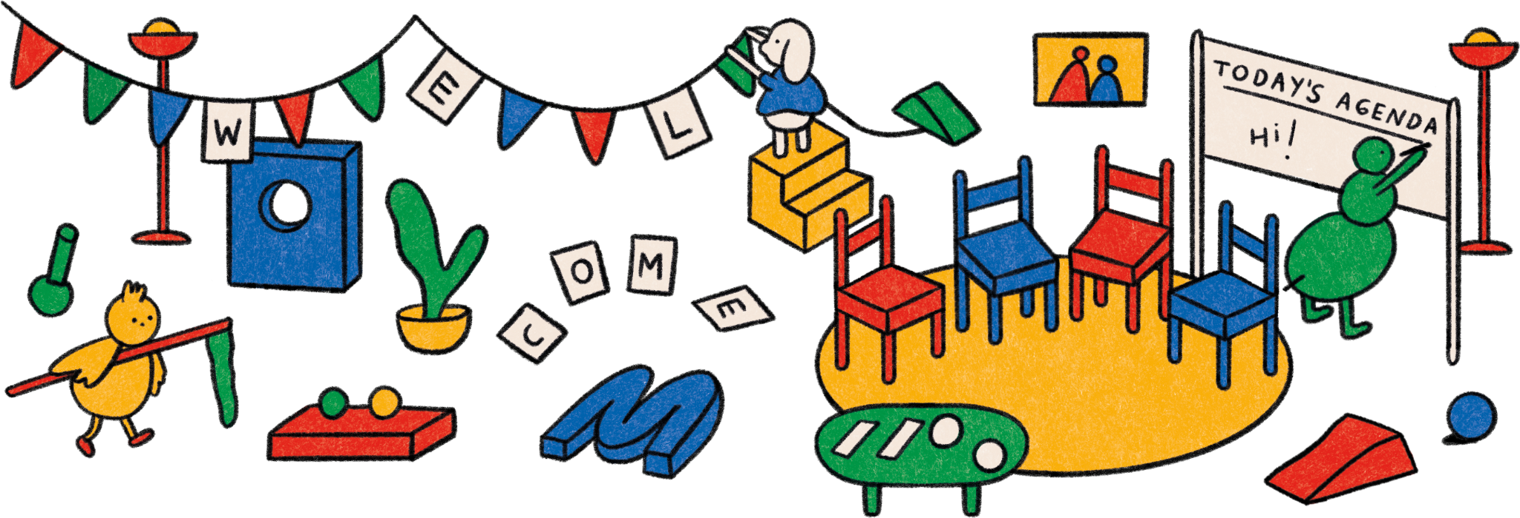

Slide 3
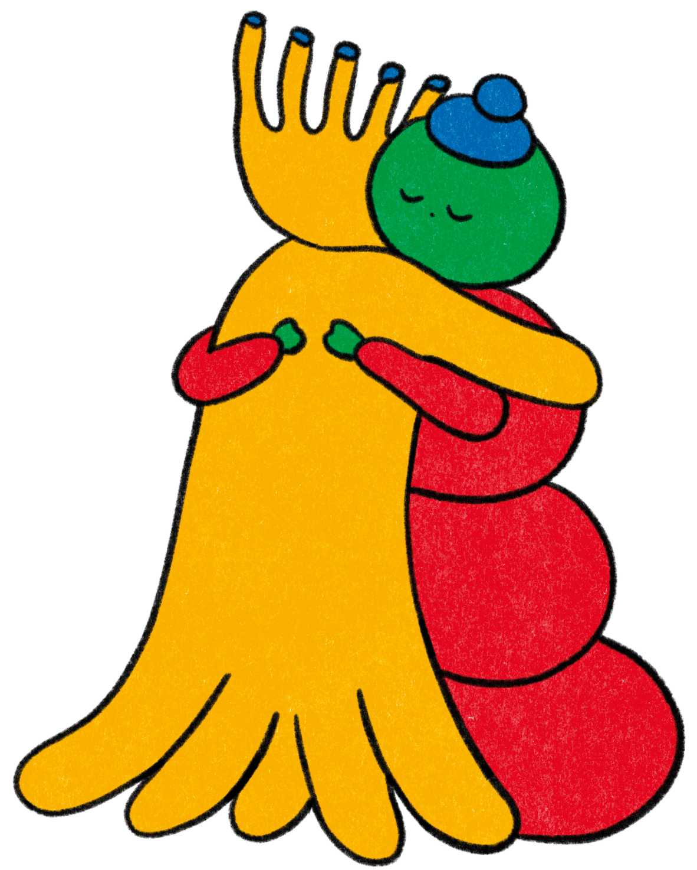
com- pas-
sion

Slide 4
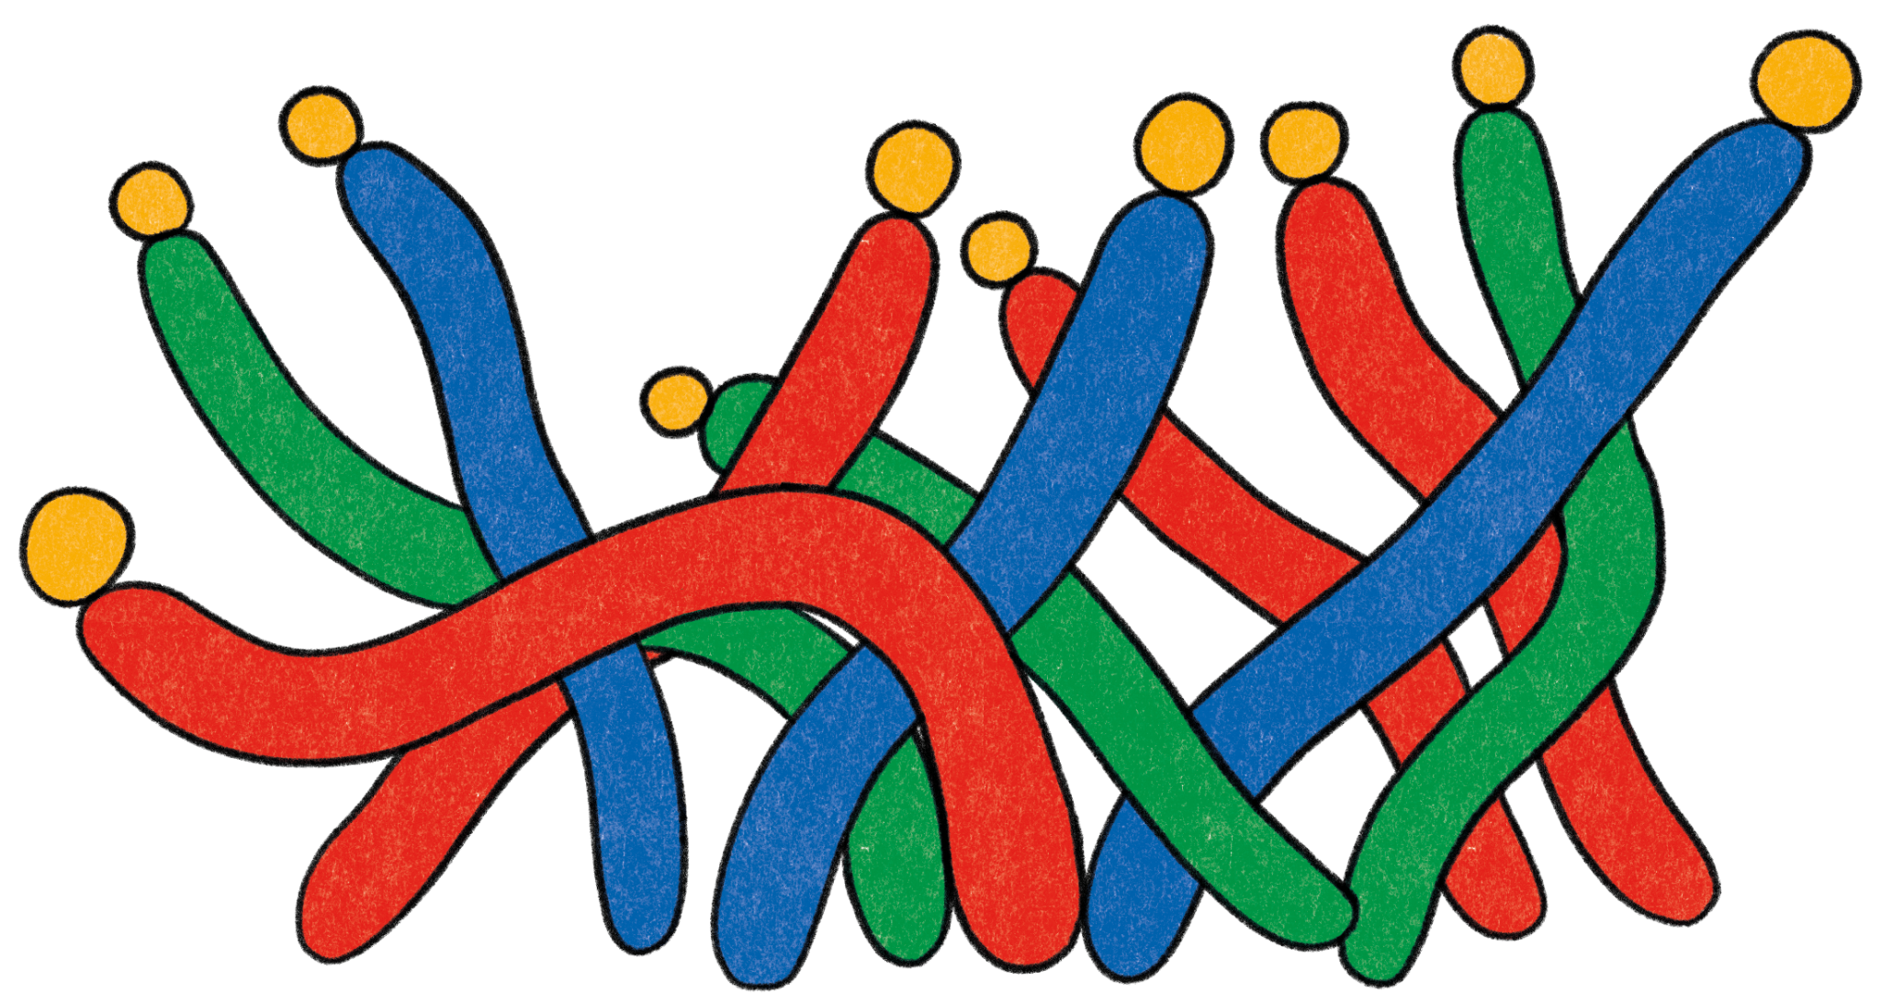
Today’s Workshop Facilitator(s):
1
Your name here
Your Title
Some contact information
2
Your name here
Your Title
Some contact information
Notes:
Key points:
Take a few moments to introduce yourself to your parent community and welcome them to the workshop.
Edit this slide to include a picture of yourself, your name and/or how you prefer to be addressed, your title, and your contact information.

Slide 5
Today’s agenda:
1
4
Welcoming Activity
What is Compassion
Compassion in Parenthood
Compassion in Childhood
Questions?
Closing Activity
2
5
3
6
Notes:
Key points:
Review what you will discuss during today’s workshop with your parent community.
Suggested script:
Over the next hour, we are going to explore the topic of compassion. We will start with a welcoming activity for the whole group, and then we will define compassion. Next, we will discuss what compassion looks like in parenthood and provide you with a practice to nurture compassion and your own well-being. After that, we will discuss compassion in childhood and provide you with a compassion activity to try out with your child. Finally, we’ll have some time for questions and then finish with a closing activity.

Slide 6
Welcome Activity
Ice Breaker
What is the best compliment your child has shared with you?
Notes:
Key points:
Have participants turn to a neighbor next to them and share the best compliment their child has shared with them. If they can’t think of a compliment their child has shared with them, they can share a compliment they would like to share with their child.

Slide 7
What is Compassion?
Notes:
Key points:
Ask your parent community to take 60 seconds and write down what compassion means to them. Participants may write down a definition, a few words that come to mind when thinking about compassion, or even a feeling.
Before moving to the next slide, invite a few participants to share what they wrote down.

Slide 8
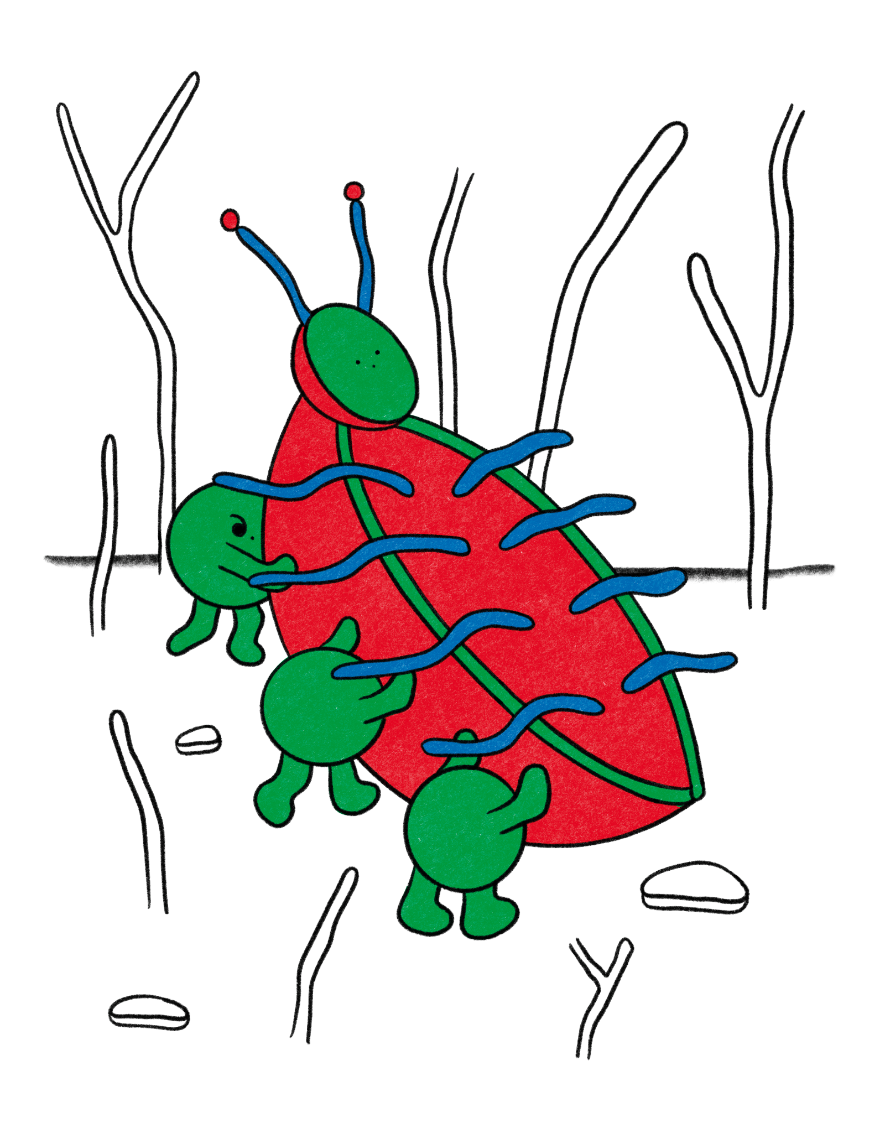
What is Compassion?
Compassion: the feeling that arises when you are confronted with another’s suffering and feel motivated to relieve that suffering
Self-compassion is compassion turned inwards:
1
Self-kindness
2
Recognition of our common humanity
3
Mindfulness
Notes:
Key points:
Define compassion for your parent community.
Be sure to highlight any answers from the previous slide that are reflected in the definition on this slide.
Suggested script:
Thank you for sharing what compassion means to you. For the rest of our time together, we are going to define compassion as the feeling that arises when you are confronted with another’s suffering and feel motivated to relieve that suffering. Self-compassion is compassion turned inwards and entails three components:
Self-kindness: Treating yourself with kindness and understanding
Recognition of our common humanity: Recognizing that everyone struggles sometimes
Mindfulness: Acknowledging your own feelings, rather than ignoring or exaggerating our feelings

Slide 9
What is Compassion?
Feeling Compassion:
1
Slows down our heart rate and increases brain activity
2
Motivates us to seek closeness and extend care to others
3
Is believed to have evolved from the unique reliance of babies on adults to survive
Notes:
Key points:
Explain why compassion is important, relevant, and beneficial to your parent community. Be sure to highlight:
When we feel compassion, our heart rate slows down, we secrete oxytocin (the “bonding hormone”), and activities in our brain related to empathy, caregiving, and feelings of pleasure increases
Feeling compassion motivates us to seek closeness and extend care to others
Many scientists believe we evolved to have compassion ingrained in our biology because human babies are vulnerable and rely on care from adults to survive
Suggested script:
Now, why is compassion so important? Why are we all here today? In short, compassion is deeply rooted in our bodies. Research shows that when we feel compassion, the effects are seen throughout our bodies. Our heart rate slows down, we secrete oxytocin (or the “bonding hormone”), and activity in the brain directly connected to empathy, caregiving, and feelings of pleasure increase, which encourages us to continue to seek closeness and extend care to others. Many scientists believe that, because babies are so uniquely vulnerable and rely on care from adults to survive, we have evolved to have compassion deeply rooted in our bodies.

Slide 10
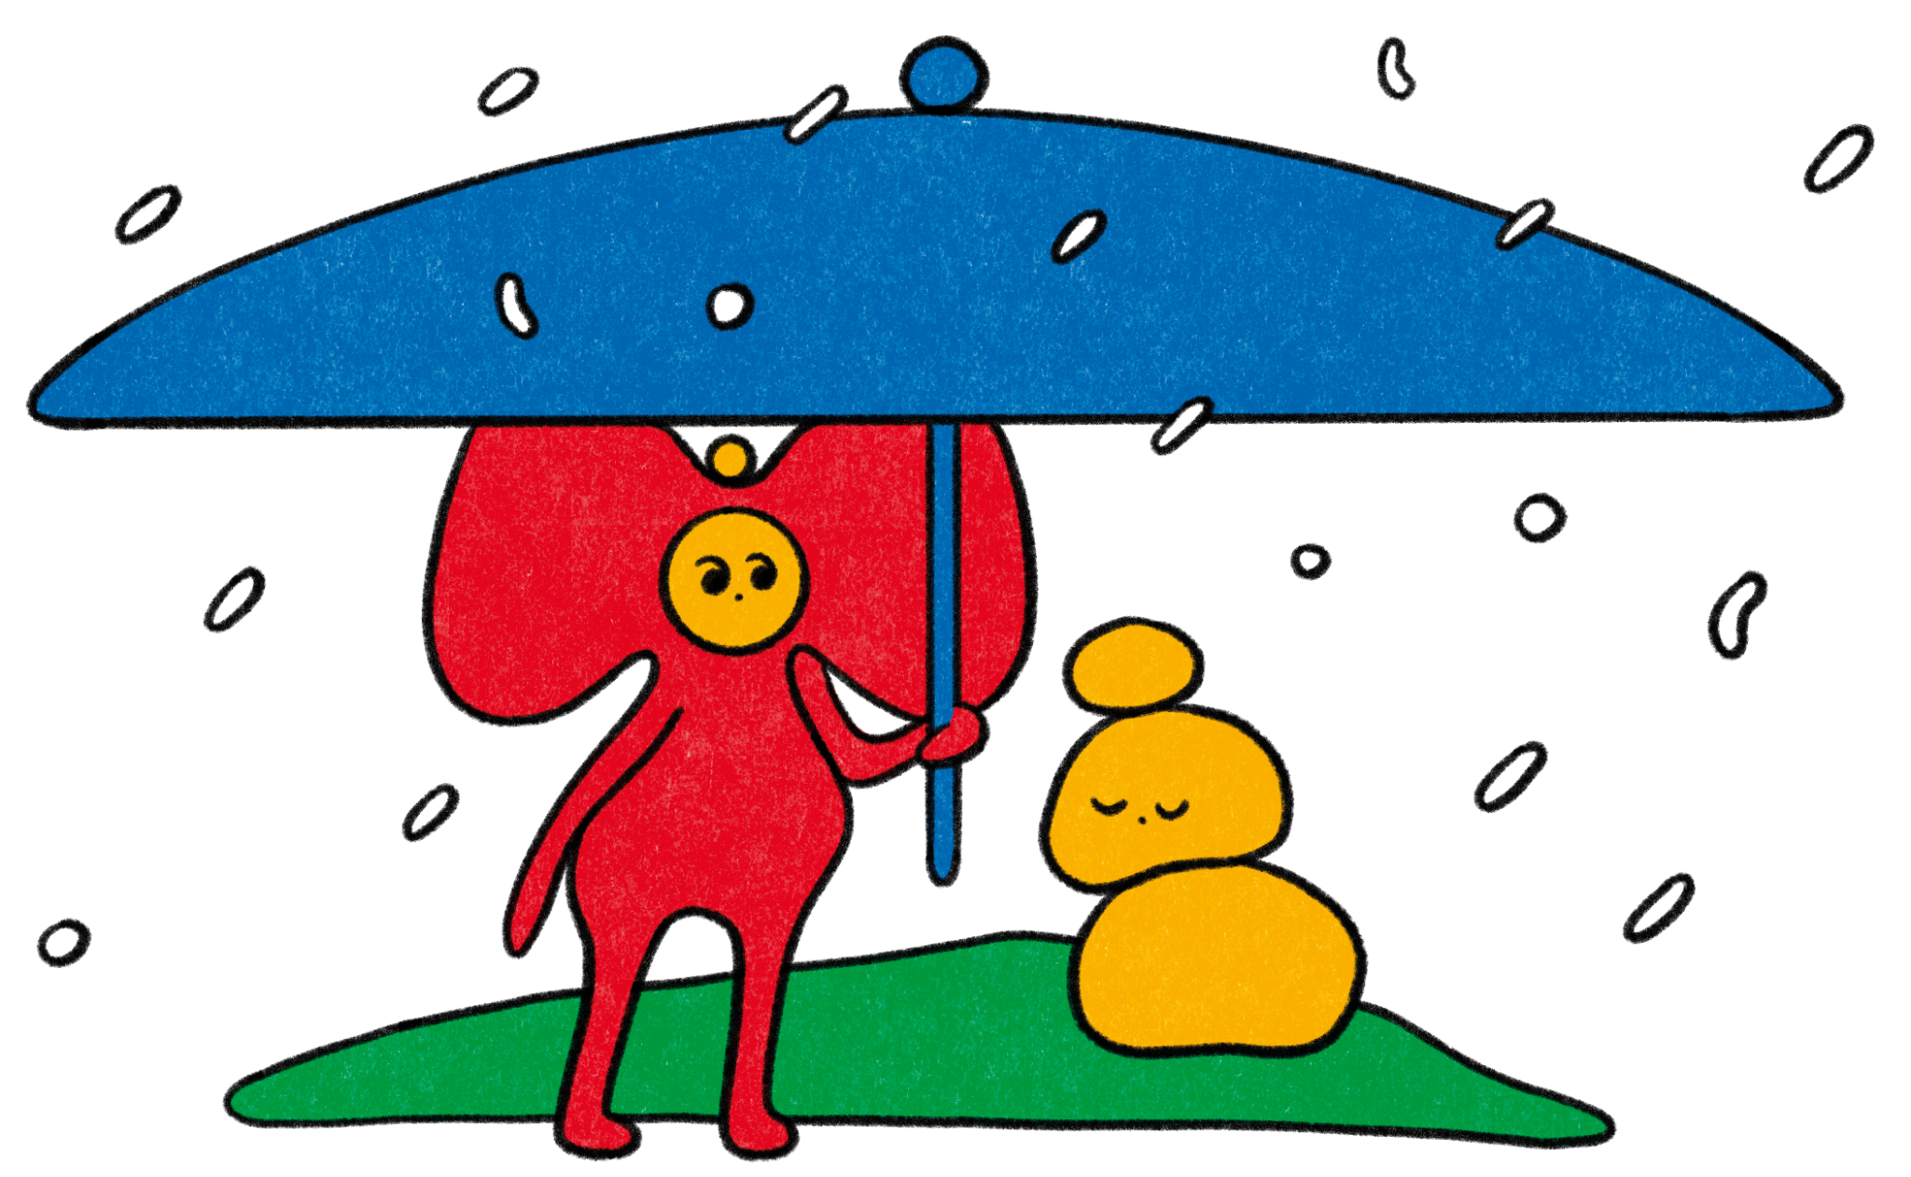
Compassion in Parenthood

Slide 11
Compassion in Parenthood
Can act as a buffer to decrease fight-or-flight stress responses
Helps parents build their emotional reserves
Benefits children when parents model self-compassion
Notes:
Key points:
Explain why fostering compassion is important for parents and caregivers. Be sure to include:
Compassion can act as a buffer that decreases fight-or-flight stress responses during challenging parenting moments
Fostering self-compassion helps parents build their emotional reserves
Modelling self-compassion benefits children, since children imitate our example
It takes practice to develop self-compassion, but parents and children can practice it together
Suggested script:
Now, why is practicing compassion important for you as a parent or primary caregiver? Parenting is biologically linked to parenting and has many benefits. Recent studies have shown that when parents show compassionate love for their children, it can help during challenging parenting moments and act as a buffer to decrease fight-or-flight responses.
Fostering compassion and self-compassion also helps parents build their emotional reserves. One study found parents who listened to a loving-kindness meditation were calmer, more sympathetic, and less angry and frustrated when asked about their emotional response to common parenting scenarios. And since children imitate our examples, treating yourself with self-compassion can help teach them to do the same. While it takes practice to foster compassion, you can practice with your child, too. Research has found that when parents and children practice self-compassion and mindfulness skills together, parenting stress and depression in children decrease and increase mindful parenting and self-compassion.

Slide 12
Nurturing
Compassion
Visualize someone important to you when you need support
See people as individuals
Respect your inner changemaker
Don’t be a sponge
Take routine self-compassion breaks
Look for commonalities
Don’t play the blame game
Notes:
Key points:
Share practical tips on nurturing Compassion in our own lives. Be sure to include the following tips:
Respect your inner changemaker
Don’t play the blame game
Look for commonalities
Don’t be a sponge
See people as individuals
Take routine self-compassion breaks
Visualize someone important to you when you need support
Suggested script:
We now understand why fostering compassion for parents and caregivers is important, but you may be wondering, “Now what? How do we foster compassion?” We have a few tips on nurturing compassion in our own lives with our own communities.
Respect your inner changemaker: We’re less likely to curb our compassion when we think we’re capable of making a difference.
Don’t play the blame game: We feel less compassion for others when we blame them for their own misfortune.
Look for commonalities: Seeing yourself as similar to others increases feelings of compassion.
Don’t be a sponge: Try to be receptive to other people’s feelings without adopting those feelings as your own.
See people as individuals (not abstractions): One study found people were more likely to give money to an anti-hunger charity after reading about a starving girl than after reading statistics on starvation.
Take routine self-compassion breaks: Take breaks and acknowledge your moments of suffering, acknowledge other parents have felt this way, too, and then offer yourself kindness.
Visualize the presence of someone important to you when you need support: One study found this practice makes it easier to show yourself self-compassion

Slide 13
Practicing Compassion in Parenthood:
Feeling Supported
Why Try It?
Recalling how others have comforted us can:
1
Can make us more trusting and compassionate
2
Remind us of how we want to support others
3
Helps us direct our energy toward caring for others
Notes:
Key points:
Explain how Feeling Supported is a useful practice and why they should try it. Be sure to include:
Research suggests that increasing momentary feelings of comfort by thinking about supportive relationships can make us more trusting, compassionate, and helpful toward others
Reflecting on the people in our life who love and support us can increase our feelings of security and remind us of the qualities we want to embody when supporting others
When we feel safe and secure, our energy can be more easily directed toward caring for others
Remind participants where they can find this activity on their workshop handout.
Suggested script:
In addition to the previous tips on nurturing compassion, we also have a practice for you to try called Feeling Supported, a practice of recalling how others have comforted us, which can foster compassion.
Research suggests that increasing momentary feelings of comfort by thinking about supportive relationships can make us more trusting, compassionate, and helpful toward others. Reflecting on the people in our life who love and support us can increase our feelings of security, as well, and remind us of the qualities we want to embody when supporting others. And when we feel safe and secure, our energy can be more easily directed toward caring for others.

Slide 14
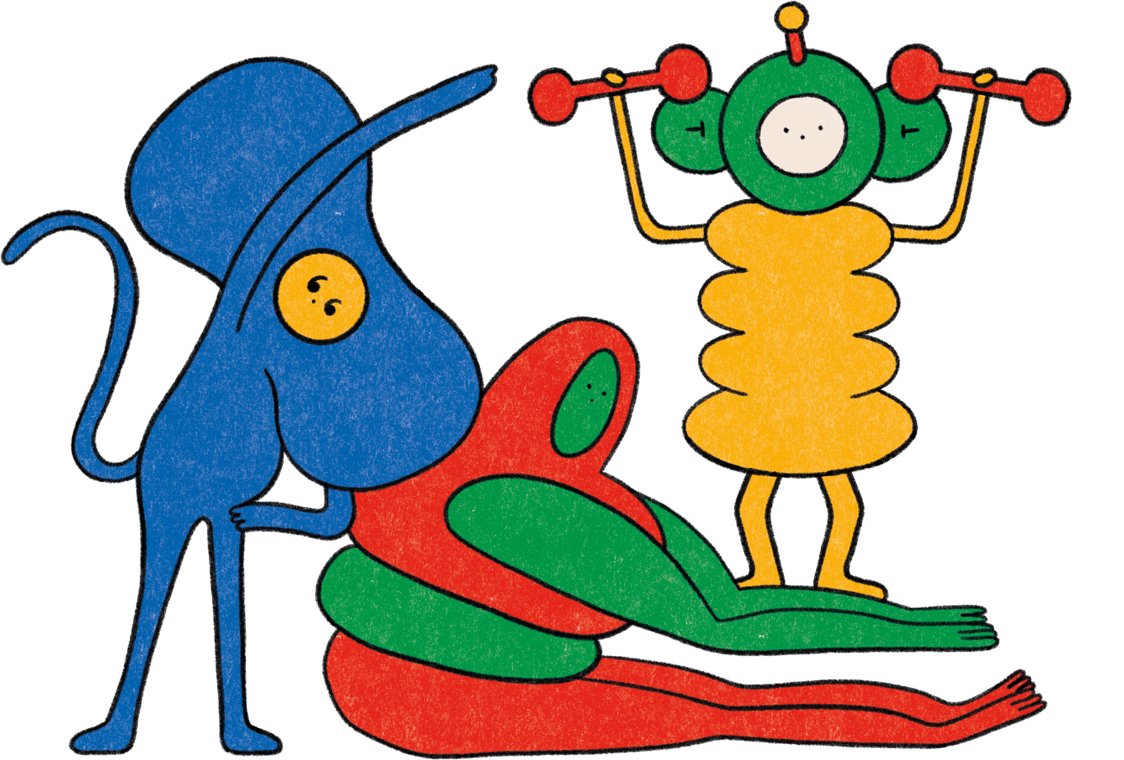
Practicing Compassion in Parenthood:
Feeling Supported
How To Do It:
Make a list of the people who offer you comfort
Write down six positive qualities they demonstrate
Visualize a situation when one of these people helped you
Write a brief description of the situation and how you felt
Notes:
Key points:
Walk participants through Feeling Connected.
During and after the practice, encourage the parents to pause to notice their thoughts, sensations, and feelings.
Remind participants where they can find this activity on their workshop handout.
Suggested script:
Now, take a moment and make list of the people who offer you comfort or security. When making this list, think about who you most like to spend time with, who you find most challenging to be away from, who you want to talk to when you’re worried about something, who you turn to when you’re feeling down, who will always be there for you, and who do you want to share your successes with.
Next, write down six positive qualities that these people strongly demonstrate.
Now, visualize a specific situation when you felt worried or distressed and one of the people from your list comforted and helped you.
Finally, write a brief description of the situation and how you felt.

Slide 15
Reflect - Pair - Share
Notes:
Key points:
Participants will take a few moments to reflect on their experience, share their reflections with a partner, and then share with the group.
Suggested script:
Now that you have tried the Feeling Supported practice, I want to give you all a some time to reflect. First you’re going to take a minute and reflect on your experience trying this practice. Think about how you felt and which parts of this practice felt comfortable. Did any parts feel uncomfortable? Then, you’ll turn to a partner next to you and share your reflections. Finally, we’ll have time for a couple people to share their reflections with the group.

Slide 16
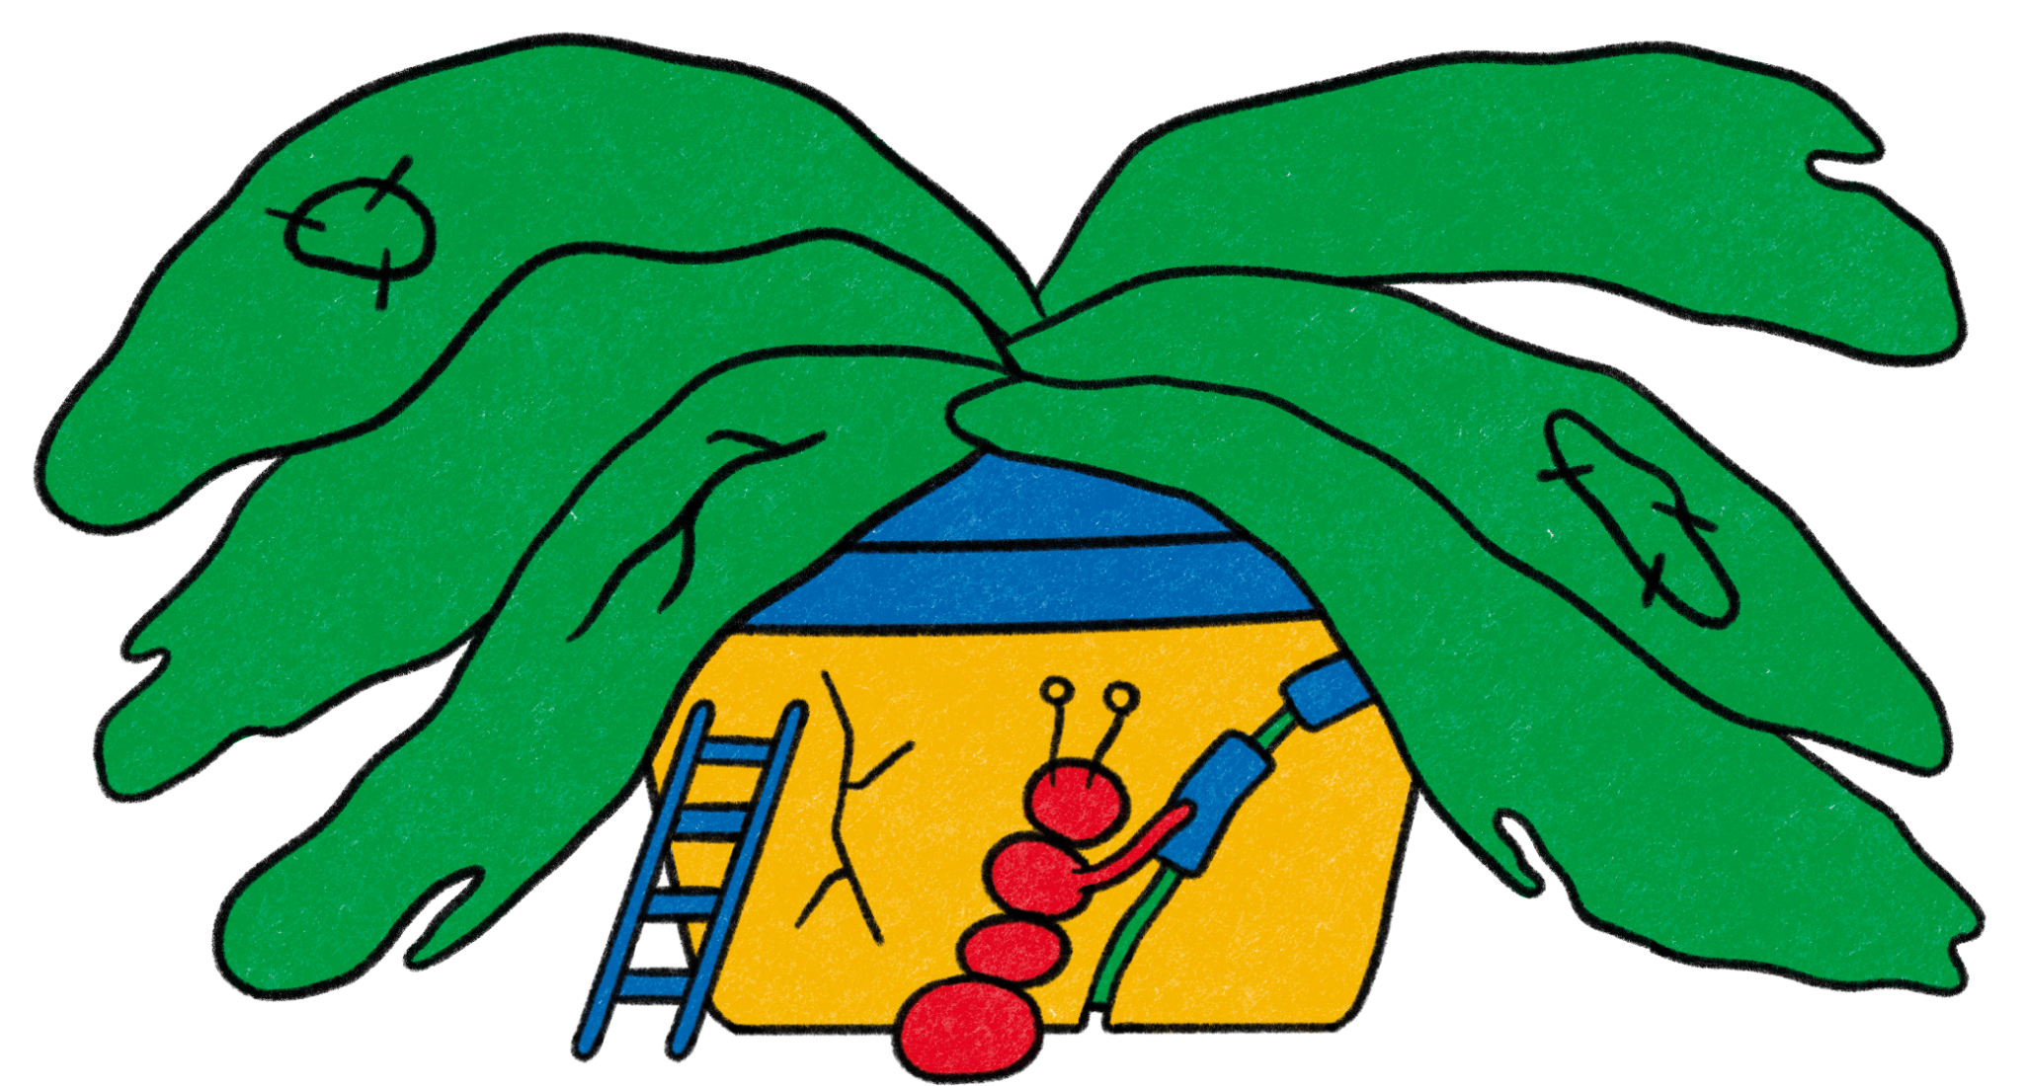
Compassion in Childhood

Slide 17
Compassion in Childhood
Children, even very young ones, show compassion towards others
Parental love and warmth can support children’s compassion
Self-compassion is particularly important for teens
Notes:
Key points:
Explain why fostering compassion is important for children. Be sure to include:
Children, including very young children, show compassion towards others
Parental love and warmth can further support children’s natural sense of compassion
Self-compassion is particularly important for teens
Suggested script:
Thank you all for participating and being open to the last practice. Now let’s explore the importance of compassion in childhood. Studies have shown that children, even very young children, show compassion towards others. As young as 14 months, toddlers will hand an object to someone who is unsuccessfully trying to reach for that object.
A parent’s love and warmth can support children’s natural sense of compassion. Research shows that greater parental warmth is connected to greater empathy, sympathy, and caring in children and that sensitive and responsive parenting supports fostering kindness in our children.
Studies have found that self-compassion is particularly important for teens, as it can help protect them issues they may face like perfectionism, depression, low self-esteem, and climate anxiety.

Slide 18
Practicing Compassion in Childhood:
Loving-Kindness Meditation
Why Try It?
Regularly practicing the Loving-Kindness Meditation can:
1
Foster our inherent kindness
2
Result in more satisfying social interactions and relationships
3
Reduce people’s focus on themselves
Notes:
*Note: there are two activities for practicing compassion in childhood. This slide is for Loving Kindness Meditation. Please choose the appropriate one to share with your parent community and hide the slides for the other activity.
Key points:
Explain how Loving Kindness Meditation is a useful practice and why they should try it. Be sure to share:
Practicing the Loving-Kindness Meditation is a great way to foster our inherent kindness, which can lead to higher satisfaction in our relationship and in our lives in general
Research suggests that when people practice the Loving-Kindness Meditation regularly, they start reacting more positively to others and their social interactions and relationships become more satisfying
Practicing this meditation regularly can also reduce people’s focus on themselves, which can lower symptoms of anxiety and depression
This practice is intended for middle childhood and teens.
Remind participants where they can find this activity on their workshop handout.
Suggested script:
And, once again, the question is how - how can we foster compassion in childhood? Loving-Kindness Meditation is a great practice to help children strengthen feelings of kindness and connection towards others.
Regularly practicing the Loving-Kindness Meditation is a great way to foster our inherent kindness, and research suggests that kind people tend to be more satisfied with their social interactions, relationships, and their lives in general. In addition, practicing the Loving-Kindness Meditation can reduce people’s focus on themselves, which can lower symptoms of anxiety and depression

Slide 19
Practicing Compassion in Childhood:
Loving-Kindness Meditation
How To Do It:
Find a comfortable position
Notice your breath
Receive loving kindness
Notice lingering positive emotions
Send loving kindness
Notice lingering positive emotions
Closing
Notes:
*Note: there are two activities for practicing compassion in childhood. This slide is for Loving Kindness Meditation. Please choose the appropriate one to share with your parent community and hide the slides for the other activity.
Key points:
Walk participants through Loving Kindness Meditation.
During and after the practice, encourage the parents to pause to notice their thoughts, sensations, and feelings.
Remind participants where they can find this activity on their workshop handout.
Suggested script:
You can find this practice and the corresponding script in your workshop handout, but we’ll go through it together now. To get started, you will ask your child to find a comfortable reclined or seated position. Once they are in their comfortable position, you will ask them to focus on their breath as their belly rises and falls as they inhale and exhale. They will continue this for 30 seconds.
After 30 seconds, you will ask them to receive loving kindness by focusing on someone they genuinely believe cares deeply for them. As they breath, as them to inhale this positive energy. They will continue this for 15 seconds.
Next, as they let go of this person, have your child notice any lingering positive emotions in the body. They will continue this for 15 seconds.

Slide 20
Practicing Compassion in Childhood:
Pleasant Events Calendar for Kids
Why Try It?
This practice can:
1
Can reduce stress and increase feelings of curiosity and gratitude
2
Encourage children to be proactive about making time for themselves
3
Allow children to feel more open to receiving and offering care
Notes:
*Note: there are two activities for practicing compassion in childhood. This slide is for Pleasant Events Calendar for Kids. Please choose the appropriate one to share with your parent community and hide the slides for the other activity.
Key points:
Explain how Pleasant Events Calendar for Kids is a useful practice and why they should try it. Be sure to share:
Children can also experience stress that feels overwhelming at times, but research shows that taking care of and being kind to themselves can help adolescents reduce stress and increase feelings of curiosity and gratitude
This practice encourages children to be proactive about creating space for themselves, so they can look forward to things that make them happy
Being self-compassionate may allow children to be more open to receiving and offering care
This practice is intended for middle childhood and teens.
Remind participants where they can find this activity on their workshop handout.
Suggested script:
And, once again, the question is how - how can we foster compassion in childhood? Pleasant Events Calendar for Kids is a great practice to help children cultivate self-compassion by planning enjoyable activities.
Just like adults, children can also feel stress that feels overwhelming, but research shows that taking care of and being kind to themselves can help them reduce stress and increase feelings of curiosity and gratitude. By planning ahead, this practice encourages children to be proactive about making time for themselves, so they can look forward to things that make them happy. This build self-compassion, which can also allow children to be more open to receiving and offering care.

Slide 21
Practicing Compassion in Childhood
Pleasant Events Calendar for Kids
How To Do It:
Reflect
Schedule
Track
Notes:
*Note: there are two activities for practicing compassion in childhood. This slide is for Pleasant Events Calendar for Kids. Please choose the appropriate one to share with your parent community and hide the slides for the other activity.
Key points:
Walk participants through Pleasant Events Calendar for Kids.
Remind participants where they can find this activity on their workshop handout.
Suggested script:
To foster self-compassion in your child, you’ll work with them to carve out time to explore their passions and do things that bring them joy.
To get started, you will encourage your kid to reflect and write down a list of activities they enjoy. Next you will help them find time slots on the calendar when they can schedule one or two activities. Finally, you’ll place the calendar in a visible location and help them track the activities by adding a sticker or a checkmark when they are completed.

Slide 22
Reflect - Pair - Share
Notes:
Key points:
Participants will take a few moments to reflect on their experience, share their reflections with a partner, and then share with the group.
Suggested script:
Now we’ll take a few minutes to reflect on this practice. First, I’ll give you a minute to reflect on how you might introduce this activity to your child. What do you think would work well for you? Are you anxious about any pieces of this practice? Then, you’ll turn to a partner next to you and share your reflections. Finally, we’ll have time for a couple people to share their reflections with the group.

Slide 23
Questions
Notes:
(This is an optional slide, please remove it if you aren’t interested in a question period)
Key points:
Take questions from the parent community.

Slide 24
Closing Activity
What is one word that describes your learnings from today’s workshop?
Notes:
Key points:
Go around the room and invite each parent community member to share one word that describes their learnings from today or how they’re feeling after today’s workshop.

Slide 25
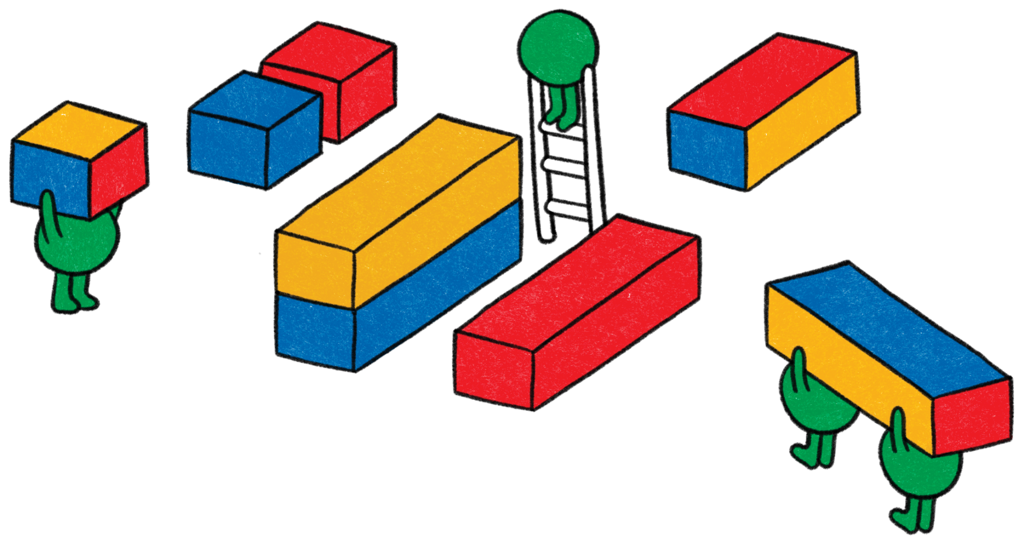
Thank You!
1
Your name here
Your Title
Some contact information
2
Your name here
Your Title
Some contact information

