Slide 1
Welcome!
SOCIAL CONNECTION
1
Editing Slides
Before your workshop, review each slide and the accompanying speaker notes. Make any necessary edits to best meet the needs of your parent community.
A few notes on how to use this slide deck
2
Speaker Notes
There are two parts to the speaker notes for the slides throughout this slide deck. The first part is key points for you to keep in mind as the speaker. The second part is a suggested script. Not all slides contain a suggested script.
If you prefer working in Google Slides, you can make a copy of the Google Slides to work in here: https://bit.ly/3AySB5Q
3
Online vs. In-Person Presentations
If presenting in an online format, please modify the slides for a virtual workshop. For example, if the directions suggest participants turn to a partner next to them to share, modify the instructions and put participants into small breakout rooms.
4
Hide or delete this slide before your workshop.
Notes:
Note: This slide should not be included in the workshop presentation. Hide or delete this slide before your workshop.

Slide 2
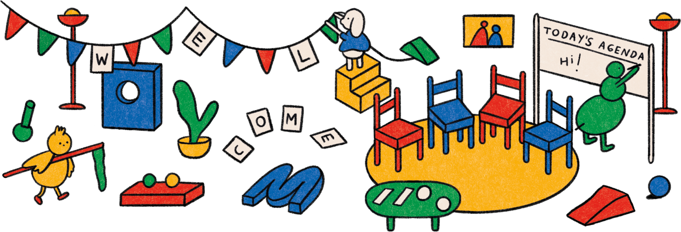
SOCIAL CONNECTION

Slide 3
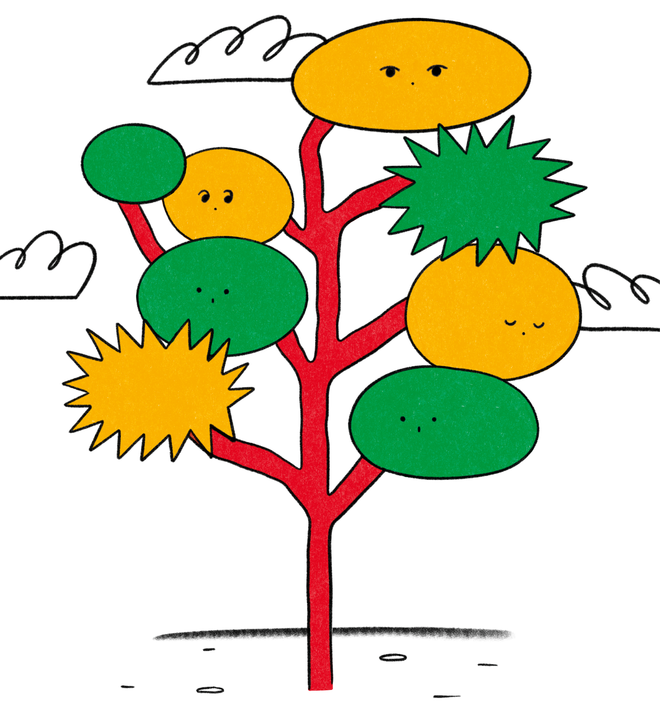
socialcon nec-
SOCIAL CONNECTION
tion

Slide 4
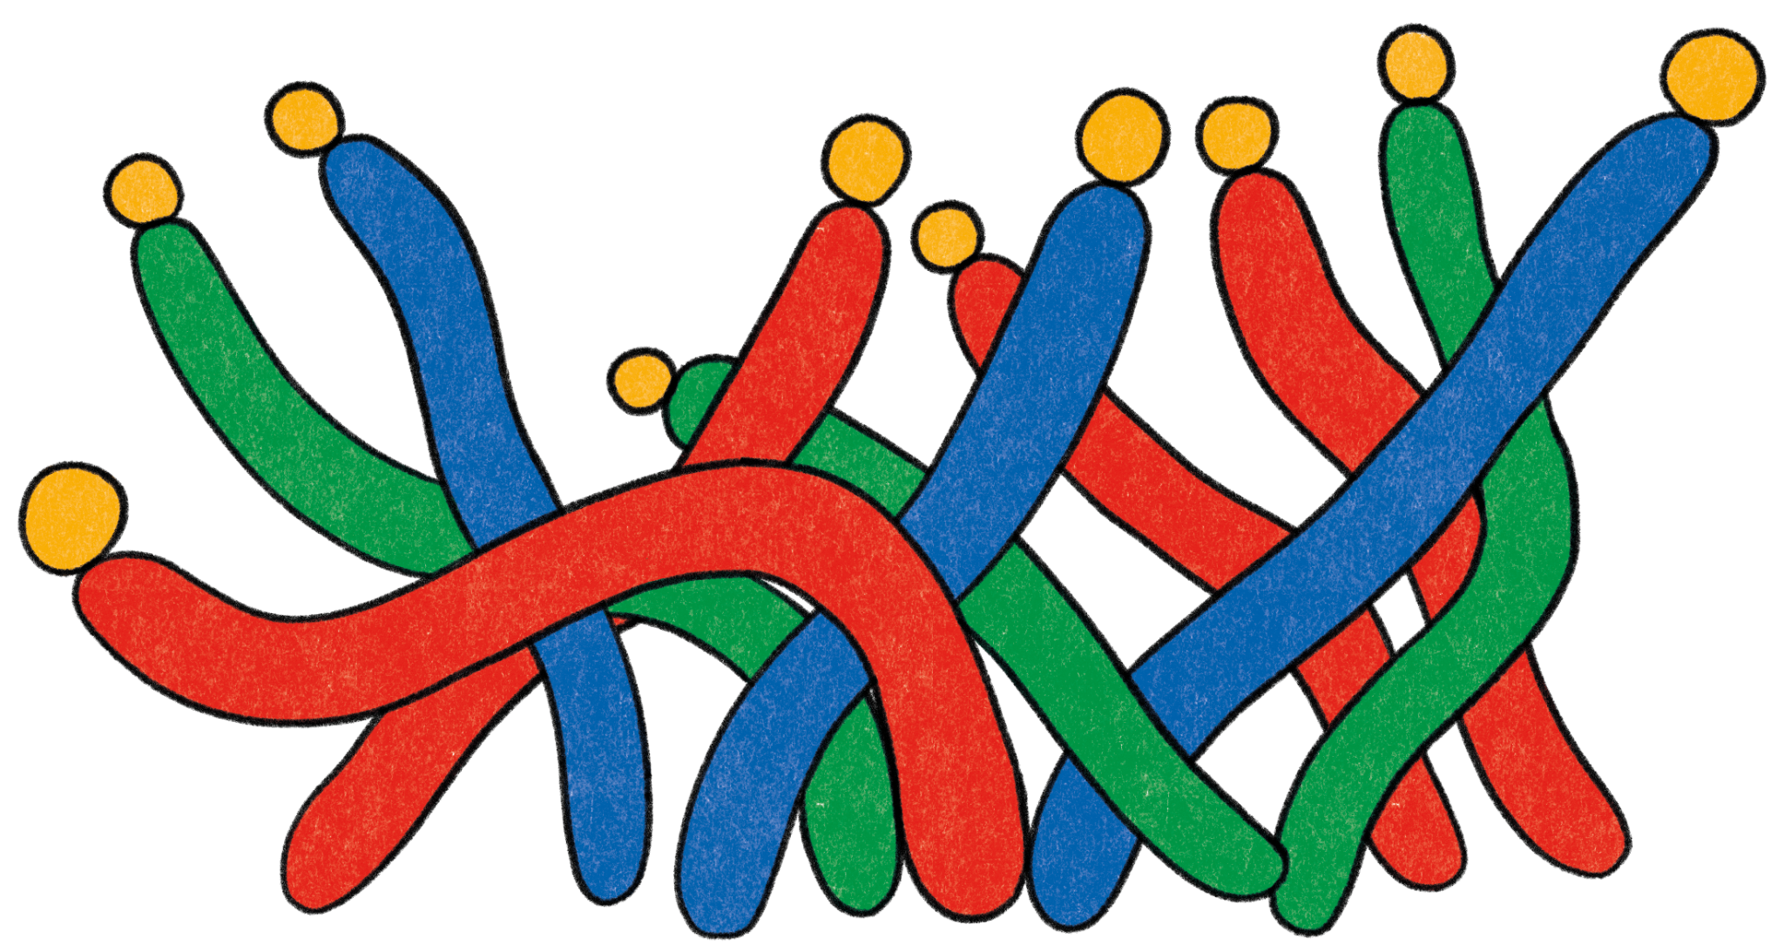
Today’s Workshop Facilitator(s):
SOCIAL CONNECTION
1
Your name here
Your Title
Some contact information
2
Your name here
Your Title
Some contact information
Notes:
Key points:
Take a few moments to introduce yourself to your parent community and welcome them to the workshop.
Edit this slide to include a picture of yourself, your name and/or how you prefer to be addressed, your title, and your contact information.

Slide 5
Today’s agenda:
SOCIAL CONNECTION
1
4
Welcoming Activity
What is Social Connection?
Social Connection in Parenthood
Social Connection in Childhood
Questions?
Closing Activity
2
5
3
6
Notes:
Key points:
Review what you will discuss during today’s workshop with your parent community.
Suggested script:
Over the next hour, we are going to explore the topic of Social Connection. We will start with a welcoming activity for the whole group, and then we will define social connection. Next, we will discuss what social connection looks like in parenthood and provide you with a practice to nurture social connection and your own well-being. After that, we will discuss social connection in childhood and provide you with a social connection activity to try out with your child. Finally, we’ll have some time for questions and then finish with a closing activity.

Slide 6
Welcome Activity
SOCIAL CONNECTION
Ice Breaker
What is the best piece of parenting advice you've ever received?
Notes:
Key points:
Ask your parent community to turn to a neighbor and share the best piece of parenting advice they’ve ever received. If they can’t think of a piece of advice they’ve received, they can share advice they’d want to give a friend.

Slide 7
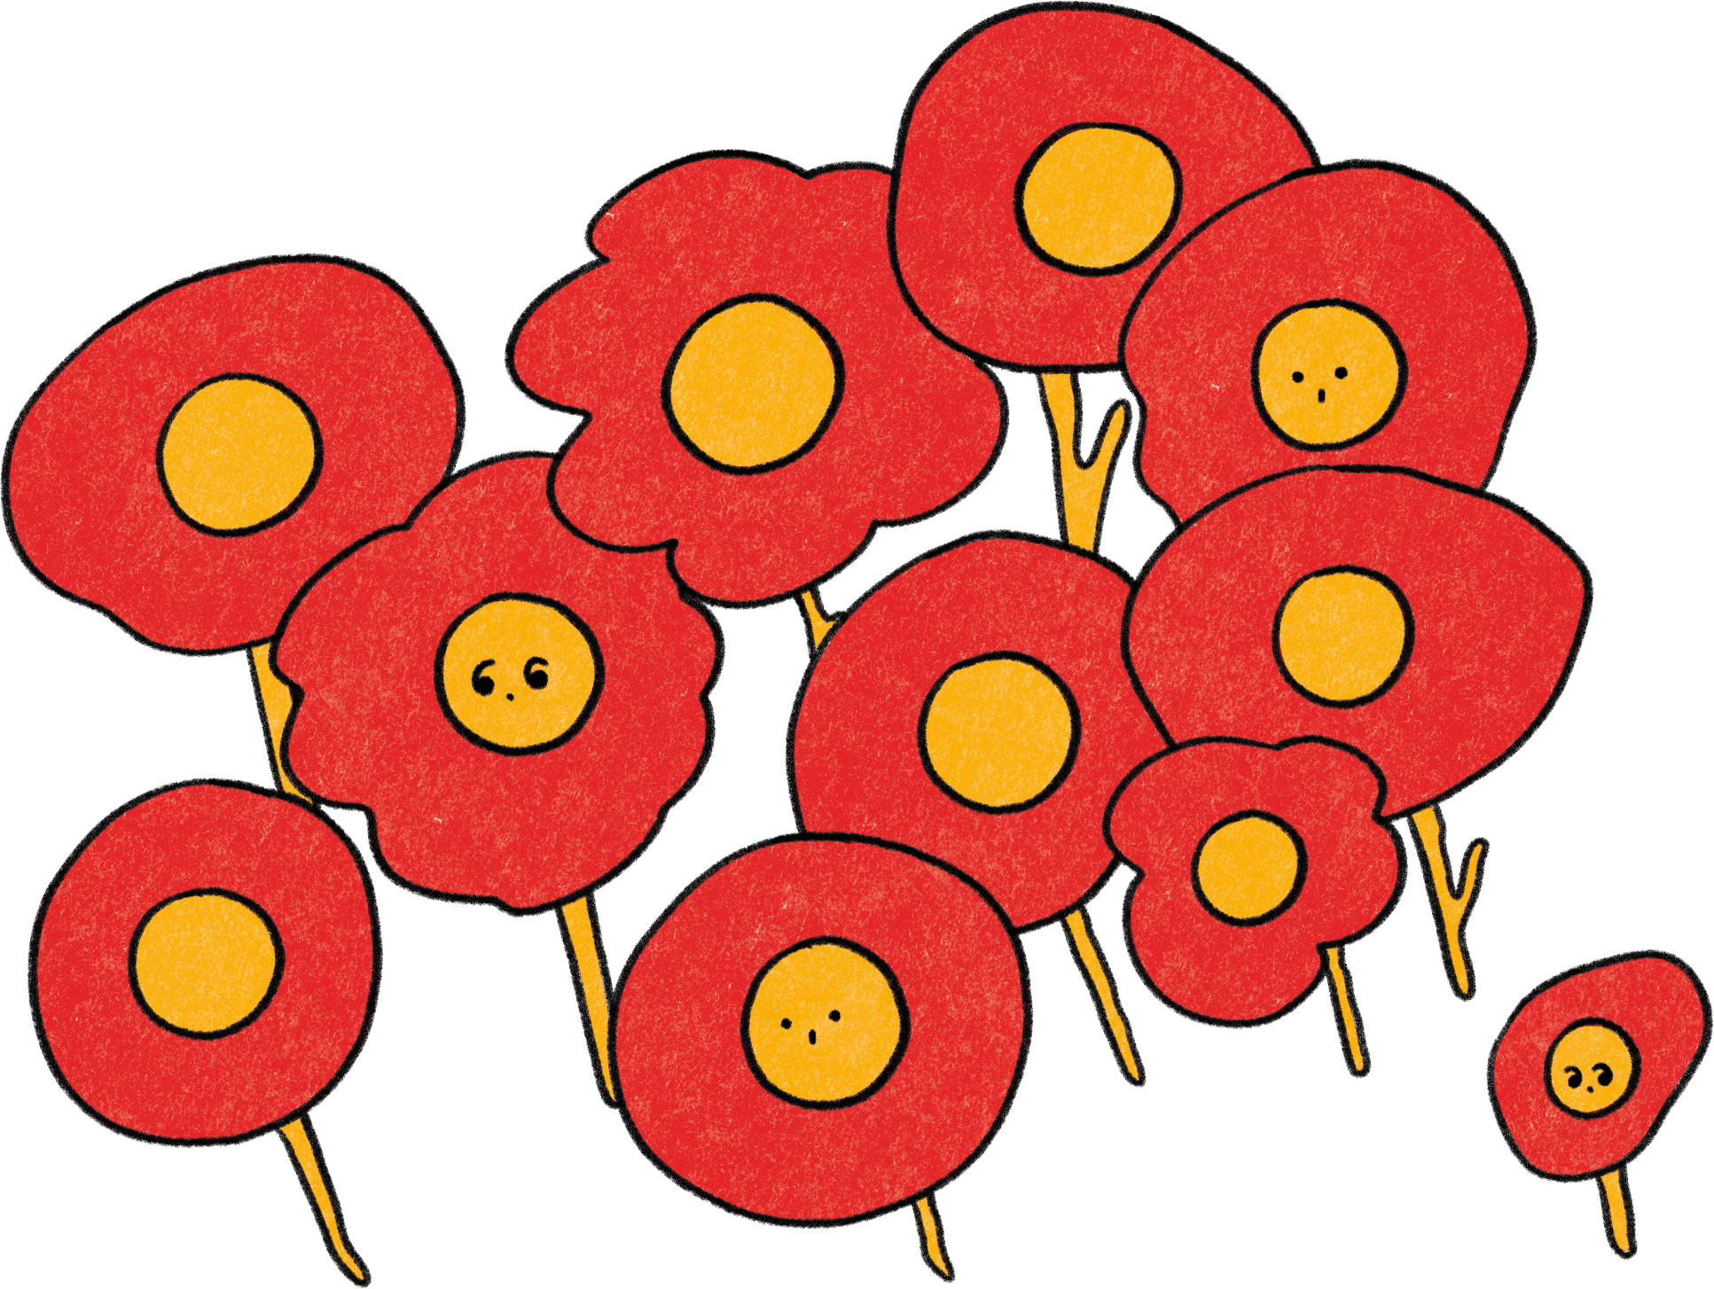
What is Social Connection?
SOCIAL CONNECTION
Our feelings of closeness to others and our sense of belonging
Social connection is measured in three ways:
1
2
3
Structure
Function
Quality
Notes:
Key points:
Ask your parent community to take 60 seconds and write down what Social Connection means to them. Participants may write down a definition, a few words that come to mind when thinking about Social Connection, or even a feeling.
Before moving to the next slide, invite a few participants to share what they wrote down.

Slide 8
What is Social Connection?
SOCIAL CONNECTION
Strong social connections provide:
1
Nurturance and protection from harm
2
Longer life expectancy
3
Protection against general health problems and mental distress following childhood adversity
Notes:
Key points:
Explain why Social Connection is important, relevant, and beneficial to your parent community. Be sure to highlight:
Being connected and belonging to a group provides nurturance and protection from harm.
Decades of research shows people with stronger social connections tend to live longer compared to those with weaker social connections.
Strong connections to caregivers who provided safety, stability, and nurturance early on in life is a protective factor against general health problems and mental distress following childhood adversity like a household challenge.
Suggested script:
Now, why is Social Connection so important? Why are we all here today? In short, humans are social, and being connected and belonging to a group provides benefits like care, attention, and protection.
As a parent or primary caregiver, you are usually the social connections for babies and young children. As they age, children will, ideally, make connections with children their age and other people outside of you and the immediate family, and later have strong connections as adults.
Decades of research shows that people with stronger social connections usually live longer than those with weaker connections. Additional research shows that strong connections to a caregiver early in life can help protect against health problems later and against mental distress following childhood adversity. Ultimately, our social connections open up more possibilities.
As you can see, not only is it important for children to have strong social connections, but for all of us to develop them, too.

Slide 9
Social Connection in Parenthood
SOCIAL CONNECTION

Slide 10
Social Connection in Parenthood
SOCIAL CONNECTION
About one-third of parents today feel chronically lonely
Strong social connection can nurture a parent’s well-being
This leads to greater emotional well-being for both parents and children
Notes:
Key points:
Explain why fostering Social Connection is important for parents and caregivers. Be sure to include:
About one-third of parents feel chronically lonely, which can be detrimental to both our well-being and the well-being of our children.
Strong social connection can nurture a parent’s well-being and protect those who had difficult childhoods.
Research shows that unconditional acceptance, reliable comfort, authenticity in relationships, and friendship satisfaction allow moms to feel more satisfied with daily life.
Social support for parents leads to greater emotional well-being and resilience in both parents and children.
Suggested script:
For you as a parent or primary caregiver, it’s important to understand the role Social Connection plays in parenthood. As we just discussed, having strong social connections is beneficial to our health and wellbeing and allows us to flourish. But, as found in a 2021 article, about one-third of parents feel chronically lonely, which can ultimately affect both us and our children, and, according to a 2023 article, parents of neurodivergent children often feel even more socially isolated.
Research shows, however, that strong social connection can be a transformative way to nurture your well-being. Among dads who faced childhood adversity, those with higher social support have lower cortisol—a hormone that is secreted in the body as a response to stress—than those with lower social support. They have about the same cortisol level as those without difficult childhoods.
We also know from a 2015 study on mothers what helps parents build stronger social connections overall. In this study, researchers found that four personal supports were essential for moms:
Unconditional acceptance: Do you feel seen and loved for the person that you are?
Reliable comfort: When deeply distressed, do you feel comforted in the ways you need?
Authenticity in relationships: How much of the “self” do you show to others—is your “outer self” very much the same as your “inner self”?
Friendship satisfaction:How satisfied do you feel about the frequency of visiting with your friends?
When these supports are provided for mothers - and we can take these learnings to apply to parents and caregivers in general - they feel more like they belong in the community, and they feel more satisfied with their daily lives.
The same way weaker social connections for parents and caregivers can affect both parents and children, stronger social support for parents leads to greater emotional well-being and resilience in both parents and children.

Slide 11
Nurturing
Social Connection
SOCIAL CONNECTION
Being vulnerable
Finding ways to be generous
Showing love
Take action
Notes:
Key points:
Share practical tips on nurturing social connection in our own lives. Be sure to include the following tips:
Take action.
Be vulnerable.
Find ways to be generous.
Show love.
Suggested script:
We now understand why fostering Social Connection for parents and caregivers is important, but you may be wondering, “Now what? How do we foster social connection?” Well, you already took the first step by showing up here today. And, next, we have a few tips on nurturing social connection in our own lives with our own communities.
In Marisa Franco’s 2022 book, Platonic: How the Science of Attachment Can Help You Make—and Keep—Friends, Franco encourages us to:
Take action: Put yourself in an environment where people meet regularly, assume that you’re underestimating how much people like you, open up to people in the group, and invite someone to meet up.
Be vulnerable: Take a chance to share the “truest parts” of yourself. This shows trust and care to someone, inviting them to show you their capacity for love.
Find ways to be generous: Share a meal, offer support to help them with their goals, spend time together, or even take them to a doctor’s appointment.
Show love: Greet a friend with affection, tell them you’re thinking of them, and celebrate their good news.

Slide 12
Practicing Social Connection in Parenthood:
Savoring Moments of Connection with Kids
SOCIAL CONNECTION
Why Try It?
Reflecting on caring memories can:
1
Remind us of our interconnectedness
2
Help us see ourselves as competent
3
Anchor us in times of stress
Notes:
Key points:
Explain why Social Connection is important, relevant, and beneficial to your parent community. Be sure to highlight:
Being connected and belonging to a group provides nurturance and protection from harm.
Decades of research shows people with stronger social connections tend to live longer compared to those with weaker social connections.
Strong connections to caregivers who provided safety, stability, and nurturance early on in life is a protective factor against general health problems and mental distress following childhood adversity like a household challenge.
Suggested script:
Now, why is Social Connection so important? Why are we all here today? In short, humans are social, and being connected and belonging to a group provides benefits like care, attention, and protection.
As a parent or primary caregiver, you are usually the social connections for babies and young children. As they age, children will, ideally, make connections with children their age and other people outside of you and the immediate family, and later have strong connections as adults.
Decades of research shows that people with stronger social connections usually live longer than those with weaker connections. Additional research shows that strong connections to a caregiver early in life can help protect against health problems later and against mental distress following childhood adversity. Ultimately, our social connections open up more possibilities.
As you can see, not only is it important for children to have strong social connections, but for all of us to develop them, too.

Slide 13
Practicing Social Connection in Parenthood:
Savoring Moments of Connection with Kids
SOCIAL CONNECTION
How To Do It:
Focus on a moment when you felt really connected with your child:
Reflect on the sensory details of this memory
Reflect on the emotions of your memory
Reflect on the thoughts and meaning of your memory
Reflect on the significance your memory holds for your future
Notes:
Key points:
Walk participants through Savoring Moments of Connection with Kids.
During and after the practice, encourage the parents to pause to notice their thoughts, sensations, and feelings.
Remind participants where they can find this activity on their workshop handout.
Suggested script:
Now, focus on a moment when you felt really connected with your child. For example, this can be when you felt joy while helping your child grow or when you comforted, supported, soothed, or protected them. Think about this single memory of a positive relationship experience.
Take about a minute for each of the following reflections:
Reflect on the sensory details of your memory, like touch, sight, taste, sound, and smell. What did your child look like? What was the air like?
Reflect on the emotions of your memory. How were you feeling at that time?
Reflect on the thoughts and meaning of your memory. What were you thinking during that time? Did you learn something about yourself?
Reflect on the significance your memory holds for your future. How close did you feel to your child at that time? How will it affect your relationship in the future?
Finally, take about a minute to let your mind wander in any way related to this memory. For example, how is this memory related to other relationships in your life? During this last minute of the practice, write down the memory or any details associated with it for you to come back to in the future.

Slide 14
Reflect - Pair - Share
SOCIAL CONNECTION
Notes:
Key points:
Participants will take a few moments to reflect on their experience, share their reflections with a partner, and then share with the group.
Suggested script:
Now that you have tried practicing social connection in the context of parenthood, I want to give you all some time to reflect. First you’re going to take a minute and reflect on your experience trying this practice. Think about how you felt, what felt useful to you, or maybe what you might do differently the next time you practice this. Then, you’ll turn to a partner next to you and share your reflections. Finally, we’ll have time for a couple people to share their reflections with the group.

Slide 15
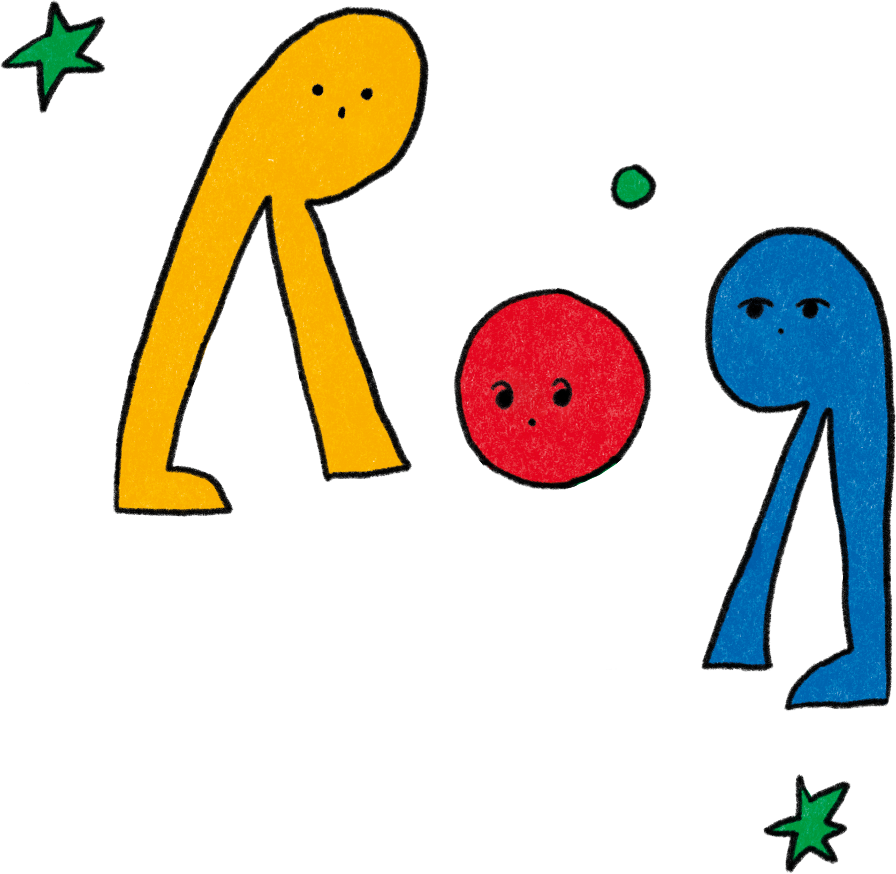
Social Connection in Childhood
SOCIAL CONNECTION

Slide 16
Social Connection in Childhood
SOCIAL CONNECTION
You are an essential social connection for your child
The time you spend with your child develops this loving connection
This secure attachment can set your child up with lasting health benefits
Childhood friendships with peers are also key to their well-being
Notes:
Key points:
Explain why fostering Social Connection is important for children. Be sure to include:
Research on early attachment—the unique, loving bond between children and their caregivers—suggests that a key part of developing secure and loving relationships is spending time with our children to support their needs and emotions.
Securely attached children tend to have higher self-esteem, show better self-control, and perform better in school.
What’s more, secure attachments can set us up with lasting benefits for our health and growth—people who grow up without these loving bonds may experience adverse health impacts such as immune system dysfunction and chronic illness.
Beyond social connections within the family, childhood friendships are essential to well-being.
Suggested script:
Thank you all for participating and being open to the last practice. Now let’s explore the importance of social connection in childhood. As we discussed earlier, the social connections for babies and young children are usually primary caregivers and close family members - you all here in this room today.
Research on our early childhood experiences with social connection shows that an important part of developing secure and loving relationships is spending time with our children to support their needs and emotions and becoming a safe base that children can return to for safety and comfort. Securely attached children tend to have higher self-esteem, show better self-control, and perform better in school. These children tend to be more compassionate, which can support them in building positive relationships with others. In addition, people who did not grow up with these secure social connections may see the effects on their health later in life, such as through chronic illness.
Beyond social connections within the family, childhood friendships are essential to well-being, too. Having just one friend can help children be more invested in their schoolwork, protect them from bullies, and friendships across ethnicities can help kids be more adaptable and socially confident.

Slide 17
Practicing Social Connection in Childhood:
36 Questions to Help Kids Make Friends
SOCIAL CONNECTION
Why Try It?
This activity can:
1
Replicate the journey of friendship with increasingly intimate questions
2
Practice taking turns listening with curiosity as feelings of closeness develop
3
Learn the valuable life skill of fostering connectivity
Notes:
Key points:
Explain how 36 Questions to Help Kids Make Friends is a useful practice and why they should try it. Be sure to share:
Mirroring the emotional journey of friendship, the 36 questions become increasingly intimate.
Taking turns listening with genuine interest and curiosity and the experience of feeling seen and heard allow feelings of closeness to develop.
Knowing how to talk to others in a way that fosters genuine connectivity and paves the way for real friendship—particularly with those different from us—is a valuable life skils.
Remind participants where they can find this activity on their workshop handout.
Suggested script:
And, once again, the question is how - how can we foster social connection in childhood? 36 Questions to Help Kids Make Friends is a great practice to help children build closeness that you can go home and try with your child right away.
This practice consists of 36 questions that become increasingly intimate, requiring partners to reveal more about themselves as they answer questions progressively. As partners take turns and listen to the other with interest and curiosity, the experience of feeling seen and heard allows for feelings of closeness and connection to develop. This practice helps children build closeness with someone, including with a child from a different background. Understanding how to talk to others and foster connectivity is a valuable life skill.

Slide 18
Practicing Social Connection in Parenthood: 36 Questions to Help Kids Make Friends
SOCIAL CONNECTION
How To Do It:
Ask your child which child they would be interested in getting to know better (this could be an existing friend)
Find a time when they can meet up and take turns asking answering the questions
Encourage them to spend the same amount of time listening and talking
Notes:
Key points:
Walk participants through 36 Questions to Help Kids Make Friends.
Remind participants that these questions are designed to get progressively more intimate to mirror developing a new friendship.
Remind participants where they can find this activity on their workshop handout.
Suggested script:
To get started, encourage your child to identify another child, perhaps of a different race or ethnicity, whom they don’t know well and would be interested in becoming friends with.
Find a 15-minute period when the children can meet up. When they meet, the children will take turns asking and answering the 36 questions. Remember: the questions get more and more personal as the list continues. If you are unable to schedule a time with a new friend, you might consider sharing a couple of these questions with your child to help them prepare for when they meet someone new.
Encourage the children to spend the same amount of time talking and listening. Remind them that they only need to share information they feel comfortable sharing.
Your child can use these questions to help them become closer to an existing friend or someone they already know. You can even use these questions together to strengthen your connection.

Slide 19
Practicing Social Connection in Parenthood: 36 Questions to Help Kids Make Friends
SOCIAL CONNECTION
Sample Questions
What is your favorite dessert or flavor of ice cream?
Describe your best friend (without saying his/her name).
Think about your greatest dream or wish. What is your biggest obstacle in making it come true?
How would you describe a true friend?
What is one thing you wish you were better at?
If you could be invisible for a day, what would you do?

Slide 20
Reflect - Pair - Share
SOCIAL CONNECTION
Notes:
Key points:
Participants will take a few moments to reflect on their experience, share their reflections with a partner, and then share with the group.
Suggested script:
Now we’ll take a few minutes to reflect on this practice. First, I’ll give you a minute to reflect on how you might introduce this activity to your child. What do you think would work well for you? Are you anxious about any pieces of this practice? Then, you’ll turn to a partner next to you and share your reflections. Finally, we’ll have time for a couple people to share their reflections with the group.

Slide 21
Questions
SOCIAL CONNECTION
Notes:
(This is an optional slide, please remove it if you aren’t interested in a question period)
Key points:
Take questions from the parent community.

Slide 22
Closing Activity
SOCIAL CONNECTION
What is one word that describes your learnings from today’s workshop?
Notes:
Key points:
Go around the room and invite each parent community member to share one word that describes their learnings from today or how they’re feeling after today’s workshop.

Slide 23
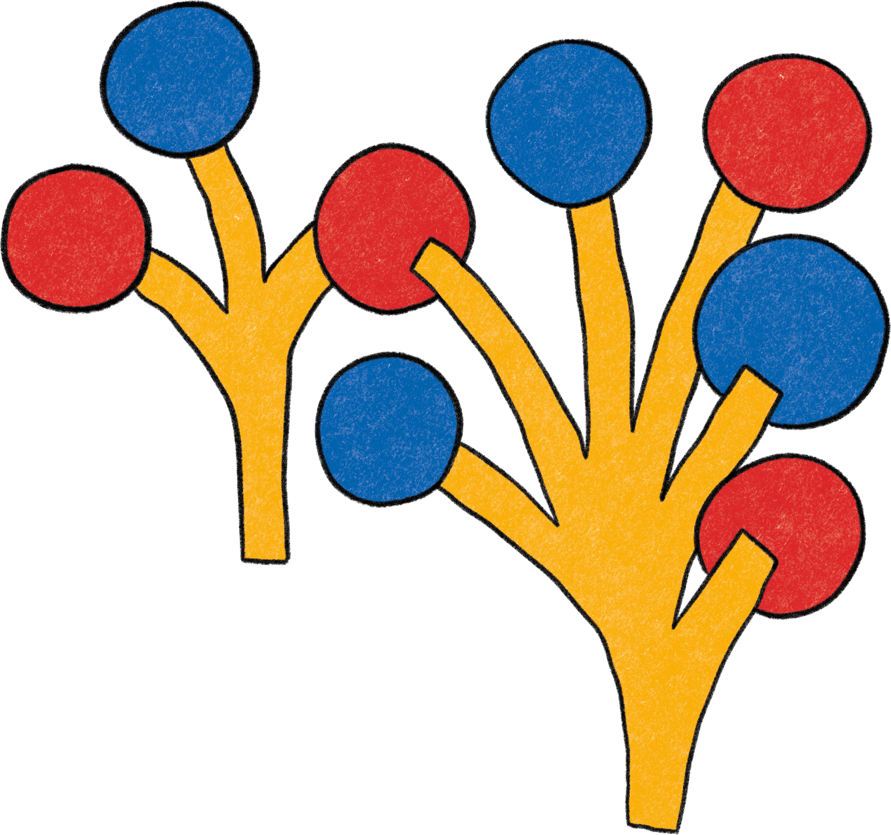
Thank You!
SOCIAL CONNECTION
1
Your name here
Your Title
Some contact information
2
Your name here
Your Title
Some contact information

