Slide 1
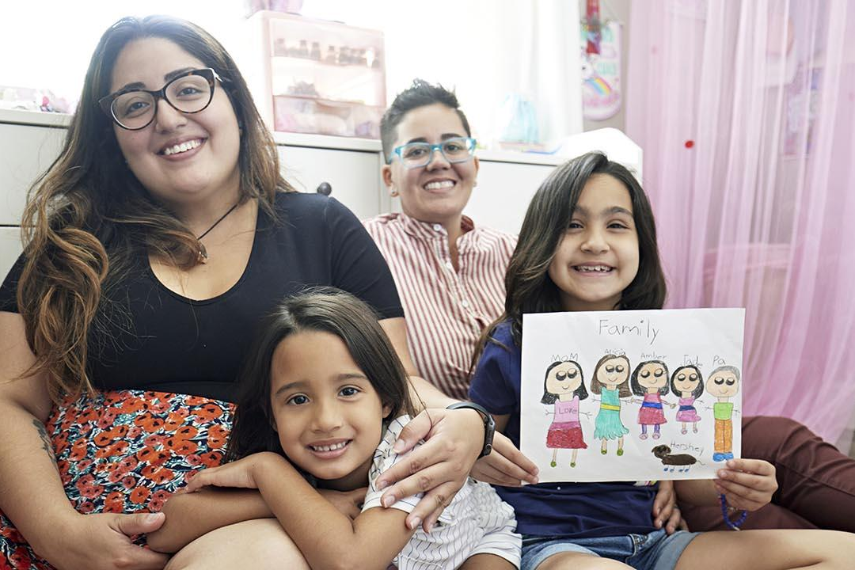
California Social and Emotional Learning Topic 6
Supporting SEL through Family and Community Engagement

Slide 2
California Social and Emotional Learning
Add a Welcoming Ritual here
Notes:
Add SEL Signature Practices to your presentation.
The SEL 3 Signature Practices are one tool for fostering a supportive environment and promoting SEL. They intentionally and explicitly help build a habit of practices through which students and adults enhance their SEL skills.
For a short presentation of what SEL 3 Signature Practices are, along with a list of practices, see the following:
https://docs.google.com/presentation/d/1utb0X71RHbzQdt-aZmOQfiFkg_kHltO7i-hUoOPb2m0/edit?usp=sharing

Slide 3
California Social and Emotional Learning
6.1
Exploring Family and Community Engagement with an SEL Lens
TOPIC 6: Supporting SEL through Family and Community Engagement
Notes:
As educators we must build bridges between school and the home by providing opportunities for parents, caregivers, and families to be involved in their child’s education. Systemic SEL invites us to move beyond involvement, center relationships, and enact a partnership model in which families and educators work together to support student social, emotional, and academic development, each with important and complementary roles.

Slide 4
Learning Objectives
6.1 Exploring Family and Community Engagement with an SEL Lens
Understand how major stakeholders view family and community engagement and SEL
Explore practical ways that schools engage in authentic partnerships with families and communities
Examine the ways having a culturally responsive lens is essential to effective FCE and SEL
Consider how to develop partnerships with families and communities around SEL
Link Objectives to Developmental Indicators in California Transformative SEL Competencies
Notes:
In this module, we explore Family and Community Engagement (FCE) as an essential part of school-wide social and emotional learning that focuses on whole child development.
We will:
Understand how major stakeholders view family and community engagement and SEL
Explore practical ways that schools engage in authentic partnerships with families and communities
Examine the ways having a culturally responsive lens is essential to effective FCE and SEL
Consider how to develop partnerships with families and communities around SEL

Slide 5
Involvement may include “[s]ending home flyers about meetings and activities, recruiting chaperones for field trips, soliciting parents’ help with fundraisers” which “contribute to a school, but may result in low parent engagement, and may not make a substantial impact on students learning and thriving.”
“Effective family and community engagement is an intentional and systemic partnership of educators, families, and community members. These partners share responsibility for a student’s preparation for school, work, and life, from the time the child is born to young adulthood. To build an effective partnership, educators, families, and community members need to develop the knowledge and skills to work together, and schools must purposefully integrate family and community engagement with goals for students learning and thriving.”
The California Department of Education makes the distinction between family and involvement and engagement in the following ways:
Notes:
The California Department of Education makes the distinction between family and involvement and engagement in the following ways: Link to full handout with descriptions here: https://ggie.berkeley.edu/wp-content/uploads/2021/07/Family-Involvement-to-Engagement-Handout.pdf Continuum from Involvement to Partnership
What does “engagement” or “partnership” really look like in terms of social and emotional learning? This chart offers a continuum from traditional family involvement to engagement to partnership with social and emotional learning focused examples. While it is necessary and positive for schools to “involve” parents as “helpers,” research tells us it will not lead to shared ownership of student outcomes and school improvement in the ways engagement and partnerships will.
Involvement
involvement may include “[s]ending home flyers about meetings and activities, recruiting chaperones for field trips, soliciting parents’ help with fundraisers” which “contribute to a school, but may result in low parent engagement, and may not make a substantial impact on students learning and thriving.”
Engagement
“effective family and community engagement is an intentional and systemic partnership of educators, families, and community members. These partners share responsibility for a student’s preparation for school, work, and life, from the time the child is born to young adulthood. To build an effective partnership, educators, families, and community members need to develop the knowledge and skills to work together, and schools must purposefully integrate family and community engagement with goals for students learning and thriving.”

Slide 6
Maximize the resources of the entire school community, including expanded learning opportunities, early learning and care programs, and family and community partnerships, to advance SEL and student well-being.
Family Engagement: Provide families with options for meaningful contributions to, and participation in, their child’s learning experience to build respectful, mutually beneficial relationships.
Expanded Learning: Establish shared goals across all youth serving settings, such as after school programs and summer learning programs, to leverage capacity and increase shared responsibility for positive student outcomes.
Early Learning: Consider the inclusion of early learning and care programs as SEL systems are developed.
Community Partnerships: Address the basic needs of students and families, including social and emotional well-being, through partnerships with community-based organizations and other stakeholders.
Notes:
In California’s Social and Emotional Learning Guiding Principles (2017), Guiding Principle number four and its sub-principles focus on the role of families, communities, and partnerships in promoting SEL:
Partner with Families and Community
Maximize the resources of the entire school community, including expanded learning opportunities, early learning and care programs, and family and community partnerships, to advance SEL and student well-being.
A. Family engagement: Provide families with options for meaningful contributions to, and participation in, their child’s learning experience to build respectful, mutually beneficial relationships.
B. Expanded learning: Establish shared goals across all youth serving settings, such as after school programs and summer learning programs, to leverage capacity and increase shared responsibility for positive student outcomes.
C. Early learning: Consider the inclusion of early learning and care programs as SEL systems are developed.
D. Community partnerships: Address the basic needs of students and families, including social and emotional well-being, through partnerships with community-based organizations and other local stakeholders.

Slide 7
Video
Video: Authentic Family Partnerships | Schoolwide SEL
6.1 Exploring Family and Community Engagement with an SEL Lens
Notes:
Watch this video from Think PBS in partnership with CASEL, Montgomery County Educational Services Center, and Ohio Department of Education on Cultivating Authentic Family Partnerships. https://www.youtube.com/watch?v=RgErDZ2pXZc

Slide 8
Let’s Discuss
After watching the video, reflect on the following questions:
What stands out to you?
How do YOU view Family and Community engagement?
What are the most effective ways you partner with caregivers and families to support the social and emotional well-being of your students?
Notes:
Facilitation Tip:
Debrief (5-7 min.) as a group
Invite a volunteer from each area of focus to:
Describe key points about that area/domain
Considerations
Ideas for improvement
Ask the larger group to add other considerations and ideas for improvement (if time permits).

Slide 9
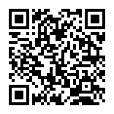
Article Read:
Family Engagement and SEL
Enhancing social-emotional learning with a whole-school, whole-family, whole-day approach
Notes:
Read the article that offers ideas for schools to support FCE around SEL and for families to support their child’s social and emotional skill building at home.
Ask participants to scan the QR code, provide handout, or share this link to the article: https://www.gse.harvard.edu/news/uk/18/07/family-engagement-and-sel

Slide 10
Let’s Discuss
After reading the article, reflect on the following questions:
What are the strengths of this article?
Are there any ideas or practices mentioned in the article that you or your school or district currently engage in?
Are there any practices or ideas that you’re not currently using that you’d like to try?
Using a culturally responsive lens, how might you adapt and apply some of these suggestions?
Notes:
Give participants 5 minutes to individually reflect on the article and note their answers to the following questions before discussing as a group:
Application:
What are the strengths of this article?
Are there ideas or practices mentioned in the article that you or your school or district currently engage in?
Are there any practices or ideas that you’re not currently using that you’d like to try?
Using a culturally responsive lens, how might you adapt and apply some of these suggestions?

Slide 11
Let’s Discuss
After reading the article, reflect on the following questions:
How would you critique this article? What is missing?
Thinking about the section titled “For Families: SEL Practices that Continue the Work of Schools,” do you feel these suggestions would work for your learning community? Why or why not?
Notes:
How would you critique this article? What is missing?
Thinking about the section titled “For Families: SEL Practices That Continue the Work of Schools,” do you feel these suggestions would work for your learning community? Why or why not?
(Group these questions for application and critique to help facilitate a group discussion.)

Slide 12
Developing Life Skills in Children: A Roadmap for Communicating with Parents
“Parents believe that home and school both have a role in children’s social, emotional, cognitive, and academic development, but not an equal one. In the survey, parents are more likely to view home as the place where these skills are ”taught” (95%) and schools as the place where they are ”reinforced” (92%). The focus groups reveal even more strident opinions on this topic, with parents seeing themselves as primarily responsible for their child's development, and the school serving as a partner. “
“I think their role is to go along with the parent and be a bridge,” says a Dayton, OH, parent. “It’s not their job to raise my child. That’s my job.”
“Don’t tell me something my child should be doing in my house,” says an Oakland, CA, parent.
Notes:
Pause the discussion and give participants one minute to read the text on the slide (also listed below).
After discussing what Harvard’s Graduate School of Education says about FCE and SEL, consider a 2018 parent research report called Developing Life Skills in Children: A Roadmap for Communicating with Parents. Survey results point to a key dilemma: http://nationathope.org/wp-content/uploads/lh-dlsc-road-map.pdf
“Parents believe that home and school both have a role in children’s social, emotional, cognitive, and academic development, but not an equal one. In the survey, parents are more likely to view home as the place where these skills are “taught” (95%) and schools as the place where they are “reinforced” (92%). The focus groups reveal even more strident opinions on this topic, with parents seeing themselves as primarily responsible for their child’s development, and the school serving as a partner. “I think their role is to go along with the parent and be a bridge,” says a Dayton, OH, parent. “It’s not their job to raise my child. That’s my job.” “Don’t tell me something my child should be doing in my house,” says an Oakland, CA, parent.”

Slide 13
Let’s Discuss
Do you think characterizing SEL as “continuing the work of schools” is accurate? Will it help build partnerships with parents/caregivers? Why or why not?
Do you think parent/caregiver opinions about SEL have changed since the pandemic and other significant collective societal traumas in 2020-21?
What are some accessible and helpful ways you (or others) have connected SEL to parenting/raising children?
Notes:
Restart discussion and ask the following questions. Set context by prompting them to consider these sentiments and their own opinions about the role of schools in promoting SEL.
Do you think characterizing SEL as “continuing the work of schools” is accurate? Will it help build partnerships with parents/caregivers? Why or why not?
Do you think parent/caregiver opinions about SEL have changed since the pandemic and other significant collective societal traumas in 2020-21?
Wrap up question: What are some accessible and helpful ways you (or others) have connected SEL to parenting/raising children?

Slide 14
Social Emotional Learning with Families: From Involvement to Partnership
Notes:
Overview: As educators we must build bridges between school and the home by providing opportunities for parents, caregivers, and families to be involved in their child’s education. Systemic SEL invites us to move beyond involvement, center relationships, and enact a partnership model in which families and educators work together to support student social, emotional, and academic development, each with important and complementary roles.

Slide 15
What does “engagement” or “partnership” really look like in terms of social and emotional learning? This chart offers a continuum from traditional family involvement to engagement to partnership with social and emotional learning focused examples. While it is necessary and positive for schools to “involve” parents as “helpers,” research tells us it will not lead to shared ownership of student outcomes and school improvement in the ways engagement and partnerships will.
Continuum from Involvement to Partnership
Notes:
Link to full handout with descriptions here: https://ggie.berkeley.edu/wp-content/uploads/2021/07/Family-Involvement-to-Engagement-Handout.pdf
Involvement:
Families help with school-directed classroom tasks such as preparing SEL lesson materials as directed by teacher
-Families attend and volunteer at school-led SEL events
-Families supply food or materials for events or
-Schools share information about SEL initiatives with families
-Families read and respond to communication from school about SEL
Continuum from Involvement to Partnership
What does “engagement” or “partnership” really look like in terms of social and emotional learning? This chart offers a continuum from traditional family involvement to engagement to partnership with social and emotional learning focused examples. While it is necessary and positive for schools to “involve” parents as “helpers,” research tells us it will not lead to shared ownership of student outcomes and school improvement in the ways engagement and partnerships will.

Slide 16
1 2 3 4 5
Involvement Engagement Partnership
Notes:
Informed by from Goodall & Montgomery (2014), Partners in Education: A Dual-Capacity Building Framework for Family-School Partnerships (2013), CASEL (2020).
https://learningfoundation.org.uk/wp-content/uploads/2016/03/Parental-involvement-to-parental-engagement-a-continuum.pdf
https://www2.ed.gov/documents/family-community/partners-education.pdf
https://schoolguide.casel.org/focus-area-3/family-partnerships/
Group discussion:
Ask participants to reflect on their experiences with FCE as educators. Has SEL been a core feature of FCE practice in their experience and context?
Have participants share what they believe are the goals of their context’s FCE practices. Capture the goals on chart paper/jamboard.
After reviewing the list of goals, consider whether anything might be missing? Where does transformative (equity-focused) SEL show up in these goals?
Gather in pairs or trios:
Draw a simple chart to illustrate the family involvement-to-engagement section of the continuum. Number 1 indicates minimal parent involvement or transactional, school-directed activities and number five indicates authentic partnership.

Slide 17
Let’s Discuss
List at least four SEL-related practices that you, your school, or your district offer families.
Where on the involvement-engagement-partnership continuum do your primary SEL-FCE practices fall? Rate each of them using the numbers on the chart.
What do you notice about the ratings?
Notes:
List at least four SEL-related practices that you, your school, or your district offer families. (i.e., they might either promote SEL or involve building SEL capacity)
Where on the involvement-engagement-partnership continuum do your primary SEL-FCE practices fall? Rate each of them using the numbers on the chart.
What do you notice about the ratings? Are they mostly on the involvement end of the spectrum, closer to engagement and partnership, or spread across the continuum?

Slide 18
Discussion
Considering these discrepancies, what can we learn about our varied FCE perspectives?As a team, what more might we learn about FCE based on what we’re hearing?
What do you think are some barriers to family engagement and partnership generally?
Why is it important to build on family involvement practices and to work toward engagement and partnership opportunities?
Notes:
Return to full group discussion: Invite each pair or trio share their list of practices and continuum ratings and capture them in a shared space.
If there are continuum rating discrepancies, ask participants to reflect on the following:

Slide 19
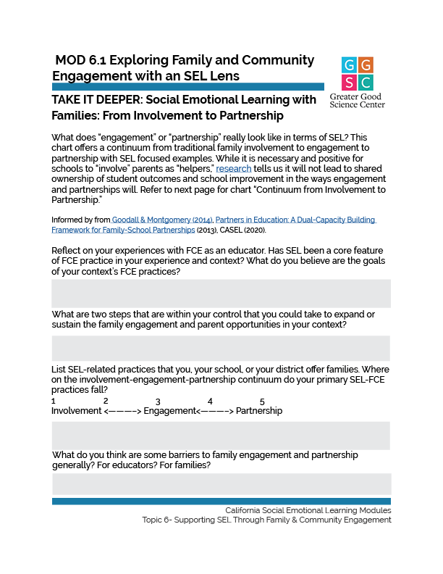
TAKE IT DEEPER
Complete “ Social Emotional Learning with Families: From Involvement to Partnership”
6.1 Exploring Family and Community Engagement with an SEL Lens
Notes:
https://ggie.berkeley.edu/wp-content/uploads/2023/10/6.1-SEL-with-Families-From-Involvement-to-Partnership.pdf

Slide 20
California Social and Emotional Learning
6.2 Building Partnerships with and Honoring the Contributions of Diverse Families
TOPIC 6: Supporting SEL through Family and Community Engagement

Slide 21
Learning Objectives
6.2 Building Partnerships with and Honoring the Contributions of Diverse Families
Explore strategies to build capacity as educators, schools, and districts alongside families to come together in partnership around students’ social, emotional, and academic growth
Take the perspective of families—and how best we can honor their contributions and expertise about their own children through a diversity, equity, and inclusion lens
Link Objectives to Developmental Indicators in California Transformative SEL Competencies

Slide 22
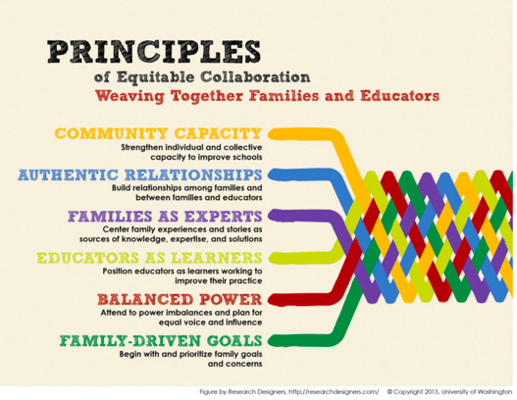
The Equitable Collaboration Framework was developed by the Equitable Parent-School Collaboration Research Project at the University of Washington’s College of Education, and is hosted on Organizing Engagement.
Notes:
The Equitable Collaboration Framework (https://organizingengagement.org/featured/equitable-collaboration-framework/) was developed by the Equitable Parent-School Collaboration Research Project at the University of Washington’s College of Education and hosted on Organizing Engagement.

Slide 23
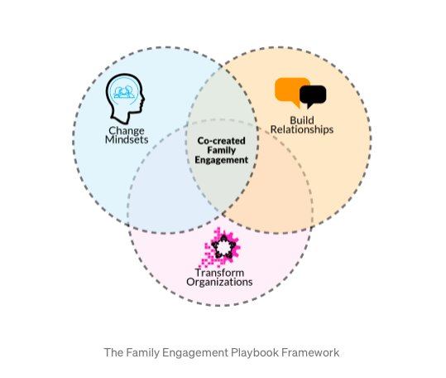
The Family Engagement Playbook, created by the Global Family Research Project, “provides people, groups, and organizations with opportunities to explore new possibilities for building capacity to promote co-created family engagement.”
Notes:
The Family Engagement Playbook, created by the Global Family Research Project, “provides people, groups, and organizations with opportunities to explore new possibilities for building capacity to promote co-created family engagement. (https://medium.com/familyengagementplaybook)

Slide 24
Let’s Discuss
Reflect: Partnership Building Practices
What was interesting or new to you?
What from these frameworks could be used in your classroom or school context?
Where do social and emotional competencies show up within these frameworks, implicitly or directly?
What barriers exist in your classroom or school to adopting an equity-focused, co-creation approach to parent engagement as described in these framework examples?
How might those be overcome?
What is one key insight or take away from the framework you explored?
Notes:
Framing: Co-creating pathways for parents and caregivers to contribute their strengths and participate in their child’s education in ways that enrich the school community is a key partnership-building practice.
Ask group members to choose one of the two FCE frameworks to explore.(See two previous slides.) Give 3-5 minutes for individual exploration. With a framework-alike partner, discuss any of the following questions:
Have participants split into two groups with each group exploring one of the resources. Ideally groups would be no larger than 5-6. Assign multiple groups to each topic as necessary. Have them discuss with a framework-alike partner and capture answers to the questions. Then share out.

Slide 25
From a Parent’s Perspective:
“There is a presumption that parents and teachers would be natural allies, but some family school interactions, particularly in low-income communities of color, suggest that the relationship is more adversarial. How and why does this conflict emerge? . . . The relationships between teachers and parents are also shaped by their perceptions of one another. Both parents and teachers share a quiet and deeply personal desire to be seen and heard for their interactions with children, but often instead feel misunderstood and underappreciated. The struggle for legitimacy, power, and appreciation creates tangible distrust between teachers and parents and between families and schools leading each party to approach the other defensively. In an environment of distrust and misunderstanding, both teachers and parents fear criticism from one another; in response, both groups often isolate themselves.” —Soo Hong, A Cord of Three Strands
Notes:
In Soo Hong’s book on lessons learned from the Logan Square Neighborhood Association’s work in Boston, A Cord of Three Strands, (2011) the author writes: Quote on Slide
(https://books.google.com/books?hl=en&lr=&id=RX4fEAAAQBAJ&oi=fnd&pg=PT6&dq=info:yxLd50GmNc8J:scholar.google.com/&ots=YziE4nYwQT&sig=ZqH3pggCJRZZIbt-HcAmNT2e9LA#v=onepage&q&f=false)
Keeping in mind Hong’s words, take 10 minutes to read the following article by Jung-Ah Choi, an assistant professor of education, St. Peter’s University, Jersey City, N.J “Why I’m not involved: Parental involvement from a parent’s perspective” (https://kappanonline.org/choi-why-im-not-involved-parental-involvement-parents-perspective/)

Slide 26
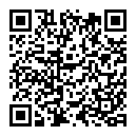
From a Parent’s Perspective: Why I’m Not Involved
Notes:
Keeping in mind Hong’s words, take 10 minutes to read the following article by Jung-Ah Choi, an assistant professor of education, St. Peter’s University, Jersey City, N.J “Why I’m not involved: Parental involvement from a parent’s perspective” (https://kappanonline.org/choi-why-im-not-involved-parental-involvement-parents-perspective/)

Slide 27
Let’s Discuss
What teacher beliefs does Choi perceive?
How do educators’ SEL skills play a role in engaging successfully with families?
What specific SEL skills are relevant to successfully adopting a culturally responsive approach to working with families?
Consider your “Belief System” about Family Engagement
What are your strengths in this area?
Are there ways you could continue to explore your own mindset and beliefs about family engagement?
What, in particular, would you like to continue to work on?
Notes:
Framing: According to research (https://link.springer.com/article/10.1007/s10643-006-0063-5) certain factors may influence teacher beliefs about parents and families. For example:
Teachers’ own sociocultural background and childhood experiences. “An assertive parent who is seeking to be a leader may bring about a defensive reaction” from a teacher whose own parents did not seek out leadership roles or who ceded decision-making to the educator.
School culture and norms. If the school signals to parents that “their roles are limited and do not involve leadership then teachers receive distorted messages about how to approach and develop meaningful parent and family involvement.”
As you reflect on Hong’s words and Choi’s article, discuss the questions above.

Slide 28
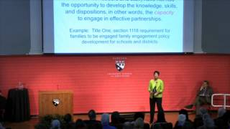
Video
Linking Family Engagement to Learning: Karen Mapp's '8 for 8'
Notes:
Activity: Watch Karen Mapp’s (7:40) presentation Linking Family Engagement to Learning.
https://www.youtube.com/watch?v=KDPY1t8E6Cg

Slide 29
Linking Family Engagement to SEL
Relational: how are we being intentional about getting to know families?
Interactive: how are we providing hands-on, engaging, practical opportunities for engagement?
Collaborative: how are we intentionally learning from families and working together?
Developmental: how are we expanding from “providing services” to families to building capacity of families?
Linked to Learning: how are we linking our FCE to student learning?
Notes:
Form five groups, one for each of the categories discussed in Mapp’s presentation. (See below). Each group will focus on only one of the categories. Provide each group with markers and a piece of chart paper with a line drawn down the middle. (This exercise can also be done on a jam board.)
Categories
Relational - How are we being intentional about getting to know families?
Interactive - How are we providing hands-on, engaging, practical opportunities for engagement?
Collaborative - How are we intentionally learning from families and working together?
Developmental - How are we expanding from “‘providing services” to families to building capacity of families?
Linked to Learning (linked to SEL) - How are we linking our FCE to student (social, emotional, and academic) learning?

Slide 30
Linking Family Engagement to SEL
Current Family Engagement practices
Potential/Aspirational practices
“Ways our FCE work is relational: We send surveys to parents asking about their child, family culture, and traditions.“
“Potential ways our FCE work could be relational: We could begin home visits or family meet ups in public spaces. “
Notes:
Have each group identify and note on one side of the chart paper their context’s current family engagement practices on one side and potential/aspirational practices on the other side. For example, column 1 might say: “Ways our FCE work is relational: We send home surveys to parents asking about their child, family culture, and traditions.” Column 2 might say: “Potential ways our FCE work could be relational: We could begin home visits or family meet ups in public spaces.”
Have the groups ‘visit’ the chart paper of each of the other groups and add ideas to each column.
Wrap up question: Out of the Potential/Aspirational items for each of the five areas, decide as a group at least one thing you would like to focus on as a group or school.

Slide 31
Activity: Funds of Knowledge
Intentionally gathering and using information about families’ assets, experiences, and skills or funds of knowledge requires that educators develop their social and emotional skills and foster trusting relationships with families. Review the chart Funds of Knowledge
adapted from the work of Gonzalez, Moll, and Amanti (2005) by Bank Street College
Notes:
Leveraging the knowledge and experiences of families and community members is essential to enriching the classroom curriculum in an inclusive and culturally sustaining and expansive way. Intentionally gathering and using information about families’ assets, experiences, and skills or funds of knowledge requires that educators develop their social and emotional skills and foster trusting relationships with families
Individually: Review the chart Funds of Knowledge (https://modules.nceln.fpg.unc.edu/sites/modules.nceln.fpg.unc.edu/files/foundations/handouts/Mod%204%20Funds%20of%20knowledge.pdf) adapted from the work of Gonzalez, Moll, and Amanti (2005) by Bank Street College on the second page of this document

Slide 32
Let’s Discuss
Activity: Funds of Knowledge
What are the existing tools and practices educators use to surface families’ strengths and knowledge?
How would you enhance this Funds of Knowledge chart to be appropriate for families now?
What would you add?
What would remove, if anything?
What are the ways you could or are using the information collected?
When inviting families to contribute to the school, how can we balance what educators know or believe the school or classroom “needs” and what families' talents, knowledge, and skills actually are?
What is one idea you heard that you want to try or learn more about?
Notes:
Discuss as a group: What are the existing tools and practices educators use to surface families’ strengths and knowledge?
How would you enhance this Funds of Knowledge chart to be appropriate for families in 2021-2022? What would you add? What would you remove, if anything
Wrap up question: What is one idea you heard in the discussion you want to try or learn more about?

Slide 33
County Office Spotlight
Let’s Reflect!
Are any of the ideas or approaches in the Building Partnerships slides new to you or did they spark ideas?
Beyond SEL 101 or SEL Foundations presentations to families, how might families be engaged to inform and enhance SEL practices within the school day?
What questions might you ask to learn more about incorporating culturally responsive practices in school-wide and classroom based SEL practice?
Notes:
San Diego County Office of Education curated resources on FCE and SEL:
Building Partnerships and Honoring the Contributions of Diverse Families (SLIDES 1-9) discusses cultivating welcoming environments for diverse families, tips on what, when, and how to share information about SEL with families, and starter ideas for including families in SEL efforts. (https://greatergood.berkeley.edu/slides/BUILDING_PARTNERSHIPS__HONORING_THE_CONTRIBUTIONS_OF_DIVERSE_FAMILIES._San_Diego_Unified_pptx_.pptx_
SEL Strategies and Tips for Families (SLIDES 10-26) a curated presentation for use with families at an engagement event that offers simple ways for families to support their children’s social and emotional development, an introduction to CASEL’s five core SEL competencies, and some SEL developmental milestones. (https://ggsc.berkeley.edu/slides/SEL_STRATEGIES__TIPS_FOR_FAMILIES._San_Diego_Unified_.pptx)
Review the slides and discuss:
Are any of the ideas or approaches in the Building Partnerships slides new to you or did they spark ideas? In the SEL Strategies and Tips for Families?
Beyond SEL 101 or SEL Foundations presentations to families, how might families be engaged to inform and enhance SEL practices within the school day?
Wrap up question: What questions might you ask to learn more about incorporating culturally responsive practices in school-wide and classroom based SEL practice

Slide 34
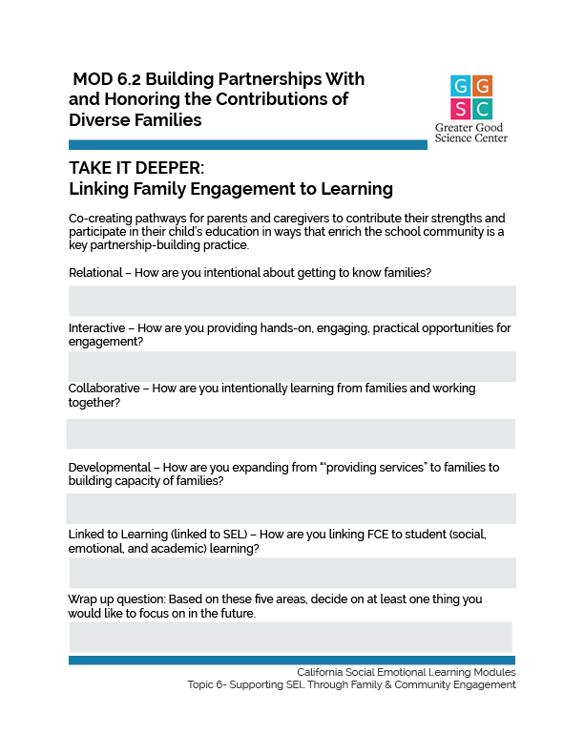
TAKE IT DEEPER
Complete “Linking Family Engagement to Learning”
6.2 Building Partnerships with and Honoring the Contributions of Diverse Families
Notes:
Let’s further examine our own beliefs and our classroom cultures. Allow learners to consider these questions independently. Perhaps they note surprising responses with a star and highlight beliefs they would like to change.
https://ggie.berkeley.edu/wp-content/uploads/2023/10/6.2-Linking-Family-Engagement-to-Learning.pdf

Slide 35
California Social and Emotional Learning
6.3 Listening and Communicating Effectively with Families
TOPIC 6: Supporting SEL through Family and Community Engagement

Slide 36
Learning Objectives
6.3 Listening and Communicating Effectively with Families
Explore four keys of effective communication
Learn strategies for really listening to parents and caregivers
Examine a communication and outreach rubric with a culturally responsive lens
Link Objectives to Developmental Indicators in California Transformative SEL Competencies
Notes:
Expand objectives to California Developmental Indicators through making connections to SEL competencies in California on developmental age span.
Sourced from CDE (July 2023): The California Department of Education (CDE) aims to support and advance the efforts of educators across California who are working to fully integrate systemic SEL and equity by building on the promise of T-SEL as a concept. To provide these supports, the CDE has articulated developmental indicators for CASEL’s five core competencies:
Self-Awareness (Intrapersonal Focus)
Self-Management (Intrapersonal Focus)
Social Awareness (Interpersonal Focus)
Relationship Skills (Interpersonal Focus)
Responsible Decision-Making (Inter and Intrapersonal)

Slide 37
Child-centered: communication that is highly individualized… focusing on a child’s specific strengths and struggles allows both teachers and family members to better support the child’s development.
Constructive: communication and information is meaningful and useful because it provides families with practical suggestions. Positive language that focuses on solutions helps families remain optimistic.
Clear and concrete: communication is most beneficial to families in supporting children’s actual learning. This is particularly important when communicating about issues of social and emotional development for which parents and families may not share a common vocabulary. Communication with families should give specific examples and clear guidelines using simple language and minimal text. Keeping this principle in mind may help minimize miscommunications resulting from differences in literacy, language, and culture.
Continuous: communication keeps families informed about their child’s development and in sync with classroom practices and policies. Teachers should reach out to families as early as possible to establish a collaborative tone and maintain regular contact throughout the school year.
Four key characteristics of effective school–family communication

Slide 38
Group Reflection
The authors add: “It is not our intention to overburden teachers with the responsibility for constant communication with families about social and emotional development. In fact, quality of school–family interactions, rather than quantity, seems to predict student achievement and behavior.”
What are your communications strengths? How do you bring those strengths into your efforts to keep families informed, gather helpful information from them, and build relationships?
What are some ways you can find the “Goldilocks zone” of communication (not too much, not too little, just right)?

Slide 39
Video
A Parent Reflects on Building Relationships with Teachers
Notes:
Setting the Scene for Communication with Families and an Active Listening Strategy
Begin by watching this video (3:28) from the San Francisco Unified School District FCE toolkit. It features a parent discussing relationship building and communication. (https://www.youtube.com/watch?v=vbyhao0FtaQ)

Slide 40
Make the first move: Don’t wait until parents contact you about a concern or problem. Instead, begin building a positive partnership by reaching out before school begins, or at least early in the year. Sharing brief notes about a child’s successes is a good opener.
Offer conversation starters: Help things along by offering guiding questions. A focused question like, “What’s one thing you’d really like your child to accomplish in school this year?” is easier to answer than a broad question like, “What do you want your child to learn?” Asking, “What’s one thing your child is good at” shows that you’re thinking about a child’s strengths—and encourages families to do the same.
Give parents a chance to think: I encourage teachers to send home a question or two for parents to consider before school meetings. Parents are less likely to feel put on the spot, and conversations are usually more productive and positive. [Also from the article: Accommodate parents’ literacy skills. How does your school reach out to parents who speak limited English or struggle with reading? Are translators available during meetings? Do you translate communications sent home and school signage into parents’ native languages?]
Seek first to understand: It’s even more important to listen with openness and compassion in high-risk conversations and dialogues, and when conflicts occur. Instead of responding defensively, show that you are genuinely interested in hearing concerns. Leaning into these situations with curiosity and respect for parents will further strengthen trust. Statements like, “I can tell this is very important to you. I’d like to hear more about that” or “What do you think might help in this situation?” are apt to open lines of communication and make everyone feel understood.
Tips for authentically listening to and engaging with parents and caregivers
Notes:
(http://www.ascd.org/publications/educational-leadership/may11/vol68/num08/How-to-(Really)-Listen-to-Parents.aspx)
Make the first move. Don't wait until parents contact you about a concern or problem. Instead, begin building a positive partnership by reaching out before school begins, or at least early in the year. Sharing brief notes about a child's successes is a good opener.
Offer conversation starters. Help things along by offering guiding questions. A focused question like, "What's one thing you'd really like your child to accomplish in school this year?" is easier to answer than a broad question like, "What do you want your child to learn?" Asking, "What's one thing your child is good at" shows that you're thinking about a child's strengths—and encourages families to do the same.
Give parents a chance to think. I encourage teachers to send home a question or two for parents to consider before school meetings. Parents are less likely to feel put on the spot, and conversations are usually more productive and positive. [Also from the article: Accommodate parents' literacy skills. How does your school reach out to parents who speak limited English or struggle with reading? Are translators available during meetings? Do you translate communications sent home and school signage into parents' native languages?]
Seek first to understand. It's even more important to listen with openness and compassion in high-risk conversations and dialogues, and when conflicts occur. Instead of responding defensively, show that you are genuinely interested in hearing concerns. Leaning into these situations with curiosity and respect for parents will further strengthen trust. Statements like, "I can tell this is very important to you. I'd like to hear more about that" or "What do you think might help in this situation?" are apt to open lines of communication and make everyone feel understood.

Slide 41
L | Listen, empathize, and communicate respect
A | Ask questions and ask permission to take notes
F | Focus on the issues
F | Find a first step
Don’t
C | Criticize people who aren’t present
R | React hastily and promise something you can’t deliver
Y | Yakety-yak-yak
The LAFF don’t CRY mnemonic reminds teachers to use positive active listening steps.
Notes:
Next, review the LAFF Don’t CRY Strategy, from Using Active Listening to Improve Collaborative With Parents. The LAFF don’t CRY mnemonic reminds teachers to use positive active listening steps. This is just one possible approach to active listening that can be adopted by educators when communicating with families. (Note: “Yakety-yak-yak” means to talk too much!)
”: Chart from Using Active Listening to Collaborative with Parents.

Slide 42
Group Reflection
Thinking about the video of the SFUSD parent, what strategies does the educator use from:
The “How to (Really) Listen to Parents” excerpt?
The “LAFF don’t CRY” strategy?
Other?
What insights did you have after reviewing these materials?
What would you add to these resources? What else do educators need to know?
Drawing on the LAFF don’t CRY strategy, what does “respect” look like to you? What does respect look like in other cultures you’re familiar with? How do you demonstrate respect and ensure parents/family members feel they are being treated with dignity?
What other active listening strategies do you know or use?
Wrap up question: How can we continue to reflect on the ways our own communication style impacts our students and colleagues?

Slide 43
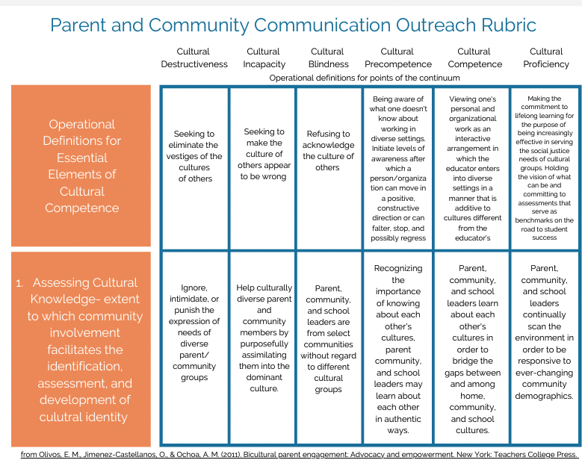
In “Bicultural Parent Engagement”, edited by Olivos, Jiménez-Castellanos, & Ochoa, the Parent and Community Communication and Outreach rubric describes a continuum of understanding and actions from cultural destructiveness to cultural competence and proficiency.
Notes:
In Bicultural Parent Engagement, edited by Olivos, Jiménez-Castellanos, & Ochoa, the Parent and Community Communication and Outreach rubric describes a continuum of understanding and actions from cultural destructiveness to cultural competence and proficiency. Download Rubric: https://ggie.berkeley.edu/wp-content/uploads/2021/07/Parent-and-Communication-Outreach-Rubric.pdf
Have participants individually explore the rubric and use these reflection questions (adapted from prompts by the authors) to guide a journal entry.
What are your reflections on the practices described under cultural destructiveness? Did anything surprise you? If you are familiar with these concepts, what would you add?
What about the practices listed under cultural proficiency? Did anything surprise you there? If you are familiar with these concepts, what would you add to this section of the continuum?
Does this rubric make you aware of any new opportunities for building more cultural competence in your interactions with families and community?

Slide 44
Whole group discussion:
What did you find interesting about the rubric?
Can we ever become “culturally proficient”?
What are some actions we can take to become more culturally proficient?
What role does cultural humility play in parent and community communication?
How might the five social and emotional competencies help us to advance along the “Parent and Community Communication and Outreach” continuum?
How could this rubric be used as a tool in your professional practice? In your school? Your district?
Notes:
Whole group discussion:
What did you find interesting about the rubric? Was anything new to you?
Can we ever become “culturally proficient”? What are some actions we can take to become more culturally proficient?
What role does cultural humility play in parent and community communication?
How might the five social and emotional competencies help us to advance along the “Parent and Community Communication and Outreach” continuum? For example: Which self-management skills might support more culturally proficient interactions with families and community members?
Self awareness?
Social awareness?
Relationship skills?
Responsible decision-making?
Wrap up question: How could this rubric be used as a tool in your professional practice? In your school? Your district?

Slide 45
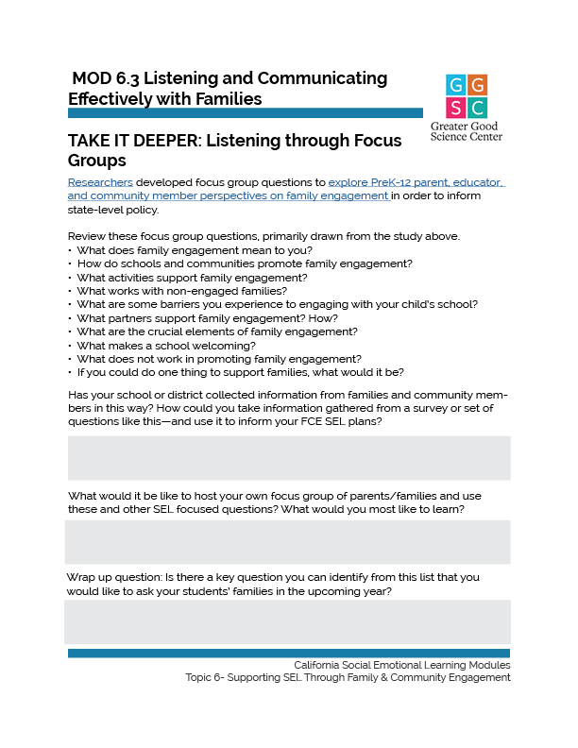
TAKE IT DEEPER
Complete “Listening through Focus Groups”
6.3 Listening and Communicating Effectively with Families
Notes:
https://ggie.berkeley.edu/wp-content/uploads/2023/10/6.3-Listening-through-Focus-Groups.pdf

Slide 46
California Social and Emotional Learning
6.4 Expanded Learning and SEL: Collaborating Across In-School and OST Contexts
TOPIC 6: Supporting SEL through Family and Community Engagement

Slide 47
Learning Objectives
6.4 Expanded Learning and SEL: Collaborating Across In-School and OST Contexts
Reflect on the Eight Essential Practices for supporting SEL developed by the National Afterschool Association
Identify ways to align our SEL efforts across in-school and out-of-school time.
Explore how to develop more authentic school-program partnerships that prioritize social and emotional skills.
Link Objectives to Developmental Indicators in California Transformative SEL Competencies
Notes:
Expand objectives to California Developmental Indicators through making connections to SEL competencies in California on developmental age span.
Sourced from CDE (July 2023): The California Department of Education (CDE) aims to support and advance the efforts of educators across California who are working to fully integrate systemic SEL and equity by building on the promise of T-SEL as a concept. To provide these supports, the CDE has articulated developmental indicators for CASEL’s five core competencies:
Self-Awareness (Intrapersonal Focus)
Self-Management (Intrapersonal Focus)
Social Awareness (Interpersonal Focus)
Relationship Skills (Interpersonal Focus)
Responsible Decision-Making (Inter and Intrapersonal)

Slide 48
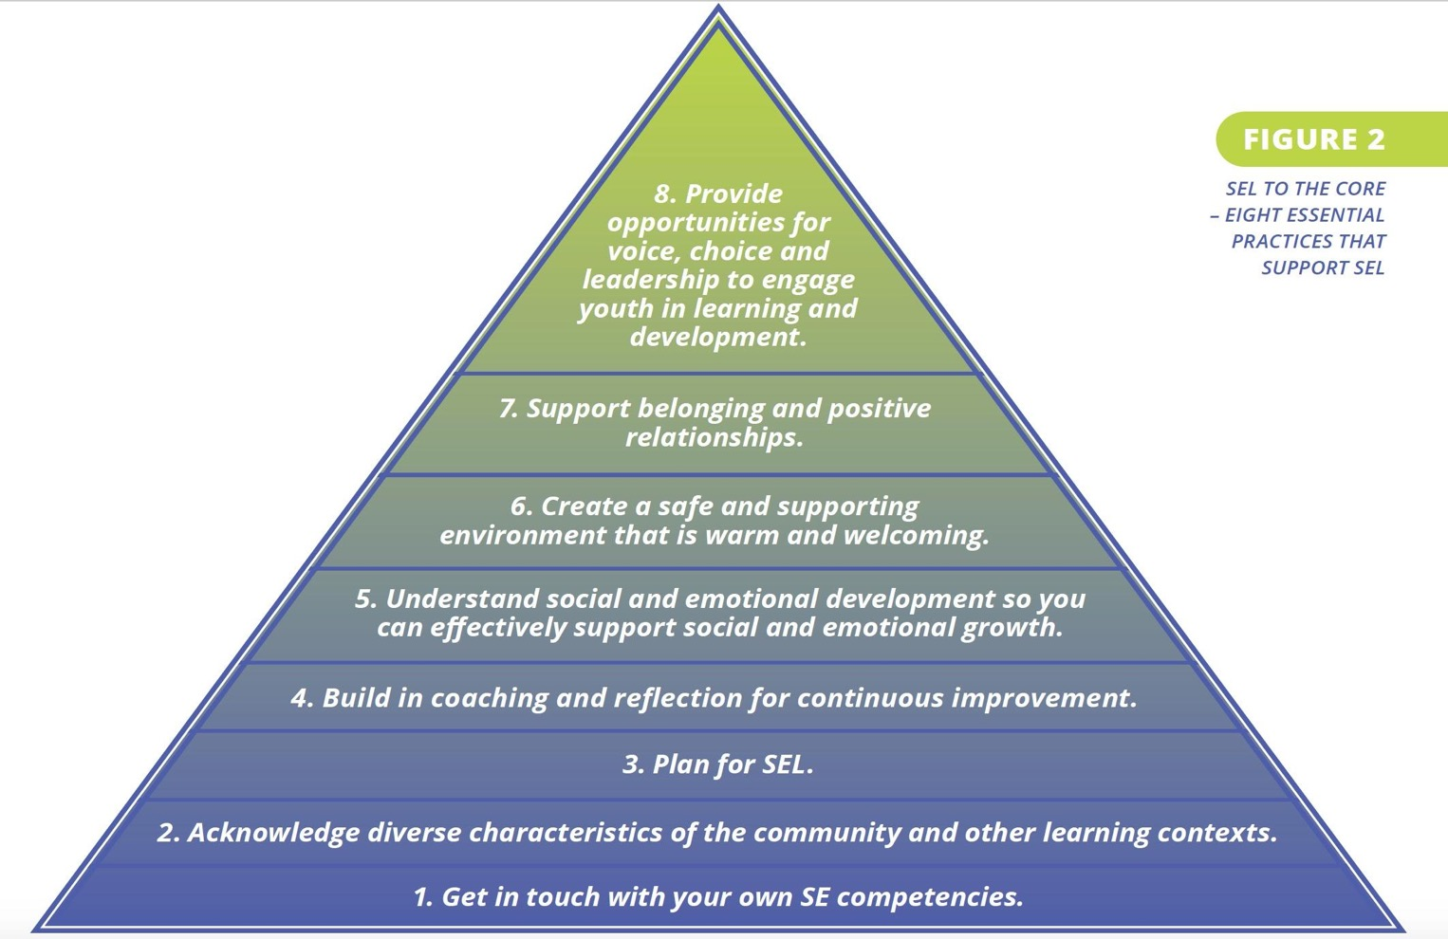
Notes:
We start our exploration of Expanded Learning and social and emotional skills by reviewing the Eight Essential Practices suggested by the National Afterschool Association: https://naaweb.org/resources/sel-to-the-core

Slide 49
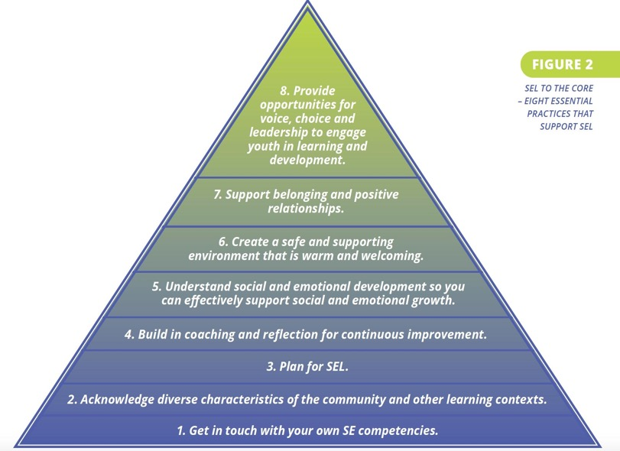
Eight Essential Practices
In what ways are these practices similar or different from those we would consider essential in school?
What are some of our individual and collective strengths?
What are some areas for growth?
Notes:
Share the graphic. Invite group members to read each one aloud. After reviewing the Eight Essential Practices, form groups to discuss:
In what ways are these practices similar or different from those we would consider essential in school?
What are some of our individual and collective strengths?
Identify some areas for growth.

Slide 50
“School day and expanded learning professionals can most effectively develop their students’ social-emotional skills when they work together, providing students with consistent social-emotional learning strategies and environments. Unfortunately, these educators don’t always speak the same language. Too often they fail to recognize their common purpose, in part because they use different terminology and operate in silos.” Finding Common Ground: Connecting Social-Emotional Learning During and Beyond the School Day by Partnership for Children and Youth,
Notes:
Connecting OST and the Traditional School Day through SEL
Aligning around SEL can be one important way to connect traditional school day educators and OST/Expanded Learning partners. A California-based example is the Expanded Learning 360°/365 Project, a partnership initiative “dedicated to promoting the development of critical skills beyond academics that research has identified as essential to young people’s success in school, work, and life.” http://www.expandedlearning360-365.com/partner-organizations.html
In a 2016 report, Finding Common Ground: Connecting Social-Emotional Learning During and Beyond the School Day, by Partnership for Children and Youth (PCY), a founding member of the project, not sharing a common language is identified as one barrier to aligned and consistent SEL for students: https://www.partnerforchildren.org/resources/2017/11/1/finding-common-ground
“School day and expanded learning professionals can most effectively develop their students’ social-emotional skills when they work together, providing students with consistent social-emotional learning strategies and environments. Unfortunately, these educators don’t always speak the same language. Too often they fail to recognize their common purpose, in part because they use different terminology and operate in silos.”

Slide 51
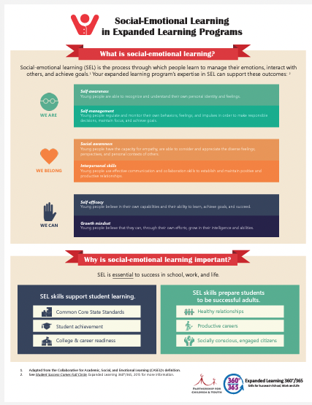
Infographic
Social-Emotional Learning in Expanded Learning Programs
By Partnership for Children and Youth and Project 360/365, that provides a simple framework for practitioners to understand the goals of SEL, and A Crosswalk Between the CDE Quality Standards for Expanded Learning with SEL competencies.
Notes:
Review this two page infographic by Partnership for Children and Youth and Project 360/365, that provides a simple framework for practitioners to understand the goals of SEL, and A Crosswalk Between the CDE Quality Standards for Expanded Learning with SEL competencies. https://static1.squarespace.com/static/59f76b95268b96985343bb62/t/59fc9d889140b7375c475294/1509727626269/SEL+Fact+Sheet_with+hyperlinks+underlined.pdfhttps://www.afterschoolnetwork.org/sites/main/files/file-attachments/_crosswalk.pdf

Slide 52
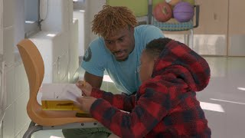
Video
Scaffolding Academics with Social Emotional Skills in the Afterschool Space
Notes:
https://www.youtube.com/watch?v=btXOc60UQ0Q

Slide 53
Let’s Discuss!
OST and SEL
After reading the quote from the Finding Common Ground report, what are your takeaways? Aside from lacking a shared language around SEL, can you identify other barriers to SEL alignment across settings?
What did you notice in the two-page infographic and the video in terms of simplified language?
What might be the benefits of using accessible SEL terms and simple practices when working across settings?
Does teaching SEL feel more, or less effective in OST? Why?
Identify several ways you can intentionally coordinate across school and after-school settings.

Slide 54
Define the targeted SEL Skills
Describe success in terms of observable behaviors by staff and students
Use backwards-mapping to determine the necessary system-level supports
Use common and consistent expectations, language, key practices, tools, and support.
Combine professional learning activities and /or communities of practice
Employ a liaison to coordinate communication of practices, learning themes, and information related to student or family level service provision.
School and OST Partnerships
Notes:
Ask the group to review the list on the next two slides.
What do they notice?
What patterns and trends can they identify?
In order to plan a successful SEL initiative, school and OST partnerships collaborate to:
(From the National Afterschool Association - https://naaweb.org/resources/sel-to-the-core)
- Define the targeted SEL skills
- Describe success in terms of observable behaviors by staff and students
- Use backwards-mapping to determine necessary system-level supports.
- Use common and consistent expectations, language, key practices, tools, and support
- Combine professional learning activities and/or communities of practice
- Employ a liaison to coordinate communication of practices, learning themes, and information related to student or family level service provision
- Engage all stakeholders to better incorporate the goals, needs, and desires of the school community, reflect the culture and identities of stakeholders, and maintain active supporters of the program
These additional items are from the American Institutes for Research and Policy Analysis for California Education examination of California’s Expanded Learning system during COVID-19 response https://edpolicyinca.org/publications/expanded-learning-partnerships)
- Collaboratively plan and implement integrated services
- Provide integrated supports that reflect the science of learning and development
- Prioritize equity
- Develop relationships so that partnerships are “more than transactional” and become authentically collaborative, with shared leadership and unity of purpose among staff

Slide 55
Engage all stakeholders to better incorporate the goals, needs, and desires of the school community, reflect the culture and identities of stakeholders, and maintain active supporters of the program.
Collaboratively plan and implement integrated services.
Provide integrated supports that reflect the science of learning and development.
Prioritize equity.
Develop relationships so that partnerships are “more than transactional” and become authentically collaborative—with shared leadership and unity of purpose among staff.
from the American Institutes for Research and Policy Analysis for California Education examination of California’s Expanded Learning system during COVID-19 response
School and OST Partnerships
Notes:
Ask the group to review the list.
What do they notice?
What patterns and trends can they identify?
In order to plan a successful SEL initiative, school and OST partnerships collaborate to:
(From the National Afterschool Association - https://naaweb.org/resources/sel-to-the-core)
- Define the targeted SEL skills
- Describe success in terms of observable behaviors by staff and students
- Use backwards-mapping to determine necessary system-level supports.
- Use common and consistent expectations, language, key practices, tools, and support
- Combine professional learning activities and/or communities of practice
- Employ a liaison to coordinate communication of practices, learning themes, and information related to student or family level service provision
- Engage all stakeholders to better incorporate the goals, needs, and desires of the school community, reflect the culture and identities of stakeholders, and maintain active supporters of the program
(From the American Institutes for Research and Policy Analysis for California Education examination of California’s Expanded Learning system during COVID-19 response https://edpolicyinca.org/publications/expanded-learning-partnerships)
- Collaboratively plan and implement integrated services
- Provide integrated supports that reflect the science of learning and development
- Prioritize equity
- Develop relationships so that partnerships are “more than transactional” and become authentically collaborative, with shared leadership and unity of purpose among staff

Slide 56
S: Sequenced, step by step
A: Active forms of learning including active practice of new skills
F: Focused, specific time and attention on skill development
E: Explicit in defining the skills they were attempting to promote
School and OST Partnerships Quality Matters
Notes:
Quality Matters: What evidence-based design elements help expanded learning programs become more effective in producing positive student outcomes for SEL?
In a 2010 meta-analysis of afterschool programs and social-emotional skills, researchers found four evidence-based practices that form the acronym SAFE to be effective in developing SEL skills in youth. (https://naaweb.org/professional-development/item/1224-s-a-f-e-social-emotional-learning-programming-boosts-participants-personal-social-and-academic-outcomes#:~:text=These%20four%20practices%20form%20the,activities%20to%20achieve%20its%20objectives.)
S: Sequenced, step by step
A: Active forms of learning, including active practice of new skills
F: Focused, specific time and attention on skill development
E: Explicit in defining the skills they were attempting to promote
Outcomes in youth attending programs using these SAFE practices showed improvements in several areas, including self-perception, school bonding, and positive social behaviors along with significant reductions in problem behaviors. Students in programs not using evidence-based practices did not show significant gains on these outcomes.
For more insights on planning integrated whole child support through partnership with OST programs, view these Key Principles to Guide Collaboration Between Schools and Expanded Learning.
https://edpolicyinca.org/publications/expanded-learning-partnerships

Slide 57
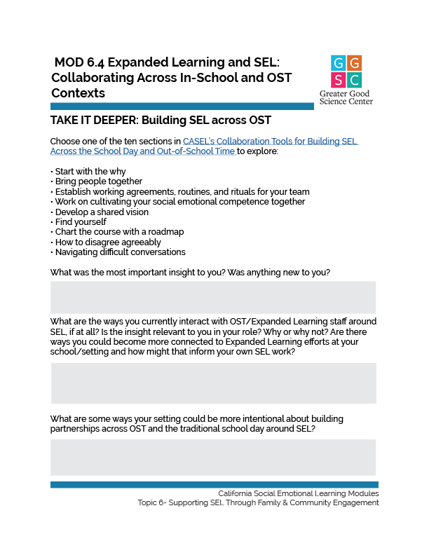
TAKE IT DEEPER
Complete “Building SEL across OST”
6.4 Expanded Learning and SEL: Collaborating Across In-School and OST Contexts
Notes:
As part of the The Partnerships for Social Emotional Learning Initiative (PSELI) initiative, “a multiyear effort exploring whether and how children can benefit from intentional partnerships between schools and out-of-school time programs focused on building social and emotional skills,” CASEL developed several tools for its Guide to Schoolwide SEL that align with and provide support to enact the insights above. https://ggie.berkeley.edu/wp-content/uploads/2023/10/6.4-Building-SEL-across-OST.pdf

Slide 58
Video
Connecting School and Afterschool with Shared Practices
Notes:
Next, watch the following video Scaffolding Academics with Social Emotional Skills in the Afterschool Space from Edutopia.
https://www.edutopia.org/video/connecting-school-and-afterschool-shared-practices

Slide 59
Let’s Discuss!
Video: Connecting School and Afterschool with Shared Practices
Which of the shared signature practices seemed most effective to you?
Are any of these practices in place in your setting?
What SEL competencies are addressed in each signature practice?
How do these practices set students up for success in other areas of the program?
What strategies would you use to implement shared practices in your setting?
Notes:
Watch: Connecting School and Afterschool with Shared Practices (5:48 from Edutopia): https://www.youtube.com/watch?v=P-w9sX_TOLk
Let’s Reflect:
Which of the shared signature practices seemed most effective to you?
Are any of these practices in place in your setting?
Pair and Share: Discuss In groups of 2-3:
What SEL competencies are addressed in each signature practice?
How do these practices set students up for success in other areas of the program?
What strategies would you use to implement shared practices in your setting?

Slide 60
California Social and Emotional Learning
6.5 Aligning around SEL Through Community Partnerships
TOPIC 6: Supporting SEL through Family and Community Engagement
Notes:
SEL happens in a variety of settings across home, school, and community. We can increase the consistency of SEL for students with intentional planning, partnership, and alignment between schools, families, and community-based organizations.

Slide 61
Learning Objectives
6.5 Aligning around SEL Through Community Partnerships
Survey potential community partners
Learn how schools and community-based organizations can work together effectively to create opportunities for SEL development
Explore how community organizations can build on SEL and academic skills, link skills to real-world application, and introduce students to career pathways or further education and training
Consider the role of community organizations in building trusting relationships with families and leveraging assets for equity
Link Objectives to Developmental Indicators in California Transformative SEL Competencies
Notes:
Expand objectives to California Developmental Indicators through making connections to SEL competencies in California on developmental age span.
Sourced from CDE (July 2023): The California Department of Education (CDE) aims to support and advance the efforts of educators across California who are working to fully integrate systemic SEL and equity by building on the promise of T-SEL as a concept. To provide these supports, the CDE has articulated developmental indicators for CASEL’s five core competencies:
Self-Awareness (Intrapersonal Focus)
Self-Management (Intrapersonal Focus)
Social Awareness (Interpersonal Focus)
Relationship Skills (Interpersonal Focus)
Responsible Decision-Making (Inter and Intrapersonal)

Slide 62
Family-School-Community Partnerships
(Warren, Hong, Rubin, & Uy, 2009)
Notes:
Framing: Community partners offer resources, services, and expertise that can enrich our school programs to benefit students and families, strengthening relationships and reinforcing a sense of belonging and promoting community engagement. Today, we’re going to explore what makes a successful community-family-school partnership and surface possible local organizations to include.
Ask: What community organizations are we already partnering with and what services do they provide?
Successful School-Parent-Community Partnerships
In Beyond the Bake Sale: A Community-Based Relational Approach to Parent Engagement in Schools the authors state “[m]any of the same neighborhoods with families who are disconnected from public schools . . . often contain strong community-based organizations with deep roots in the lives of families.” They contrast traditional parent involvement approaches with three parent engagement practices often used by youth serving Community-Based organizations (CBOS). https://citeseerx.ist.psu.edu/viewdoc/download?doi=10.1.1.615.9522&rep=rep1&type=pdf
These approaches are based on case studies of successful school-parent-community partnerships:
An emphasis on relationship building among parents and between parents and educators
A focus on the leadership development of parents
An effort to bridge the gap in culture and power between parents and educators
Have participants review the chart on the slide and discuss:
What are the assets CBOs have that lend themselves to promoting SEL?
With a pair or small group, list the SEL skills students and adults may experience when engaged in and negotiating community-based learning.: SEL Skills (https://ggie.berkeley.edu/practice/identifying-social-emotional-learning-skills/)

Slide 63
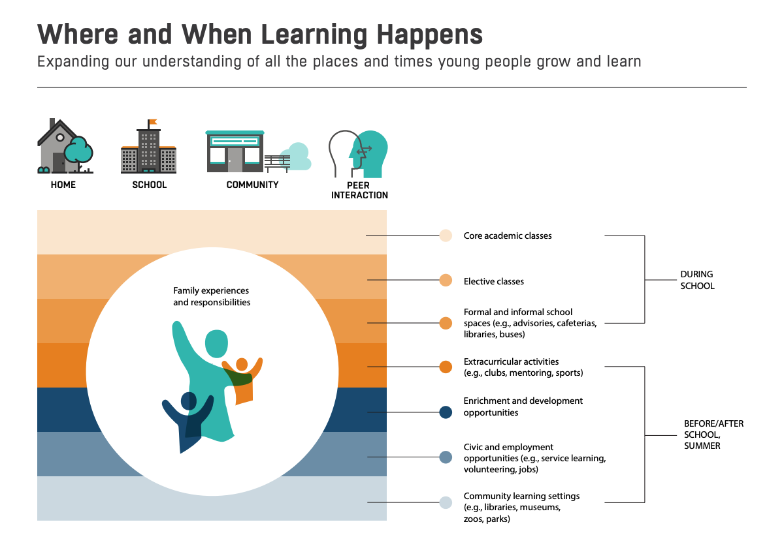
What SEL Skills do you think are primarily developed during the traditional school day?
What SEL Skills may be developed through extracurricular and enrichment activities?
What SEL Skills may be developed in civic opportunities or community learning settings?
What are likely commonalities and differences across settings?
From a Nation at Risk to a Nation at Hope
Notes:
Where and When Learning Happens
Framing: Learning happens at home, during school, in out-of-school stem (OST), and within the community through adult-student and peer interactions.
Examine the continuum of learning infographic from the report From a Nation at Risk to a Nation at Hope. (https://www.aspeninstitute.org/wp-content/uploads/2023/02/Nation-at-Hope.pdff)
What SEL skills do you think are primarily developed during the traditional school day?
What SEL skills may be developed through extracurricular and enrichment activities?
What SEL skills may be developed in civic opportunities or community learning settings?
What are likely commonalities and differences across settings? Why?

Slide 64
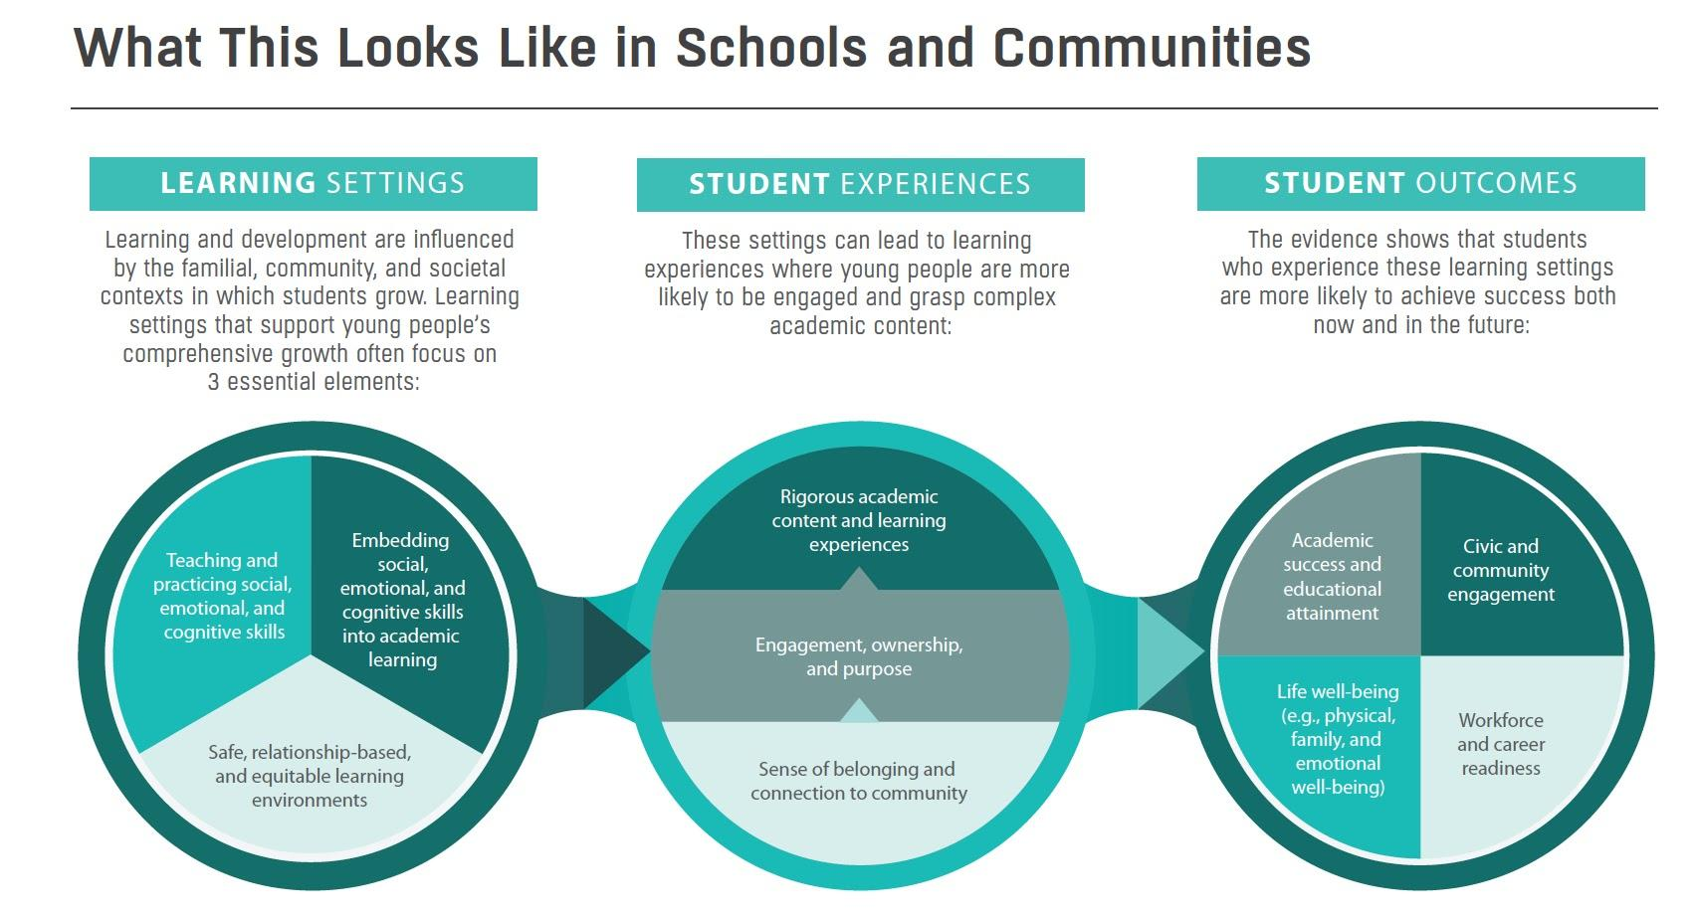
How Learning Happens
From a Nation at Risk to a Nation at Hope
Notes:
How Learning Happens
A report from From a Nation at Risk to a Nation at Hope (https://nationathope.org/wp-content/uploads/2018_aspen_final-report_full_webversion.pdf) describes elements of success as student engagement, ownership, and a sense of purpose. Review this infographic from the report that discusses what this looks like in schools and communities.

Slide 65
Let’s Discuss
In what ways do community partnerships offer high engagement for students and what SEL skills are involved? What differentiates this from the traditional school day?
How does a sense of belonging and connection to the community drive engagement, ownership, and purpose? What SEL skills are activated by these qualities? How can we best embed and align the 3 essential elements for learning across settings?
Looking at the student outcomes, can you characterize the key SEL skills associated with each outcome and link it to potential community-based experiences?
Notes:
How Learning Happens
A report from From a Nation at Risk to a Nation at Hope (https://nationathope.org/wp-content/uploads/2018_aspen_final-report_full_webversion.pdf) describes elements of success as student engagement, ownership, and a sense of purpose. Review this infographic from the report that discusses what this looks like in schools and communities.

Slide 66
SEL in Service of Community Empowerment
Centering students’ lived experiences and identities in SEL
Using SEL discussions to validate students’ experiences of oppression
Using SEL instruction as a space to encourage youth to use their voice for social justice
Notes:
Community-based organizations can leverage SEL as a way to foster community-level responsibility and empowerment. SEL competencies can help youth understand community issues. In turn, community organizations are well situated to help youth increase and harness their self and social awareness, and connect them to adults in the community with resources for advocacy and civic involvement.
SEL practice focused on transforming inequitable settings and systems, and promoting justice-oriented civic engagement is being defined as Transformative SEL by CASEL. In the brief Rising Up Together: Spotlighting Transformative SEL in Practice with Latinx Youth, (https://casel.org/wp-content/uploads/2021/03/SEL-Rising-Up-Together.pdf) the authors highlight three principles for engaging transformative SEL:
Centering students' lived experiences and identities in SEL
Using SEL discussions to validate students’ experiences of oppression
Using SEL instruction as a space to encourage youth to use their voice for social justice
Community-based organizations, especially those focused on community empowerment, can hold key practices to strengthen student SEL such as acknowledging trauma that occurs at a community level, engaging reflection about the impact of current events and issues affecting students, and providing ways students can build agency.

Slide 67
Let’s Discuss
How can you help students to become informed and engaged citizens and community members?
Are you doing everything you can to move your students closer to opportunity?
Who are partners or stakeholders you could connect with to understand more about the role CBOs can play supporting social and emotional learning?
Notes:
Discussion questions:
How can you help students to become informed and engaged citizens and community members?
Are you doing everything you can to move your students closer to opportunity?
Who are partners or stakeholders you could connect with to understand more about the role CBOs can play in supporting social and emotional learning?
CBOs contribute to a learning ecosystem across the community, interconnecting the places where children, youth, and families live, learn, work, and play. In the paper Thriving, Robust Equity, and Transformational Learning and Development (https://www.air.org/sites/default/files/Thriving-Robust-Equity%2C-and-Transformative-Learning-and-Development-July-2020.pdf) connections between schools, families, and community organizations create opportunity structures to address inequity and increase resilience to adversity.
Learning is facilitated by safe, inclusive, connected, and culturally responsive and engaging environments. Relationships and experiences are highlighted as multipliers of transformative learning and development. Community-based partnerships provide connections between youth, families, schools, and community to increase relationships, experiences, and opportunities to learn and develop SEL skills.

Slide 68
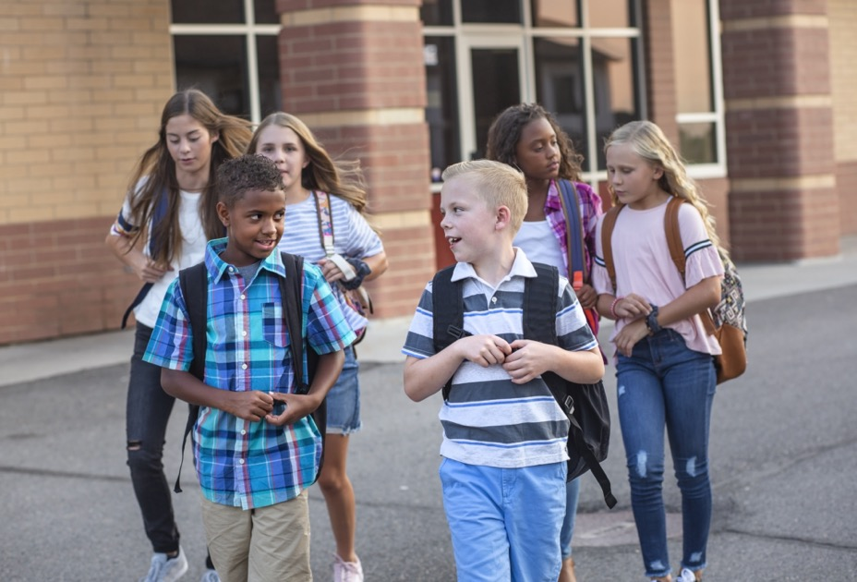
Let’s Discuss
What community-based organizations in your locale can affirm diverse student identities and students’ lived experiences?
What community-based organizations can provide opportunities for student agency?
Notes:
Learning is facilitated by safe, inclusive, connected, and culturally responsive and engaging environments. Relationships and experiences are highlighted as multipliers of transformative learning and development. Community-based partnerships provide connections between youth, families, schools, and community to increase relationships, experiences, and opportunities to learn and develop SEL skills.
Discussion questions:
1. Going back to the list that was generated in Welcoming Ritual what community-based organizations in your locale can affirm diverse student identities and students’ lived experiences?
2. What community-based organizations can provide opportunities for student agency

Slide 69
Collective Impact and SEL
Shared community vision
Evidence-based decision making
Collaborative action
Investment and sustainability
Notes:
The Strive Together Cradle to Career Network takes a collective impact approach to improving social, emotional, and academic outcomes for youth. This report, Stronger Results with Community Based Organizations (https://www.strivetogether.org/wp-content/uploads/2017/03/CollectiveImpact_StrongerResultswithCBOs_2014.pdf) includes the Cradle to Career Framework for Building Civic Infrastructure. The four key areas are:
Shared Community Vision
Evidence-based Decision making
Collaborative Action
Investment and Sustainability

Slide 70
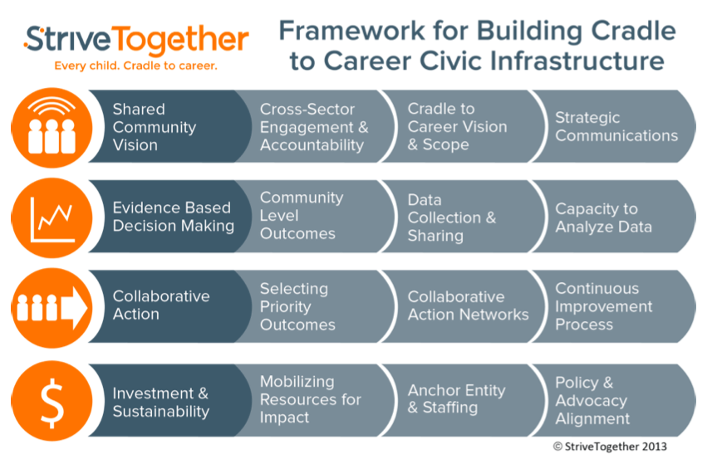
Notes:
The Strive Together Cradle to Career Network takes a collective impact approach to improving social, emotional, and academic outcomes for youth. This report, Stronger Results with Community Based Organizations (https://www.strivetogether.org/wp-content/uploads/2017/03/CollectiveImpact_StrongeResultswithCBOs_2014.pdf) includes the Cradle to Career Framework for Building Civic Infrastructure. The four key areas are:
Shared Community Vision
Evidence-based Decision making
Collaborative Action
Investment and Sustainability
Have participants complete the downloadable pdf on the next slide.

Slide 71
TAKE IT DEEPER
Complete “Creating a Network Approach”
6.5 Aligning around SEL Through Community Partnerships
Notes:
https://ggie.berkeley.edu/wp-content/uploads/2023/10/6.5-Creating-a-Network-Approach.pdf

Slide 72
Case Study
Check out three different Case Studies and reflect on the questions below.
Case Study: Blue Lake Rancheria Fosters SEL and Culturally Responsive Education Through Community Partnerships in Humboldt County
Case Study: Community-based Watershed Education Spawns New Generations of Scientists
Case Study: Traditional Ecological Knowledge (TEK) and Culturally Sustaining Education
Reflect: What did you notice about the variety of community-based learning opportunities offered through partnerships with district, tribal, nonprofit, and government organizations? Were there 1-2 programs that peaked your interest?
Choose a community-based program described above and explore. What SEL skills might students develop through their engagement?
What SEL opportunities for adults are presented in these programs?
List several potential partners or locations for community-based learning in your area. What sorts of programs can you imagine? What possibilities for SEL can you envision?

Slide 73
THE RESULTS
98%
OF THE WORLD POPULATION RATED THEMSELVES 9 ON THE HAPPINESS SCALE
Contributing Consultants
Pamela McVeagh-Lally
and
Barbara Short

