Slide 1
California Social and Emotional Learning Topic 3
Teaching for Social, Emotional, and Academic Development

Slide 2
California Social and Emotional Learning
Add a Welcoming Ritual here
Notes:
Add SEL Signature Practices to your presentation. https://ggie.berkeley.edu/wp-content/uploads/2023/05/Welcoming_Closing-Activities.pptx
The SEL 3 Signature Practices are one tool for fostering a supportive environment and promoting SEL. They intentionally and explicitly help build a habit of practices through which students and adults enhance their SEL skills.
For a short presentation of what SEL 3 Signature Practices are, along with a list of practices, see the following:
https://docs.google.com/presentation/d/1utb0X71RHbzQdt-aZmOQfiFkg_kHltO7i-hUoOPb2m0/edit?usp=sharing

Slide 3
California Social and Emotional Learning
3.1 Preparing to Support SEL in Classrooms
TOPIC 3: Teaching for Social, Emotional, and Academic Development
Notes:
Adult Readiness for SEL

Slide 4
Learning Objectives
3.1 Preparing to Support SEL in Classrooms
Examine four important components for preparing teachers to support SEL in their classrooms:
Exploring your own SEL skills as an educator
Facing resistance to SEL
Three misconceptions about social, emotional, and academic development
Shifting educator mindsets
Link Objectives to Developmental Indicators in California Transformative SEL Competencies
Notes:
Expand objectives to California Developmental Indicators through making connections to SEL competencies in California on developmental age span.
Sourced from CDE (July 2023): The California Department of Education (CDE) aims to support and advance the efforts of educators across California who are working to fully integrate systemic SEL and equity by building on the promise of T-SEL as a concept. To provide these supports, the CDE has articulated developmental indicators for CASEL’s five core competencies:
Self-Awareness (Intrapersonal Focus)
Self-Management (Intrapersonal Focus)
Social Awareness (Interpersonal Focus)
Relationship Skills (Interpersonal Focus)
Responsible Decision-Making (Inter and Intrapersonal)

Slide 5
“When educators are given the time and space to learn and practice essential social and emotional skills, they can develop their resilience, align their instructional choices to their purpose, and become more effective educators for their students.”
Notes:
Read the quote to the group. Then, briefly introduce the connections between social, emotional, and academic development (SEAD) for students and adult SEL skills.
From the Introduction:
In recent years, new knowledge about brain science and research about learning has demonstrated that emotions and social relationships strongly influence learning. More specifically, Dr. Immordino-Yang, affective neuroscientist and human-development psychologist, has found that it is neurobiologically impossible to build memories, engage complex thoughts, or make meaningful decisions without emotions.
These are key lessons from what we now know about how people learn effectively:
Positive relationships and attachments are the essential ingredients that catalyze healthy development and learning.
Children actively construct knowledge when they are able to connect what they know to what they are learning within their social and cultural contexts.
Learning is social, emotional, and academic. Children learn best when they feel safe and supported, have a sense of belonging, and instruction is engaging and challenging.
Learning is enhanced by physical activity, joy, and opportunities for self-expression.
Students’ perceptions of their own ability influence learning. Labels and ranking against other students create stigma, while readiness and purpose motivate the development of new skills.
These findings have significant implications for teaching and learning: in order for schools to support students effectively, schools need to be centered on relationships, where social and emotional skills are fully integrated with academic learning, and where students are encouraged to develop confidence and ownership over their learning.

Slide 6
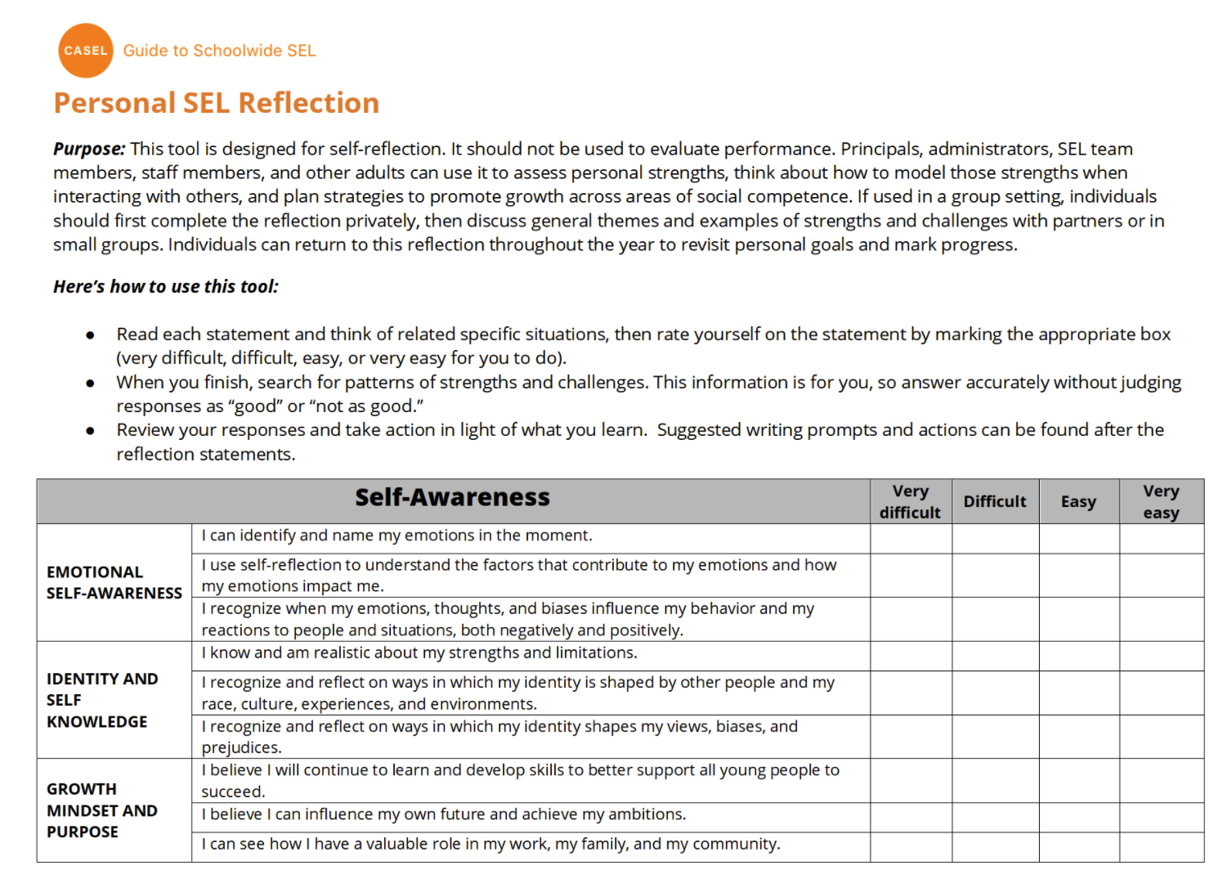
Practice
Personal SEL Reflection Tool How are we using our SEL skills as educators? Let’s find out!
3.1 Preparing to Support SEL in Classrooms
Notes:
We’re going to start by individually exploring our own SEL skills as educators, so that we can better understand our SEL strengths and areas for growth. Developing SEL skills is a lifelong process -- challenges and problems never go away!
Share with the group that they will be using a Personal SEL Reflection Tool (https://ggie.berkeley.edu/practice/personal-sel-assessment-and-reflection/) to consider how they model and practice social and emotional skills in the classroom. Play soft instrumental music and provide enough time for teachers to go through the tool individually. Briefly discuss confidentiality (see next slide). Teachers will discuss their observations in small groups, but they will not be asked to turn in their own personal SEL reflection. This is a professional growth tool.

Slide 7
Confidentiality
This is a professional growth tool, not an evaluation. While you will discuss insights gained from taking this survey with a small group, you don’t have to show the results to anybody.
Notes:
Reflecting on your own SEL skills can feel vulnerable, especially in a group. When introducing this activity, start by sharing that this is a reflection tool for personal and professional growth, not a performance assessment. Share the objectives of the activity, and make sure teachers have enough time to reflect individually first. Use pairs or small groups to create a more intimate conversation among teachers. If you notice that teachers are not open to sharing, think about creating opportunities for them to get to know each other better that will help build trust.

Slide 8
Reflection
Based on your self-assessment, what are some skills that you intentionally practice? How do they support your interactions with students?
What are some skills that you’d like to further develop?
List one or two actions that you can take to develop areas of growth.
How will you know that you are making progress to develop your skills?
What kind of support would you need in order to intentionally practice these social, emotional, and cultural competencies on a daily basis?
Notes:
Facilitation Tip:
Consider journaling reflections on these discussion questions independently, in pairs, or in small groups.

Slide 9
Whole Group Discussion
What are the main takeaways from this reflection?
Are there patterns and/or themes that we should be addressing as a staff?
What kind of support would you need to stay motivated and accountable to continue growing your social and emotional competencies?

Slide 10
Understanding Resistance to
SEL
Notes:
Resistance to change is a normal part of any change process. SEL team leaders and administrators can support educators by considering and exploring, as a group, the elements that make it difficult for teachers to embrace or implement SEL. While this conversation may be difficult, when teachers have an opportunity to share their concerns—while administrators and leaders take the time to understand these issues—they can become more invested in implementing SEL in their classrooms.

Slide 11
Explore It
The goal of SEL is to create a school community that promotes students’ social, emotional, and academic learning.
The work is focused on building cultures of belonging, developing emotional resilience, trauma-informed practices and culturally responsive pedagogies in service of equitable outcomes for all students.
Notes:
Framing: Share that SEL requires much more than a single program or teaching method. Because students’ learning is influenced by their interactions across many settings, promoting student SEL requires thoughtful coordination of strategies that reach across classrooms, all areas of the school, families and community partners.

Slide 12
3 Key Strategies to
Create the Conditions for Meaningful Learning
Building a Supportive Classroom Environment: Community-Building, Creating a Sense of Belonging and Emotional Safety, Student-Centered Discipline.
Integration of SEL and Instruction: Fostering Academic Mindsets, Aligning SEL and Academic Objectives, Using Interactive Pedagogy.
Explicit SEL Instruction
Notes:
Framing: Provide 3 Key Strategies to Create the Conditions for Meaningful Learning

Slide 13
Group/Small Group Brainstorm
Share examples of how you are integrating SEL in the classroom for each key strategy
Building a Supportive Classroom Environment: Community-Building, Creating a Sense of Belonging and Emotional Safety, Student-Centered Discipline.
Integration of SEL and Instruction: Fostering Academic Mindsets, Aligning SEL and Academic Objectives, Using Interactive Pedagogy.
Explicit SEL Instruction
Notes:
As a group (or in smaller breakout groups), create a poster with examples of how teachers are integrating SEL in the classroom.

Slide 14
Use this interactive rubric to reflect on how you are integrating SEL in your classroom.
Practice
This Photo by Unknown Author is licensed under CC BY-NC
Notes:
Use this interactive rubric (https://schoolguide.casel.org/rubric/?focus-area=focus-area-3&rubric-item=supportive-classroom-environment) to reflect on the ways that teachers are implementing these 3 key strategies in their classrooms. Once teachers have an opportunity to go through the rubric individually, form small groups to discuss the results.

Slide 15
Small Group Discussion
What did you notice after completing the rubric? Are there any areas that you’d like to develop?
How is SEL in your classroom similar and/or different from other grades and/or classrooms at your school?

Slide 16
“This is too much.”
“I will never be able to do all these things well.”
“I need more time!”
Notes:
Share with the group that it is normal to experience resistance, individually or as a staff, and have thoughts like “This is too much. I will never be able to do all these things well,” or “I need more time! I cannot implement these strategies until I am sure how they can be implemented in my classroom.” Also, acknowledge educators who may feel energized by this process!

Slide 17
It is normal and healthy to experience
resistance to SEL.

Slide 18
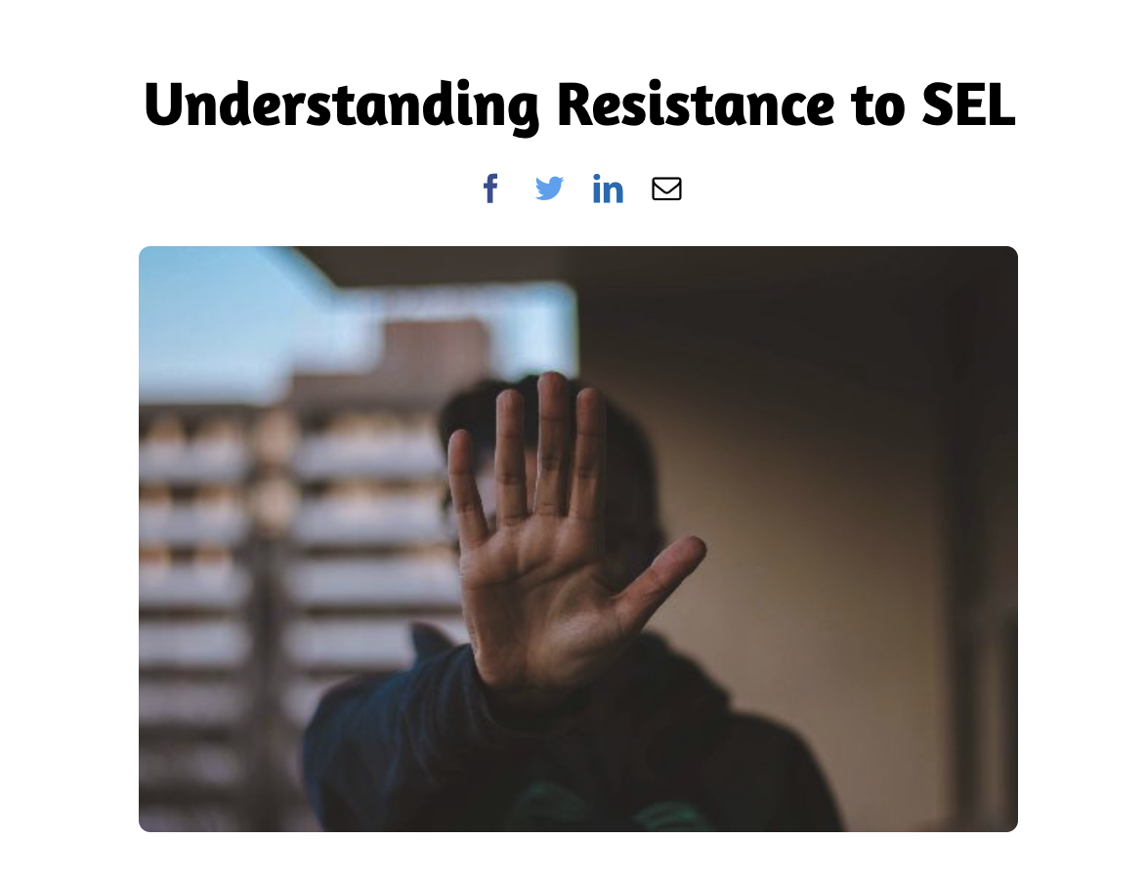
Individual Reflection
Read Article
Make two lists: one with “supports/levers” and one with “challenges” for SEL implementation in your classroom. Include aspects that are internal (your own experience, energy, interest in bringing SEL to your classroom) and external (grade level support, district commitment to SEL, etc.)
From the challenges list, identify which items belong to the 3 levels of resistance described in the article.
This Photo by Unknown Author is licensed under CC BY-NC
Notes:
Read: As a group, read this article that describes 3 levels of resistance to SEL (https://loreamartinez.com/2021/03/30/understanding-resistance-to-sel/). Allow time for teachers to reflect individually following these prompts:
Make two lists: one with “supports/levers” and one with “challenges” for SEL implementation in your classroom. Include aspects that are internal (your own experience, energy, interest in bringing SEL to your classroom) and external (grade level support, district commitment to SEL, etc.)
From the challenges list, identify which items belong to the 3 levels of resistance described in the article.

Slide 19
Small Group Discussion
What did you learn from this exercise? What were your feelings, thoughts and actions as you were reflecting on these challenges?
What supports would you need to overcome the obstacles you identified in each category?
Who can you enlist to help you increase your levers and decrease the challenges?
Which challenges are completely out of your control (and you may need to let go of)?
Write down 1 or 2 steps you can take to overcome some of the challenges you identified.

Slide 20
Shifting
Mindsets
Notes:
Note: This section can also be completed individually using this downloadable and fillable pdf (see slide 25). https://ggie.berkeley.edu/wp-content/uploads/2023/09/3.1-Shifting-Mindsets.pdf
Prepare to lead this section by first reviewing Growth Mindset for Staff.
It is important for SEL teams to come together and examine the beliefs teachers hold about SEL implementation and the role of the teacher in supporting students’ social and emotional growth. Facilitators should ensure that educators feel safe sharing their own understanding of SEL. The goal is to examine teachers’ beliefs with curiosity, so the group can together to overcome these misconceptions or others that may exist within the group.

Slide 21
Growth Mindset for Staff
What is one skill you have recently learned?
Notes:
Ask staff to share one skill they recently learned. It could be something related to their personal lives.

Slide 22
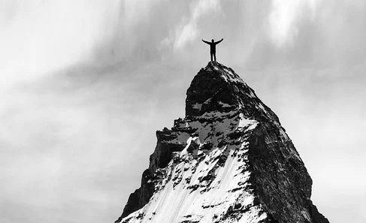
What is a “growth mindset”?
Those who believe that their abilities are developed through dedication and hard work, not innate talent—are more likely to be resilient when things get tough and persevere to achieve goals.
Dweck, 2006
Notes:
Share the definition of growth mindset, included in the Growth Mindset for Staff (https://schoolguide.casel.org/focus-area-2/learn/growth-mindset-for-staff/) activity.

Slide 23
Activity: Growth Mindset
Read the article.
Take the Mindset Quiz.
Discuss in small groups.
One takeaway you want to try.
1
2
3
4
Notes:
Use this Growth Mindset for Staff (https://schoolguide.casel.org/focus-area-2/learn/growth-mindset-for-staff/) activity, courtesy of Chicago Public Schools, to explore the concept of growth mindset as it relates to SEL implementation at your school.
Read the article: https://schoolguide.casel.org/resource/carol-dweck-on-fixed-and-growth-mindset-thinking-among-teachers/
Take the Mindset Quiz: http://homepages.math.uic.edu/~bshipley/MindsetQuiz.w.scores.pdf

Slide 24
Small Group Discussion
What was one thing that resonated with you?
Did this article motivate you to try something new?
What does the growth mindset look like at our school?
What would it take for us to adopt a growth mindset schoolwide?
Notes:
For the reflection, focus on identifying where individuals and/or the school hold a fixed mindset related to SEL implementation. Then, consider how you could might develop a growth mindset in those areas.

Slide 25
TAKE IT DEEPER
Complete “ Shifting Mindsets”
3.1 Preparing to Support SEL in Classrooms
Notes:
Slides 20-24 can also be done individually using this downloadable and fillable pdf: https://ggie.berkeley.edu/wp-content/uploads/2023/09/3.1-Shifting-Mindsets.pdf

Slide 26
California Social and Emotional Learning
3.2
Explicit SEL Instruction
TOPIC 3: Teaching for Social, Emotional, and Academic Development
Notes:
Explicit instruction of SEL skills is a key part of social, emotional, and academic development. According to Nick Yoder, CASEL’s former Director of Policy and Practice, “There are numerous evidence-based SEL programs that provide students with an opportunity to understand what those SEL competencies are. They also provide teachers with active instruction and authentic ways to engage students in developing those core competencies.” However, as we’ll learn in this module, it’s important to note that students’ varying developmental needs require different approaches to teaching SEL.

Slide 27
Learning Objectives
3.2
Explicit SEL Instruction
Explore and discuss discrete SEL skills
Review, discuss, and explore how to use the SEL Kernels from Harvard’s EASEL Lab in an elementary classroom
Explore and discuss how to teach SEL to middle and high school students in a developmentally-appropriate way
Link Objectives to Developmental Indicators in California Transformative SEL Competencies
Notes:
Expand objectives to California Developmental Indicators through making connections to SEL competencies in California on developmental age span.
Sourced from CDE (July 2023): The California Department of Education (CDE) aims to support and advance the efforts of educators across California who are working to fully integrate systemic SEL and equity by building on the promise of T-SEL as a concept. To provide these supports, the CDE has articulated developmental indicators for CASEL’s five core competencies:
Self-Awareness (Intrapersonal Focus)
Self-Management (Intrapersonal Focus)
Social Awareness (Interpersonal Focus)
Relationship Skills (Interpersonal Focus)
Responsible Decision-Making (Inter and Intrapersonal)

Slide 28
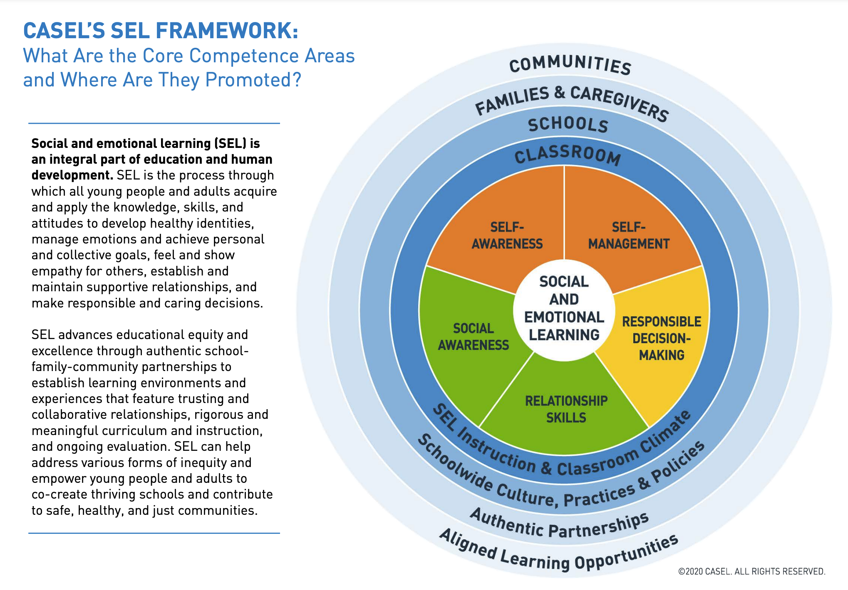
Reflect
Explore
What is a word or phrase that you really connect to? Why?
If you visited an SEL-filled classroom, what would you see?
At this point in your educator journey, how important do you think SEL is to support students’ growth?
This Photo by Unknown Author is licensed under CC BY-NC
Notes:
CASEL is the Collaborative for Academic, Social, and Emotional Learning, and is a leader in the field of SEL.
Start by reading CASEL’s definition of SEL (pg. 1) (https://casel.org/wp-content/uploads/2020/12/CASEL-SEL-Framework-11.2020.pdf). Ask participants to reflect individually and then share in small groups:
What is a word or phrase that you really connect to? Why?
If you visited an SEL-infused classroom, what would you see?
At this point in your educator journey, how important do you think SEL is to support students’ growth?

Slide 29
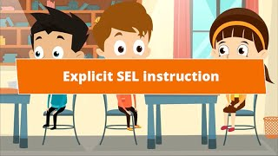
Video
Explicit SEL Instruction
Notes:
As you watch this video, think about the ways your school is explicitly teaching SEL (if not applicable, skip this step).
Then, watch CASEL’s video Explicit SEL Instruction (https://www.youtube.com/watch?v=Dk265K7-pLY).

Slide 30
Let’s Discuss
After watching the video consider:
What are some explicit ways you and/or your colleagues are currently integrating SEL into your school?
What ideas from the video would you like to try in your classroom or as a school?
What is the role of SEL in our school community, based on the students and families we serve?
If we were extremely successful with SEL implementation, what would we see people doing/feeling/thinking? What do we need to get there?
How can we strengthen the school’s SEL instruction? What resources would make it possible?

Slide 31
Exploring Social and Emotional Competencies

Slide 32
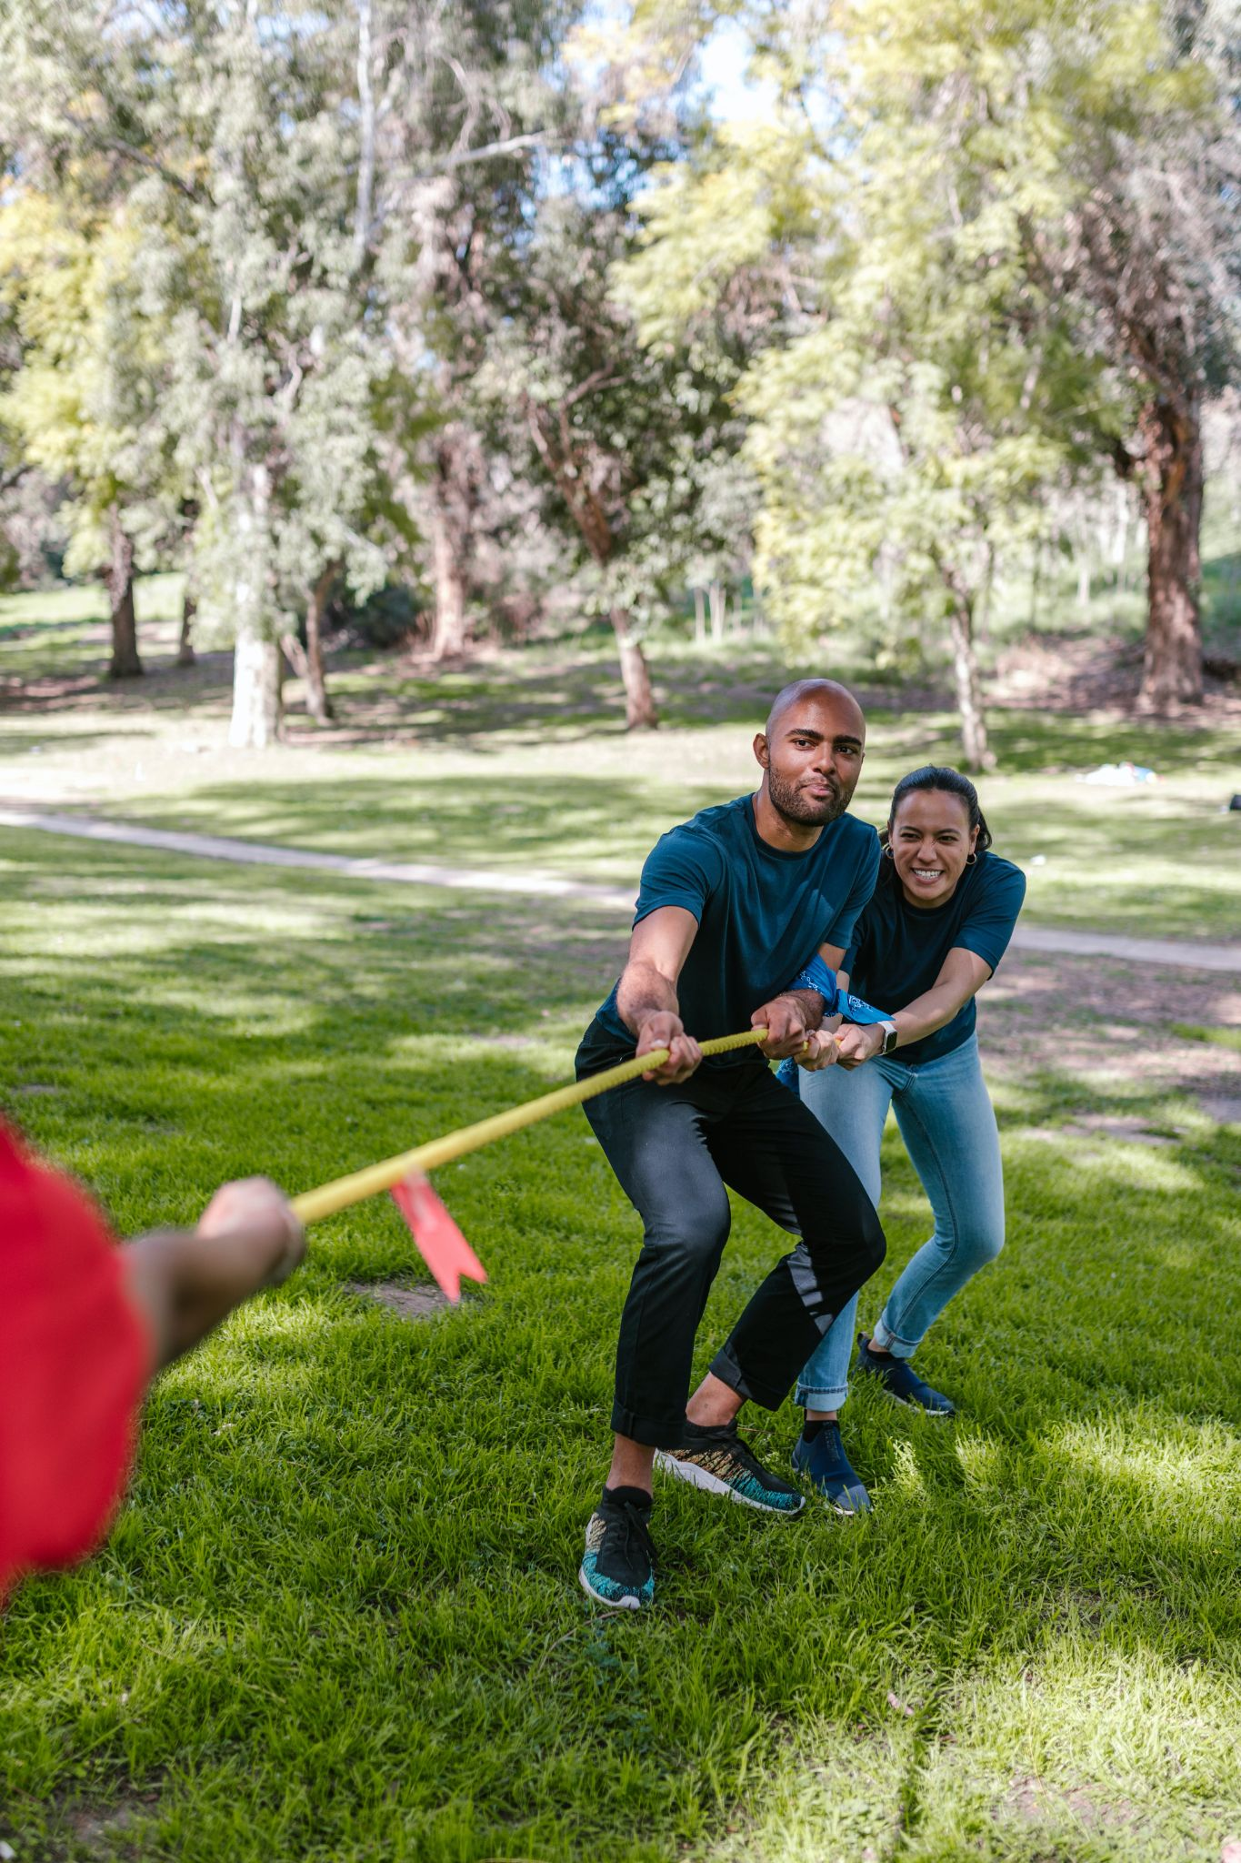
Practice:
Coming Together
This Photo by Unknown Author is licensed under CC BY-NC
Notes:
20 min.
Practice: Coming Together
Once you are done with the welcoming ritual, introduce a group activity called “Coming Together” (https://ggie.berkeley.edu/wp-content/uploads/2021/05/Come_Together_Exercise.pdf). Follow the directions in the link to engage participants in this activity. Once you decide how many people will participate in the activity, you can designate a few individuals to be observers. (Please note that you will need a long rope. Other materials listed are recommended, but not necessary to complete the activity.)

Slide 33
Debrief
What were you feeling? What was it like not to be able to see, or hear, or feel, or speak, or understand the directions?
Did you try any strategies that didn’t work? Why didn’t they work? What did you do about that? Did you step into a leadership position? Did anyone?
As a group, how did you communicate? What was difficult about communicating? What helped the communication?
How difficult was the activity for you if you had with a visible or invisible challenge?
Notes:
Debrief
Use the following prompts to debrief the activity:
What were you feeling? What was it like not to be able to see, or hear, or feel, or speak, or understand the directions?
Did you try any strategies that didn’t work? Why didn’t they work? What did you do next? Did anyone step into a leadership position?
As a group, how did you communicate? What was difficult about communicating? What helped the communication?
How difficult was the activity for you if you had a visible or invisible challenge?

Slide 34
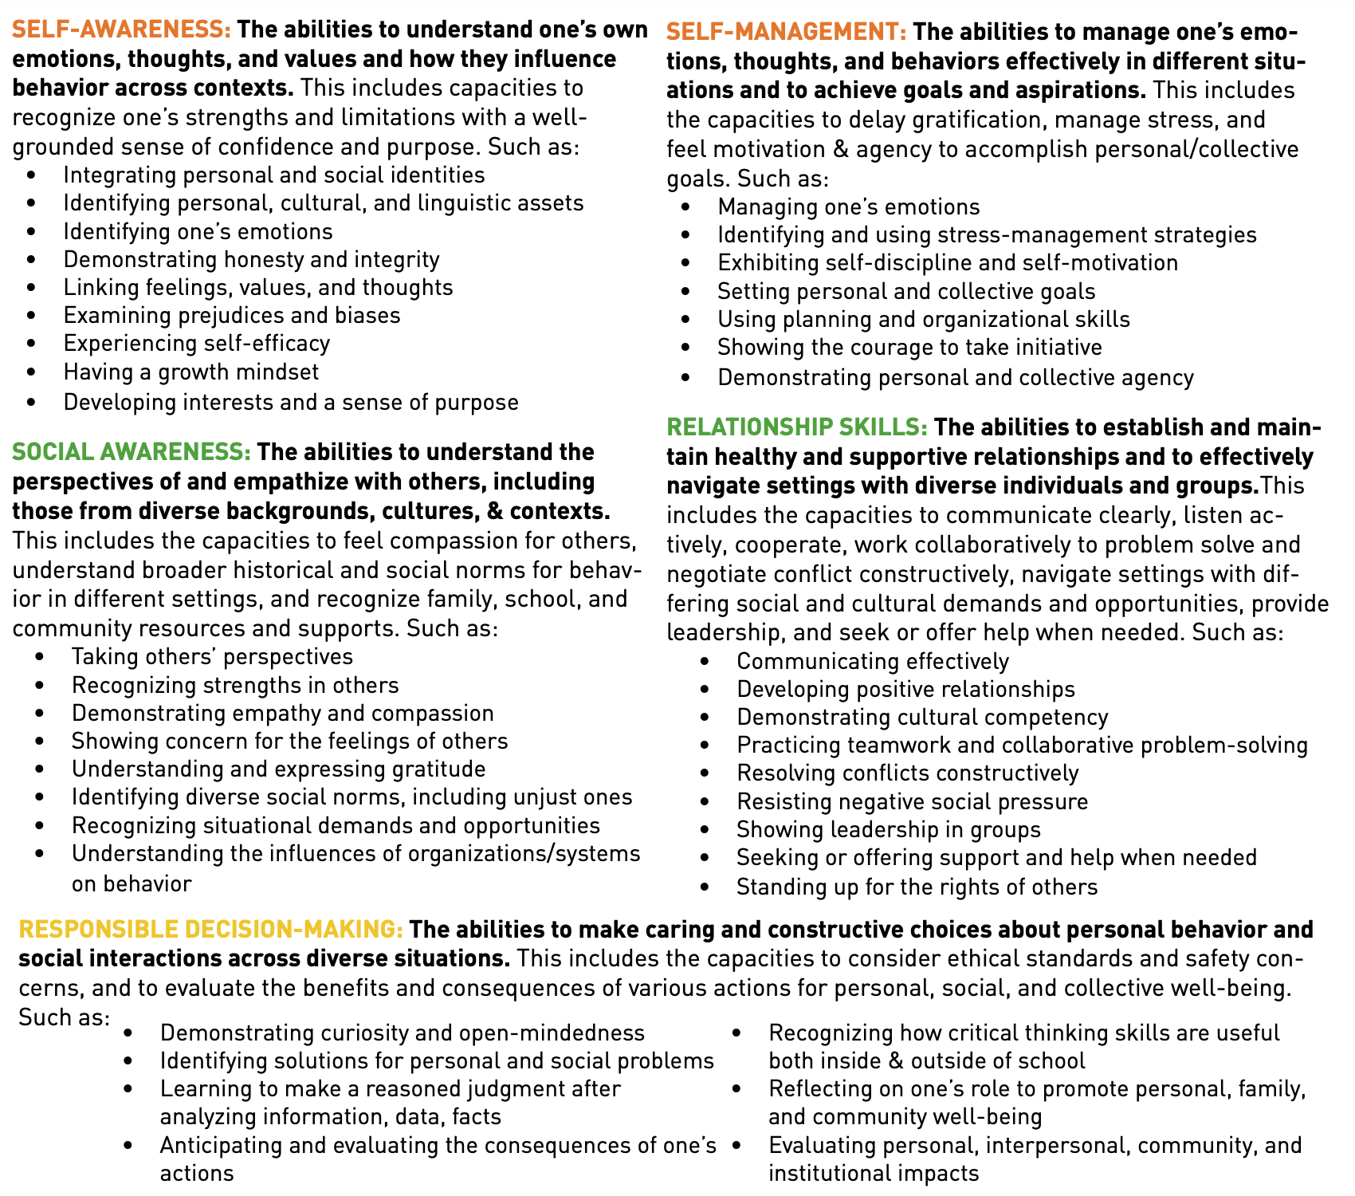
Dive Deeper
Step 1: Identify the discrete skills in each one of the CASEL 5 competencies that you used and/or observed others using.
Step 2: Which discrete skills did you not use that could have helped you complete the task?
Step 3: If you could do this activity again, what would you like to do differently? What would you like others to do differently?
Notes:
10 min.
Dive Deeper
Now, using pg. 2 from the CASEL SEL Framework (https://casel.org/wp-content/uploads/2020/12/CASEL-SEL-Framework-11.2020.pdf) document, divide the group into smaller groups (4 people max) to identify the discrete skills from each SEL competency that they used and/or saw others applying.
Step 1: Identify the discrete skills in each one of the CASEL 5 competencies that you (or others) used.
Step 2: Which discrete skills could have helped you complete the task?
Step 3: If you could do this activity again, what would you like to do differently? What would you like others to do differently?

Slide 35
For Elementary Educators
Using SEL Kernels
Kernels have been developed for grades K-6 and include a variety of activity types and instructional methods, such as games, routines, and storytelling. Each kernel includes adaptations and extension activities, as well as grade level differentiations when applicable.
Kernels for Kindergarten
Kernels for 1st grade
Kernels for 2nd grade
Kernels for 3rd grade
Kernels for 4th grade
Kernels for 5th grade
Kernels for 6th grade
Notes:
Now let’s look at explicit SEL lessons for elementary students. (If you’re working with adolescents, skip to slide 38).
Developed by Harvard University’s Ecological Approaches to Social Emotional Learning (EASEL) Laboratory, kernels are specific activities or strategies that are commonly used by research-based programs to support the growth and development of social and emotional skills and competencies.
Drawing from EASEL’s content analysis of 25 leading SEL programs, kernels have been categorized into the following constructs: cognitive, emotional, interpersonal, character, and mindset. Read more about each of these constructs.

Slide 36
For Elementary Educators
Why are Kernels Important?
Kernels offer teachers choice and flexibility.
Kernels are highly customizable.
Kernels are free and easy to use.
Kernels can be used across a wide variety of educational contexts, adding to their impact and value.
Kernels help cultivate children’s social, emotional, and behavioral skills—all keys to their success.
Notes:
Developed by Harvard University’s Ecological Approaches to Social Emotional Learning (EASEL) Laboratory, kernels are specific activities or strategies that are commonly used by research-based programs to support the growth and development of social and emotional skills and competencies.
Drawing from EASEL’s content analysis of 25 leading SEL programs, kernels have been categorized into the following constructs: cognitive, emotional, interpersonal, character, and mindset. Read more about each of these constructs.

Slide 37
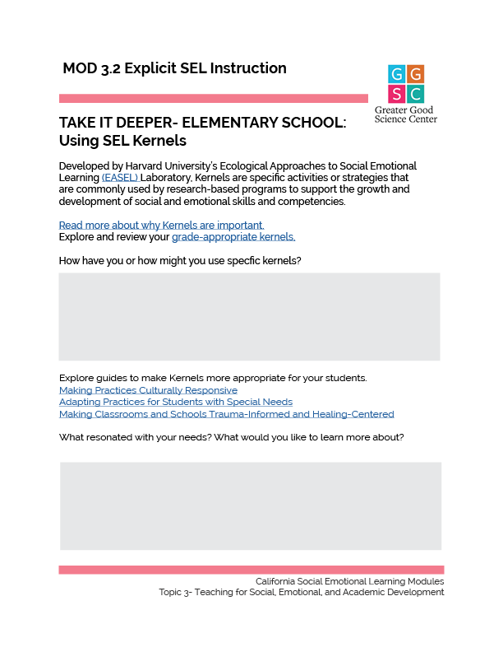
TAKE IT DEEPER
Elementary Educators: Complete “Using SEL Kernels”
3.2 Explicit SEL Instruction
Notes:
https://ggie.berkeley.edu/wp-content/uploads/2023/09/3.2-Elementary-Using-SEL-Kernels.pdf

Slide 38
For Middle and High School
Teaching SEL to Adolescence in a Developmentally-Appropriate Way
According to University of Texas professor David Yeager, “Typical SEL programs—which directly teach skills and invite participants to rehearse those skills over the course of many classroom lessons—have a poor track record with middle adolescents (roughly age 14 to 17), even though they work well with children. But some programs stand out for their effectiveness with adolescents. Rather than teaching them skills, effective programs for adolescents focus on mindsets and climate. Harnessing adolescents’ developmental motivations, such programs aim to make them feel respected by adults and peers and offer them the chance to gain status and admiration in the eyes of people whose opinions they value.”
Notes:
Now let’s look at teaching SEL to adolescents.
Invite participants to read the quote on the slide and then discuss or brainstorm ways they are currently teaching and/or integrating SEL into their work with students. Next, have participants complete the pdf on the following slide.

Slide 39
TAKE IT DEEPER
Middle School and Secondary Educators: Complete “Adolescents and SEL Programs ”
3.2 Explicit SEL Instruction
Notes:
https://ggie.berkeley.edu/wp-content/uploads/2023/09/3.2-Middle-High-Adolescents-and-SEL-Programs.pdf

Slide 40
California Social and Emotional Learning
3.3 Planning for Social-Emotional- Academic Development
TOPIC 3: Teaching for Social, Emotional, and Academic Development
Notes:
Synthesizing learnings about SEAD, today we’ll collaborate around planning integrated social, emotional, academic development lessons.

Slide 41
Learning Objectives
3.3 Planning for Social-Emotional-
Academic Development
Examine approaches for social, emotional, and academic integration that address both content standards and curricula
Plan an integrated social-emotional-academic development (SEAD) lesson
Explore 3 Signature Practices that foster a supportive learning and collegial environment and promote SEL
Link Objectives to Developmental Indicators in California Transformative SEL Competencies
Notes:
Expand objectives to California Developmental Indicators through making connections to SEL competencies in California on developmental age span.
Sourced from CDE (July 2023): The California Department of Education (CDE) aims to support and advance the efforts of educators across California who are working to fully integrate systemic SEL and equity by building on the promise of T-SEL as a concept. To provide these supports, the CDE has articulated developmental indicators for CASEL’s five core competencies:
Self-Awareness (Intrapersonal Focus)
Self-Management (Intrapersonal Focus)
Social Awareness (Interpersonal Focus)
Relationship Skills (Interpersonal Focus)
Responsible Decision-Making (Inter and Intrapersonal)

Slide 42
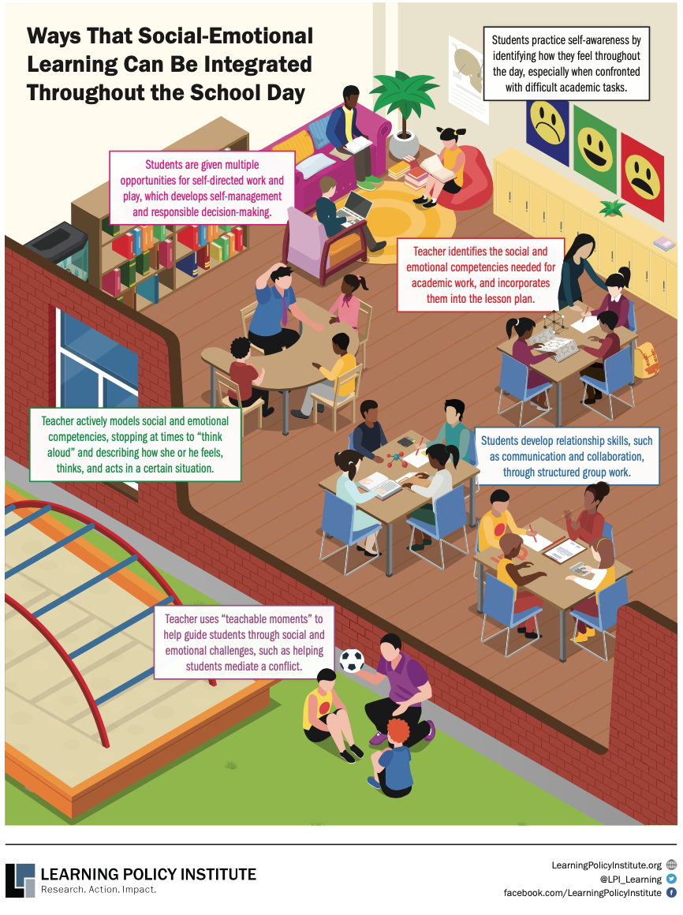
What are other ways…
to integrate SEL throughout the school day?
Notes:
Integrating SEL with academic learning happens through what students are learning (the curriculum) and how they learn it (the process).
Provide the graphic Ways that SEL Can Be Integrated Throughout the Day (https://drive.google.com/file/d/1b5IN2wNLZ3LmGiyYtXMwD1FLqKPFSmHK/view?usp=sharing) Give a few moments for review and then ask:
What are other ways to integrate SEL throughout the school day?
Partners turn and talk
Then, they share ideas with the whole group (record)

Slide 43
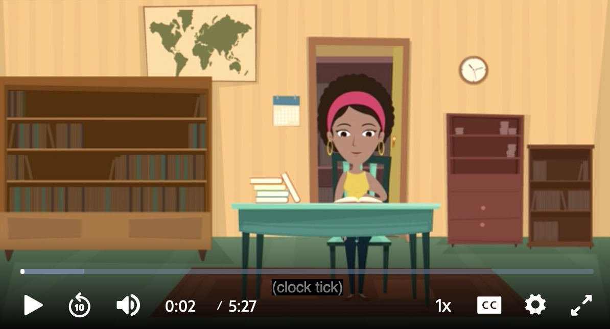
Integrating Social, Emotional, and
Academic Learning
What are ways you:
Promote academic mindsets
Tie objectives to what is relevant to your learners
Build relationships with and among students
Notes:
Show this 5 min. video from CASEL: Schoolwide SEL: SEL Integrated with Academic Instruction (https://www.youtube.com/watch?v=JCBCQrcZFEQ)
Note that we are all integrating SEL into our academic instruction—but we may not be explicitly naming it! As we debrief the video example, take time to share In grade level or content-alike small groups. Discuss any of the following:
What are ways you already:
Promote academic mindsets?
Tie objectives to what is relevant to your learners?
Build relationships with and among students?
Invite volunteers to share ideas from their group discussion.

Slide 44
Two Approaches
Notes:
Next, we explore two approaches for integrating SEL within academic instruction.

Slide 45
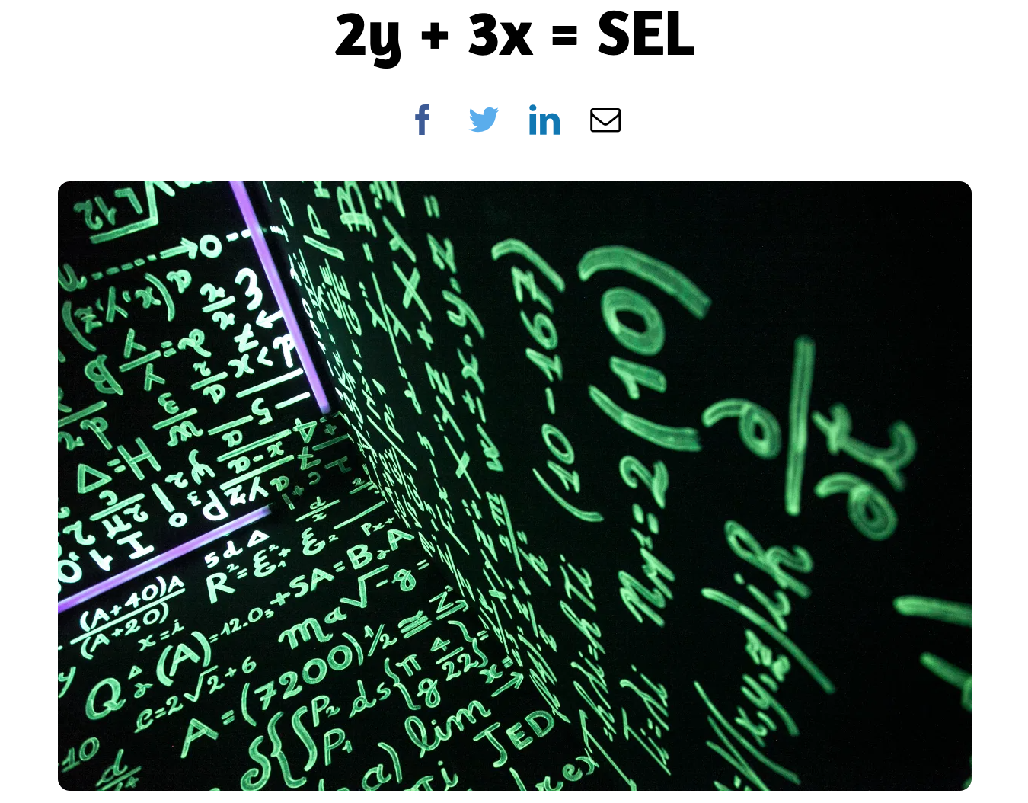
Say Something
Begin With the Standards
Turn to a partner:
What is an ”aha” or new learning?
In what ways are you already connecting content standards with SEL?
After reading this article, what are you inspired to do?
This Photo by Unknown Author is licensed under CC BY-NC
Notes:
Provide a link to 2y + 3x = SEL (https://loreamartinez.com/2016/03/22/2y-3x-sel/) and give 2-3 minutes for group members to read the article.
Ask group members to turn to a partner and “Say Something”
What is an ‘aha’ or new learning?
In what ways are you already connecting content standards with SEL?
After reading this article, what are you inspired to do?
Invite a few group members to share out with the whole group.

Slide 46
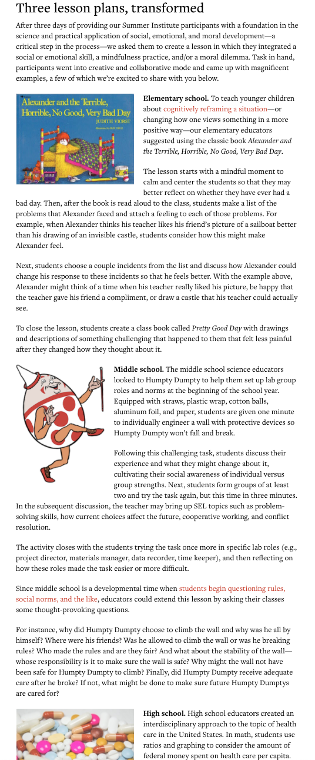
Use the School Curricula
Form 3 groups:
Everyone reads the two opening sections
Three lesson plans, transformed
Please read:
Group 1: Elementary School
Group 2: Middle School
Group 3: High School
As a group, discuss the key points. What is relevant to your context? What are some take-aways?
Share out with the whole group.
This Photo by Unknown Author is licensed under CC BY-NC
Notes:
Another way to think about integration is to make a connection between the curricula and SEL. For example, many topics, books, people, and concepts in the curricula already involve:
a person’s emotional life
an ethical dilemma
a situation calling for compassion
a societal challenge
the ethical use of knowledge
cross-group interactions
an implicit prosocial concept, such as ecosystems or the Declaration of Independence.
Provide a link to the article: How Social-Emotional Skills Can Fit into School Curricula (https://greatergood.berkeley.edu/article/item/how_social_emotional_skills_can_fit_into_school_curricula).
Ask everyone to read up to “Three lesson plans, transformed.” Then, ask group 1 to read: Elementary School, group 2 reads Middle School and group 3 reads High School.
Groups discuss key points and ideas for how they can fit SEL into their school curricula, and then share with the whole group.

Slide 47
Planning an Integrated Social, Emotional,
Academic Lesson
Notes:
Framing: Synthesizing learnings about SEAD, today we’ll collaborate around planning integrated social, emotional, academic development lessons. To start, we’ll examine SEL connections to standards.

Slide 48
Mix and Mingle
When the music starts, move around and greet your colleagues non-verbally.
When the music stops, find a partner.
Four (4) rounds
Notes:
Explain the activity:
When the music starts, move around and greet your colleagues non-verbally.
When the music stops, find a partner. (Those without a partner can join pairs to become a triad)
Four rounds, each one allowing for discussion of a Common Core Standard

Slide 49
Round #1:
Common Core Math Standard
Students make sense of problems
and persevere in solving them.
Partners discuss:
What are corresponding SEL self-awareness and self-management skills?
Notes:
Round 1: Common Core Math Standard
Students make sense of problems and persevere in solving them.
Ask partners to brainstorm corresponding SEL self-awareness self-management skills.
Invite a few volunteers to share corresponding SEL skills. (Record on chart or electronically)

Slide 50
When constructing viable arguments, students justify their conclusions, communicate them to others, and respond to the arguments of others.
Round #2:
Common Core Math Standard
Partners discuss:
What are corresponding SEL “social awareness” and “relationship” skills?
Notes:
Round 2: Common Core Math Standard
When constructing viable arguments, students justify their conclusions, communicate them to others, and respond to the arguments of others.
Ask partners to brainstorm corresponding SEL “social awareness” and “relationship” skills.
Invite a few volunteers to share corresponding SEL skills. (Record on chart or electronically)

Slide 51
RL.3.3 Describe characters in a story (e.g., their traits, motivations, or feelings) and explain how their actions contribute to the sequence of events.
Round #3:
Common Core ELA Standard
Partners discuss:
What are corresponding SEL “self awareness,” “social awareness,” and “responsible decision-making” skills?
Notes:
Round 3: Common Core English Language Arts Standard
RL.3.3 Describe characters in a story (e.g., their traits, motivations, or feelings) and explain how their actions contribute to the sequence of events.
Ask partners to brainstorm corresponding SEL “self-awareness,” “social awareness,” and “responsible decision-making” skills
Invite a few volunteers to share corresponding SEL skills. (Record on chart or electronically)

Slide 52
W.7.6 Use technology, including the Internet, to produce and publish writing and link to and cite sources as well as to interact and collaborate with others, including linking to and citing sources.
Round #4:
Common Core ELA Standard
Partners discuss:
What are corresponding SEL “relationship” and “responsible decision-making” skills?
Notes:
Round 4: Common Core English Language Arts Standard
W.7.6 Use technology, including the Internet, to produce and publish writing and link to and cite sources as well as to interact and collaborate with others, including linking to and citing sources.
Ask partners to brainstorm corresponding SEL relationship and responsible decision-making skills
Invite a few volunteers to share corresponding SEL skills. (Record on chart or electronically)

Slide 53
Group Reflection
After exploring SEL and content standards:
What are some new learnings and insights?
What do you want to keep in mind as you plan integrated SEAD lessons?
What is something you appreciated about this activity?
What SEL skills did you use or notice others using?
Notes:
Invite everyone to thank their partner and then debrief as a whole group:
What are some new learnings and insights?
What do you want to keep in mind as you plan integrated SEAD lessons?
What is something you appreciated about this activity?
What SEL skills did you use or notice others using?

Slide 54
Review Resources
Before planning an integrated social, emotional and academic lesson, take some time to review these resources from CASEL. Note the academic focus and related SEL focus..
SEL in Elementary ELA Instruction
SEL in Elementary Math Instruction
SEL in High School ELA Instruction
SEL in Middle School Social Studies Instruction
Sample lessons
Notes:
Before having participants plan an integrated social, emotional, and academic lesson using the downloadable & fillable pdf on slide 58, have them take some time to review these resources from CASEL:
SEL in Elementary ELA Instruction
SEL in Elementary Math Instruction
SEL in High School ELA Instruction
SEL in Middle School Social Studies Instruction
Sample lessons. Note the academic focus and related SEL focus.

Slide 55
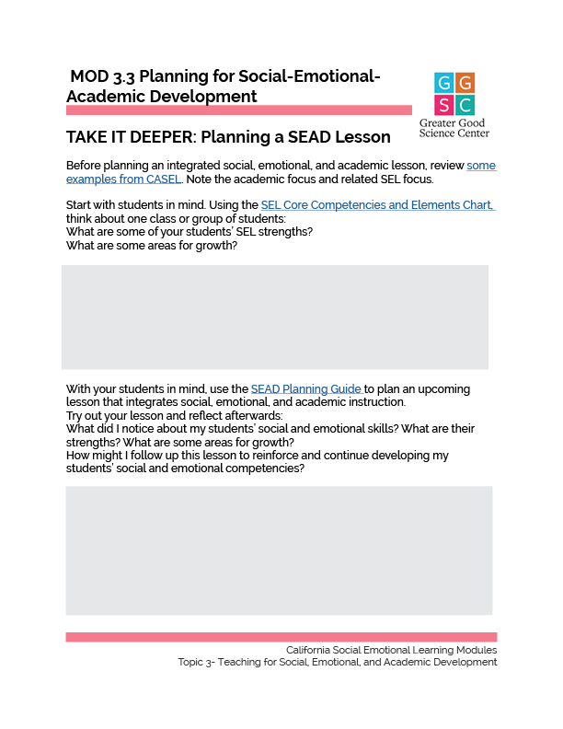
TAKE IT DEEPER
Complete “Planning a SEAD Lesson”
3.3 Planning for Social-Emotional-
Academic Development
Notes:
https://ggie.berkeley.edu/wp-content/uploads/2023/09/3.3-Planning-an-SEAD-Lesson.pdf

Slide 56
California Social and Emotional Learning
3.4
Integrating Social and Emotional Learning Into Leading
TOPIC 3: Teaching for Social, Emotional, and Academic Development
Notes:
Framing: We know the toll that stress is taking on educators and staff—overwhelm, exhaustion, and burnout are common. We also know that creating a culture of belonging with trust, safety, respect, and collaborative relationships among staff members can help mitigate this stress. Allowing educators—and students—to have a voice in decision-making and opportunities to address issues of concern in creative, equitable, and culturally responsive ways is a powerful way to begin building a school culture grounded in trust.
Leaders (district, school site, department chairs, grade level leads, instructional coaches, and mentors) are key!
This module is intended for leaders supporting themselves and other leaders in their districts, schools sites, and organizations in integrating SEL into the very fabric of our daily work.

Slide 57
Learning Objectives
3.4
Integrating Social and Emotional Learning Into Leading
Explore cultivating healthy relationships through 1:1 conversations
Explore using meetings and professional learning experiences to strengthen adult social and emotional competencies and build communities that thrive
Explore a systemic approach to SEL within the context of a Multi-Tiered System of Support (MTSS)
Link Objectives to Developmental Indicators in California Transformative SEL Competencies
Notes:
Expand objectives to California Developmental Indicators through making connections to SEL competencies in California on developmental age span.
Sourced from CDE (July 2023): The California Department of Education (CDE) aims to support and advance the efforts of educators across California who are working to fully integrate systemic SEL and equity by building on the promise of T-SEL as a concept. To provide these supports, the CDE has articulated developmental indicators for CASEL’s five core competencies:
Self-Awareness (Intrapersonal Focus)
Self-Management (Intrapersonal Focus)
Social Awareness (Interpersonal Focus)
Relationship Skills (Interpersonal Focus)
Responsible Decision-Making (Inter and Intrapersonal)

Slide 58
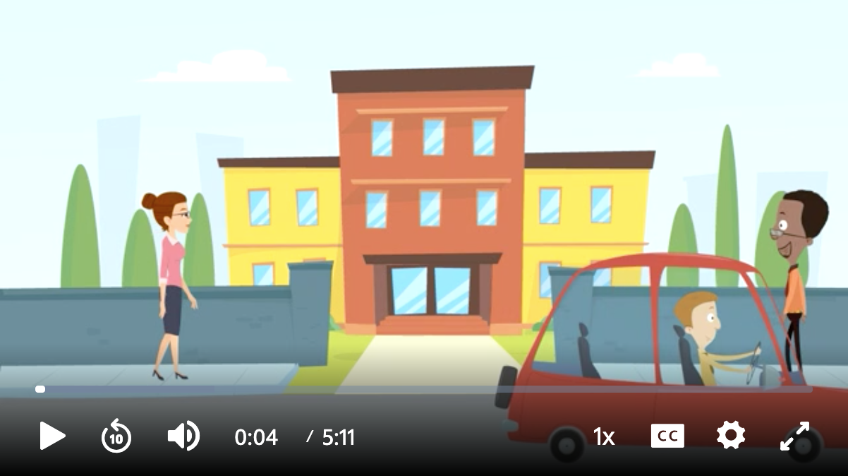
Focus on Adult SEL
3-2-1
Reflect individually.
Describe 3 ways you strengthen social and emotional development in your department, grade level, team, and/or staff meetings.
Next, create 2 intentions.
Finally, identify 1 person you can enlist to support you.
Notes:
This video offers a glimpse into how leaders can strengthen adult social and emotional competencies and impact culture and climate, staff relationships, and overall well-being.
Ask group members to reflect individually and then share as a group.
Describe three ways you strengthen social and emotional development in your department, grade level, team, and/or staff meetings.
Next, create two intentions.
Finally, identify one person you can enlist to support you.
Debrief by pointing out a variety of entry points for leaders, in the broadest sense, to strengthen relationships and collaboration among staff members, with families and community partners, which, in turn, creates a positive, respectful, and caring culture and climate, improves the overall health and wellbeing of all the adults, as well as promotes instruction with a commitment to equity, inclusion, and cultural expansiveness that teaches and reaches the whole child .

Slide 59
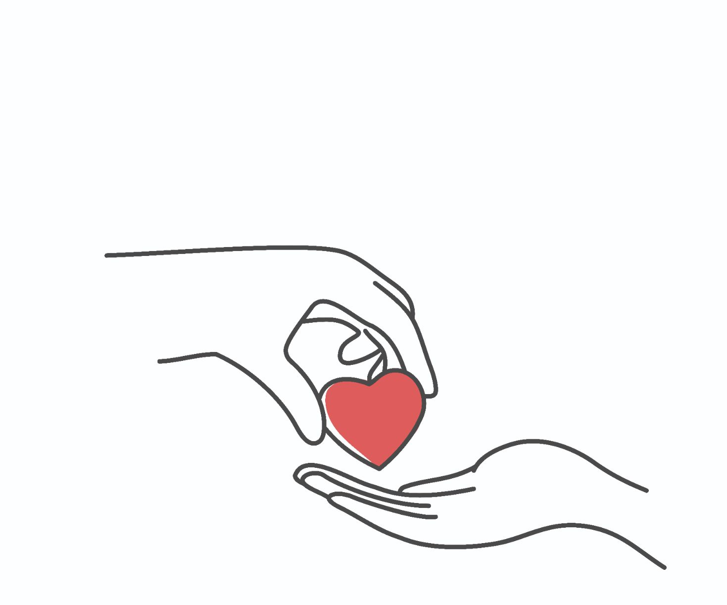
Cultivating Healthy Relationships through 1:1 Conversations
Notes:
Next, we move into cultivating 1:1 relationships through authentic conversation with scaffolds for conversation to ensure safety and trust through inquiry.
Framing: The COVID pandemic reminded us that schools are complex systems where everything affects everything else and that our energy, commitment, and sense of community are more important than materials and schedules are. New priorities have emerged, with the mental and physical health of every student and educator being the most important. Chaotic and volatile conditions require leaders committed to clarity while creating a positive, healthy climate with connected relationships with every student, teacher, and parent. A compassionate mindset is a prerequisite to productively addressing family crises and social challenges.

Slide 60
“The moment we cease to hold each other, the sea engulfs us and the light goes out.”
—James Baldwin
Notes:
Share this quote:
“The moment we cease to hold each other, the sea engulfs us and the light goes out.”
- James Baldwin
Invite group members to respond: What resonates with you?
Offer: We all have opportunities to interact with others 1:1. Each interaction is an opportunity to be compassionate, kind, generous, and accepting. We can express and affirm feelings, demonstrate our own willingness to be vulnerable, examine our own biases, and open the door for others to do the same.

Slide 61
Reflect. Write.
How are you doing, really?
What has been a personal and/or professional high this week?
What has been a personal and/or professional low this week?
Notes:
3-4 min.
Let’s start by checking in. Invite group members to reflect and write:
How are you doing, really?
What has been a personal and/or professional high this week?
What has been a personal and/or professional low this week?

Slide 62
Ways of being that will serve us
Speak Authentically: Ask “what’s in my heart?” as well as “what’s in my mind?” Share your doubts, fears, and failings as well as convictions, joys, and successes. Bring your whole self.
Listen Deeply: Slow down inwardly as well as outwardly, and listen for understanding. Allow a connection to be made. Listen deeply enough to be changed by what you hear.
Be Curious: Shift from judgment to compassionate inquiry. Ask yourself: “I wonder why they think or feel this way?” “What can I learn about myself by examining my own reaction?”
Notice: Notice your thoughts, feelings, and sensations in order to be at rest in your body and grounded in your surroundings. Notice what distracts you from the present moment. Stay as engaged as possible, even when uncomfortable.
Form triads
Share your personal check-in
(3 min. each)
After everyone has spoken, share “noticings” with one another.
Emotions expressed
Body language, facial expressions
Specific words, phrases, thoughts
Commonalities, patterns, trends among group members
I noticed...
Notes:
15-20 min.
Before sharing, offer these guidelines:
Share authentically
Listen deeply
Be curious
Notice self and others
Invite participants to read silently. Invite members to “lift up” a disposition that resonates with them today.
Form triads or groups of four. Ask each member to share their check-in (3 min. each—self-monitor).
After everyone has spoken, invite group members to share what they noticed in another group member. This could be an emotion that was expressed, body language, facial expressions, words, phrases, thoughts, and even commonalities, patterns or trends among group members
Bring the whole group back together. Invite volunteers to share about their experience.

Slide 63
Interpersonal Curiosity
Inquiring
with
Open-Ended Questions
Notes:
60 min.
Framing: We all show up differently in relationships. We have many influences throughout our lifetime...our families, our cultural backgrounds, our peer groups, our community, and even our location. The purpose of this exploration is to reflect on ways we show up in relationships and to understand more deeply who we are in relationships.

Slide 64
Mixed quality relationships (positive qualities with less helpful interactions) actually cause stress and lack of trust. Satisfying relationships (with someone who understands your problems and gives the kind of support you really want) are related to more resilient patterns of stress reactivity.
From The Telomere Effect,
Elissa Epel, Ph.D and Elizabeth Blackburn, Ph.D.
Notes:
Share this quote:
Mixed quality relationships (positive qualities with less helpful interactions) actually cause stress and lack of trust. Satisfying relationships (with someone who understands your problems and gives the kind of support you really want) are related to more resilient patterns of stress reactivity.
From The Telomere Effect,
Elissa Epel and Elizabeth Blackburn
Invite a few volunteers to share what this means to them, or what resonates.

Slide 65
Reflect
What would you like people to say about you?
Jot down three qualities or attributes of you at your best in relationships.
v
Notes:
Start off by asking individuals to reflect:
What would you like people to say about you?
Jot down three qualities or attributes of you at your best in relationships.

Slide 66
In this relationship, I am...
Receptive Argumentative Open Finding fault and blame Curious Judgmental Appreciative Going for win-win solutions | Responsible Distracted Compassionate Non-Judging Defensive Harsh Assertive Present | Justifying my actions Closed Acknowledging Dismissive Putting my needs ahead of their needs Deferential Avoiding conflict Something else...
v
Notes:
Next, ask group members to draw three“heads” on their paper.
The head on the left is a close family member or friend. Really allow yourself to picture that person—feel what it’s like being together.
Look over the list of qualities,, and select a few that really represent how you show up in relationship with this close family member or friend.
The head in the middle is a more neutral person to you—it could be a co-worker or acquaintance. Again, really imagine that person.
Look over “ways of being in a relationship” with this person in mind.
How do you show up with this person?
Finally, the head on the right is someone you have a hard time working with or being with. Allow yourself to imagine a typical interaction with this person. What emotions come up?
Once more, review the ways of being in relationship with this person in mind.
How do you show up with this person?

Slide 67
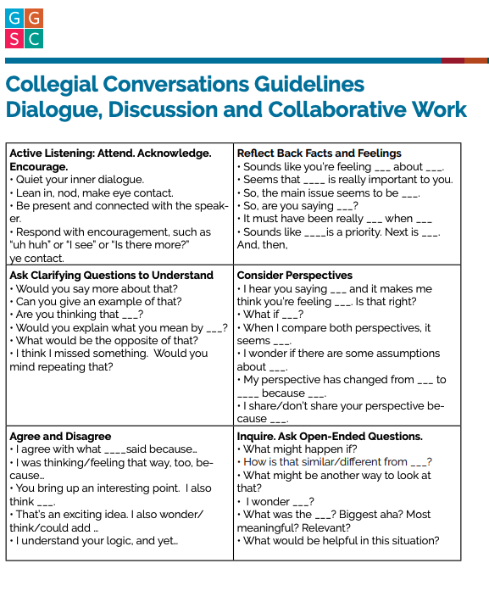
Open-Ended Questions
Conversation Guidelines
Ask questions you do not have answers to.
Ask questions to help the other person reflect— not to satisfy your own curiosity.
Use the person’s language.
Be brief and to the point.
Use creative metaphors.
Avoid yes/no and right/wrong responses.
Notes:
Before group members pair up, offer guidelines for open-ended questions:
Ask questions you do not have answers to.
Ask questions to help the other person reflect— not to satisfy your own curiosity.
Use the person’s language.
Be brief and to the point.
Use creative metaphors.
Avoid yes/no and right/wrong responses.
Refer back to these Collegial Conversation Guidelines (https://ggie.berkeley.edu/wp-content/uploads/2021/06/Module4_CollegialConversationsHandout.pdf) , if needed.

Slide 68
Partner Conversations
Part 1: Share (10 min)
Partner A shares whatever they feel comfortable sharing.
Partner B listens and then gently inquires, asking open-ended questions to support reflection about the ways you show up differently in relationships.
Switch (5 min. each)
Part 2: Explore (10 min.)
Now, consider that person who is difficult for you—and with whom you show up in a relationship differently than with a close family member/friend or even someone more neutral than you.
If you were to show up as your best self, what would need to happen? What would need to shift in YOU in order to show up with the qualities you mentioned at the outset, i.e., What would you would like people to say about you?
Notes:
Form partners for 1:1 conversations.
Part 1: Share (10 min.)
Partner A shares whatever they feel comfortable sharing. B listens and then inquires, asking open-ended questions to support reflection about the ways you show up differently in relationships and why. How might your respective genders, races, cultural backgrounds, sexual identities, abilities, religions or other factors be influencing those relationships?
Switch. (5 min. each)
Part 2: Explore (10 min.)
Now, consider that person who is difficult for you—and with whom you show up in a relationship differently than with a close family member/friend or even someone more neutral than you.
If you were to show up as your best self, what would need to happen? What would need to shift in YOU in order to show up with the qualities you mentioned at the outset, i.e., What would you would like people to say about you?

Slide 69
Debrief
What was surprising to you?
What do you want to keep in mind about influences on relationships with students and families?
What is something your partner said or did that gave you the sense they understood and supported you?
v
Notes:
Debrief with the whole group.
What was surprising to you?
What do you want to keep in mind about influences on relationships with students and families?
What is something your partner said or did that gave you the sense they understood and supported you?
Acknowledge the group’s willingness to be authentic, present, and supportive of one another.

Slide 70
“Our actions entrench the power of the light on this planet. Every positive thought we pass between us makes room for more light. And if we do more than think, then our actions clear the path for even more light. That is why forgiveness and compassion must become more important principles in public life.”
—Representative John R. Lewis (1940-2020)
Notes:
Share a final quote:
“Our actions entrench the power of the light on this planet. Every positive thought we pass between us makes room for more light. And if we do more than think, then our actions clear the path for even more light. That is why forgiveness and compassion must become more important principles in public life.”
Representative John R. Lewis (1940-2020)
Invite a few comments. What words or phrases resonate with you?

Slide 71
Entry Points: Meetings and Professional Learning Experiences
Notes:
40-60 min. total
Overview: We have explored the 3 Signature SEL Practices for designing classroom lessons. Here we adapt the design principles to develop robust meetings and professional learning sessions that strengthen adult SEL competencies and capacities, while also cultivating a climate of respect, support and meaningful engagement.
NOTE for MARIAH: NEED TO LINK TO SEL PRACTICES ONCE HAVE URL

Slide 72
What is least useful?
How do you like your feedback?
What is most useful?
Notes:
Make a T chart.
Begin by asking the group “How do you like your feedback? What kind of feedback is most helpful?” Generate ideas and record.
Then, ask, What kind of feedback is least useful?
Ask group members to take a moment to reflect on the type of feedback they typically provide to others (adults and/or students)

Slide 73
Read. Discuss.
Triads discuss:
What is an ‘aha’ or new learning?
How might this article influence the ways you give feedback to others?
Notes:
Provide the article or link to Tell Me So I Can Hear (https://ggie.berkeley.edu/wp-content/uploads/2021/05/tell-me-so-i-can-hear-1.pdf)
Ask triads to discuss:
What is an ‘aha’ or new learning?
How might this article influence the ways you give feedback to others?
Invite volunteers to share new learnings and intentions.

Slide 74
Plan a Meeting or Professional Learning Experience
Applying 3 Signature SEL Practices
Notes:
Framing: The 3 Signature SEL Practices provide design principles for integrating SEL into any meeting or professional learning session. Additionally, meetings and professional learning sessions need a section for sharing the goals and agenda referring back to norms and agreements, and even addressing feedback, or parking lot questions. Thus an Overview section in every agenda is important. Equally important is addressing business and announcement items. Thus, a Managing section can easily follow engagement with the main topic and precede the Optimistic Closure. SEL considerations that include thinking about the immediate needs of the staff as well as addressing broader social issues are important, too. Planning is driven by many factors and in this section, we’ll start by reviewing design principles and then move to deeper, relevant SEL considerations.

Slide 75
3 Signature SEL Practices
SEL 3 Signature Practices Playbook - Casel Schoolguide
Open each meeting, professional learning experience, or lesson with a WELCOME INCLUSION ACTIVITY, ROUTINE, OR RITUAL that is grounding, builds community, and connects to the work ahead
Use ENGAGING strategies to anchor thinking and learning throughout the experience. Build in a balance of interactive and reflective experiences, varied in complexity to practice SEL skills, and sequenced to support your group’s current needs.
Close each experience in an intentional way. An OPTIMISTIC CLOSURE supports individual and shared understanding of the learning, celebrates accomplishments, helps identify next steps, or makes connections to one’s own context.
Notes:
Begin by reviewing the 3 Signature SEL Practices.
Invite participants to share any experiences with the 3 Signature Practices.

Slide 76
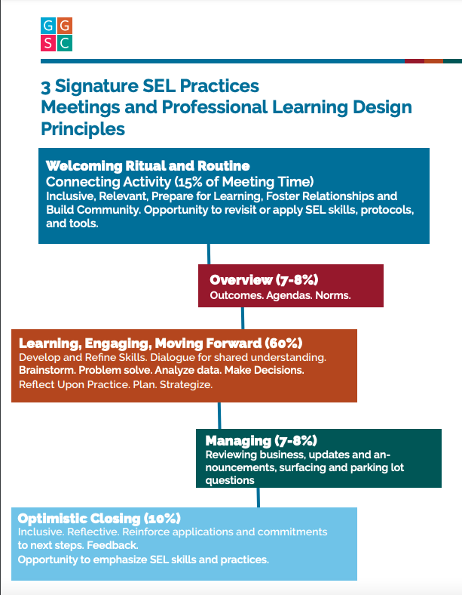
Notes:
Offer Meetings and Professional Learning Design Principles (https://ggie.berkeley.edu/wp-content/uploads/2021/06/Meeting-and-Design-Principles_Final.pdf) as a way to think about a meeting design that is based on the 3 Signature SEL practices and builds in those other essentials--an Overview--with meeting/PL goals, agenda, norms, etc. as well as a Managing section that addresses business and announcements.

Slide 77
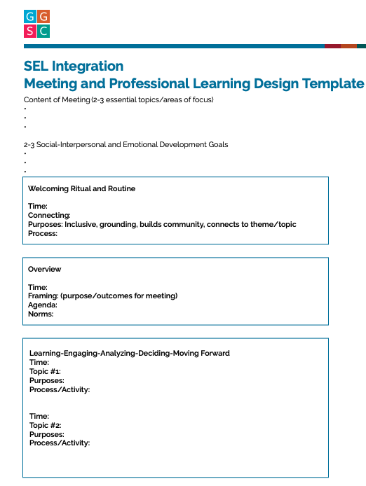
Planning Considerations
What self-awareness skills do you plan to address? In what ways might you integrate personal and social identities, examine prejudice and bias, identify and label emotions, link feelings, values, and thoughts?
How can you integrate stress management and/or emotion regulation strategies in your meeting or professional learning session?
In what ways can you cultivate social awareness? How might you engage group members in perspective-taking, compassion, and/or identifying social norms, including unjust ones?
How will you foster the relationship skills needed for collaborative problem-solving, learning, engaging with one another around the topic(s) of focus?
In what ways will you foster critical thinking and decision-making for solutions to personal and social problems and wellbeing?
Notes:
10 min.
Ask group members to select an upcoming meeting or professional learning experience for focus. First, invite leaders to consider the SEL questions on the left side of the slide.
What self-awareness skills do you plan to address? In what ways might you integrate personal and social identities, examine prejudice and bias, identify and label emotions, link feelings, values, and thoughts?
How can you integrate stress management and/or emotion regulation strategies in your meeting or professional learning session?
In what ways can you cultivate social awareness? How might you engage group members in perspective-taking, compassion, and/or identifying social norms, including unjust ones?
How will you foster the relationship skills needed for collaborative problem-solving, learning, engaging with one another around the topic(s) of focus?
In what ways will you foster critical thinking and decision-making for solutions to personal and social problems and wellbeing?
Next, provide a hard copy or link to the Meeting/Professional Learning Planning Guide (https://ggie.berkeley.edu/wp-content/uploads/2021/06/Module4_PlanningTemplateFinal.pdf) to support thinking and planning.
Provide a link to the one page 3 Signature SEL Practices for Adults (https://www.ousd.org/Page/15473) as a handout or link to the 3 Signature Practices Playbook (https://schoolguide.casel.org/resource/three-signature-sel-practices-for-adult-learning/).

Slide 78
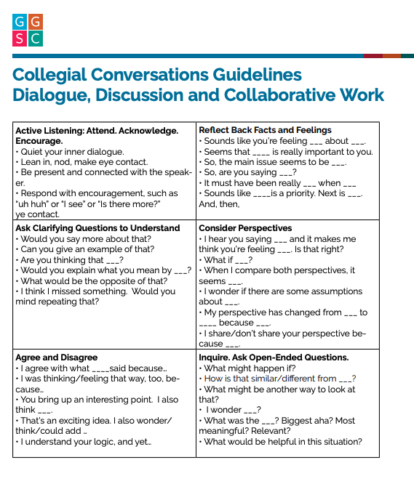
Partner Feedback
Conversation Guidelines
Partner A shares their meeting/professional learning plan. B listens, summarizes, and asks clarifying questions, if appropriate.
Partner A identifies the type of feedback they would like.
Partner A and B engage in brainstorming and discussion about the lesson plan, with B inquiring, asking open-ended questions, and offering feedback in the area(s) requested.
Switch. (10 min. each)
Notes:
After approximately 10 min. of individual planning time, form partners. Partners share plans with one another and provide feedback.
Partner A shares their meeting/professional learning plan. B listens, summarizes, and asks clarifying questions, if appropriate.
Partner A identifies the type of feedback they would like.
Partner A and B engage in brainstorming and discussion about the lesson plan, with B inquiring, asking open-ended questions, and offering feedback in the area(s) requested.
Switch. (8-10 min. each)
Remind group members of the Conversation Guidelines (https://ggie.berkeley.edu/wp-content/uploads/2021/06/Module4_CollegialConversationsHandout.pdf). Provide a link or hard copy.

Slide 79
Debrief
What is something your partner said or did that supported your thinking and helped improve your plan?
Fill in the blanks:
Before I was thinking….
Now I’m thinking….
Notes:
Debrief (5-7 min.)
Ask volunteers to share:
Debrief by asking participants to share ways their partner said or did that supported their thinking and helped improve their plan?
Fill in the blanks:
Before I was thinking…
Now I’m thinking...

Slide 80
Towards
Systemic SEL
Notes:
Note: This section can be completed individually using this downloadable and fillable pdf (see slide 97).
60 min. total
Framing: In addition to 1:1 conversations, meetings, and professional learning as entry points for SEL, the learning environment itself can strengthen a staff’s social and emotional development and overall well-being. Leaders use examples from positive classroom learning environments as a launching pad for thinking about the adults’ environment. Then, we put it all together with a systems approach to SEL that includes strengthening adult SEL, promoting SEL for students, and practicing continuous learning and improvement with formative assessments.

Slide 81
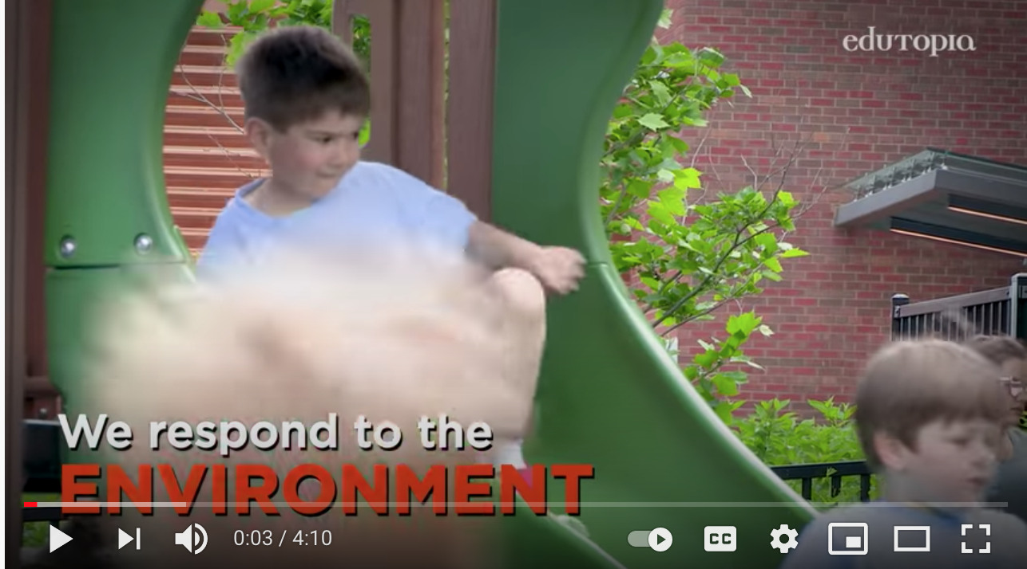
Watch.
Brainstorm
What would a positive environment for the adults include?
How might we enhance our social and emotional supports?
With your group, brainstorm your dream environment.
Prepare to share out with colleagues.
Notes:
• Begin by watching Creating a Positive Learning Environment together. (https://www.youtube.com/watch?v=T9ynlPs_NTM).
• We know the learning environment is important for our students. It is just as important for the adults. What would a positive learning environment for the adults include? How might we enhance our social and emotional supports?
• Activity Instructions:
• Give each table group a chart and colored markers to record their brainstorming.
• Ask groups to envision ways to enhance their social and emotional supports and create a chart (or other representation) for sharing out to the whole group.

Slide 82
Share Ideas.
Discuss.
What outcomes might result from improving our environment?
What are some concrete and do-able next steps?
Notes:
Ask one person from each group to share their ideas.
Post the charts.
Group members reflect and share with one another whole and/or small group:
What outcomes might result from improving our environment?
What are some concrete and doable next steps?

Slide 83
Putting it All Together:
A Systems Analysis
Notes:
Framing: A systems approach to SEL has the potential to create profound change within a school. In CA, MTSS provides an overarching frame for whole child education for ALL students. CA’s SEL Guiding Principles (2018) commit CA educators to whole child education and equity, building capacity, partnering with families and communities, and continuous learning and improvement.
A comprehensive SEL systemic plan includes strengthening adult SEL, promoting SEL for students, and practicing continuous improvement within environments that include classrooms, schools, families, and communities. This is a long-term process and is most effective when all members of the school community are aware of, committed to, and take ownership of SEL. And, it begins with taking stock of current practices, envisioning where you want to go and planning how to move forward. CASEL offers a School Guide to help school communities address systemic SEL.

Slide 84
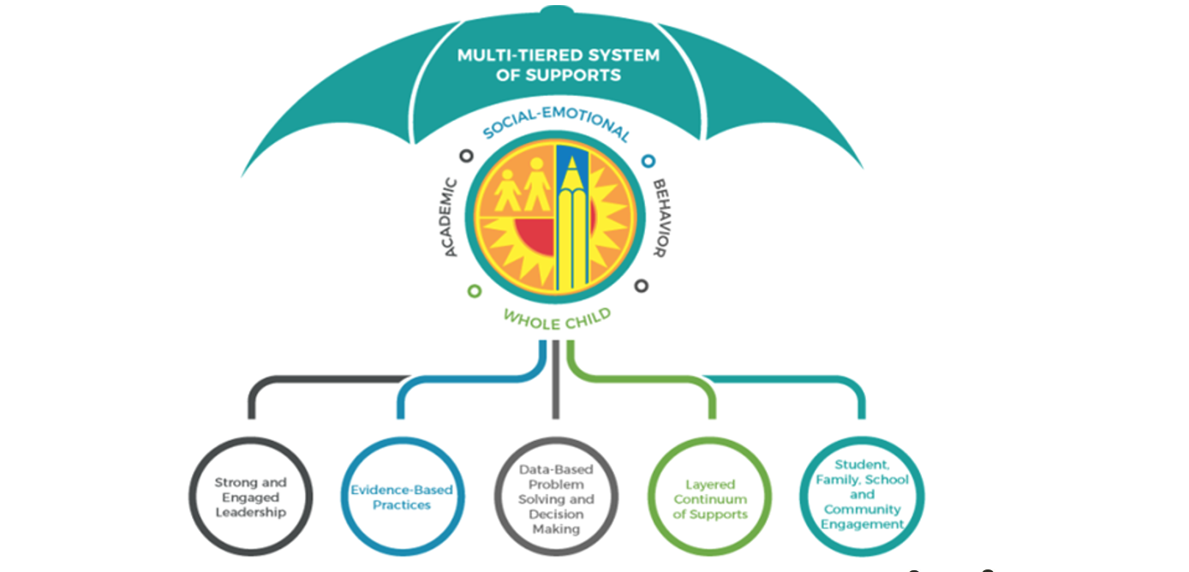
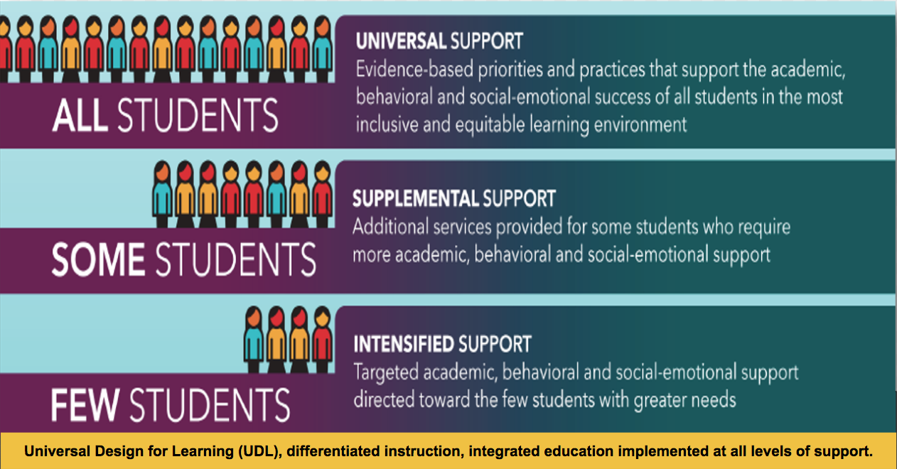
California MTSS Framework
Inclusive Social-Emotional Learning—
a critical feature
Notes:
A Multi-Tiered System of support is organized in tiers (e.g. All—Universal, Some—needing supplemental supports and A Few—needing intensified support) for whole child education that ensures academic, social, emotional learning and respectful behavior towards others.
In most versions of the MTSS graphic (and even in this umbrella graphic), SEL is visualized as a separate section, yet, it is an integral part of whole child education.

Slide 85
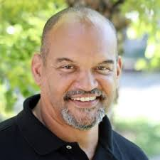
Transformative SEL
SEL serves as a mechanism for equity by:
Healing & resisting oppression
Advancing collective well-being
Reimagining relationships & learning environments
Redistributing power
Co-designing communities where we all belong & thrive
A process whereby young people & adults build strong, respectful and lasting relationships that facilitate co-learning through critical examination of root causes of inequities, and the development of collaborative solutions to personal, community, and societal concerns
—Robert Jagers, Ph.D., VP of Research, CASEL
Notes:
Emphasize CA’s SEL Guiding Principles include whole child education and a commitment to equity. Invite someone to read Transformative SEL.
Add that SEL serves as a mechanism for equity by: (Invite a different person to speak aloud each principle)
Healing & resisting oppression
Advancing collective well-being
Reimagining relationships & learning environments
Redistributing power
Co-designing communities where we all belong & thrive

Slide 86
Exploring 5 Components
Individually:
Read your section.
Use the rubric to assess and identify areas for continuous improvement in your focus area.
Review the considerations and ideas to inform how you might strengthen this area in your district or at your site.
As a group:
Share and discuss your assessments , ideas, and considerations.
Form groups.
Strengthen Adult SEL
A Supportive Classroom Environment
Explicit SEL Instruction
Integration of SEL and Academic Instruction
Practice Continuous Improvement
Notes:
Activity Instructions:
Form 5 groups. Assign each group a topic.
Strengthen Adult SEL (https://schoolguide.casel.org/focus-area-2/overview/)
A Supportive Classroom Environment (https://schoolguide.casel.org/focus-area-3/classroom/a-supportive-classroom-environment/)
Explicit SEL Instruction (https://schoolguide.casel.org/focus-area-3/classroom/explicit-sel-instruction/)
Integration of SEL and Academic Instruction (https://schoolguide.casel.org/focus-area-3/classroom/integration-of-sel-and-instruction/)
Practice Continuous Improvement (https://schoolguide.casel.org/focus-area-4/overview/)
After groups are formed, provide the instructions and links.
Individually, read your section. (5-7 min.)
Use the rubric to assess and identify areas for continuous improvement in your context.
Review the considerations and ideas to inform how you might strengthen this area in your district or at your site.
As people finish up their individual assessments and planning, invite group members to share and discuss their assessments, ideas and considerations. (10 min.)

Slide 87
Debrief
Share Out
Describe key points about that area/domain
Considerations
Ideas for improvement
Whole Group
What might be other considerations and ideas for improvement
Notes:
Debrief (5-7 min.) as a group
Invite a volunteer from each area of focus to:
Describe key points about that area/domain
Considerations
Ideas for improvement
Ask the larger group to add other considerations and ideas for improvement (if time)

Slide 88
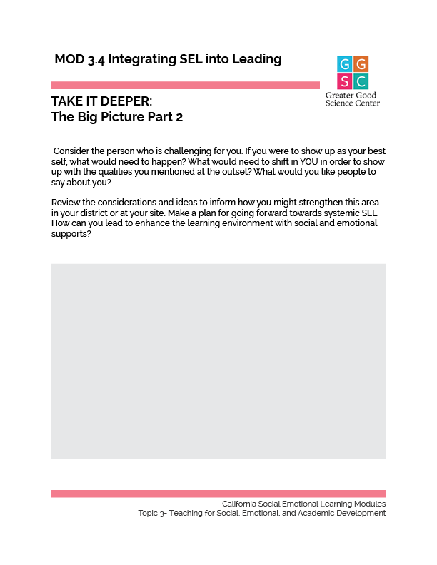
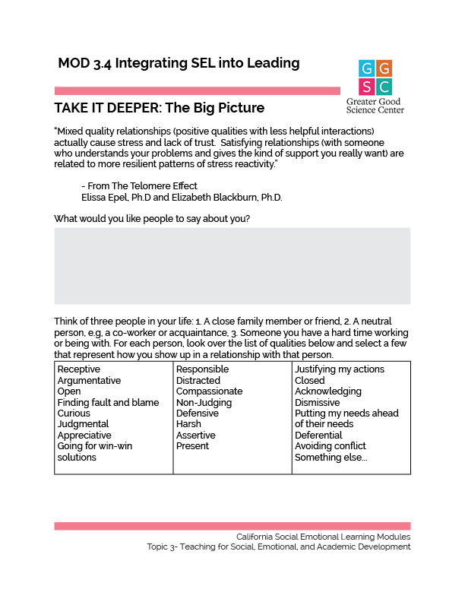
TAKE IT DEEPER
Complete “The Big Picture”
3.4
Integrating Social and Emotional Learning Into Leading
Notes:
https://ggie.berkeley.edu/wp-content/uploads/2023/09/3.4-The-Big-Picture.pdf
https://ggie.berkeley.edu/wp-content/uploads/2023/09/3.4-The-Big-Picture-Part-2.pdf

Slide 89
California Social and Emotional Learning
Add an Optimistic Closure here
Notes:
Add SEL Signature Practices to your presentation.
The SEL 3 Signature Practices are one tool for fostering a supportive environment and promoting SEL. They intentionally and explicitly help build a habit of practices through which students and adults enhance their SEL skills.
For a short presentation of what SEL 3 Signature Practices are, along with a list of practices, see the following:
https://docs.google.com/presentation/d/1utb0X71RHbzQdt-aZmOQfiFkg_kHltO7i-hUoOPb2m0/edit?usp=sharing

Slide 90
THE RESULTS
98%
OF THE WORLD POPULATION RATED THEMSELVES 9 ON THE HAPPINESS SCALE
Contributing SEAD Consultants
Wendy Baron, M.A.
and
Lorea Martinez, Ph.D.

