Slide 1
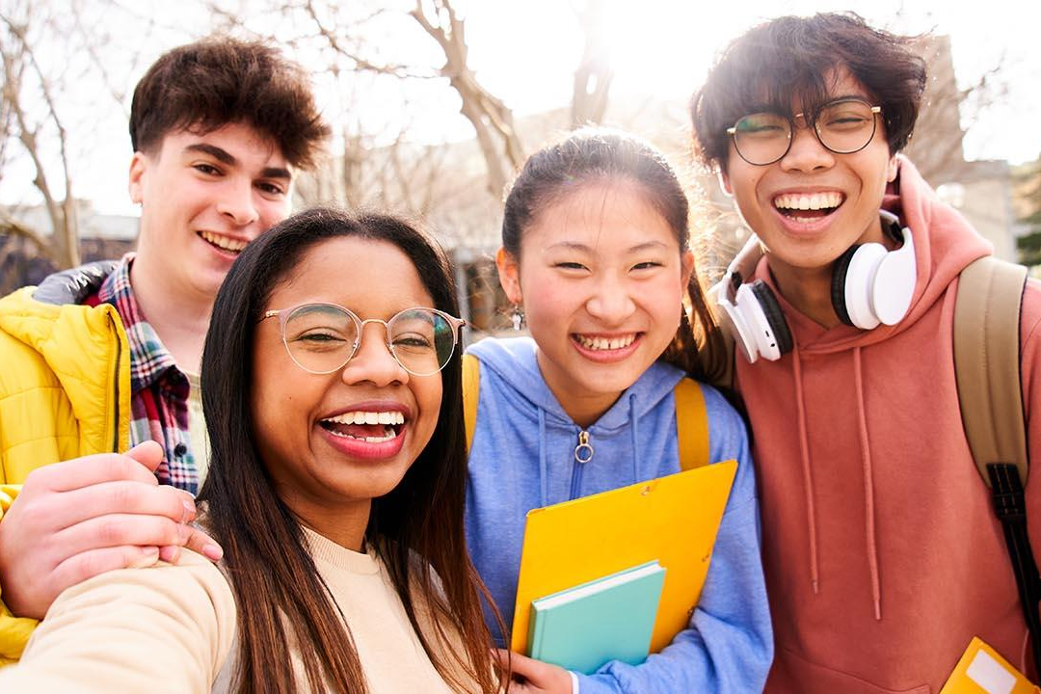
California Social and Emotional Learning Topic 2
Safety & Belonging in Classrooms and Schools
Notes:
Designed & narrated by Vicki Zakrzewski, Ph.D., Education Director
https://ggie.berkeley.edu/person/vicki-zakrzewski/

Slide 2
California Social and Emotional Learning
Add a Welcoming Ritual here
Notes:
Add SEL Signature Practices to your presentation.
The SEL 3 Signature Practices are one tool for fostering a supportive environment and promoting SEL. They intentionally and explicitly help build a habit of practices through which students and adults enhance their SEL skills.
For a short presentation of what SEL 3 Signature Practices are, along with a list of practices, see the following:
https://docs.google.com/presentation/d/1utb0X71RHbzQdt-aZmOQfiFkg_kHltO7i-hUoOPb2m0/edit?usp=sharing

Slide 3
California Social and Emotional Learning
2.1
Why Belonging Matters
TOPIC 2: Safety & Belonging in Classrooms and Schools
Notes:
The science of trust and belonging tells us there are things we can do to build a school environment where everyone—students and staff alike—feels like they belong, and where they can bring their authentic selves and thrive.
As all educators know, schools are a slice of humanity and there’s absolutely no guarantee that we are going to understand or even get along with all of our colleagues and students. But we can overcome these challenges.

Slide 4
Learning Objectives
2.1 Why Belonging Matters
Explore why belonging in schools matters as wells as our beliefs about social and emotional well-being and belonging and how they impact students
Discover the questions of belonging that students ask themselves, and how schools can respond to those questions
Examine how seeing our students and colleagues as human beings first helps to meet basic psychological needs of autonomy, competence, and relatedness
Identify aspects of positive teacher-student and peer relationships, and explore how to cultivate them
Explore creating a safe learning environment using the science of psychological safety and trust
Link Objectives to Developmental Indicators in California Transformative SEL Competencies
Notes:
Expand objectives to California Developmental Indicators through making connections to SEL competencies in California on developmental age span.
Sourced from CDE (July 2023): The California Department of Education (CDE) aims to support and advance the efforts of educators across California who are working to fully integrate systemic SEL and equity by building on the promise of T-SEL as a concept. To provide these supports, the CDE has articulated developmental indicators for CASEL’s five core competencies:
Self-Awareness (Intrapersonal Focus)
Self-Management (Intrapersonal Focus)
Social Awareness (Interpersonal Focus)
Relationship Skills (Interpersonal Focus)
Responsible Decision-Making (Inter and Intrapersonal)

Slide 5
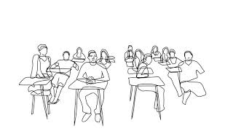
Video
Video: Creating a Safe Learning Environment: The Science of Belonging
2.1 Why Belonging Matters
Notes:
While watching the video, encourage participants to respond to these questions on a piece of paper:
When was a time you felt you belonged, and when was a time you didn’t?
What are the researchers’ definitions of belonging and the implications for schools?
What research is shared on the importance of belonging in schools and how does it impact students?

Slide 6
Let’s Discuss
After watching the video, reflect on the following questions:
What were the two researchers’ definitions of “belonging” provided in the video?
What did you agree with in the two definitions? What is missing?
Think of a time when you felt like you belonged in a learning environment—when both your peers and your teacher(s) accepted you, cared about who you were as a person, and you felt safe to speak up, take risks, and fail – what did it feel like? What did your teacher(s) and peers do or say to make you feel like you belonged?
Notes:
Put participants in groups of 3-5 to discuss these three questions.

Slide 7
Let’s Discuss
Now, think of a time when you didn’t feel like you belonged,
What did it feel like physically?
What did it feel like emotionally?
How do you act and what do you feel like when you’re in an environment where you feel you belong?

Slide 8
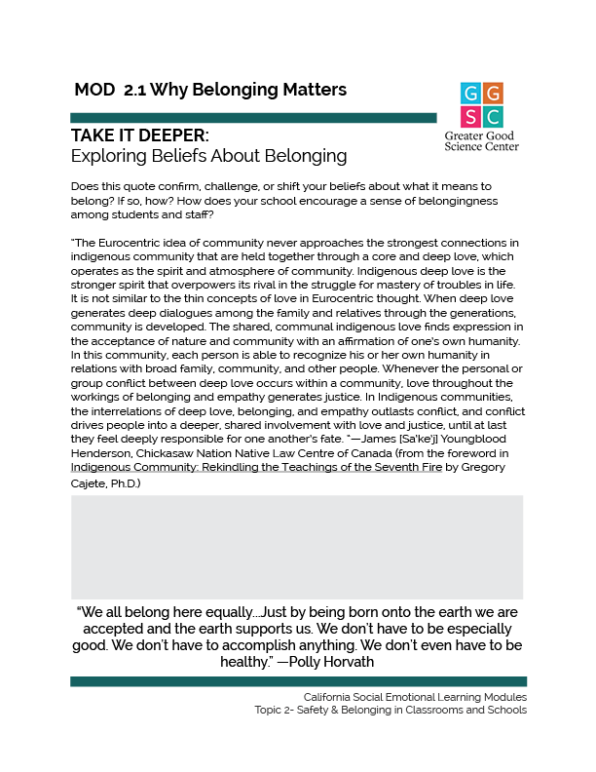
TAKE IT DEEPER
Complete “Exploring Beliefs about Belonging”
2.1 Why Belonging Matters
Notes:
Let’s further define “belonging” and what that can mean in our schools. Here is a downloadable guide to help you. https://ggie.berkeley.edu/wp-content/uploads/2023/09/2.1-Exploring-Beliefs-About-Belonging.pdf

Slide 9
Group Reflection
After completing Beliefs About Belonging reflect:
What does this quote tell us about how justice can lead to a greater sense of community and belonging? Think about a time when an injustice has fractured a school community or sense of belonging? What was the response from students and staff? When have you experienced a time when justice has brought people together and affirmed belonging for a person or group of people?
Notes:
Allow learners to consider these questions independently. Perhaps they note surprising responses with a star and highlight beliefs they would like to change.

Slide 10
California Social and Emotional Learning
2.2 Knowing Ourselves First: Surfacing Our Beliefs About Social and Emotional Well-Being and Belonging in Schools
Topic 2: Safety & Belonging in Classrooms and Schools
Notes:
To create a school culture where everyone belongs, we need to examine our own beliefs about social and emotional well-being and belonging. Why? Because that’s where our behavior and attitudes towards students and colleagues start. If we communicate to them that they don’t measure up or belong—whether we mean to or not—then it’s our responsibility to undo these beliefs in ourselves.
In this module, we start by examining our beliefs about belonging. We also look at how certain SEL skills are culturally defined, and why some SEL skills may not fit with some of our students’ cultural backgrounds.

Slide 11
Learning Objectives
2.2 Knowing Ourselves First: Surfacing Our Beliefs About Social and Emotional Well-Being and Belonging in Schools
Examine our beliefs about emotions, success, fairness, and other cultural norms, and compare them with others’ beliefs, using the “iceberg” model of culture
Compare how individualistic cultures versus collectivist cultures view the self and others, and explore how these differing views have an enormous impact on how we teach SEL in today’s diverse schools
Determine how educators can make SEL “culturally-expansive” to honor students’ families’ varying approaches to social and emotional well-being
Link Objectives to Developmental Indicators in California Transformative SEL Competencies
Notes:
Expand objectives to California Developmental Indicators through making connections to SEL competencies in California on developmental age span.
Sourced from CDE (July 2023): The California Department of Education (CDE) aims to support and advance the efforts of educators across California who are working to fully integrate systemic SEL and equity by building on the promise of T-SEL as a concept. To provide these supports, the CDE has articulated developmental indicators for CASEL’s five core competencies:
Self-Awareness (Intrapersonal Focus)
Self-Management (Intrapersonal Focus)
Social Awareness (Interpersonal Focus)
Relationship Skills (Interpersonal Focus)
Responsible Decision-Making (Inter and Intrapersonal)

Slide 12
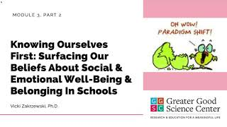
Video
Why We Need to Examine Our Beliefs
2.2 Knowing Ourselves First: Surfacing Our Beliefs About Social and Emotional Well-Being and Belonging in Schools

Slide 13
Let’s Discuss
After watching the video consider:
How do you define personal well-being and collective well-being?
How are your definitions relevant to your students’ lives, both in and out of school? Would they agree with your definitions? Would your colleagues agree?
Why are you bringing this work into your classroom or school?
Do your reasons align with your colleagues’ reasons and/or with why students’ families might want to do this work in schools?
Notes:
Facilitation Tip:
If facilitating with a group, put participants in groups of 3-5 to discuss the first two questions, and ask them to discuss how the strategies have been helpful to them. Allow learners to consider the last two questions independently.

Slide 14
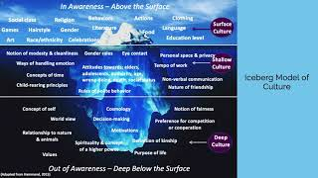
Video
Surfacing Our Beliefs About Social and Emotional Well-Being
2.2 Knowing Ourselves First: Surfacing Our Beliefs About Social and Emotional Well-Being and Belonging in Schools

Slide 15
Let’s Discuss
After watching the video consider:
If you were to explain the iceberg model of culture to a student or colleague, how would you explain it?
How can the iceberg model of culture be used to surface our beliefs about social-emotional well-being?
If a student or colleague comes from a different background than yours, how might you learn more about their background in order to better connect with them?

Slide 16
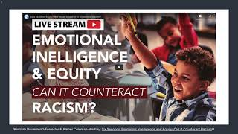
Video
How Culture Impacts SEL “Norms” and Curricula
2.2 Knowing Ourselves First: Surfacing Our Beliefs About Social and Emotional Well-Being and Belonging in Schools

Slide 17
Let’s Discuss
After watching the video consider:
When have you seen or read an SEL lesson that didn’t align with your cultural beliefs and background or with your students’ background? How might you adapt the lesson to fit the cultural norms of your students?
Think of a time you may have changed or avoided discussions on race, culture, or identity because the content felt too “risky” or made you uncomfortable because of your beliefs? What might be a downside of avoiding conversations or topics you personally find challenging?
Do your beliefs about personal and collective well-being privilege your values over your students’ values in any way? For example, do you believe that personal well-being is more important than collective well-being? If your beliefs differ, is it possible to honor these differences in a way where none are viewed through a deficit lens?

Slide 18
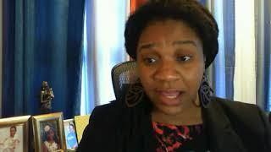
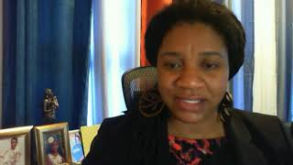
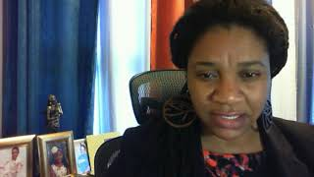
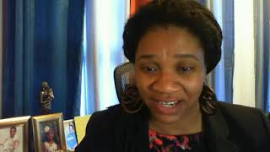
Video Series
Kamilah Drummond-Forrester on Belonging: What Does It Mean to Belong?
Building a Culture of Belonging through Adult Reflection Bringing an Equity Lens to SEL A New Vision of Education
Notes:
https://www.youtube.com/watch?v=OvyRQvK-Skw
https://www.youtube.com/watch?v=Q6HDGHZp_cY
https://youtu.be/zmgAQ1lozEg https://www.youtube.com/watch?v=1oCD2BNDmsI

Slide 19
Let’s Discuss
After watching the videos consider:
What stood out for you from the interview with Kamilah? Why?
What reflection practice do you use to challenge your assumptions about others?

Slide 20
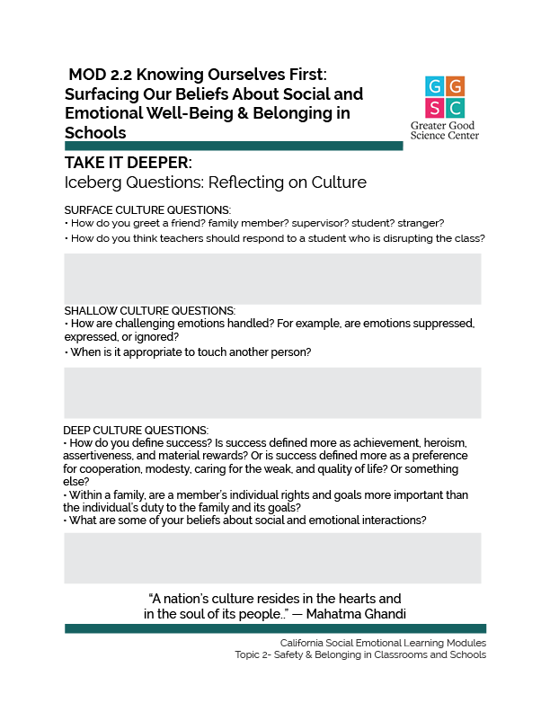
TAKE IT DEEPER
Complete “Iceberg Questions: Reflecting on Culture”
2.2 Knowing Ourselves First: Surfacing Our Beliefs About Social and Emotional Well-Being and Belonging in Schools
Notes:
Let’s further examine our own beliefs and our classroom cultures. https://ggie.berkeley.edu/wp-content/uploads/2023/09/2.2-Iceberg-Questions-Reflecting-on-Culture.pdf Allow learners to consider these questions independently. Perhaps they note surprising responses with a star and highlight beliefs they would like to change.

Slide 21
Group Reflection
Use your responses from the Iceberg Questions handout to consider the following:
How are your personal beliefs positively contributing to bringing SEL into your classroom or school?
In what ways could you make SEL increasingly “culturally expansive” in your classroom or school to honor your students’ families varying approaches to social and emotional well-being?
What are three immediate next steps you can take to better understand your beliefs and their impact on the classroom or school culture, better understand your classroom or school’s social norms and the beliefs driving them, and/or make SEL increasingly “culturally expansive?”

Slide 22
California Social and Emotional Learning
2.3 The Questions of Belonging: Interventions to Help Students Feel Like They Belong
Topic 2 Safety & Belonging in Classrooms and Schools

Slide 23
Learning Objectives
2.3 The Questions of Belonging: Interventions to Help Students Feel Like They Belong
Examine the questions of belonging students hold within themselves
Explore practical, research-based ways schools can address questions of belonging
Link Objectives to Developmental Indicators in California Transformative SEL Competencies
Notes:
Expand objectives to California Developmental Indicators through making connections to SEL competencies in California on developmental age span.
Sourced from CDE (July 2023): The California Department of Education (CDE) aims to support and advance the efforts of educators across California who are working to fully integrate systemic SEL and equity by building on the promise of T-SEL as a concept. To provide these supports, the CDE has articulated developmental indicators for CASEL’s five core competencies:
Self-Awareness (Intrapersonal Focus)
Self-Management (Intrapersonal Focus)
Social Awareness (Interpersonal Focus)
Relationship Skills (Interpersonal Focus)
Responsible Decision-Making (Inter and Intrapersonal)

Slide 24
Video
Seeing Each Other as Human Beings: The Questions of Belonging
2.3 The Questions of Belonging: Interventions to Help Students Feel Like They Belong

Slide 25
Group Reflection
Describe a time when you walked into a situation that was totally new for you and you didn’t know anyone or the social norms of the situation. What were you feeling? What was your behavior? What questions went through your mind? Did you eventually feel like you belonged? If so, what helped you to do so?
What questions of belonging do you think your students might have? How could you learn more from your students about their feelings of belonging?
What structures and/or values in your school might make students feel as if they don’t belong? If you were to use one of the research-based interventions to help students feel like they belong—or some other method—how could you ensure that the intervention did not help maintain structures that excluded students?
How are you bringing student voice into creating a culture of belonging at your school? What more could you do?
Notes:
Facilitation Tip:
Instruct participants to consider the first discussion question independently. Then, assign participants small groups to discuss the remaining three questions, generating a written group list of student questions, school structures and/or values impacting student belonging, and ideas for learning more and addressing each.
Many Questions of Belonging article (mentioned in the video)

Slide 26
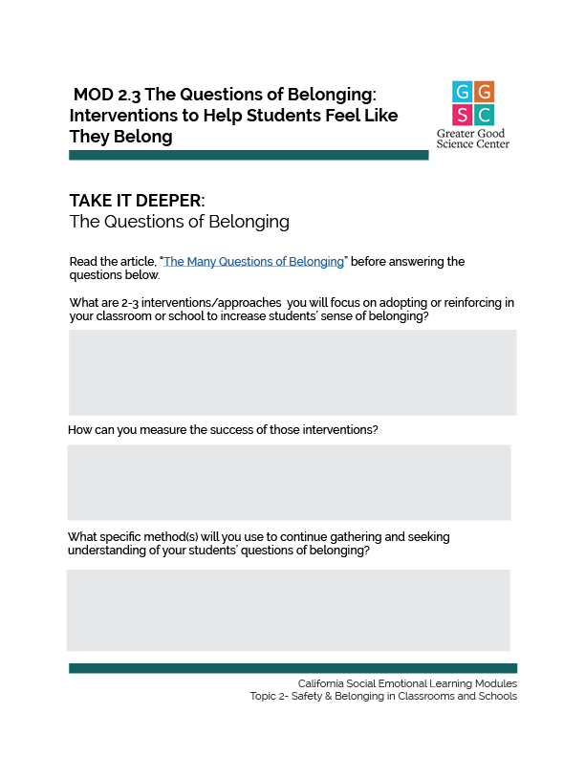
TAKE IT DEEPER
Complete “The Questions of Belonging”
2.3 The Questions of Belonging: Interventions to Help Students Feel Like They Belong
Notes:
https://ggie.berkeley.edu/wp-content/uploads/2023/09/2.3-The-Questions-of-Belonging.pdf

Slide 27
California Social and Emotional Learning
2.4
Meeting Students’ Psychological Needs to Help Them Feel Like They Belong
Topic 2 Safety & Belonging in Classrooms and Schools

Slide 28
Learning Objectives
2.4 Meeting Students’ Psychological Needs to Help Them Feel Like They Belong
Review the four basic psychological needs that affect motivation and belonging
Brainstorm examples of how educators and schools can meet the four basic psychological needs that affect motivation and belonging for their students
Link Objectives to Developmental Indicators in California Transformative SEL Competencies
Notes:
Scientists have discovered that we have three, perhaps four, basic psychological needs that directly affect our motivation. Addressing these needs in students has the potential to greatly impact their intrinsic motivation and sense of belonging. Expand objectives to California Developmental Indicators through making connections to SEL competencies in California on developmental age span.
Sourced from CDE (July 2023): The California Department of Education (CDE) aims to support and advance the efforts of educators across California who are working to fully integrate systemic SEL and equity by building on the promise of T-SEL as a concept. To provide these supports, the CDE has articulated developmental indicators for CASEL’s five core competencies:
Self-Awareness (Intrapersonal Focus)
Self-Management (Intrapersonal Focus)
Social Awareness (Interpersonal Focus)
Relationship Skills (Interpersonal Focus)
Responsible Decision-Making (Inter and Intrapersonal)

Slide 29
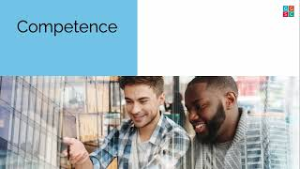
Video
Meeting Students’ Psychological Needs to Help Them Feel Like They Belong
2.4 Meeting Students’ Psychological Needs to Help Them Feel Like They Belong
Notes:
https://www.youtube.com/watch?v=W7SYx5JVHSY&t=2s

Slide 30
Group Reflection
How is your school meeting students’ need for autonomy, giving them space to choose who they want to be and the lives they want to live? What is one thing your school could do to increase students’ sense of autonomy? How is your school meeting this need in teachers?
How is your school meeting students’ need for relatedness, or helping them feel connected to people and groups? What is one thing your school could do to increase students’ sense of relatedness? How is your school meeting this need in teachers?
How is your school meeting students’ need for competence, helping them to use and grow their skills and expertise, both inner and outer? What is one thing your school could do to increase students’ feeling of competence? How is your school meeting this need in teachers?
Notes:
Facilitation Tip:
Divide participants into small groups and assign each group one of the three psychological needs included in the discussion questions. Provide time for groups to discuss the questions related to their assigned need and ask them to share the group’s thoughts aloud.

Slide 31
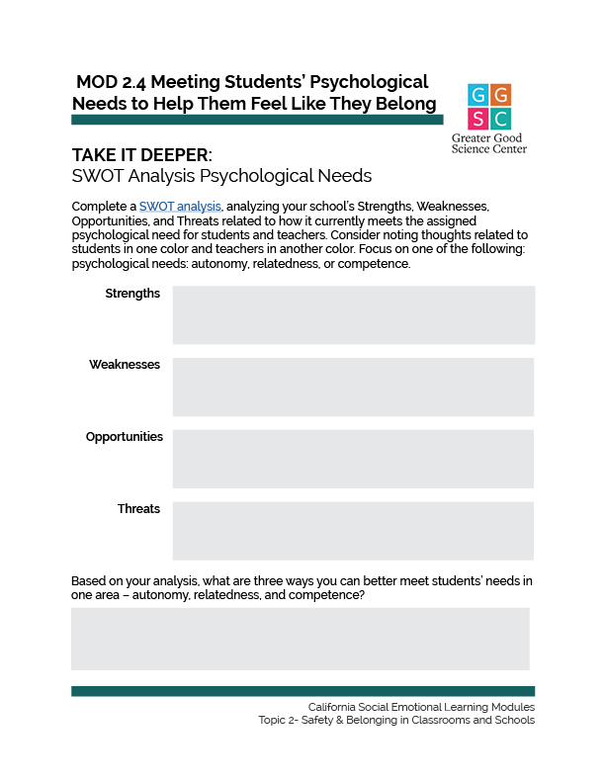
TAKE IT DEEPER
Complete “SWOT Analysis Psychological Needs”
2.4
Meeting Students’ Psychological Needs to Help Them Feel Like They Belong
Notes:
Let’s assess how well our classrooms or schools are currently meeting students’ basic psychological needs and identify ways we can better meet them. Here is a downloadable guide to help you. https://ggie.berkeley.edu/wp-content/uploads/2023/09/2.4-SWOT-Analysis-Psychological-Needs.pdf

Slide 32
California Social and Emotional Learning
2.5 Cultivating Belonging Through Teacher-Student and Peer Relationships
TOPIC 2: Safety & Belonging in Classrooms and Schools

Slide 33
Learning Objectives
2.5 Cultivating Belonging Through Teacher-Student and Peer Relationships
Brainstorm ways to build stronger teacher-student relationships with students
Brainstorm ways to encourage stronger peer relationships among students
Link Objectives to Developmental Indicators in California Transformative SEL Competencies
Notes:
Expand objectives to California Developmental Indicators through making connections to SEL competencies in California on developmental age span.
Sourced from CDE (July 2023): The California Department of Education (CDE) aims to support and advance the efforts of educators across California who are working to fully integrate systemic SEL and equity by building on the promise of T-SEL as a concept. To provide these supports, the CDE has articulated developmental indicators for CASEL’s five core competencies:
Self-Awareness (Intrapersonal Focus)
Self-Management (Intrapersonal Focus)
Social Awareness (Interpersonal Focus)
Relationship Skills (Interpersonal Focus)
Responsible Decision-Making (Inter and Intrapersonal)

Slide 34
Video
Video: Cultivating Belonging Through the Teacher-Student Relationship
2.5 Cultivating Belonging Through Teacher-Student and Peer Relationships
Notes:
https://youtu.be/VEpEWYn7XiA

Slide 35
Let’s Discuss
After watching the video, reflect on the following questions:
How do you foster positive relationships with students?
How do you support students in their development of healthy identities?
What supports are in place at your school that help students and teachers to cultivate positive relationships with each other?
In what ways could you or your school improve in any of these areas?

Slide 36
Video
Video: Cultivating Belonging Through Peer Relationships
2.5 Cultivating Belonging Through Teacher-Student and Peer Relationships

Slide 37
Let’s Discuss
After watching the video, reflect on the following questions:
How do you and/or your school encourage positive relationships among students?
How does your school encourage cross-group friendships?
What opportunities do students have to take the lead in building relationships with other students?
In what ways could you or your school improve in any of these areas?

Slide 38
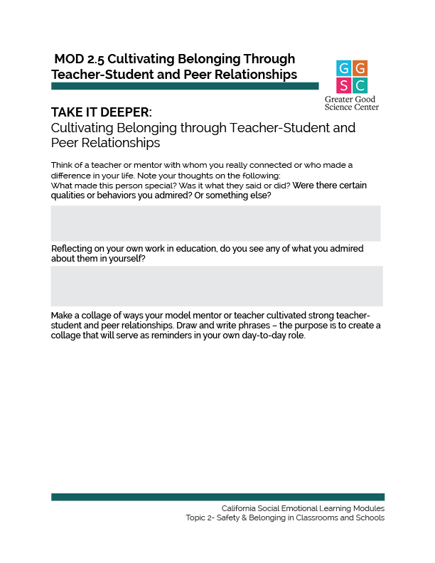
TAKE IT DEEPER
Complete “Cultivating Belonging through Teacher-Student and Peer Relationships”
2.5 Cultivating Belonging Through Teacher-Student and Peer Relationships
Notes:
https://ggie.berkeley.edu/wp-content/uploads/2023/09/2.5-Cultivating-Belonging-through-Teacher-Student-and-Peer-Relationships.pdf

Slide 39
California Social and Emotional Learning
2.6
Building a Belonging School Through Trust and Psychological Safety
Topic 2: Safety & Belonging in Classrooms and Schools
Notes:
Two critical underlying mechanisms for building a safe learning environment in which everyone belongs are trust and psychological safety. Without these, students and staff alike may feel stifled and limited in their capacity to bring their full selves to the educational process.

Slide 40
Learning Objectives
2.6 Building a Belonging School Through Trust and Psychological Safety
Explore the components of trust and how these might play out in a school
Examine what happens when trust in schools is not present, along with what encourages and discourages us from trusting each other
Determine what administrators need from teachers and vice versa in order to build a trusting school environment
Define psychological safety and what it looks like in a work environment
Link Objectives to Developmental Indicators in California Transformative SEL Competencies
Notes:
Expand objectives to California Developmental Indicators through making connections to SEL competencies in California on developmental age span.
Sourced from CDE (July 2023): The California Department of Education (CDE) aims to support and advance the efforts of educators across California who are working to fully integrate systemic SEL and equity by building on the promise of T-SEL as a concept. To provide these supports, the CDE has articulated developmental indicators for CASEL’s five core competencies:
Self-Awareness (Intrapersonal Focus)
Self-Management (Intrapersonal Focus)
Social Awareness (Interpersonal Focus)
Relationship Skills (Interpersonal Focus)
Responsible Decision-Making (Inter and Intrapersonal)

Slide 41
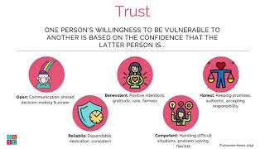
Video
Using the Science of Trust to Build a Belonging School Culture
2.6 Building a Belonging School Through Trust and Psychological Safety

Slide 42
Let’s Discuss
After watching the video consider:
Think of a work experience in which there was a high level of trust among you and your colleagues. What did that feel and look like? How was trust fostered?
Consider the elements of trust (i.e., openness, benevolence, honesty, reliability, competence). How were these put into practice among you and your colleagues?
How does your school foster trust among staff and students—or does it? What is one thing that could help increase the levels of trust, especially with diverse groups?

Slide 43
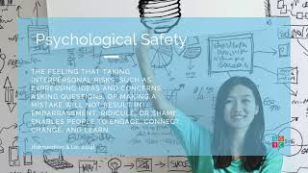
Video
Using the Science of Psychological Safety and Trust to Build a Belonging School Culture
2.6 Building a Belonging School Through Trust and Psychological Safety
Notes:
https://www.youtube.com/watch?v=uzL9ouHXRcA (4:44)

Slide 44
Let’s Discuss
After watching the video consider:
At your school, how do people respond to mistakes?
As a school leader, how do you express vulnerability to your staff?
How does your school’s culture make it safe for staff, students, and families to take risks, make mistakes, speak up, and share new ideas?
What is one thing that your school could do to create a more psychologically safe environment?
What role do trust and psychological safety play in the cultivation of belonging?
How can you build a sense of trust and psychological safety among stakeholders in order to build a culture of belonging?
What policies and structures does your school have in place that might limit student belonging? For example, do you have policies about dress, hair, or cultural practices that target certain groups, such as Black girls? How do you think this affects students’ sense of psychological safety and what can you do about it?

Slide 45
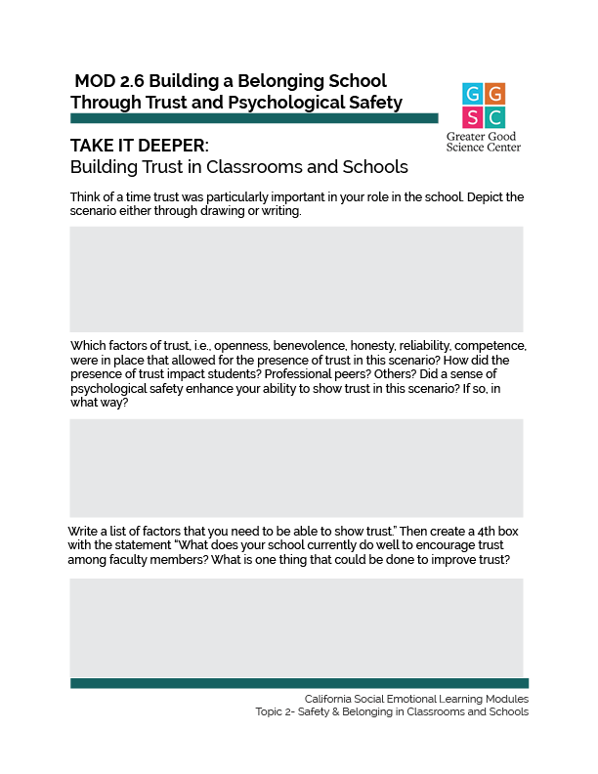
TAKE IT DEEPER
Complete “Building Trust in Classrooms and Schools”
2.6 Building a Belonging School Through Trust and Psychological Safety
Notes:
https://ggie.berkeley.edu/wp-content/uploads/2023/09/2.6-Building-Trust-in-Classrooms-and-Schools.pdf

Slide 46
California Social and Emotional Learning
Add an Optimistic Closure here
Notes:
Add SEL Signature Practices to your presentation.
The SEL 3 Signature Practices are one tool for fostering a supportive environment and promoting SEL. They intentionally and explicitly help build a habit of practices through which students and adults enhance their SEL skills.
For a short presentation of what SEL 3 Signature Practices are, along with a list of practices, see the following:
https://docs.google.com/presentation/d/1utb0X71RHbzQdt-aZmOQfiFkg_kHltO7i-hUoOPb2m0/edit?usp=sharing

Slide 47
THE RESULTS
98%
OF THE WORLD POPULATION RATED THEMSELVES 9 ON THE HAPPINESS SCALE
Designed & narrated by
Vicki Zakrzewski, Ph.D.
Education Director
Notes:
https://ggie.berkeley.edu/person/vicki-zakrzewski/

