Slide 1
California Social and Emotional Learning
Caring for Yourself
The Science of Emotional Resilience
Notes:
Designed and narrated by Amy L. Eva, PhD, Associate Education Director, Greater Good Science Center

Slide 2
California Social and Emotional Learning
Add a Welcoming Ritual Here
Notes:
Add SEL Signature Practices (e.g., welcoming rituals, optimistic closures, etc.) to your presentation: https://ggie.berkeley.edu/wp-content/uploads/2023/05/Welcoming_Closing-Activities.pptx
The SEL 3 Signature Practices are one tool for fostering a supportive environment and promoting SEL. They intentionally and explicitly help build a habit of practices through which students and adults enhance their SEL skills.
For a short presentation of what SEL 3 Signature Practices are, along with a list of practices, see the following:
https://docs.google.com/presentation/d/1utb0X71RHbzQdt-aZmOQfiFkg_kHltO7i-hUoOPb2m0/edit?usp=sharing

Slide 3
California Social and Emotional Learning
1.1 Understanding Your Emotions
TOPIC 1: Caring for Yourself: The Science of Emotional Resilience
Notes:
Regardless of how we might FEEL about the emotions we experience every day, they can actually provide valuable information about students, colleagues, ourselves, and the work we do. Emotions reflect our sensitivity to our environment, cueing us to see what’s relevant, and ultimately informing our decisions and actions.

Slide 4
Learning Objectives
1.1 Understanding your Emotions
Link Objectives to Developmental Indicators in California Transformative SEL Competencies
Explore what emotions are and why they are important
Explore how our cultural backgrounds affect our beliefs about our emotions (and how we express them
Notes:
Expand objectives to California Developmental Indicators through making connections to SEL competencies in California on developmental age span.
Sourced from CDE (July 2023): The California Department of Education (CDE) aims to support and advance the efforts of educators across California who are working to fully integrate systemic SEL and equity by building on the promise of T-SEL as a concept. To provide these supports, the CDE has articulated developmental indicators for CASEL’s five core competencies:
Self-Awareness (Intrapersonal Focus)
Self-Management (Intrapersonal Focus)
Social Awareness (Interpersonal Focus)
Relationship Skills (Interpersonal Focus)
Responsible Decision-Making (Inter and Intrapersonal)

Slide 5
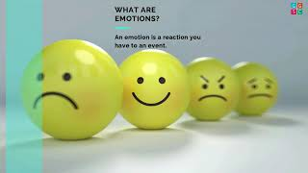
Video
Video: What are Emotions? Why Are They Important?
Notes:
https://www.youtube.com/watch?v=W7SYx5JVHSY&t=2s
Video Running Time: 4:51

Slide 6
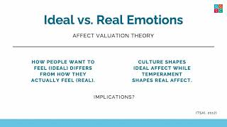
Video
Beliefs about Emotions: Ideal vs. Real Emotions
Notes:
https://www.youtube.com/watch?v=-RLWAK6TsJQ
Video Running Time: 4:12

Slide 7
Video
Cultural Differences in Emotional Expression
Notes:
https://www.youtube.com/watch?v=B91chp9R
Video Running Time: 4:25

Slide 8
Group Reflection
After watching the videos, reflect on the following questions:
What concepts from the videos were new to you? Many people believe that emotions are “bad” or even “dangerous.” What’s your best argument for why emotions are important and valuable? What are the ways we can apply research about the critical importance of emotions to our everyday lives? For example, how can you make this information accessible to colleagues, leaders, educators, families and students in your context?
Notes:
If facilitating with a group, watch videos and then put participants in groups of 3-5 to discuss these three questions.

Slide 9
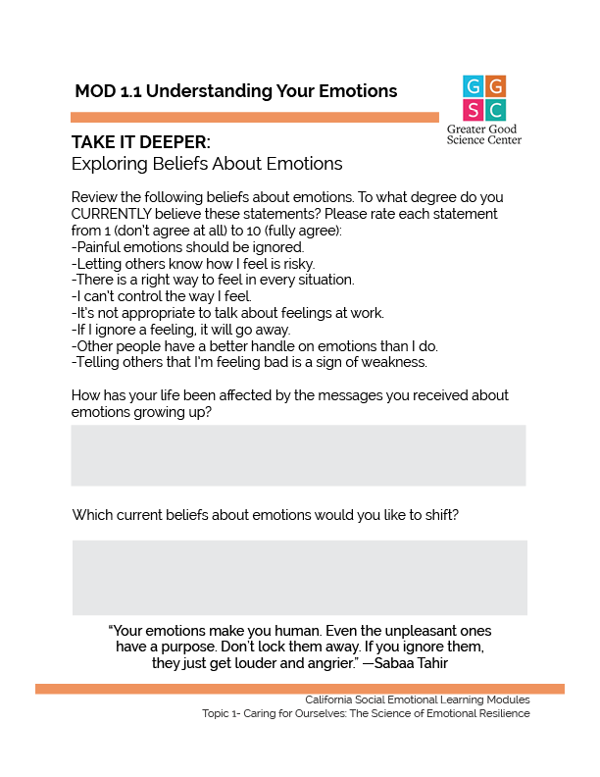
TAKE IT DEEPER
Complete “Exploring Beliefs about Emotions”
1.1 Understanding Your Emotions
Notes:
https://ggie.berkeley.edu/wp-content/uploads/2023/09/1.1-Exploring-Beliefs-About-Emotions.pdf

Slide 10
Reflection
After completing the reflection “Exploring Beliefs About Emotions,” consider the following:
Did any of your responses surprise you? Are you paying attention to your own emotional journey throughout the work day? Why or why not?
What emotions are you experiencing most often throughout the day? What messages are your emotions giving you?
Which beliefs about emotions would you like to shift or change? (Note: Some research suggests that believing emotions are completely “uncontrollable” may lead to depressive symptoms. And the belief that emotions are “bad,” in general, can predict poorer psychological health like higher anxiety and depression.)
Notes:
Invite learners to consider these questions independently. Perhaps they might note surprising responses with a star and highlight beliefs they would like to change. If time permits, they can share insights with one another.

Slide 11
California Social and Emotional Learning
1.2
Navigating Your Emotions
TOPIC 1: Caring for Yourself: The Science of Emotional Resilience

Slide 12
Learning Objectives
1.2 Navigating your Emotions
Identify research-based strategies for navigating difficult emotions.
Highlight healthy ways of relating to emotions.
Link Objectives to Developmental Indicators in California Transformative SEL Competencies
Notes:
Expand objectives to California Developmental Indicators through making connections to SEL competencies in California on developmental age span.
Sourced from CDE (July 2023): The California Department of Education (CDE) aims to support and advance the efforts of educators across California who are working to fully integrate systemic SEL and equity by building on the promise of T-SEL as a concept. To provide these supports, the CDE has articulated developmental indicators for CASEL’s five core competencies:
Self-Awareness (Intrapersonal Focus)
Self-Management (Intrapersonal Focus)
Social Awareness (Interpersonal Focus)
Relationship Skills (Interpersonal Focus)
Responsible Decision-Making (Inter and Intrapersonal)

Slide 13
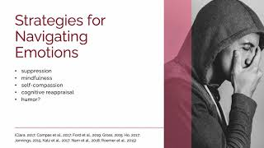
Video
Strategies for Navigating Emotions
Notes:
https://www.youtube.com/watch?v=6Er7Ven0Flw
Video Running Time: 5:12

Slide 14
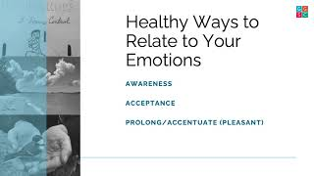
Video
Healthy Ways of Relating to Our Emotions
Notes:
https://youtu.be/nMy7j8oaZkg
Video Running Time: 3:43

Slide 15
Group Reflection
After watching the videos, consider the following questions:
What were the strategies for navigating difficult emotions described in the video?
Which strategies were new to you? Which strategies have you practiced before?
Emotions are accompanied by thoughts. Sometimes our self-talk is negative or critical. What are some examples of negative self-talk? What might be a reframe of that thought so it is more positive, kind, and optimistic?
There are no “bad” emotions: We know even emotions experienced as negative or uncomfortable can be useful if harnessed toward a goal. Can you think of a time you used a negative emotion or experience as fuel to make positive change?
Notes:
Facilitation Tip:
If facilitating with a group, put participants in groups of 3-5 to discuss the first two questions, and ask them to discuss how the strategies they identified have been helpful to them. Allow learners to consider the last two questions independently.

Slide 16
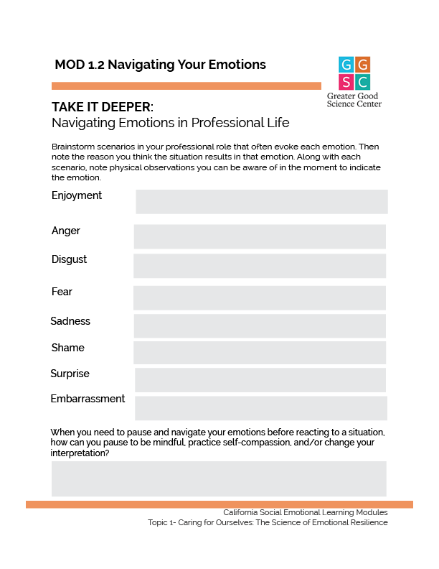
TAKE IT DEEPER
Complete “Navigating Emotions in Professional Life”
1.2 Navigating Your Emotions
Notes:
Allow learners to consider these questions independently. https://ggie.berkeley.edu/wp-content/uploads/2023/09/1.2-Navigating-Emotions-in-Professional-Life.pdf

Slide 17
Group Reflection
After completing the reflection “Navigating Emotions in Professional Life,” reflect on the following questions:
Why might a similar workplace scenario evoke different emotions for each of us?
How can our personal backgrounds and experiences influence the emotions we might experience in a scenario?
Why is it helpful to recognize how our cultural backgrounds affect our beliefs around emotions?
Notes:
If the discussion does not answer this question, follow-up with: How can our personal backgrounds and experiences influence the emotion we might experience in a scenario?
Ask: Why is it helpful to recognize how our cultural backgrounds affect our beliefs around emotions?
Optional extension activity: Provide learners with a copy of the extension activity handout. Challenge them to practice identifying their emotions throughout the work week, noting situations where they experience each emotion, and responding to the reflection questions at the end of the week:
What emotions surprised me this week?
How might my background and experiences have influenced the emotions I felt in these scenarios?
What else did I learn about my emotions this week?

Slide 18
California Social and Emotional Learning
1.3
Learning How to be Kind to Yourself
TOPIC 1: Caring for Yourself: The Science of Emotional Resilience
Notes:
First, ask participants how they demonstrate kindness. Likely, their examples and thoughts will highlight ways they demonstrate kindness to others. Point out the trend and remind them that the concept of displaying kindness also applies to how they treat themselves. Then, begin with the introductory language.
Many of us may be pretty good at extending kindness and compassion to our students and friends, but what about ourselves? How do you treat yourself after a challenging interaction with a student or colleague? Are you kind? Do you mentally beat yourself up?

Slide 19
“If your compassion doesn’t include yourself, it is incomplete.”
—Jack Kornfield
Notes:
Jack Kornfield reminds us, “If your compassion doesn’t include yourself, it is incomplete.” Self-compassionate people tend to be more motivated, more healthy (mentally and physically) and less likely to experience burnout.

Slide 20
Learning Objectives
1.3 Learning How to be Kind to Yourself
Identify the elements of self-compassion and the research behind it.
Differentiate self-compassion from self-esteem.
Consider how self-compassion can calm our nervous systems.
Experience a self-compassion practice.
Link Objectives to Developmental Indicators in California Transformative SEL Competencies
Notes:
Expand objectives to California Developmental Indicators through making connections to SEL competencies in California on developmental age span.
Sourced from CDE (July 2023): The California Department of Education (CDE) aims to support and advance the efforts of educators across California who are working to fully integrate systemic SEL and equity by building on the promise of T-SEL as a concept. To provide these supports, the CDE has articulated developmental indicators for CASEL’s five core competencies:
Self-Awareness (Intrapersonal Focus)
Self-Management (Intrapersonal Focus)
Social Awareness (Interpersonal Focus)
Relationship Skills (Interpersonal Focus)
Responsible Decision-Making (Inter and Intrapersonal)

Slide 21
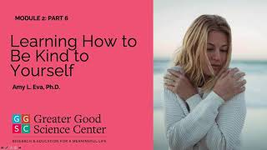
Video
What is Self-Compassion?
Notes:
https://youtu.be/xr8G5dBUyj4
Video Running Time: 4:22

Slide 22
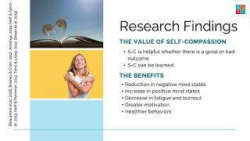
Video
What are Some of the Benefits of Self-Compassion?
Notes:
https://youtu.be/P9tVTQVdT5E
Video Running Time: 4:24

Slide 23
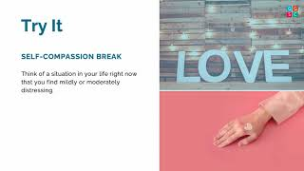
Video
Try a Practice: Self-Compassion Break
Notes:
https://www.youtube.com/watch?v=iaYuJDPbslA
Video Running Time: 5:33

Slide 24
Group Reflection
After watching the videos, consider these questions:
How would you describe self-compassion?
Which elements of self-compassion do you resonate with most (e.g., mindfulness, common humanity, kindness)? Why?
What is something you are experiencing that you might consider as common to humanity right now? What emotions are coming up for you around that? What would you say to a friend to support them if they were in your situation? Turn that around. Now say it to yourself.
Notes:
Facilitation Tip:
If facilitating with a group, put participants in groups of 3-5 to discuss.

Slide 25
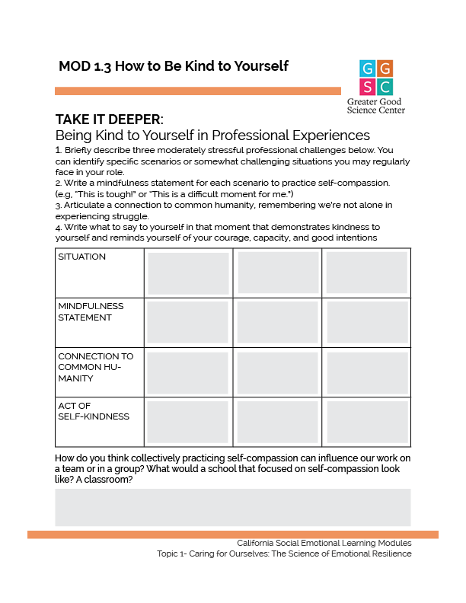
TAKE IT DEEPER
Complete “Being Kind to Yourself in Professional Experiences”
1.3 Learning How to be Kind to Yourself
Notes:
Instruct participants to briefly identify three challenging situations in each box in the first row. They can either reference specific scenarios or describe ongoing challenges that they frequently face at work.
Ask the participants to recall the mindfulness step to practicing self-compassion referred to in the video. Remind them it should look like naming and validating the struggle, such as: “This is a moment of suffering, and it’s really hard.” Instruct them to write a mindfulness statement specific to each situation.
Ask the participants to recall what the video meant with regard to connecting the situation to common humanity. Remind them this is an opportunity to accept our own humanity and remember we’re not alone in experiencing struggle. Instruct them to articulate a connection to common humanity specific to each situation.
Finally, instruct the participants to fill the last row with methods of showing themselves kindness specific to each scenario. They can reflect on what they truly need to say to themselves in that moment. Do they need to remind themselves of their courage? Capability? Good intentions? How can they give themselves that reminder in a way that truly feels supportive?
Next, ask participants to create a reminder for their desk of the three steps to practicing self-compassion explored in this lesson: mindfulness, common humanity, and kindness. They can use the steps in their tables as cues for practicing self-compassion in a personalized way.
https://ggie.berkeley.edu/wp-content/uploads/2023/09/1.3-Being-Kind-to-Yourself-in-Professional-Experiences.pdf

Slide 26
Group Reflection
After the completing the “Being Kind to Yourself” reflection, consider the following questions:
How do you think collectively practicing self-compassion can influence our work on a team or in a group?
What would a school that focused on self-compassion look like? A classroom? (Note: Consider allowing the group to work together to create a list of “agreements” to encourage a culture of self-compassion. Post your agreements in a common area of the workplace.)
Notes:
Facilitation Tip:
If facilitating with a group, put participants in groups of 3-5 to discuss.

Slide 27
California Social and Emotional Learning
1.4
How to Be Compassionate without Suffering So Much
TOPIC 1: Caring for Yourself: The Science of Emotional Resilience
Notes:
First, ask participants to consider a time their emotions were affected by someone else’s suffering. How did it influence their thinking or behaviors throughout the day or week? Then, begin with the introductory language.
The capacity to “feel with” and share others’ emotions, can be a beautiful gift that connects us with each other. Yet it can also feel heart-wrenching and even unbearable at times. Teachers everywhere have students in their classes who experience unbelievable challenges in their lives—and acting compassionately towards them would be a normal response. But sometimes the emotional toll of seeing so much suffering on a daily basis can lead to educator burnout.
There are tools at our disposal to help us navigate the difficult emotions we can experience when we face others’ suffering so that we can emerge with a greater capacity to be present and helpful to our students and colleagues.

Slide 28
Learning Objectives
1.4 How to Be Compassionate without Suffering So Much
Describe “empathic distress,” (a downside of empathy)—and the effects of “emotional contagion.”
Identify two pathways of empathy in the brain—one healthy and one not so healthy.
Outline five practical strategies for addressing empathic distress in order to extend compassion to others from a position of inner strength.
Experience a compassion practice.
Link Objectives to Developmental Indicators in California Transformative SEL Competencies
Notes:
Expand objectives to California Developmental Indicators through making connections to SEL competencies in California on developmental age span.
Sourced from CDE (July 2023): The California Department of Education (CDE) aims to support and advance the efforts of educators across California who are working to fully integrate systemic SEL and equity by building on the promise of T-SEL as a concept. To provide these supports, the CDE has articulated developmental indicators for CASEL’s five core competencies:
Self-Awareness (Intrapersonal Focus)
Self-Management (Intrapersonal Focus)
Social Awareness (Interpersonal Focus)
Relationship Skills (Interpersonal Focus)
Responsible Decision-Making (Inter and Intrapersonal)

Slide 29
Video
Video: Exploring Empathic Distress Versus Empathic Concern
Notes:
https://www.youtube.com/watch?v=W7SYx5JVHSY&t=2s
Video Running Time: 4:55

Slide 30
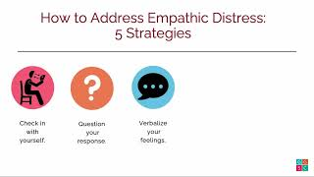
Video
Video: Strategies for Addressing Empathic Distress
Notes:
https://www.youtube.com/watch?v=W7SYx5JVHSY&t=2s
Video Running Time: 6:52

Slide 31
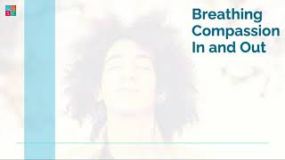
Video
Video: Try a Practice: Breathing Compassion In and Out
Notes:
https://www.youtube.com/watch?v=W7SYx5JVHSY&t=2s
Video Running Time: 4:55

Slide 32
Group Reflection
Are you sensitive to “emotional contagion” (the tendency to automatically adopt the emotional state of another person)? How do you know?
What were the five strategies for addressing empathetic distress presented in the video?
Which strategies would support you in returning to neutral, present-moment awareness when you realize you are in a state of empathic distress?
Notes:
Facilitation Tip:
Instruct learners to discuss the first question in pairs. As the full group responds to the second question, instruct learners to list the five strategies in their notes, and then highlight the strategies they would like to try to implement in response to the third question.

Slide 33
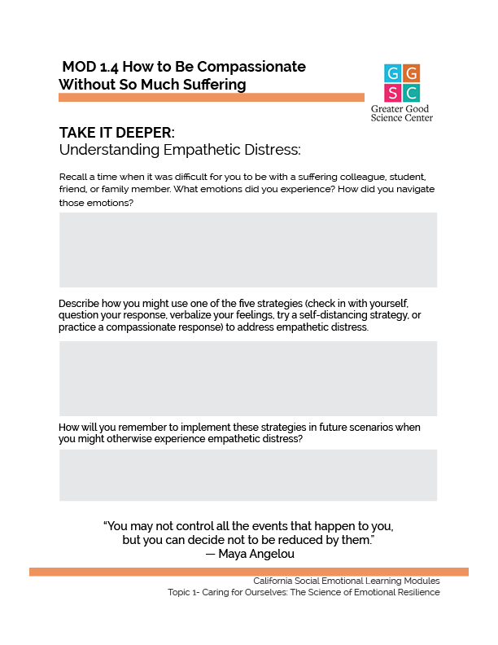
TAKE IT DEEPER
Complete “Understanding Empathetic Distress”
1.4 Learning How to Be Compassionate without Suffering So Much
Notes:
https://ggie.berkeley.edu/wp-content/uploads/2023/09/1.4-Understanding-Empathetic-Distress.pdf

Slide 34
California Social and Emotional Learning
1.5 Self-Awareness, Emotional Resilience, and Equity
TOPIC 1: Caring for Yourself: The Science of Emotional Resilience

Slide 35
Learning Objectives
1.5 Self-Awareness, Emotional Resilience, and Equity
Explore the concepts of equity, self-awareness, and emotional resilience as they relate to our work in schools
Identify strategies to address burnout in education
Link Objectives to Developmental Indicators in California Transformative SEL Competencies
Notes:
Expand objectives to California Developmental Indicators through making connections to SEL competencies in California on developmental age span.
Sourced from CDE (July 2023): The California Department of Education (CDE) aims to support and advance the efforts of educators across California who are working to fully integrate systemic SEL and equity by building on the promise of T-SEL as a concept. To provide these supports, the CDE has articulated developmental indicators for CASEL’s five core competencies:
Self-Awareness (Intrapersonal Focus)
Self-Management (Intrapersonal Focus)
Social Awareness (Interpersonal Focus)
Relationship Skills (Interpersonal Focus)
Responsible Decision-Making (Inter and Intrapersonal)

Slide 36
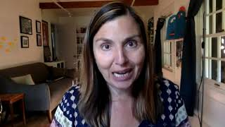
Video
Video: Equity, Self-Awareness, and Emotional Resilience
Notes:
https://www.youtube.com/watch?v=W7SYx5JVHSY&t=2s
Video Running Time: 9:46

Slide 37
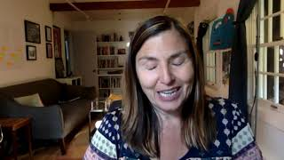
Video
Video: Responding to Stress, Exhaustion, and Burnout: A New Vision for Education
Notes:
https://www.youtube.com/watch?v=W7SYx5JVHSY&t=2s
Video Running Time: 9:43

Slide 38
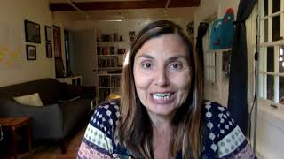
Video
Video: Practices for Emotional Resilience
Notes:
https://www.youtube.com/watch?v=W7SYx5JVHSY&t=2s
Video Running Time: 2:59

Slide 39
Group Reflection
After watching the videos, reflect on the following questions:
When you think about the importance of educational equity and the role you play in creating a more equitable district, school, or classroom, what kinds of emotions arise for you?
How would you describe your role when it comes to creating a more equitable district, school, or classroom?
In what ways might the words “control, manage, and regulate” (frequently used in our work around emotions and behavior) be contributing to oppressive practices? With the goals of agency and liberation in mind, what language could be used instead?
Notes:
If facilitating with a group, watch videos and then put participants in groups of 3-5 to discuss these three questions.

Slide 40
Group Reflection
After watching the videos, reflecting on the following questions:
Elena Aguilar says, “There’s just no way that we can do the work around equity without attending to our emotions and without cultivating the emotions that will help us to navigate the discomfort—because we are going to feel really uncomfortable.” How do you navigate uncomfortable emotions (others and your own) when you engage in important conversations about race and equity in schools? In what ways might those uncomfortable feelings inhibit you from speaking up about social injustice and racism?
What are the ways oppressive, white-dominant social norms, patriarchal, and/or capitalist patterns and language influence our work as educators as it relates to the importance of emotions to learning—and advocating for our own well-being?
Notes:
If facilitating with a group, watch videos and then put participants in groups of 3-5 to discuss these three questions.

Slide 41
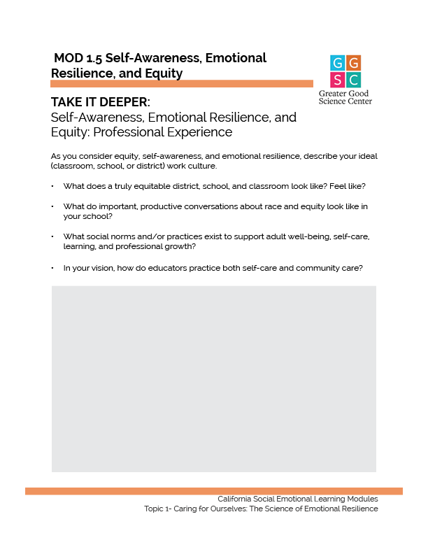
TAKE IT DEEPER
Complete “Self-Awareness, Emotional Resilience, and Equity: Professional Experience”
1.5 Self-Awareness, Emotional Resilience, and Equity
Notes:
https://ggie.berkeley.edu/wp-content/uploads/2023/09/1.5-Self-Awareness-Emotional-Resilience-and-Equity-Professional-Experience.pdf

Slide 42
TRY THIS! Identify three things you might do in your classroom, school or district to support and affirm your vision for equity, self-awareness. and emotional resilience.
1.
2.
3.
Notes:
Facilitation Tip:
Instruct the participants to write their three steps on a sticky note to keep with them.

Slide 43
California Social and Emotional Learning
Add an Optimistic Closure Here
Notes:
Add SEL Signature Practices (e.g., welcoming Rituals, optimistic closures, etc. to your presentation). https://ggie.berkeley.edu/wp-content/uploads/2023/05/Welcoming_Closing-Activities.pptx
The SEL 3 Signature Practices are one tool for fostering a supportive environment and promoting SEL. They intentionally and explicitly help build a habit of practices through which students and adults enhance their SEL skills.
For a short presentation of what SEL 3 Signature Practices are, along with a list of practices, see the following:
https://docs.google.com/presentation/d/1utb0X71RHbzQdt-aZmOQfiFkg_kHltO7i-hUoOPb2m0/edit?usp=sharing

Slide 44
THE RESULTS
98%
OF THE WORLD POPULATION RATED THEMSELVES 9 ON THE HAPPINESS SCALE
Designed and narrated by
Amy L. Eva, Ph.D.
Associate Education Director
Notes:
https://ggie.berkeley.edu/person/amy-eva/

