Slide 1
California Social and Emotional Learning
Using 3 Signature SEL Practices to Enhance Learning
Notes:
The SEL 3 Signature Practices are one tool for fostering a supportive environment and promoting SEL. They intentionally and explicitly help build a habit of practices through which students and adults enhance their SEL skills.
For a list of Signature Practices and their descriptions, see slides 11-60.

Slide 2
Intro to 3 Signature Practices
You can promote social and emotional learning and create a more supportive environment by regularly incorporating 3 Signature SEL Practices at your school or site. Intentional and explicit use of the 3 Signature Practices helps to build habits that enhance student and adult SEL skills. While not an SEL curriculum, enacting these simple practices can help people understand and experience some of the key goals of an overall systemic SEL implementation plan.

Slide 3
3 Signature SEL Practices
SEL 3 Signature Practices Playbook - Casel School Guide
Open each meeting, professional learning experience, or lesson with a WELCOME INCLUSION ACTIVITY, ROUTINE, OR RITUAL that is grounding, builds community, and connects to the work ahead.
Use ENGAGING strategies to anchor thinking and learning throughout the experience. Build in a balance of interactive and reflective experiences, varied in complexity to practice SEL skills, and sequenced to support your group’s current needs.
Close each experience in an intentional way. An OPTIMISTIC CLOSURE supports individual and shared understanding of the learning, celebrates accomplishments, helps identify next steps, or makes connections to one’s own context.
Notes:
Begin by reviewing the 3 Signature SEL Practices.
Invite participants to share any experiences with the 3 Signature Practices.

Slide 4
Welcoming Ritual
What are the 3 Signature Practices?
Notes:
15 min.
Framing: Integrating social and emotional learning within academic instruction begins with planning. When you incorporate Three Signature SEL Practices you can foster a more supportive environment while promoting SEL.

Slide 5
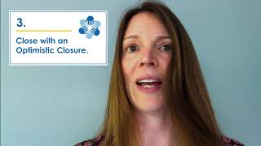
Video
3 Signature Practices Video

Slide 6
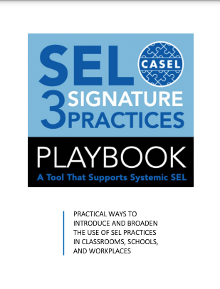
Explore Playbook
Explore the SEL 3 Signature Practices Playbook to discover examples of Welcoming Rituals and Routines, Engaging Practices, and Optimistic Closures

Slide 7
Group Reflection
3 Signature Practices
What are some takeaways for you?
An ‘aha’
A question and wondering
Notes:
Acknowledge the group’s collective expertise in opening a lesson (meeting or professional learning experience) with a WELCOME INCLUSION ACTIVITY, ROUTINE, OR RITUAL that is grounding, builds community, and connects to the work ahead.
Acknowledge also, the expertise in the room re: closing each experience in an intentional way. An OPTIMISTIC CLOSURE supports individual and shared understanding of the learning, celebrates accomplishments, helps identify next steps, or makes connections to one’s own context.
Form small groups and invite comments:
Something that resonates with you
An ‘aha’
Questions and wonderings
Ask volunteers to share our ideas from their group discussion.

Slide 8
Let’s Reflect
3 Signature Practices
In your group:
Share ideas for Welcoming Rituals and Routines or Optimistic Closures (whichever assigned)
Discuss how these activities develop SEL competencies
After brainstorming:
Share out with the whole group
Notes:
Move into small groups of 3-4 (grade level, content area, and/or role-alike)
Assign each group either Welcoming Rituals or Optimistic Closures.
Group members share ideas for Welcoming Rituals and Routines/Optimistic Closures and discuss how these activities develop SEL competencies.
Note: If in person, one person records activity ideas on chart paper. If online, groups record on a Google doc or Jamboard
Whole Group Sharing:
What are your group’s ideas?
Record on T Chart (Welcoming Rituals/Optimistic Closures)
Note: Collect ideas from the groups and compile a “playbook” that is shared among educators.

Slide 9
Debrief
Settle In: Box Breathing
Connecting Activity: Video and Discussion
Brainstorming in small groups
Reflections
Welcoming Ritual
Engaging Practices
Optimistic
Closure
Notes:
Debrief the meeting/professional learning experience through the 3 Signature SEL Practices, reinforcing that the design principles are for adult professional learning as well as classroom instruction.
Opening Activity: Video and Discussion (Welcoming Ritual)
Let’s Discuss: Brainstorming in small groups (Engaging Practice)
Closing Reflection: One Takeaway (Optimistic Closure)
Note: Provide a link to SEL 3 Signature Practices Playbook (https://schoolguide.casel.org/resource/three-signature-sel-practices-for-adult-learning/) from CASEL.

Slide 10
Welcoming Ritual
Optimistic Closure

Slide 11
Menu of Signature Practices
Welcoming Rituals
Optimistic Closure
Checking In Checking In with a Quote Community Circle Feelings Cloud Focus on Adult SEL Just Breathe Mix and Mingle SEL Everyday The Environment Counts Weather: Checking In What’s New
Building Trust Gratitude Inside-Outside Circles Intentions Key Takeaways My Next Steps Now I Think….
One Word Whip Around Six Months Suit Yourself Sum It Up

Slide 12
Welcoming Ritual
Checking In
Notes:
25-30 min.

Slide 13
Reflect. Write.
How are you doing, really?
What has been a personal and/or professional high this week?
What has been a personal and/or professional low this week?
Notes:
3-4 min.
Let’s start by checking in. Invite group members to reflect and write:
How are you doing, really?
What has been a personal and/or professional high this week?
What has been a personal and/or professional low this week?

Slide 14
Welcoming Ritual
Checking In with a Quote
Notes:
25-30 min.

Slide 15
“The moment we cease to hold each other, the sea engulfs us and the light goes out.”
—James Baldwin
Notes:
Share this quote:
“The moment we cease to hold each other, the sea engulfs us and the light goes out.”
- James Baldwin
Invite group members to respond: What resonates with you?
Offer: We all have opportunities to interact with others 1:1. Each interaction is an opportunity to be compassionate, kind, generous, and accepting. We can express and affirm feelings, demonstrate our own willingness to be vulnerable, examine our own biases, and open the door for others to do the same.

Slide 16
Welcoming Ritual
Community Circle
Notes:
15 min.

Slide 17
Community Circle
Others?
•
•
•
Ways of being that will serve us:
Speak from the heart
Listen Deeply
Honor differences and commonalities
Notes:
Once members are situated in a circle so they can see one another, share “ways of being that will serve us” for the Community Circle:
Speak from the heart
Listen Deeply
Honor differences and commonalities
Ask if anyone has others to add. Record.
Invite 3-4 group members to identify an agreement that resonates with them, and elaborate on it’s meaning.

Slide 18
Community Circle
Round #1: What is one way you support students in identifying and activating their strengths?
Round #2: What is one way you help students develop positive relationships with peers?
Round #3: What is one way you encourage student voice?
Notes:
Offer a question to the group. The first person responds, and then so on to each subsequent person to their left. Members can pass, and will have an opportunity to add their voice. Decide how many rounds, depending on number of people in the group and time.
Round #1: What is one way you support students in identifying and activating their strengths?
Round #2: What is one way you help students develop positive relationships with peers?
Round #3: What is one way you encourage student voice?
Close by inviting group members to share an appreciation for someone in the group or something about the community.

Slide 19
Welcoming Ritual
Feelings Cloud
Notes:
20 min.
Before showing slide 3, ask participants to write down one emotion they are currently experiencing on a post-it note.

Slide 20
Feelings Cloud
I need “regular” attention
I need “special” attention
Notes:
Welcoming ritual: Feelings Cloud
Draw a horizontal line on a whiteboard, and ask them to place the emotion “above the line” if they need “regular attention” or below the line if they need “special attention.” In this activity, regular attention means they are able to engage with the meeting without support, while special attention means they may need some additional support.

Slide 21
Debrief
What is the emotional weather of the group?
What patterns/themes do you notice?
How can we support each other?
What does this mean for our students?
This Photo by Unknown Author is licensed under CC BY-NC
Notes:
Debrief what you see in these feelings cloud with the group.
What is the emotional weather of the group?
What patterns/themes do you notice?
How can we support each other?
What does this mean for our students?
Close by sharing that SEL enables educators to utilize feelings clouds in their instruction to help build positive classroom environments.

Slide 22
Welcoming Ritual
Focus on Adult SEL
Notes:
15 min.

Slide 23
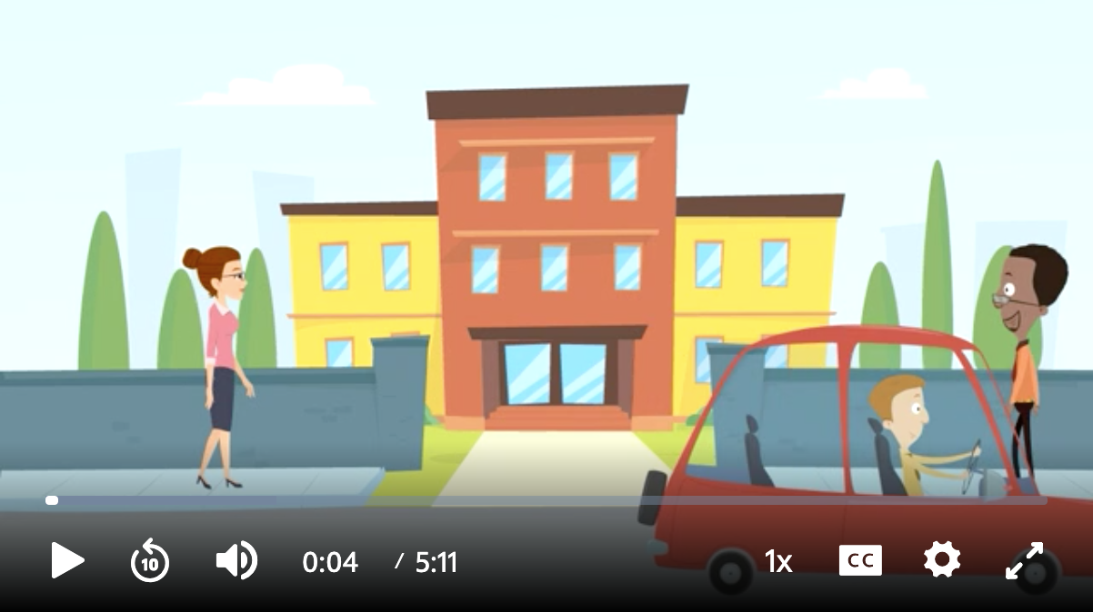
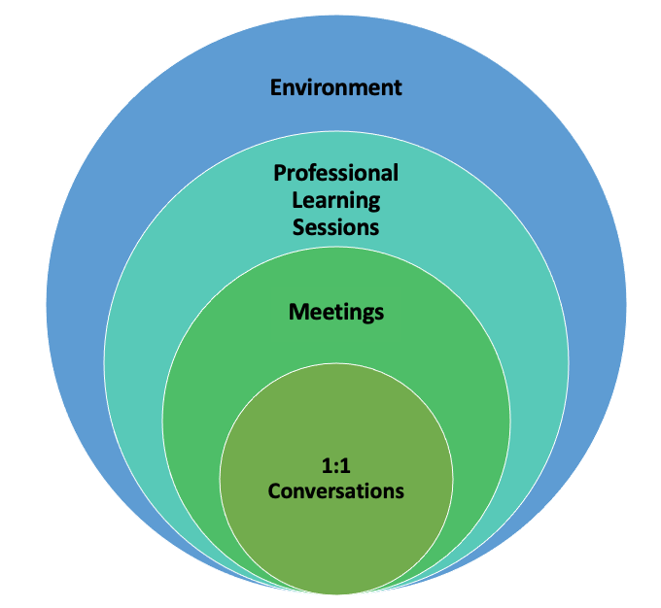
Entry Points
Strengthening, Relationships, Collaboration, School Climate, Well-being and Effective Teaching with SEL
Focus on Adult SEL
What did you notice?
What are you wondering?
Notes:
This video demonstrates how leaders can strengthen adult social and emotional competencies and impact culture and climate, staff relationships, and overall well-being.
Watch it: Focus on Adult SEL (https://ca.pbslearningmedia.org/resource/focus-on-adult-sel-animation/focus-on-adult-sel-social-emotional-learning/) (6 min.)
Afterwards, ask staff members what they noticed and what they are wondering.
Debrief by pointing out a variety of entry points for leaders, in the broadest sense, to strengthen relationships and collaboration among staff members, with families and community partners, which, in turn, creates a positive, respectful, and caring culture and climate, improves the overall health and wellbeing of all the adults, as well as promotes instruction with a commitment to equity, inclusion, and cultural expansiveness that teaches and reaches the whole child .

Slide 24
Welcoming Ritual
Just Breathe
Notes:
15 min.

Slide 25
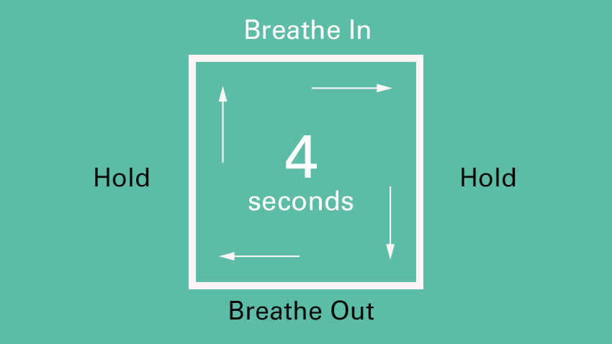
Welcome, settle in.
Box Breathing
Just breathe.
Notes:
One of the strongest and most effective physical practices to become calm and come into the moment is through our breath. Take a moment to breathe and settle in. You might try Box Breathing (4x4x4x4). Notice how you’re feeling.

Slide 26
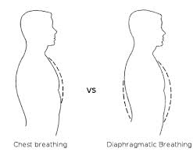
Welcome, settle in.
Just breathe.
Deeper. Taller. Wider.
Exhalation longer than inhalation Relaxation response
Chest breathing
Diaphragmatic breathing
Notes:
Begin by inviting staff to settle in and become present. Invite members to take a few deep breaths, letting themselves relax more with each breath. After about 4-5 cycles at everyone’s own pace, ask the group to notice how they are feeling and whether anything has shifted. Surface a few comments.
Debrief with a neuroscience nugget—when we deliberately slow our exhalation down, extending our diaphragm as we breathe, we change our breathing from autonomic to voluntarily—under our control, thus moving our system from sympathetic (fight/flight) to parasympathetic (rest and digest).

Slide 27
Welcoming Ritual
Mix and Mingle
Notes:
15 min.

Slide 28
Mix and Mingle
When the music starts, move around and greet your colleagues non-verbally.
When the music stops, find a partner.
Four (4) rounds
Notes:
Explain the activity:
When the music starts, move around and greet your colleagues non-verbally.
When the music stops, find a partner. (Those without a partner can join pairs to become a triad)
Four rounds, each one allowing for discussion of a fun question such as: What superpower would you like to have and why? If you could talk to any one person now or in history, who would it be and why? If you could have any question answered, what would it be and why? If you had one day to live over again, what day would you pick and why? For more questions, see the GGIE practice 36 Questions to Increase Connectedness at School.

Slide 29
Welcoming Ritual
SEL Everyday
Notes:
10 min.
Start with a get-to-know you (https://www.sessionlab.com/blog/icebreaker-games/) activity, an emotional check-in (https://clubexperience.blog/2019/10/22/5-easy-emotional-check-ins/), a game (https://www.playworks.org/resources/) or any other activity to help the group come together as a learning community. For more ideas, check out the 3 Signature SEL Practices Playbook (https://schoolguide.casel.org/uploads/2018/12/CASEL_SEL-3-Signature-Practices-Playbook-V3.pdf).

Slide 30
Welcoming Ritual
The Environment Counts
Notes:
20 min.
In our Welcoming Ritual, we address the Environment as an entry point for integrating SEL into our practices. As we’ll see in the video, our environment can have a profound influence on how we feel, think, and act.

Slide 31
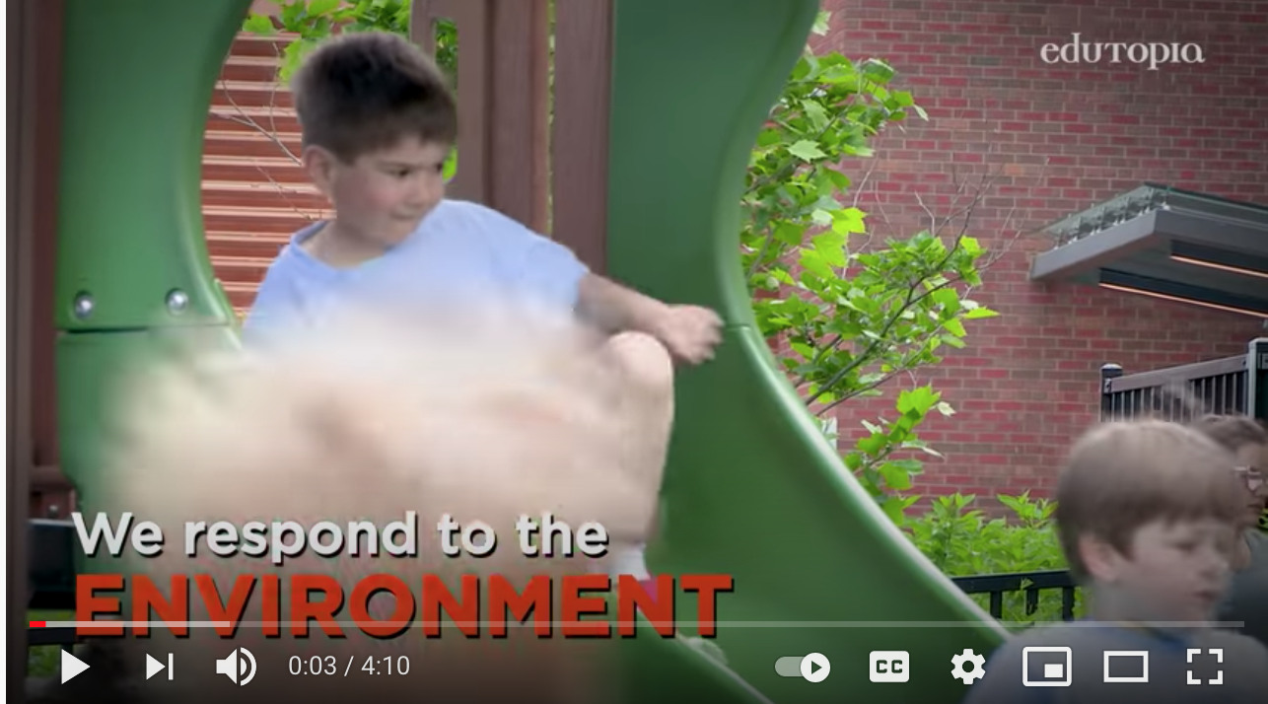
Watch.
Brainstorm
What would a positive environment for the adults include?
How might we enhance our social and emotional supports?
With your group, brainstorm your dream environment.
Prepare to share out with colleagues.
Notes:
• Begin by watching Creating a Positive Learning Environment together. (https://www.youtube.com/watch?v=T9ynlPs_NTM).
• We know the learning environment is important for our students. It is just as important for the adults. What would a positive learning environment for the adults include? How might we enhance our social and emotional supports?
• Activity Instructions:
• Give each table group a chart and colored markers to record their brainstorming.
• Ask groups to envision ways to enhance their social and emotional supports and create a chart (or other representation) for sharing out to the whole group.

Slide 32
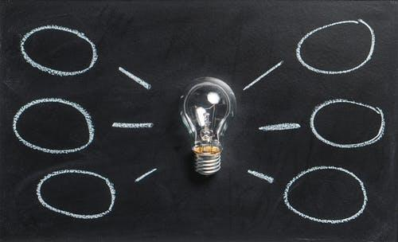
Discuss.
Share Ideas.
What outcomes might result from improving our environment?
What are some concrete and do-able next steps?
Notes:
Ask one person from each group to share their ideas.
Post the charts.
Group members reflect and share with one another whole and/or small group:
What outcomes might result from improving our environment?
What are some concrete and doable next steps?

Slide 33
Welcoming Ritual
Weather: Checking In
Notes:
15 min.

Slide 34
Welcoming Ritual
Describe your feelings as a type of weather.
What are some underlying reasons for those feelings?
Would you like to maintain or shift from your current emotions?
If so, how might you do that?
Notes:
Welcoming ritual:
Take a moment to check in: How are you feeling right now? If you were to describe your current feelings as weather, what kind of weather would that be? Dig a little deeper–what are some underlying causes for those feelings? Framing: How we feel affects our attention, learning, ability to be flexible, and to solve problems creatively. Dr. Daniel Siegel advises “name it to tame it.” By labeling our emotions and understanding causes (https://ggie.berkeley.edu/my-well-being/sel-for-adults-self-awareness-and-self-management/sel-for-adults-emotion-regulation/) for them, we are in a position to express those feelings and choose whether to maintain or shift them.
Ask the first three questions; then form triads. Invite each member to share at a level that feels comfortable.

Slide 35
Debrief
What were some similarities and differences in terms of weather?
What strategies were shared for maintaining? For shifting?

Slide 36
Welcoming Ritual
What’s New?
Notes:
15 min.

Slide 37
What’s new?
"Think of something that is new with you that you want to share with a partner."
Notes:
Welcoming Ritual: What’s New?
Ask participants to find a partner. Say, "Think of something new to share with your partner." Then give participants a moment to reflect.
Explain that each person will share their news while their partner listens silently and fully, without comments or questions.
Tell participants that you will be keeping time and that you will let them know when it is time to switch roles.
Give pairs a moment to decide who will go first, ask the starting partners to raise their hands to make sure everyone is ready, then give the go-ahead to begin.
After a minute or two, use your attention signal to quiet the room and let participants know it is time to switch roles.

Slide 38
Optimistic Closure
Building Trust
Notes:
Optimistic Closure: Building Trust
Thinking about this quote: “Partnerships move at the speed of trust.”
In small groups, share ways you do or might build trust with community partners in your role.

Slide 39
Optimistic Closure
Gratitude
Notes:
10 min.

Slide 40
Select one of the following prompts and share:
Something you are grateful for today.
Someone for whom you are grateful.
Something you appreciate about this community.
Notes:
Ask group members to select one of the following prompts and share:
Something you are grateful for today.
Someone for whom you are grateful.
Something you appreciate about this community.

Slide 41
Optimistic Closure
Inside-Outside Circles
Notes:
10 min.

Slide 42
Inside-Outside Circles
Round #1: Partners share:
What was something you learned today?
Round #2. Outside circle moves 3 people to their right. New partners share:
What is something you are going to try tomorrow?
Round #3. Inside circle moves 2 people to their right. New partners share:
What is a longer term commitment you’re making to integrating something you learned today?
Notes:
Count off by 2. 1s form an inside circle and 2s form an outside circle, with the two groups facing each other.
Round #1: Partners share:
What was something you learned today?
Round #2. Outside circle moves 3 people to their right. New partners share:
What is something you are going to try tomorrow?
Round #3. Inside circle moves 2 people to their right. New partners share:
What is a longer term commitment you’re making to integrating something you learned today?

Slide 43
Optimistic Closure
Intentions
Notes:
10 min.

Slide 44
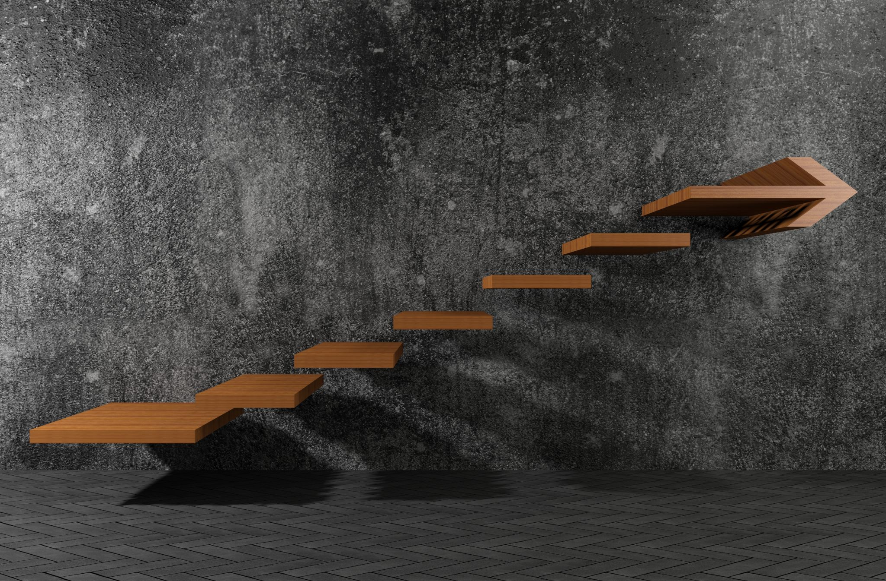
Intentions
What is one intention or next step towards systemic SEL?
Notes:
Optimistic Closure: Intentions (10 min.)
Ask group members to set one intention or next step.
Call on volunteers or ask the first person who shares to call on the next person, and so on. If online, ask group members to also use Chat box.

Slide 45
Optimistic Closure
Key Takeaways

Slide 46
What is one key takeaway from today’s session?
How can we be reminded of the positive impact of using SEL skills every day?
Notes:
Optimistic Closure

Slide 47
After reflecting on what you learned today, identify one takeaway. Why is it important to you?
A takeaway can be an idea, a strategy, a tool, or an action step.
Notes:
Optimistic Closure (10 min)
Ask participants to reflect on what they have heard and learned, then ask, "After reflecting on what you learned today, identify one takeaway. Why is it important to you? A takeaway can be an idea, a strategy, a tool, or an action step."
Give participants a minute of silent reflection time, then ask them to share verbally or in writing, depending on how much time you have left.

Slide 48
Optimistic Closure
My Next Steps
Notes:
10 min

Slide 49
My Next Step
Think about a first “next step” you’d like to take based on today’s session.
Share your next step with a partner or at your table.
Write your next step on a sticky note and post the note somewhere where you’ll see it and be reminded of your commitment.
Notes:
Optimistic Closure: My Next Step (10 min)
1. Ask participants to think of their first next step based on what they learned during the session.
2. After giving participants a minute to think about what that step would be, ask them to share their next step with a partner or at their table.
3. Ask participants to write their “next step” on a sticky note and post the note somewhere they will be reminded of their task (e.g., on their desk, inside the cover of their related text, in their assignment notebook--or they take a photo with their phone).

Slide 50
Optimistic Closure
Now I think….
Notes:
10 min.

Slide 51
I used to think…
Now, I think…
Notes:
Optimistic Closure (10 min)
Close the meeting by having staff share with the whole group:
“I used to think…. Now, I think….”

Slide 52
Optimistic Closure
One Word Whip Around
Notes:
10 min.

Slide 53
One Word Whip Around
What is one word that sums up your learning today?
Notes:
Prepare a statement or question prompt that addresses the current content. For example, “Decide on one word that sums up your learning for today.”
Invite participants to form a circle.
State the prompt, explain that everyone should prepare a one-word response, and allow a minute of private reflection time.
Ask for a volunteer to start by sharing their word. The volunteer then chooses a direction to go (left or right), and participants continue to respond in turn around the circle. It’s also okay to pass by saying, “Pass.”
Note: Rather than “correcting” anyone who responds more lengthily, allow the modeling of the remaining group members to get the group back on track

Slide 54
Optimistic Closure
Six Months
Notes:
10 min.

Slide 55
Imagine
What might be different 6 months from now with a key takeaway from today’s session?
Notes:
Optimistic Closure
Ask: What might be different 6 months from now with a key takeaway from today’s session?

Slide 56
Optimistic Closure
Suit Yourself
Notes:
10 min.

Slide 57
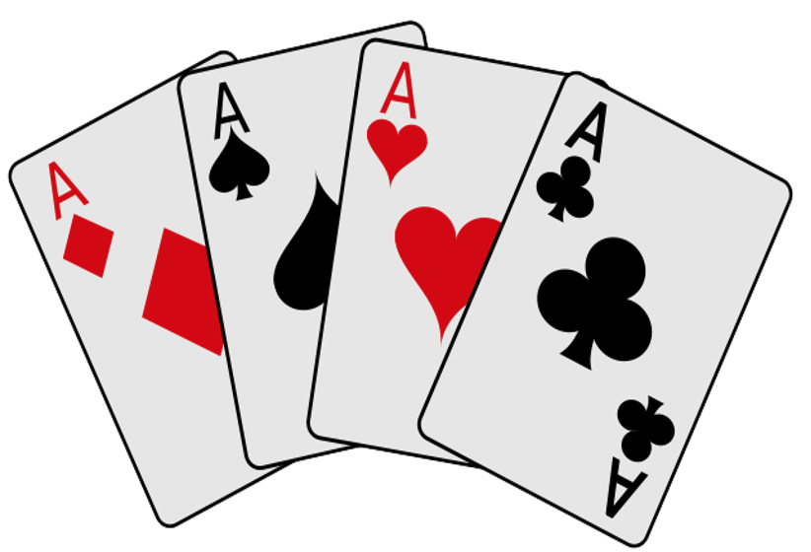
Suit Yourself
Notes:
Pass out playing cards randomly to group members. Each suit describes a category of responses:
Hearts: Something from the heart.
Clubs: Things that grew—new ideas, new thoughts, and a new point of view.
Diamonds: Gems that last forever. What are some of the gems of wisdom gathered from people or content?
Spades: Used to dig in the garden. What new ideas (seeds) are you planting? What things did people dig up during our conversations?
Give 1-2 minutes for group members to reflect.
Ask participants to either:
Form quartets and share
Share aloud with the whole group
• Online Variation:
• Group members select a suit for reflection and sharing.

Slide 58
Optimistic Closure
Sum It Up
Notes:
10 min.

Slide 59
“Our actions entrench the power of the light on this planet. Every positive thought we pass between us makes room for more light. And if we do more than think, then our actions clear the path for even more light. That is why forgiveness and compassion must become more important principles in public life.”
—Representative John R. Lewis (1940-2020)
Notes:
Share a final quote:
“Our actions entrench the power of the light on this planet. Every positive thought we pass between us makes room for more light. And if we do more than think, then our actions clear the path for even more light. That is why forgiveness and compassion must become more important principles in public life.”
Representative John R. Lewis (1940-2020)
Invite a few comments. What words or phrases resonate with you?

Slide 60
Sum It Up
What is one word or phrase that sums up your learning?

Slide 61
THE RESULTS
98%
OF THE WORLD POPULATION RATED THEMSELVES 9 ON THE HAPPINESS SCALE

Slide 62
The Pedagogy of
Confidence
Yvette Jackson, Ed.D.
3 High Operational
Practices
Identifying and activating student strengths
Building relationships
Amplifying student voice
All students have an innate desire for engagement, challenge, developing strengths, belonging, and feeling valued.
High Operational Practices guide culturally responsive pedagogy and equity through excellence..
They elicit and nurture high intellectual performances for self-actualization and personal contribution from all students.
Notes:
Introduce the Pedagogy of Confidence, by Yvette Jackson, Ed.D,
Ask for 3 volunteers to read the paragraphs.
All students have an innate desire for engagement, challenge, developing strengths, belonging, and feeling valued.
High Operational Practices guide culturally responsive pedagogy, equity through excellence.
They elicit and nurture high intellectual performances for self-actualization and personal contribution from all students.
Explain that we are going to explore 3 of these practices in our Welcoming Ritual--a Community Circle.
High Operational Practices

